Slide 1

BIKE COUNT PROJECT
Final presentation 12.12.21 – Martin Quievre – Charles Proye

Slide 2
SUMMARY
1.
4.
2.
5.
3.

Slide 3
EXPLORING THE DATASET

Slide 4
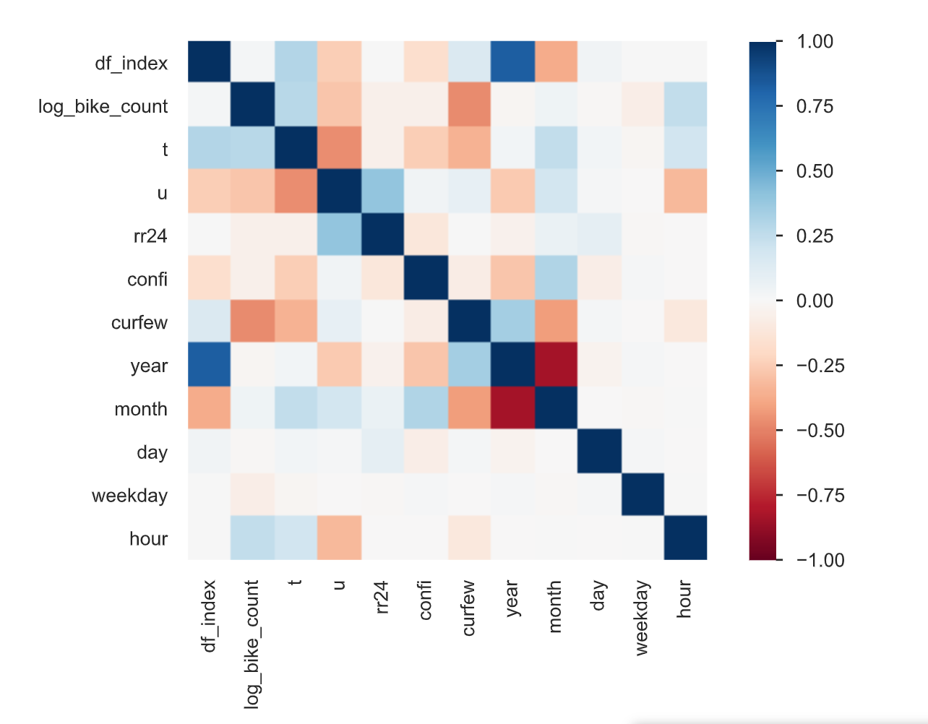
SPOT THE CORRELATION
Features significatively correlated with log_bike_count :
curfew
hour
temperature
humidity
We denote a strong correlation between :
temperature / humidity
The counter_name feature is not on the heatmap but is also strongly correlated to the target value

Slide 5
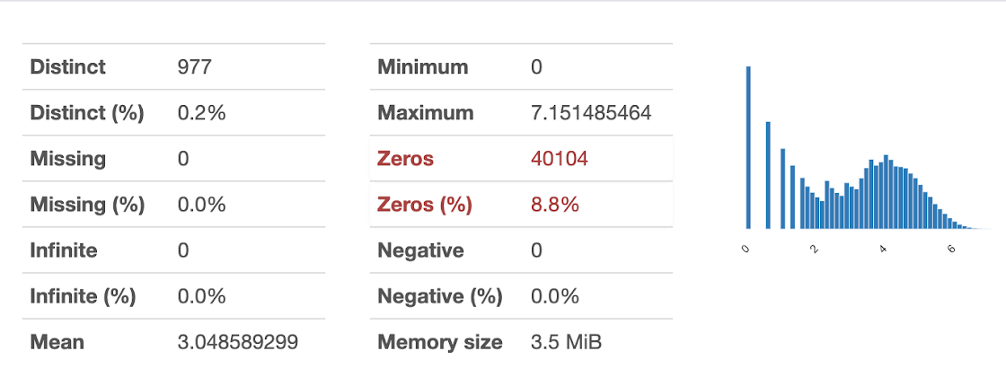
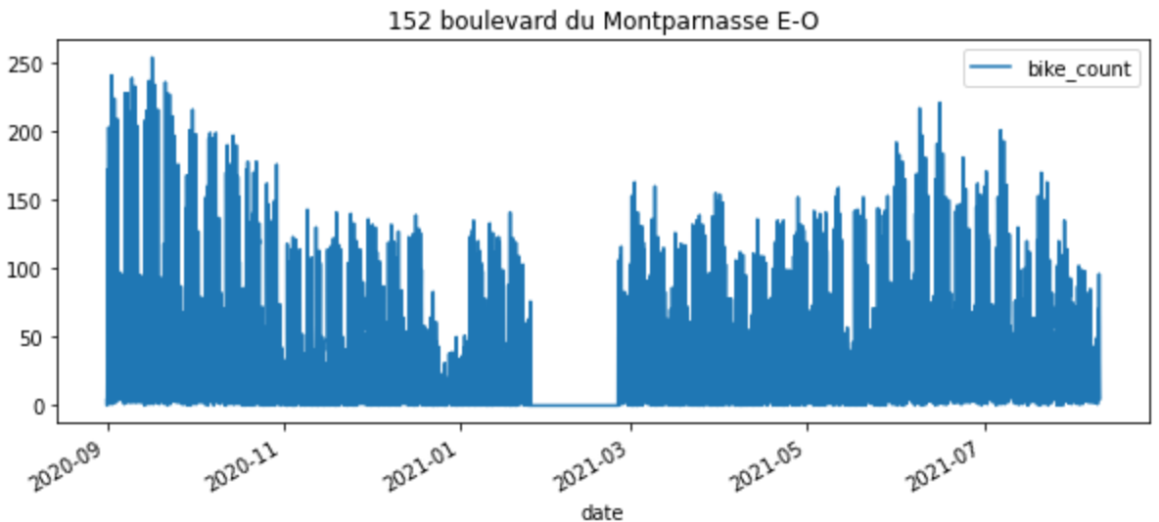
SPOT THE MISSING VALUES
Observation :
Large number of zeros, might be suspicious
Mask :
To find the potential sequences of zero
Plot :
To visualize those sequences
Those unusual values are possibly due to public work or a counter breakdown.
Creating a mask to get rid of those unusual values

Slide 6
ADDING NEW FEATURES

Slide 7
PREPROCESING

Slide 8
CHOOSING THE MODEL

Slide 9








TESTED MODELS
We have tested those eight models on the dataset :
Model without result
Model with result
RIDGE
HIST GRAD BOOST
RANDOM FOREST
Model with result that we tuned

Slide 10
TUNING THE PARAMETERS

Slide 11
PARAMETERS TUNING
To tune our parameters while dealing with the trade-off between time and precision of parameter tuning, we tried the two following methods :
# 1 By trial and error and by ‘parameter category’
# 2 Randomized Grid Search
Extract from Notebook – Method 1
Extract from Notebook – Method 1
# 1ST PART CONTROL OVER TREE STRUCTURE
params = {
'lgbmregressor__max_depth': [6,24],
'lgbmregressor__num_leaves': [2**6, 2**10],
'lgbmregressor__min_data_in_leaf':[40, 200],
'lgbmregressor__n_estimators': [130, 200],
} grid_search = GridSearchCV(pipe, param_grid=params, n_jobs=-1, cv=5)
result_gs = grid_search.fit(X_train, y_train)
print(f"Best params : {result_gs.best_params_}")
…
# RANDOMIZE GRID SEARCH
params = { 'lgbmregressor__learning_rate' : [0.01, 0.02, 0.03, 0.04, 0.05, 0.08, 0.1, 0.2, 0.3, 0.4],
'lgbmregressor__n_estimators' : [100, 200, 300, 400, 500, 600, 800, 1000, 1500, 2000],
…
'lgbmregressor__reg_alpha': [0, 1e-1, 1, 2, 5, 7, 10, 50, 100],
'lgbmregressor__reg_lambda': [0, 1e-1, 1, 5, 10, 20, 50, 100] }
grid_search = RandomizedSearchCV(pipe, param_distributions=params, n_jobs=4, cv=5, n_iter=200)
result_gs = grid_search.fit(X_train, y_train)
print(f"Best params : {result_gs.best_params_}")
Notes:
'lgbmregressor__min_child_samples': sp_randint(100, 500),
'lgbmregressor__min_child_weight': [1e-5, 1e-3, 1e-2, 1e-1, 1, 1e1, 1e2, 1e3, 1e4],
'lgbmregressor__subsample': [0.2, 0.5, 0.7, 0.9],
'lgbmregressor__max_depth': [-1, 1, 2, 3, 4, 5, 6, 7],

Slide 12





ROOT MEAN SQUARED ERROR
Notes:
'lgbmregressor__min_child_samples': sp_randint(100, 500),
'lgbmregressor__min_child_weight': [1e-5, 1e-3, 1e-2, 1e-1, 1, 1e1, 1e2, 1e3, 1e4],
'lgbmregressor__subsample': [0.2, 0.5, 0.7, 0.9],
'lgbmregressor__max_depth': [-1, 1, 2, 3, 4, 5, 6, 7],

