Slide 1

BIKE COUNT PROJECT
Final presentation 12.12.21 – Martin Quievre – Charles Proye

Slide 2
SUMMARY
1.
4.
2.
5.
3.

Slide 3
EXPLORING THE DATASET

Slide 4
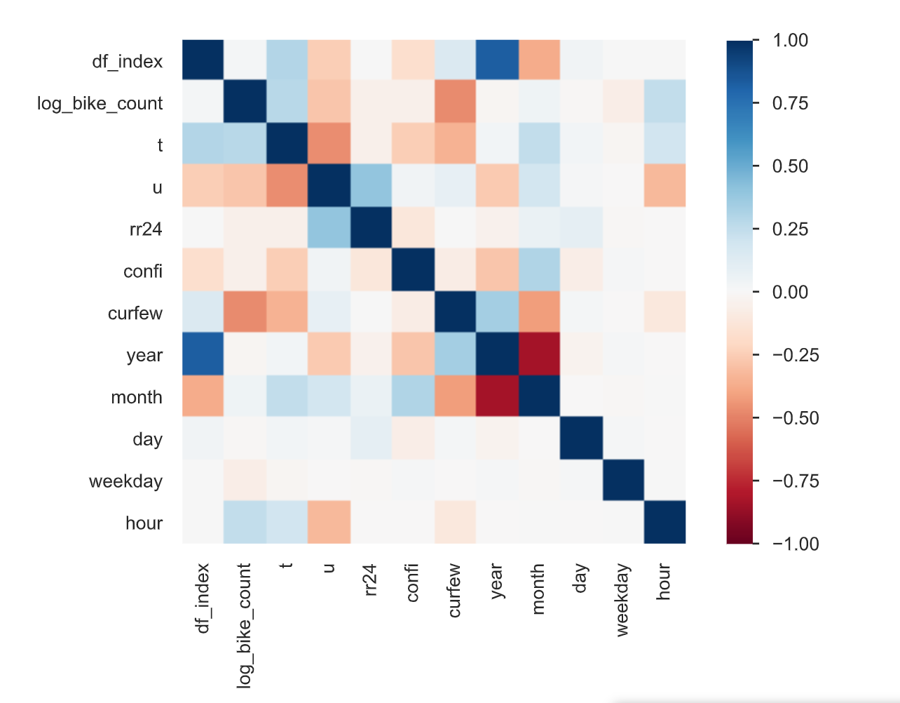
SPOT THE CORRELATION
Features significatively correlated with log_bike_count :
curfew
hour
temperature
humidity
We denote a strong correlation between :
temperature / humidity
The counter_name feature is not on the heatmap but is also strongly correlated to the target value
Notes:
Charles

Slide 5
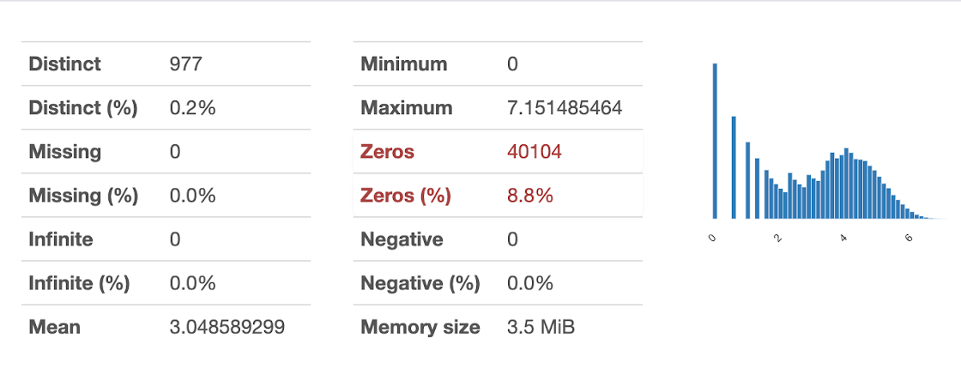
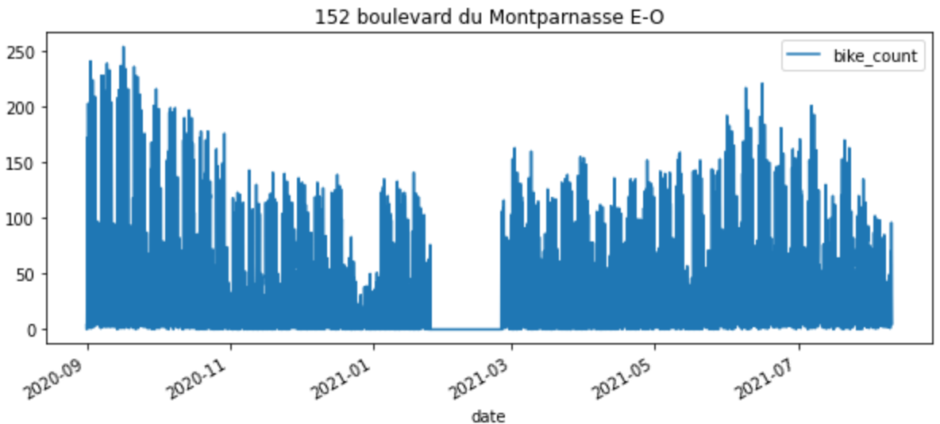
SPOT THE MISSING VALUES
Observation :
Large number of zeros, might be suspicious
Mask :
To find the potential sequences of zero
Plot :
To visualize those sequences
Those unusual values are possibly due to public work or a counter breakdown.
Creating a mask to get rid of those unusual values
Notes:
Charles

Slide 6
ADDING NEW FEATURES

Slide 7
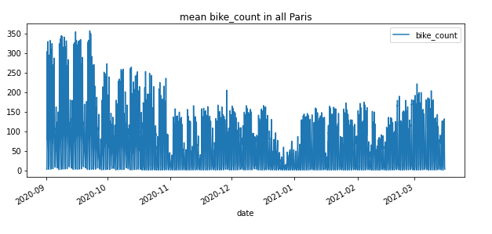
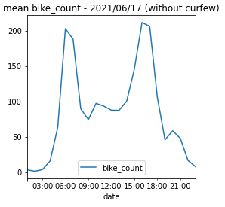
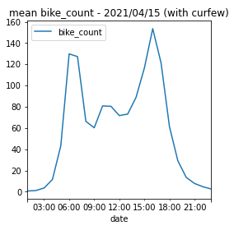
COVID IMPACT ?
2nd lockdown
Successive curfews
Impact of lockdown measures
Impact of curfew measures
We encoded new binary features using a column transformer and adding it at the beginning of our pipeline to take into account these two external phenomenons.
Notes:
Martin

Slide 8
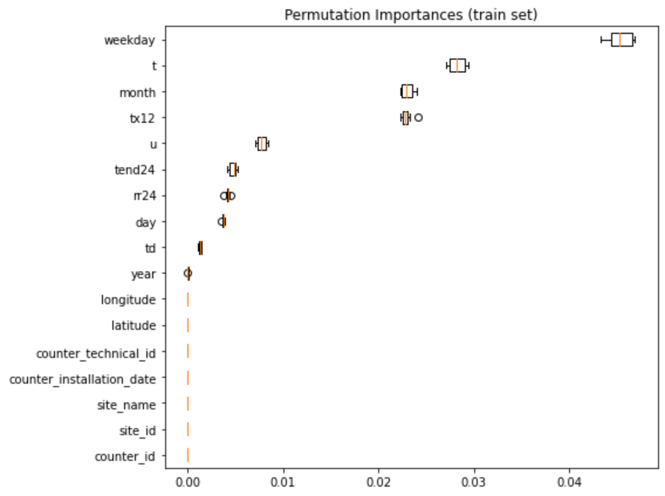


OTHER IDEAS
External data file :
Permutation importance analysis on the variables of the external data file
Choice to keep u, tend24 and rr24.
u : humidité
tend24 : tendance atmosphérique 24 dernières heures
rr24 : précipitation dans les 24 dernières heures
Other binary features - failed for bad results
Ideas to explore
opendata.paris.fr
Other datas : construction sites ? how to merge it ? Geographically ? with coordinates?
Public Holidays
Weekends
Notes:
Martin

Slide 9
PREPROCESSING

Slide 10
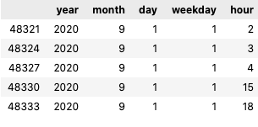
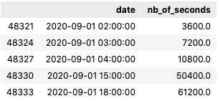
ENCODING DATES
1st method
2nd method
Code
def _encode_dates(X):
X = X.copy()
X.loc[:, 'year'] = X['date'].dt.year
X.loc[:, 'month'] = X['date'].dt.month
X.loc[:, 'day'] = X['date'].dt.day
X.loc[:, 'weekday'] = X['date'].dt.weekday
X.loc[:, 'hour'] = X['date'].dt.hour
return X.drop(columns=["date"])
Code
def _encode_dates_2(X):
X = X.copy()
X.loc[:, 'new_date'] = X['date'] - min(data['date'])
X.loc[:, 'nb_of_seconds'] =X.loc[:,'new_date'].dt.total_seconds()
return X.drop(columns=["date", 'new_date'])
Output
Output
Notes:
Martin

Slide 11
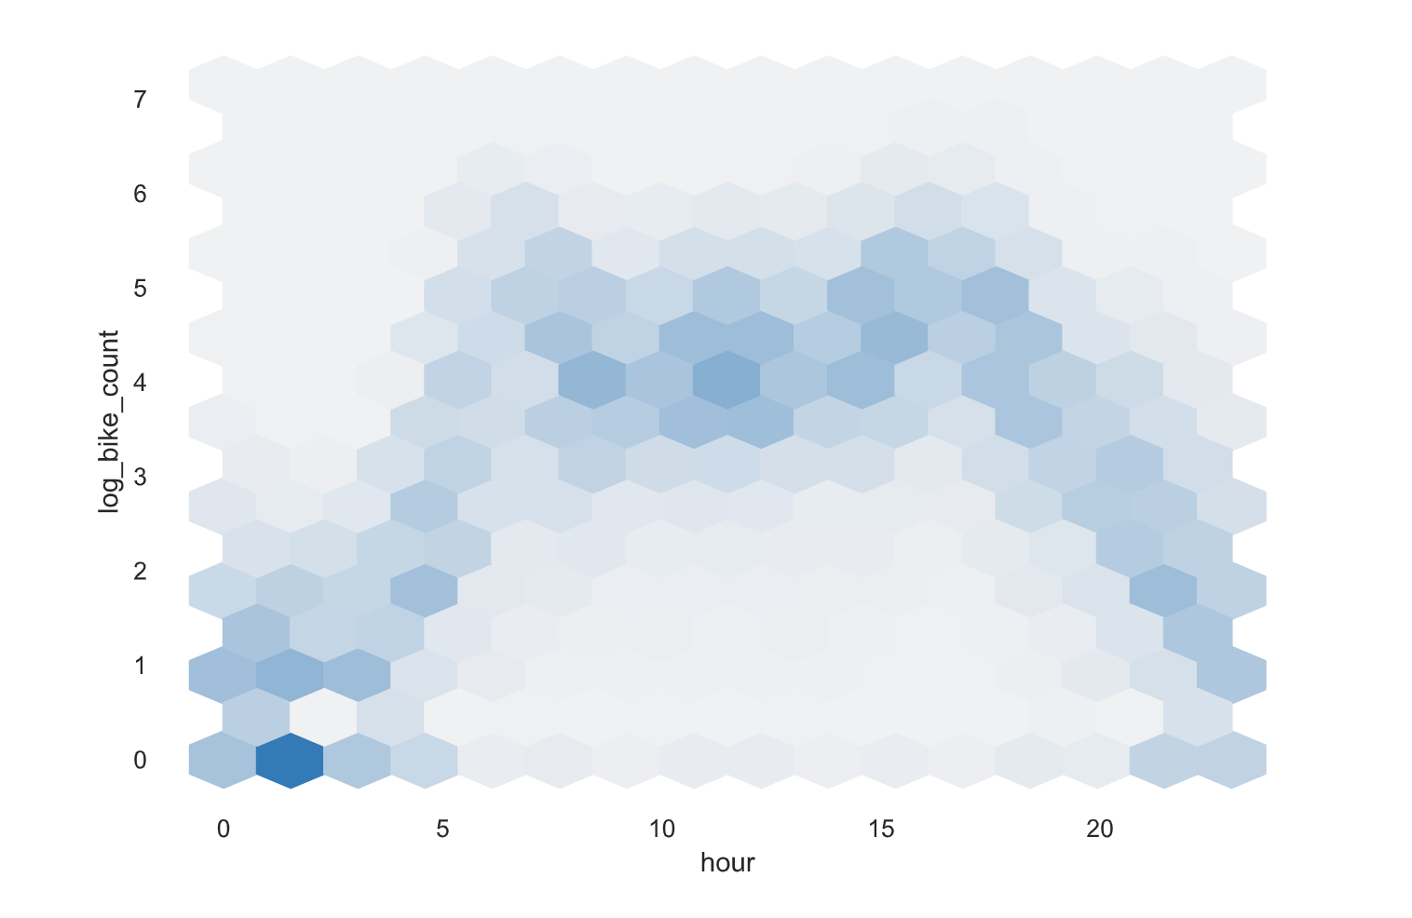
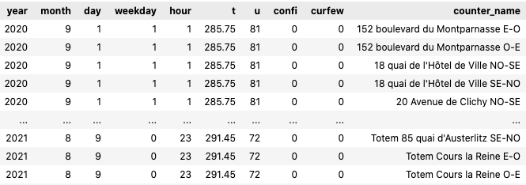
PREPROCESSING
After feature selection, merge of external and date encoding, we have the following dataset :
Standard Scaler
Ordinal Encoder
One Hot Encoder
Polynomial Features : degree = 2
Passthrough
Notes:
Charles

Slide 12
CHOOSING THE MODEL

Slide 13







TESTED MODELS
We have tested those eight models on the dataset :
Model without result
Model with result
RIDGE
HIST GRAD BOOST
RANDOM FOREST
Model with result that we tuned
Notes:
Charles

Slide 14
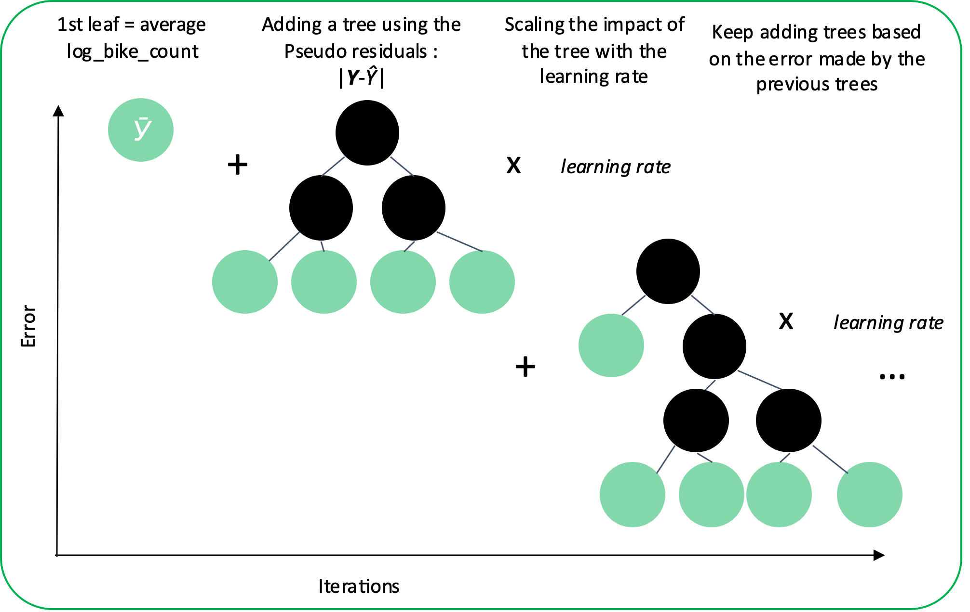
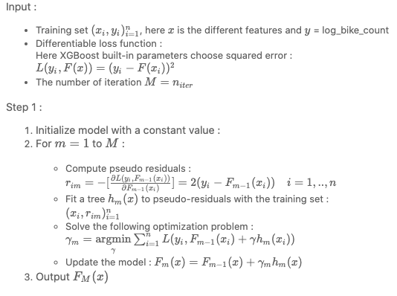
THE GRADIENT BOOSTING METHOD FOR REGRESSION
The Principle :
Mathematically :
Notes:
MArtin

Slide 15
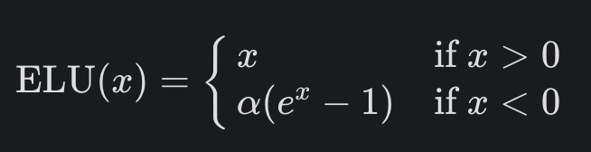
NEURAL NETWORK
Using TensorFlow and Keras we tried to implement a Neural Network :
Parameters Θ
59 * 128 + 128 = 7 680
128 * 128 + 128 = 16 512
128 + 1 = 129
24 321 parameters
Structure
One input layer – 59 inputs
Two hidden layers – 128 neurons each
One dimension output layer
Batch size : 50
Epochs : 15
Z_{1,1}
Z_{2,1}
X₁
Z₁₂
Z₂₂
Ŷ
Activation function ?
After a few tests, it appears that Exponential linear unit (ELU) activation function was better than RELU and SELU.
59 ?
counter_name : 56 features as one hot encoded
datetime : 2 features
meteo : 1 feature
Z_{1,127}
Z_{2,127}
X₅₉
Z_{1,128}
Z_{2,128}
d: 59
d: 128
d: 128
Notes:
Rectified Linear Unit

Slide 16
TUNING THE PARAMETERS

Slide 17
PARAMETERS TUNING
To tune our parameters while dealing with the trade-off between time and precision of parameter tuning, we tried the two following methods :
# 1 By trial and error and by ‘parameter category’
# 2 Randomized Grid Search
Extract from Notebook – Method 1
Extract from Notebook – Method 1
# 1ST PART CONTROL OVER TREE STRUCTURE
params = {
'lgbmregressor__max_depth': [6,24],
'lgbmregressor__num_leaves': [2**6, 2**10],
'lgbmregressor__min_data_in_leaf':[40, 200],
'lgbmregressor__n_estimators': [130, 200],
} grid_search = GridSearchCV(pipe, param_grid=params, n_jobs=-1, cv=5)
result_gs = grid_search.fit(X_train, y_train)
print(f"Best params : {result_gs.best_params_}")
…
# RANDOMIZE GRID SEARCH
params = { 'lgbmregressor__learning_rate' : [0.01, 0.02, 0.03, 0.04, 0.05, 0.08, 0.1, 0.2, 0.3, 0.4],
'lgbmregressor__n_estimators' : [100, 200, 300, 400, 500, 600, 800, 1000, 1500, 2000],
…
'lgbmregressor__reg_alpha': [0, 1e-1, 1, 2, 5, 7, 10, 50, 100],
'lgbmregressor__reg_lambda': [0, 1e-1, 1, 5, 10, 20, 50, 100] }
grid_search = RandomizedSearchCV(pipe, param_distributions=params, n_jobs=4, cv=5, n_iter=200)
result_gs = grid_search.fit(X_train, y_train)
print(f"Best params : {result_gs.best_params_}")
Notes:
'lCharles

Slide 18


RESULTS
MODELE | RMSE - RAMP | RMSE - LOCAL | TRAIN TIME | VALIDATION TIME
 | 0.743 | 0.703 | 367 | 92
 | 0.750 | 0.738 | 146 | 295
 | 0.741 | 0.741 | 257 | 47
Notes:
Martin

Slide 19
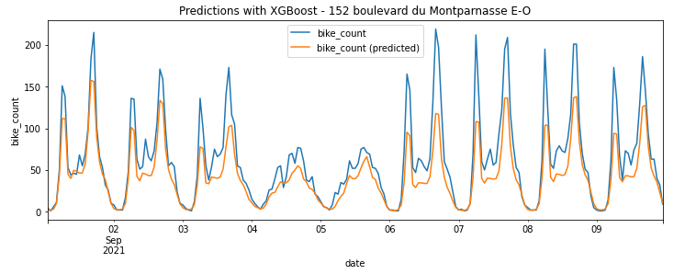
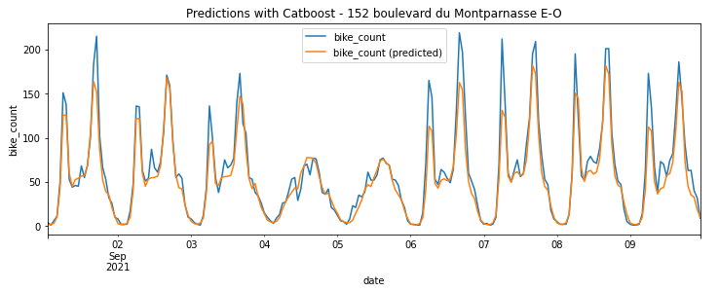
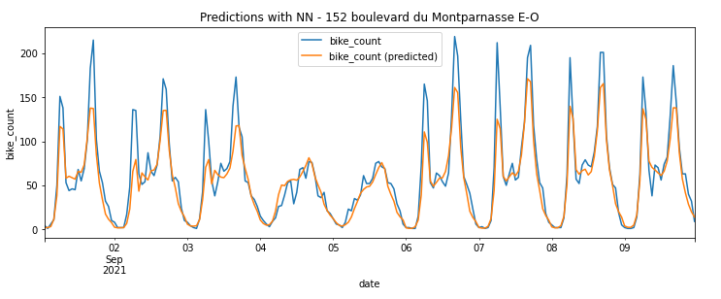
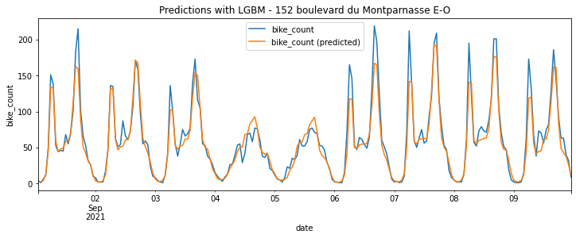
VISUALIZING THE RESULTS
Notes:
Martin

