Slide 1
UCLA Applied Finance Project 2020
Sector Misclassification
NON-CONFIDENTIAL

Slide 2
Table of Contents
Background and Data
  Comment on ideas behind the strategy
  Describe data and compare to results within “Categorization Bias in the Stock Market” by Kruger et al.
  Report results from replication
Strategy Reformulation
  Explain changes made to main strategy
  Results in- and out-of-sample
Robustness Tests
  Explain further variations
  Report results in-sample
Comments from Eric
Conclusion
Appendix

Slide 3
Background and Data

Slide 4
Background
The investment strategies we are considering are based on the paper “Categorization Bias in the Stock Market” by Kruger et al.
Some investors perceive individual firms through coarse industry classification. Such categorical thinking generates mispricing and predictability in stock-returns.
For example, think of a company within the paper industry which produces cigarette paper and therefore depends on cigarette sales. If investors were fully rational, this company would react little to the returns of the other firms in the paper industry and more to its “fundamental peers” within the cigarette business. However, some investors may base their investment decisions on the performance of the paper industry, thus generating mispricing.

Slide 5
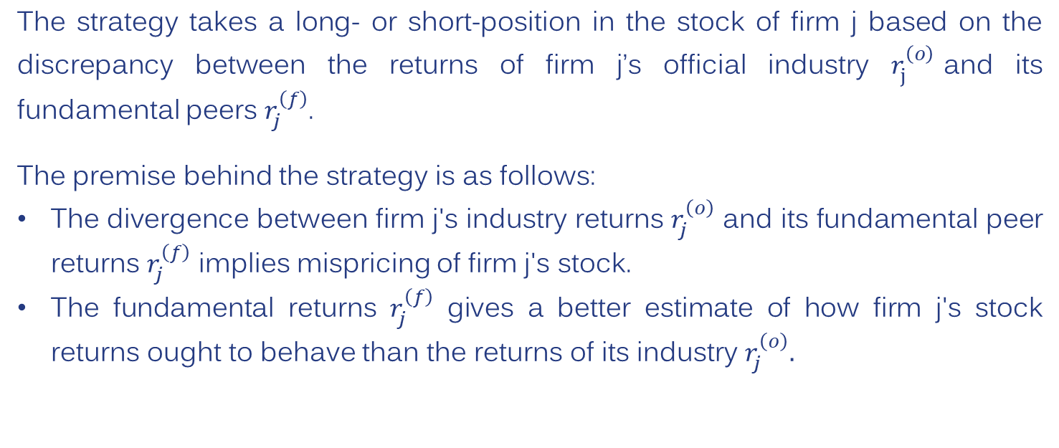
Formalization of Strategy
The strategy takes a long- or short-position in the stock of firm j based on the discrepancy between the returns of firm j’s official industry $r_{j}^{\left(o\right)}$and its fundamental peers $r_{j}^{\left(f\right)}$.
The premise behind the strategy is as follows:
The divergence between firm j's industry returns $r_{j}^{\left(o\right)}$ and its fundamental peer returns $r_{j}^{\left(f\right)}$ implies mispricing of firm j's stock.
The fundamental returns $r_{j}^{\left(f\right)}$ gives a better estimate of how firm j's stock returns ought to behave than the returns of its industry $r_{j}^{\left(o\right)}.$

Slide 6
Fundamental Peers
The fundamental peers of firm j are determined using similarity scores generated by Hoberg and Phillips, which we obtained from their website.
The similarity scores were calculated using firms' product descriptions within their 10-K filings on the EDGAR database on the SEC website.
The rarest 25% of nouns and proper nouns form a dictionary of words. The dictionary is ordered.
Each firm has a word-vector of words included in their product description. The word-vectors are normalized. Raw similarity scores are obtain by taking the dot product of firms’ normalized word-vectors to obtain the cosine similarity.
Hoberg and Phillips similarity scores truncate and normalize the raw scores. The similarity scores are between 0 and 1.

Slide 7
Example of Fundamental Peers
To illustrate the concept of fundamental peers, consider the example of Morgan Stanley in December 2013. Morgan Stanley’s industry was Capital Markets.
Goldman Sachs and BlackRock were fundamental peers and are also in the industry Capital Markets.
JPMorgan Chase was a fundamental peer but is in the industry Diversified Financial Services.
AIG was a fundamental peer but is in the industry Insurance.
Using similarity scores above 0.05, Morgan Stanley's fundamental peers contained 107 members of which 79% were from industries other than Capital Markets.

Slide 8
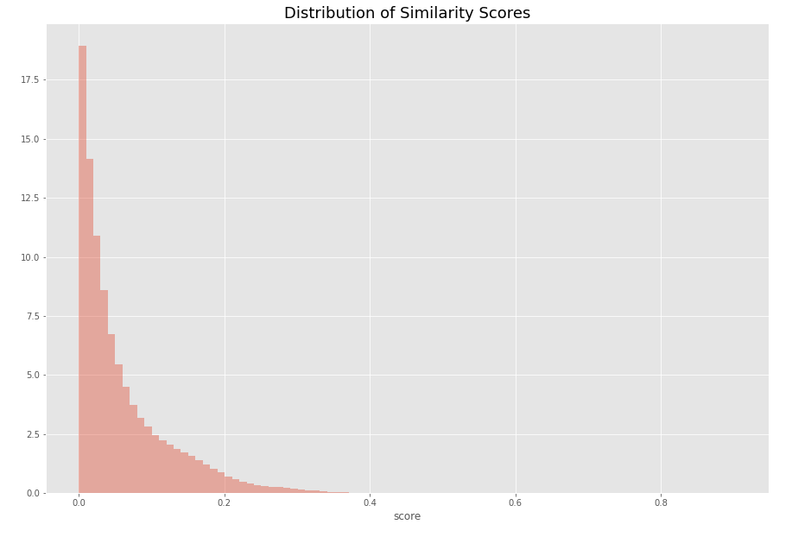
Distribution of Similarity Scores

Slide 9
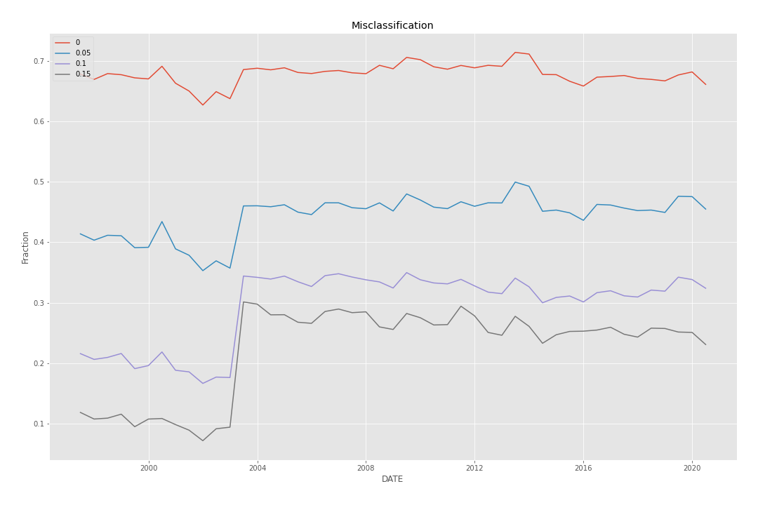
Misclassification Ratio
Similarity Score Cut-Off
$$\frac{number of fundamental peers in another industry }{number of fundamental peers }$$

Slide 10
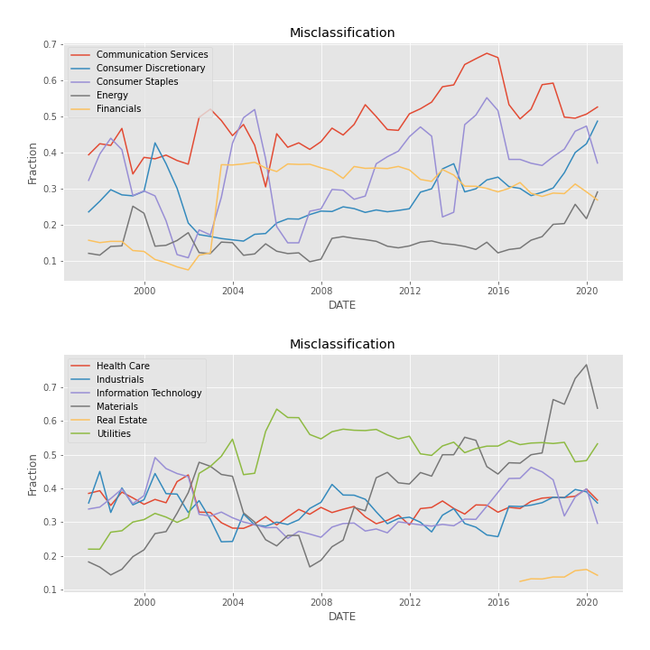
Misclassification Ratio by Sector
Sector | Mean | SD
Real Estate | 25.4% | 1.8%
Energy | 33.8% | 3.7%
Financials | 39.7% | 8.2%
Consumer Discretionary | 40.6% | 5.7%
Health Care | 47.2% | 2.8%
Consumer Staples | 52.1% | 8.4%
Information Technology | 52.6% | 3.8%
Materials | 55.5% | 9.7%
Industrials | 61.1% | 5.4%
Utilities | 64.8% | 7.9%
Communication Services | 66.4% | 4.2%

Slide 11
Data Description
 | Kruger | AFP
Return Data | CRSP US (monthly and weekly) 1997-2009 | MSCI IMI US (monthly) 1997-November 2020
Official Industry | SIC2 (Compustat) | GICS industry (MSCI)
Similarity scores | Hoberg and Phillips Data (annual) | Hoberg and Phillips Data (annual) 1989-2019
Year y’s Hoberg and Phillips data is used in year y + 1.
Subsetting (from Kruger):
Remove all firms with fewer than 5 industry or fundamental peers.
Remove firms whose share price is less than $5.
Remove firms with negative or 0 book equity.
We only included firms with a Hoberg and Phillips similarity score greater than 0.05 so that the size of the groups would match the paper’s.

Slide 12
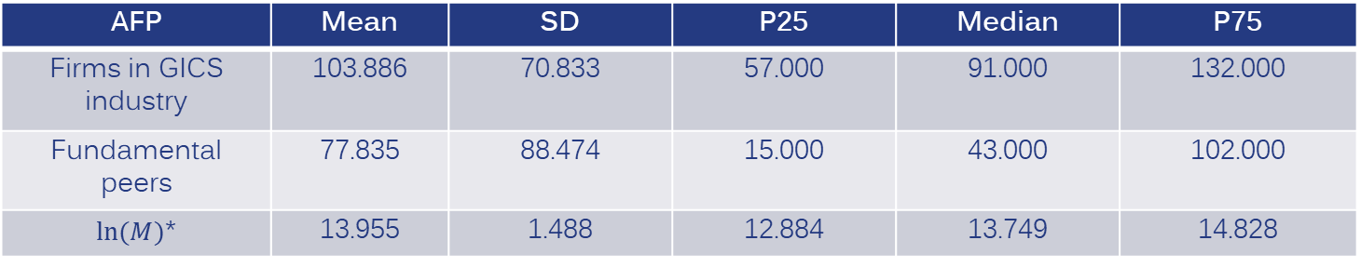
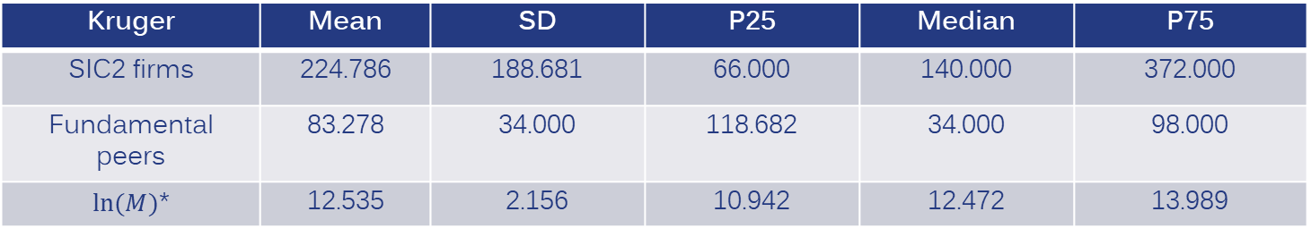
Comparison of Data 1997-2009
AFP | Mean | SD | P25 | Median | P75
Firms in GICS industry | 103.886 | 70.833 | 57.000 | 91.000 | 132.000
Fundamental peers | 77.835 | 88.474 | 15.000 | 43.000 | 102.000
$ln⁡(M)$* | 13.955 | 1.488 | 12.884 | 13.749 | 14.828
Kruger | Mean | SD | P25 | Median | P75
SIC2 firms | 224.786 | 188.681 | 66.000 | 140.000 | 372.000
Fundamental peers | 83.278 | 34.000 | 118.682 | 34.000 | 98.000
$ln⁡(M)$* | 12.535 | 2.156 | 10.942 | 12.472 | 13.989
* Market equity measured in thousands and is calculated at a monthly frequency
Notes:
Kruger’s analysis contained about three times as many observations
Our results show that many of these additional observations come from small capitalization stocks which tend to be more illiquid
GICS Industry is a much finer measure of official industry than SIC2—GICS industry groups tend to be closer to the size of Hoberg groups

Slide 13
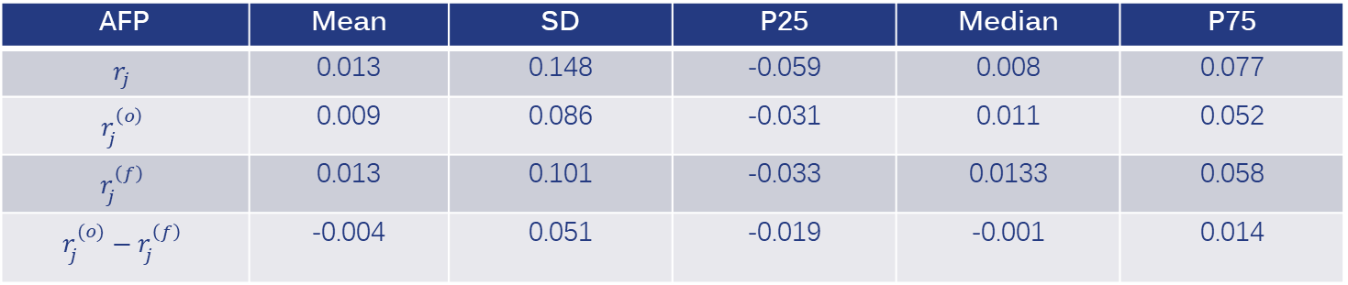
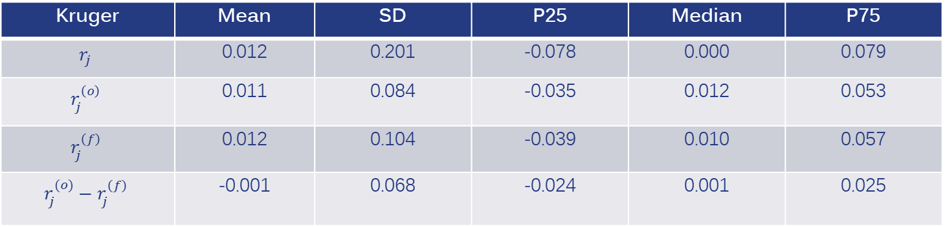
Comparison of Data 1997-2009
AFP | Mean | SD | P25 | Median | P75
$$r_{j}$$ | 0.013 | 0.148 | -0.059 | 0.008 | 0.077
$$r_{j}^{\left(o\right)}$$ | 0.009 | 0.086 | -0.031 | 0.011 | 0.052
$$r_{j}^{\left(f\right)}$$ | 0.013 | 0.101 | -0.033 | 0.0133 | 0.058
$$r_{j}^{(o)}−r_{j}^{\left(f\right)}$$ | -0.004 | 0.051 | -0.019 | -0.001 | 0.014
Kruger | Mean | SD | P25 | Median | P75
$$r_{j}$$ | 0.012 | 0.201 | -0.078 | 0.000 | 0.079
$$r_{j}^{\left(o\right)}$$ | 0.011 | 0.084 | -0.035 | 0.012 | 0.053
$$r_{j}^{\left(f\right)}$$ | 0.012 | 0.104 | -0.039 | 0.010 | 0.057
$$r_{j}^{(o)}−r_{j}^{\left(f\right)}$$ | -0.001 | 0.068 | -0.024 | 0.001 | 0.025
Notes:
Returns are comparable between the two universes—MSCI returns tend to be slightly higher

Slide 14
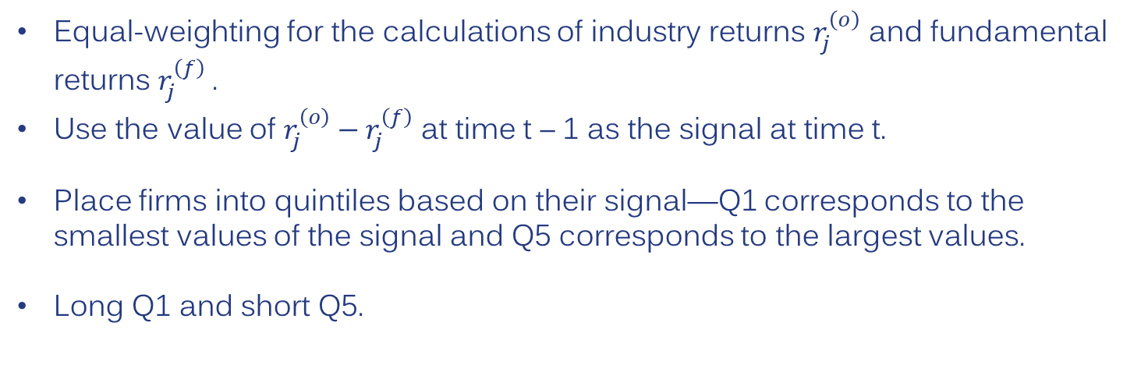
Kruger Strategy
Equal-weighting for the calculations of industry returns $r_{j}^{\left(o\right)}$ and fundamental returns $r_{j}^{\left(f\right)}$.
Use the value of $r_{j}^{\left(o\right)}−r_{j}^{\left(f\right)}$ at time t – 1 as the signal at time t.
Place firms into quintiles based on their signal—Q1 corresponds to the smallest values of the signal and Q5 corresponds to the largest values.
Long Q1 and short Q5.

Slide 15
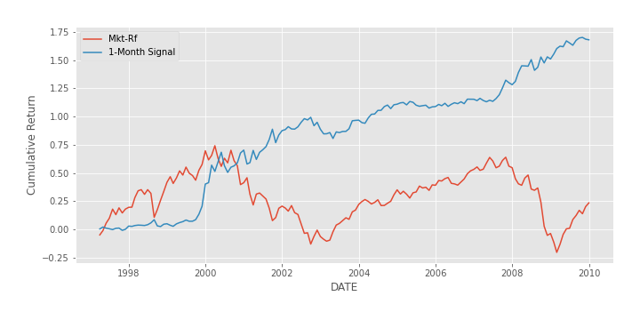
Kruger Strategy 1997-2009

Slide 16
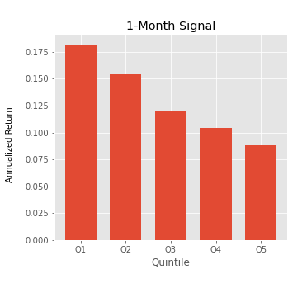
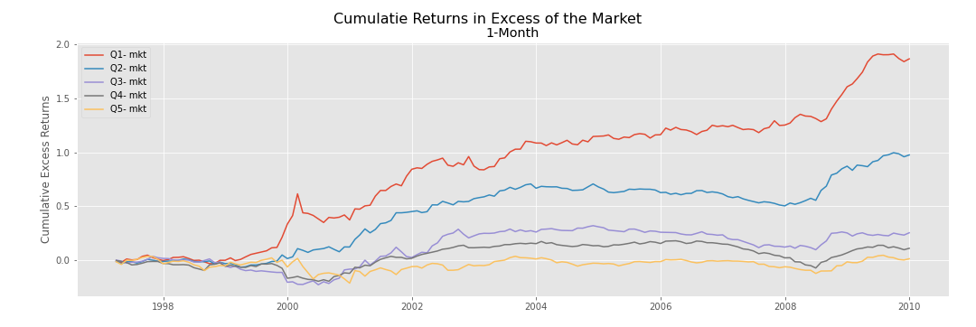
Kruger Strategy 1997-2009
 | Mean Return | SD | Sharpe (excess of riskfree) | Sharpe
Q1 | 19.7% | 23.6% | 0.70 | 0.83
Q5 | 11.5% | 24.6% | 0.34 | 0.47
Q1-Q5 | 8.2% | 9.3% | 0.53 | 0.88

Slide 17
Strategy Reformulation

Slide 18
Strategy Reformulation
Subset observations to firms in the monthly SIG US universe.
Change time range to 1997-2020.
Data from 1997-2018 was in-sample and data after December 2018 is out-of-sample.
Expand coverage by relaxing subsetting:
- Remove the $5 minimum stock price constraint.
  - Remove the positive book equity constraint.
  - Reduce the minimum group size to three—this expands coverage the most.

Slide 19
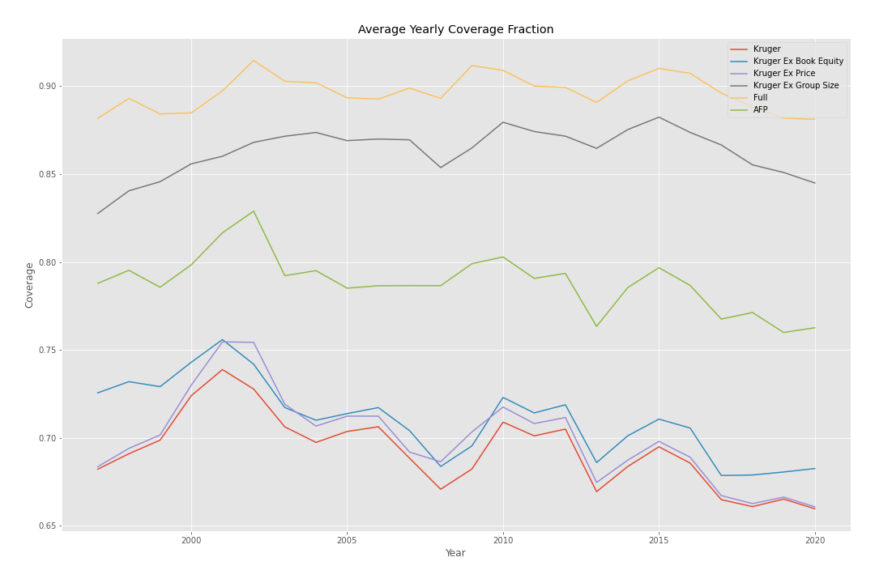
Coverage (One-Month Signal)

Slide 20
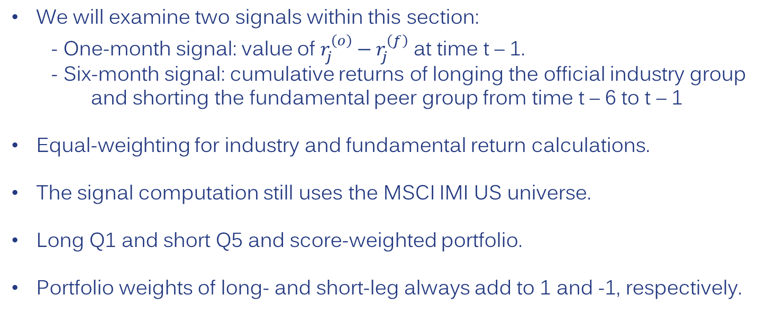
Signal and Strategy
We will examine two signals within this section:
- One-month signal: value of $r_{j}^{\left(o\right)}−r_{j}^{\left(f\right)}$ at time t – 1.
- Six-month signal: cumulative returns of longing the official industry group and shorting the fundamental peer group from time t – 6 to t – 1
Equal-weighting for industry and fundamental return calculations.
The signal computation still uses the MSCI IMI US universe.
Long Q1 and short Q5 and score-weighted portfolio.
Portfolio weights of long- and short-leg always add to 1 and -1, respectively.

Slide 21
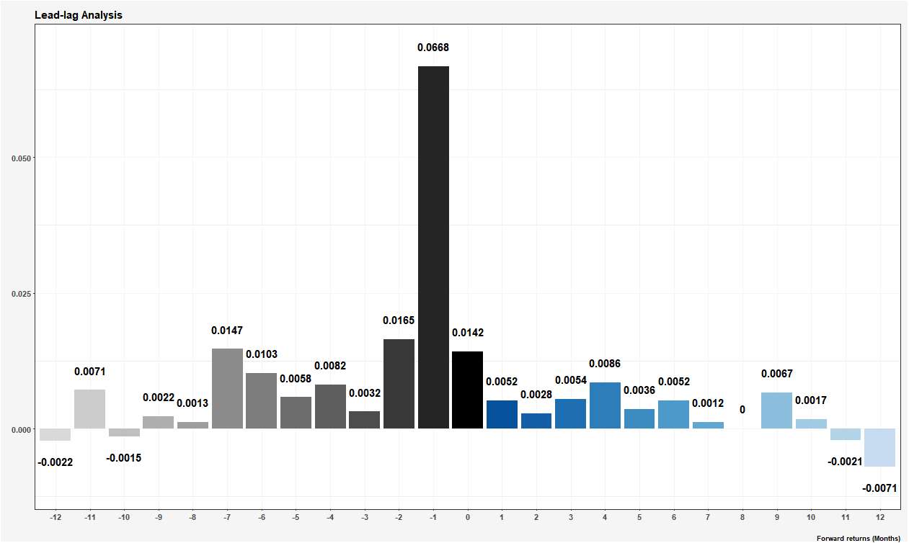
Lead-Lag ICs
IC is 0.0052 for the first month
The signal still appears to have predictive power going to the 10th month before showing negative IC
There is clearly a strong one-month momentum profile

Slide 22
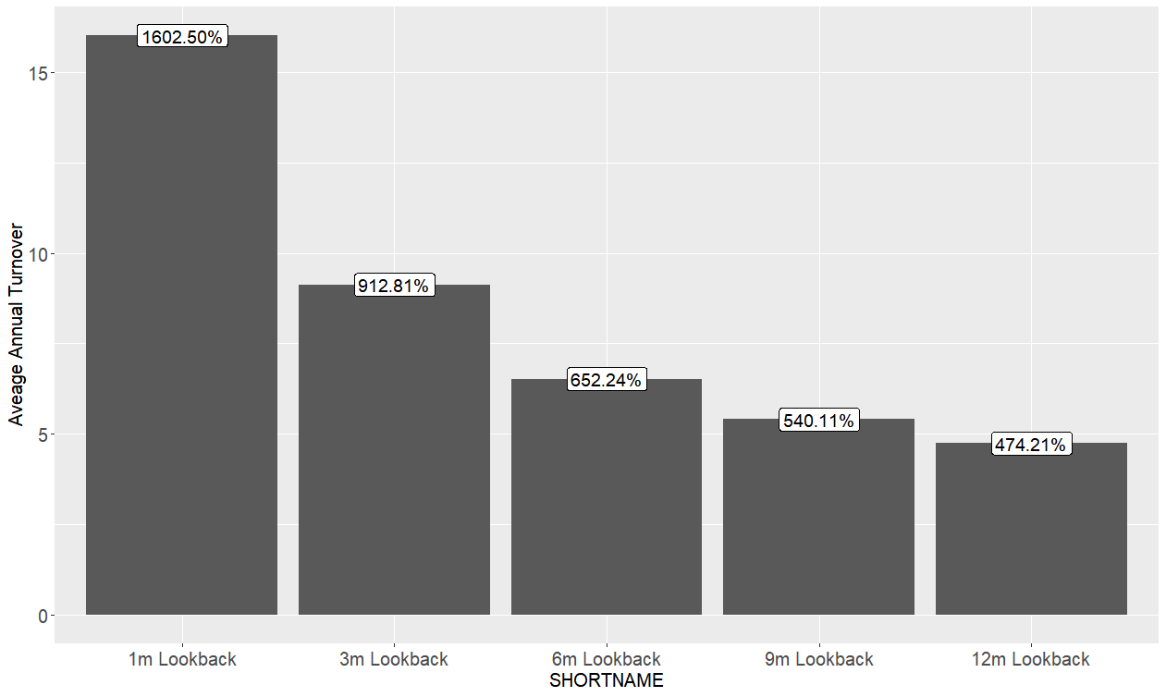
Signal Duration Comparison - Turnover
The two-way turnover of score-weight portfolios using 1-month is about 1600% annually and is about 650% for the 6-month look back signal.

Slide 23
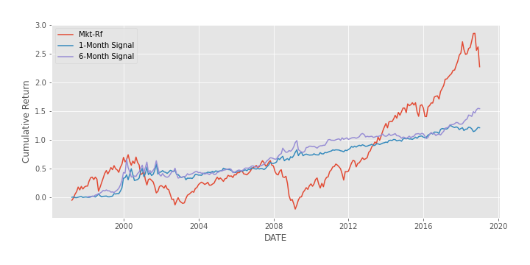
Q1-Q5 Returns 1997-2018

Slide 24
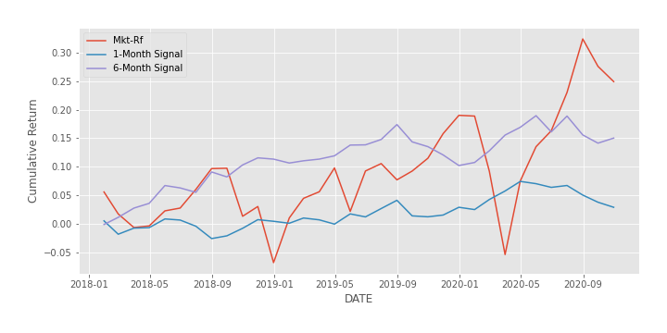
Q1-Q5 Returns 2019-2020 (Out-of-Sample)

Slide 25
Q1-Q5 Return Statistics (Annualized)
One-Month Signal
1997-2018 | Mean Return | SD | Sharpe (excess of riskfree) | Sharpe
Q1 | 11.9% | 19.4% | 0.51 | 0.61
Q5 | 7.9% | 21.1% | 0.28 | 0.37
Q1-Q5 | 4.0% | 8.3% | 0.24 | 0.48
2019-2020 | Mean Return | SD | Sharpe (excess of riskfree) | Sharpe
Q1 | 13.0% | 23.5% | 0.28 | 0.55
Q5 | 12.4% | 24.6% | 0.22 | 0.51
Q1-Q5 | 0.6% | 4.3% | -0.10 | 0.14
Six-Month Signal
1997-2018 | Mean Return | SD | Sharpe (excess of riskfree) | Sharpe
Q1 | 11.9% | 18.5% | 0.54 | 0.64
Q5 | 7.0% | 20.8% | 0.25 | 0.34
Q1-Q5 | 4.8% | 8.9% | 0.33 | 0.54
2019-2020 | Mean Return | SD | Sharpe (excess of riskfree) | Sharpe
Q1 | 13.2% | 23.7% | 0.28 | 0.56
Q5 | 9.2% | 25.8% | 0.06 | 0.36
Q1-Q5 | 4.0% | 5.7% | 0.62 | 0.70

Slide 26
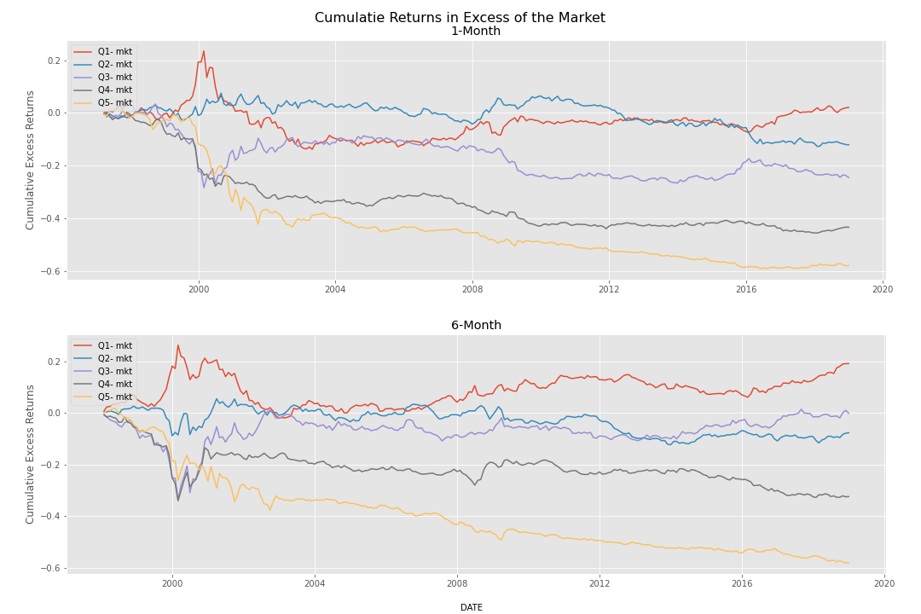
Quintile Cumulative Returns 1997-2018

Slide 27
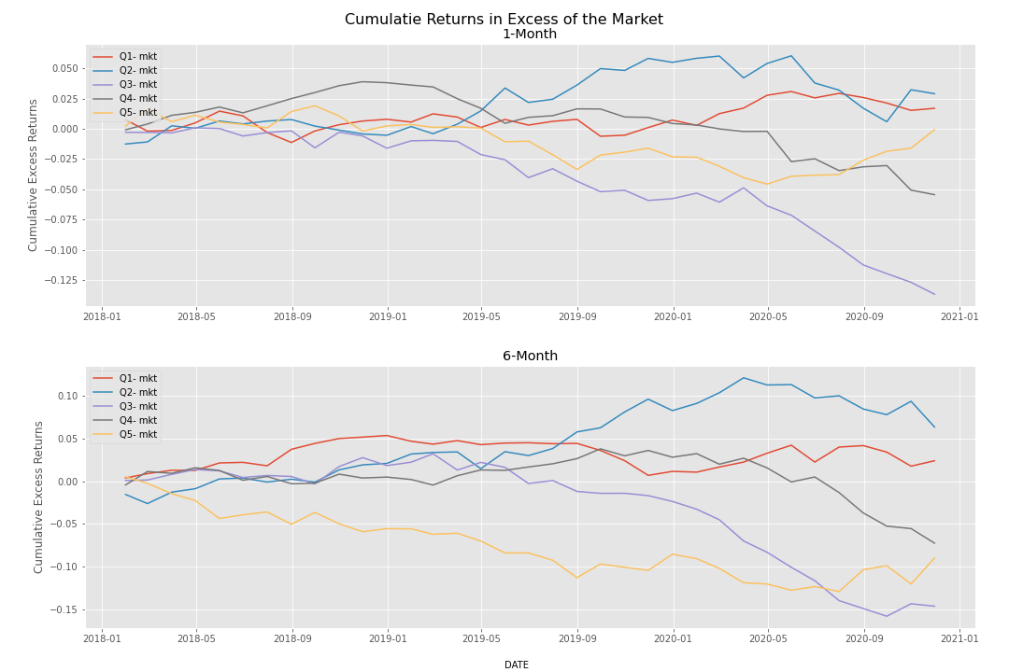
Quintiles 2019-2020 (Out-of-Sample)

Slide 28
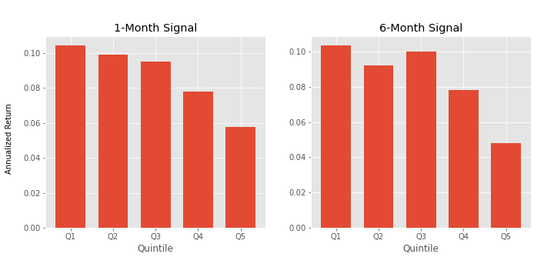
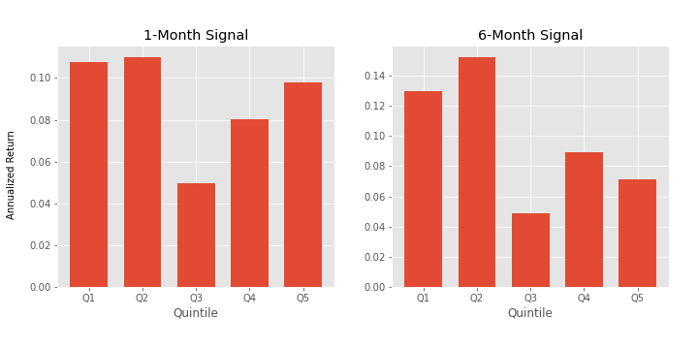
Quintile Annualized Returns
1997-2018
2019-2020

Slide 29
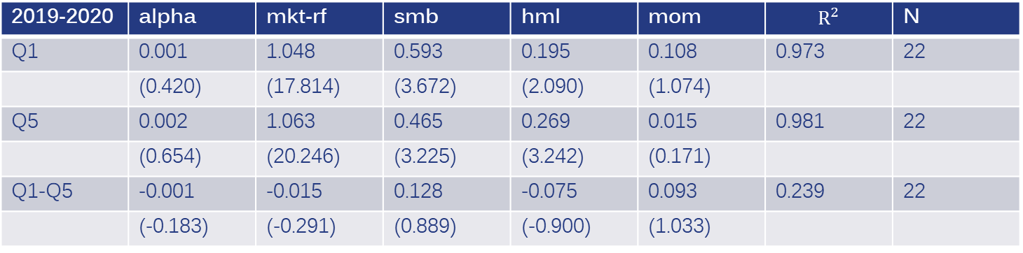
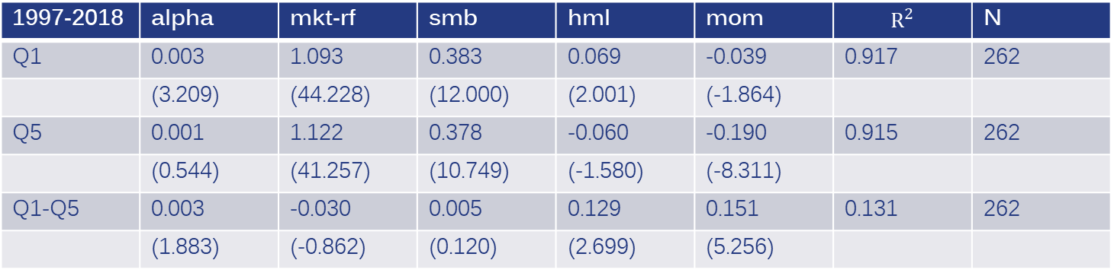
Q1-Q5 Factor Loadings (One-Month Signal)
1997-2018 | alpha | mkt-rf | smb | hml | mom | $$R^{2}$$ | N
Q1 | 0.003 | 1.093 | 0.383 | 0.069 | -0.039 | 0.917 | 262
 | (3.209) | (44.228) | (12.000) | (2.001) | (-1.864)
Q5 | 0.001 | 1.122 | 0.378 | -0.060 | -0.190 | 0.915 | 262
 | (0.544) | (41.257) | (10.749) | (-1.580) | (-8.311)
Q1-Q5 | 0.003 | -0.030 | 0.005 | 0.129 | 0.151 | 0.131 | 262
 | (1.883) | (-0.862) | (0.120) | (2.699) | (5.256)
2019-2020 | alpha | mkt-rf | smb | hml | mom | $$R^{2}$$ | N
Q1 | 0.001 | 1.048 | 0.593 | 0.195 | 0.108 | 0.973 | 22
 | (0.420) | (17.814) | (3.672) | (2.090) | (1.074)
Q5 | 0.002 | 1.063 | 0.465 | 0.269 | 0.015 | 0.981 | 22
 | (0.654) | (20.246) | (3.225) | (3.242) | (0.171)
Q1-Q5 | -0.001 | -0.015 | 0.128 | -0.075 | 0.093 | 0.239 | 22
 | (-0.183) | (-0.291) | (0.889) | (-0.900) | (1.033)

Slide 30
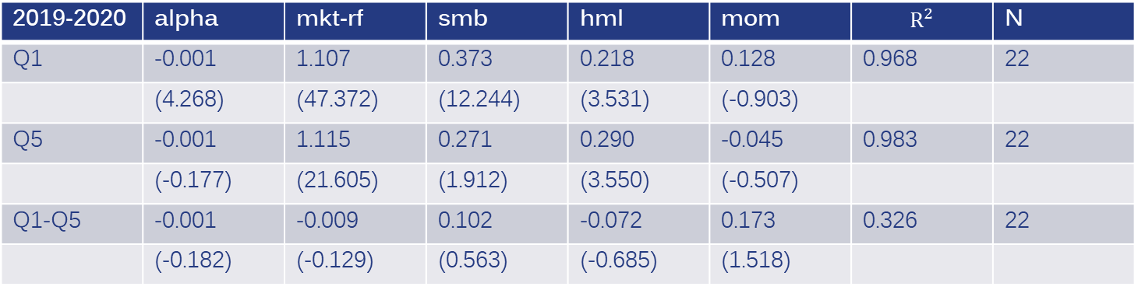
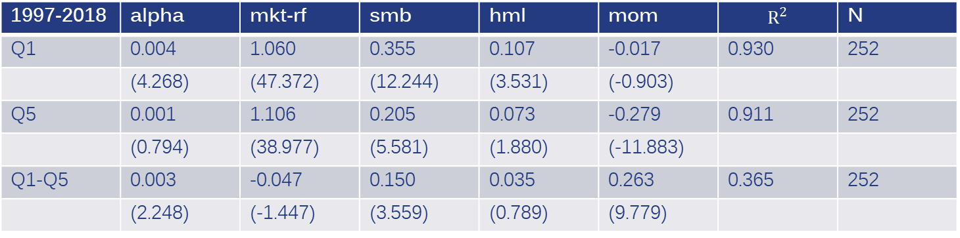
Q1-Q5 Factor Loadings (Six-Month Signal)
1997-2018 | alpha | mkt-rf | smb | hml | mom | $$R^{2}$$ | N
Q1 | 0.004 | 1.060 | 0.355 | 0.107 | -0.017 | 0.930 | 252
 | (4.268) | (47.372) | (12.244) | (3.531) | (-0.903)
Q5 | 0.001 | 1.106 | 0.205 | 0.073 | -0.279 | 0.911 | 252
 | (0.794) | (38.977) | (5.581) | (1.880) | (-11.883)
Q1-Q5 | 0.003 | -0.047 | 0.150 | 0.035 | 0.263 | 0.365 | 252
 | (2.248) | (-1.447) | (3.559) | (0.789) | (9.779)
2019-2020 | alpha | mkt-rf | smb | hml | mom | $$R^{2}$$ | N
Q1 | -0.001 | 1.107 | 0.373 | 0.218 | 0.128 | 0.968 | 22
 | (4.268) | (47.372) | (12.244) | (3.531) | (-0.903)
Q5 | -0.001 | 1.115 | 0.271 | 0.290 | -0.045 | 0.983 | 22
 | (-0.177) | (21.605) | (1.912) | (3.550) | (-0.507)
Q1-Q5 | -0.001 | -0.009 | 0.102 | -0.072 | 0.173 | 0.326 | 22
 | (-0.182) | (-0.129) | (0.563) | (-0.685) | (1.518)

Slide 31
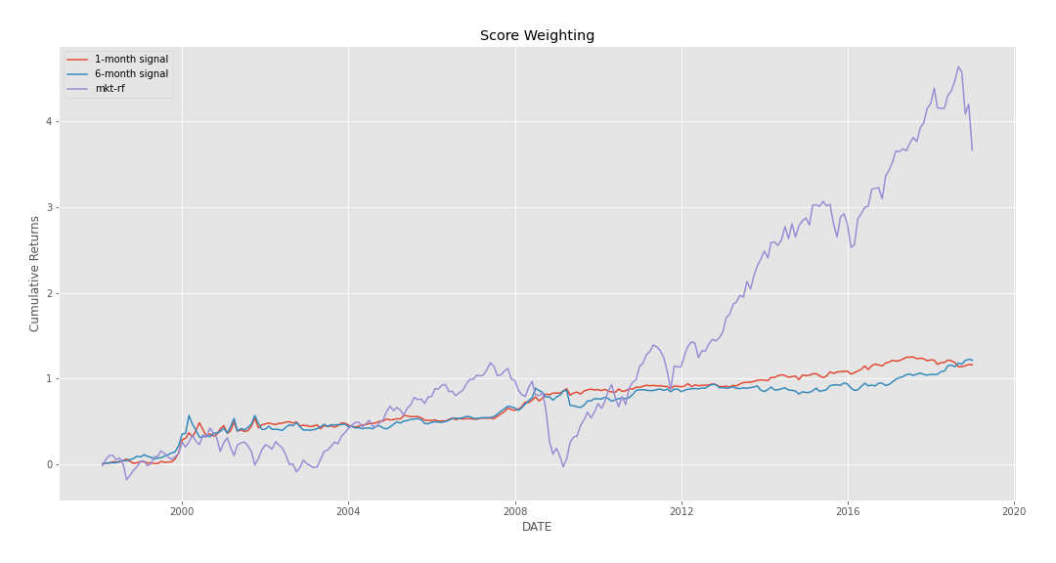
Score-Weight Portfolio 1997-2018

Slide 32
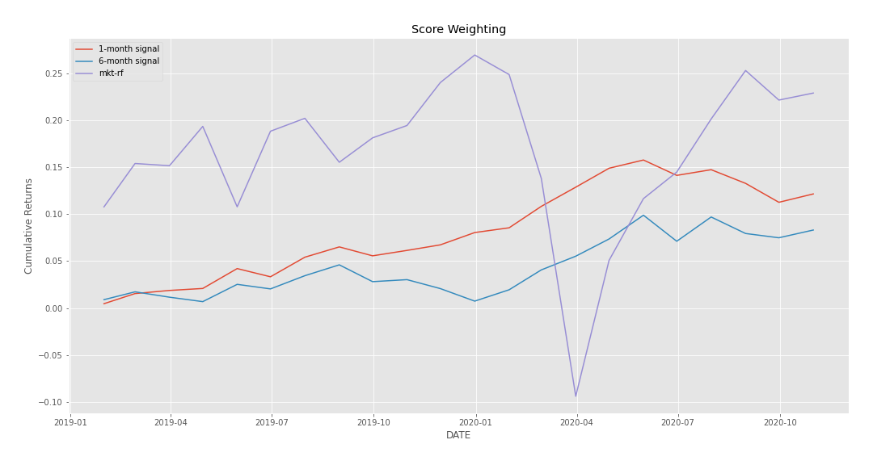
Score-Weight Portfolio 2019-2020 (Out-of-Sample)

Slide 33
Score-Weighting Return Statistics (Annualized)
1997-2018 | Mean Return | SD | Sharpe (excess of riskfree) | Sharpe
1-Month Signal | 4.0% | 6.9% | 0.29 | 0.58
6-Month Signal | 4.1% | 7.8% | 0.28 | 0.53
2019-2020 | Mean Return | SD | Sharpe (excess of riskfree) | Sharpe
1-Month Signal | 6.4% | 4.0% | 1.24 | 1.60
6-Month Signal | 4.4% | 5.0% | 0.62 | 0.88

Slide 34
Robustness Tests

Slide 35
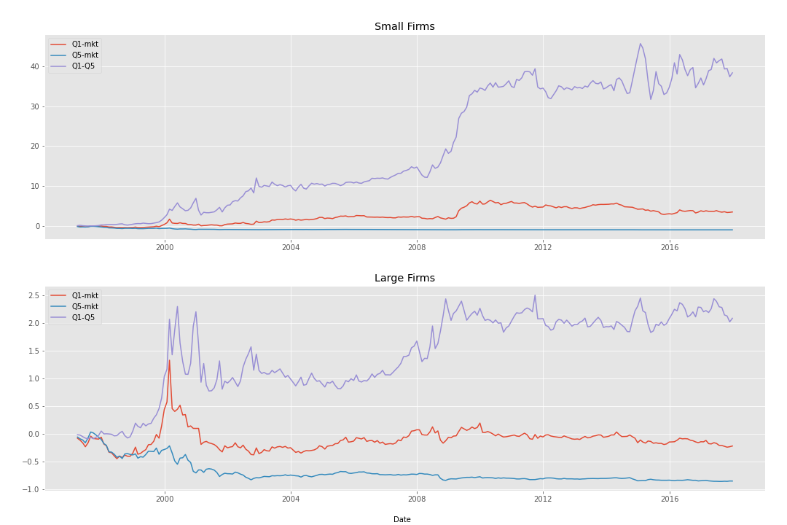
Effect of Capitalization (One-Month Signal)
MSCI IMI Universe

Slide 36
Effect of Capitalization (One-Month Signal)
MSCI IMI Universe
Small Capitalization Stocks (Returns Statistics Annualized)
1997-2018 | Mean Return | SD | Median | Sharpe (excess of riskfree) | Sharpe
Q1 | 23.6% | 31.3% | 19.9% | 0.69 | 0.75
Q5 | 2.0% | 33.4% | 7.6% | 0.00 | 0.06
Q1-Q5 | 21.6% | 28.1% | 15.1% | 0.70 | 0.77
Large Capitalization Stocks (Return Statistics Annualized)
1997-2018 | Mean Return | SD | Median | Sharpe (excess of riskfree) | Sharpe
Q1 | 13.4% | 20.7% | 12.7% | 0.55 | 0.65
Q5 | 5.2% | 24.9% | 11.0% | 0.13 | 0.21
Q1-Q5 | 8.3% | 24.1% | 6.5% | 0.26 | 0.34

Slide 37
Other Signal Construction Variations
Value-weighted industry and fundamental returns used for signal
Inverse value-weighted industry and fundamental returns used for signal
Construct a distance metric from similarity scores and use hierarchical clustering to place firms into clusters--this creates a transitive fundamental group
All the variations above are quintile sorts. We long Q1 and short Q5.
Remove firms of the same industry from the fundamental group and calculate equally-weighted returns. Use these returns as the signal. For this variation long the largest values of the signal Q5 and short the smallest Q1.

Slide 38
Other Variations Return Statistics 1997-2018
One-Month Signal (Return Statistics Annualized)
Long-Short Position | Mean Return | SD | Sharpe (excess of riskfree) | Sharpe
Value-Weighted | 1.7% | 5.0% | -0.06 | 0.34
Inverse Value-Weighted | 2.0% | 4.6% | 0.00 | 0.43
Clustering | -6.0% | 15.4% | -0.52 | -0.39
Fundamental Excluding Industry | 8.0% | 22.1% | 0.28 | 0.36
Six-Month Signal (Return Statistics Annualized)
Long-Short Position | Mean Return | SD | Sharpe (excess of riskfree) | Sharpe
Value-Weighted | 3.4% | 4.9% | 0.29 | 0.74
Inverse Value-Weighted | 3.1% | 4.8% | 0.27 | 0.65
Clustering | -3.4% | 15.8% | -0.33 | -0.22
Fundamental Excluding Industry | 6.8% | 20.6% | 0.25 | 0.33

Slide 39
Comments from Eric

Slide 40
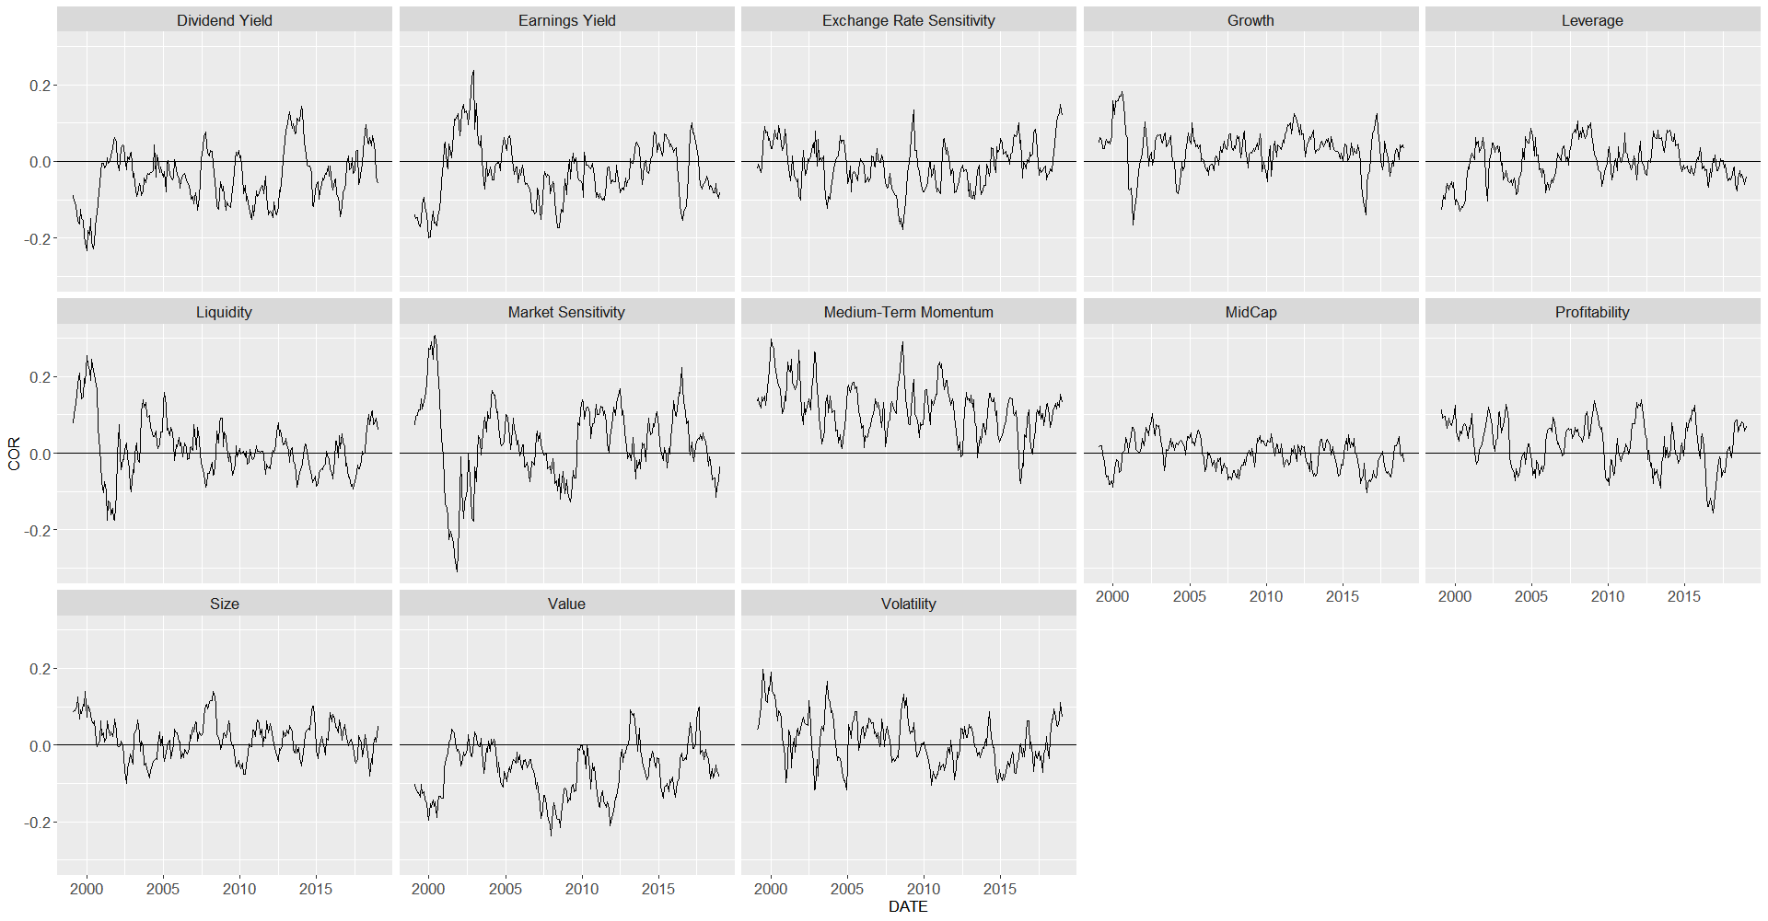
Axioma Risk Factor Correlations
The signal typically has positive correlations to Momentum, Market Sensitivity, Growth, and Profitability, with negative correlations to Value factors.

Slide 41
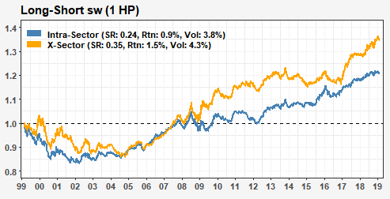
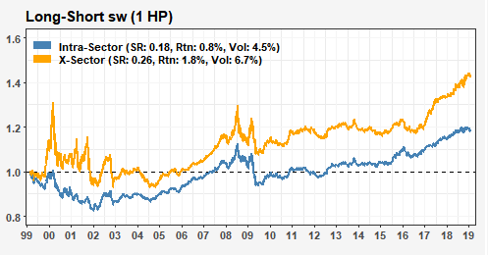
Neutralized Signal Performance
We try neutralizing the signal’s exposures to Axioma Momentum, Size, Liquidity, and Market Sensitivity through orthogonalization.
The resulting neturalized signal shows smoother performance, especially during the tech bubble and GFC periods.
This results in an improvement in SR to 0.35.
Neutralized Signal
Original Signal

Slide 42
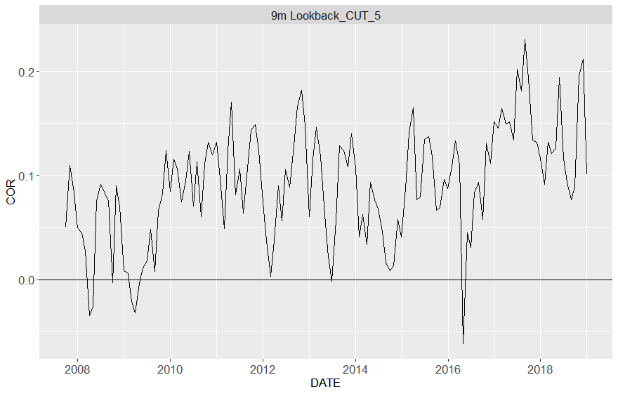
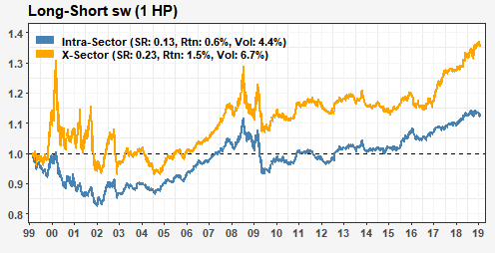
Correlation to Econlink Subcomposite
The signal has on average 0.09 score correlation to SIG’s Econlink factor, with some increase in recent years.
After neutralizing the signal to Econlink, we find that the score weight performance is mostly unaffected and still shows moderate performance.
Based on the intuition behind the signals, and these results, we would suggest incorporation into the Econlink bucket of signals.

Slide 43
Conclusion

Slide 44
Conclusion
Replication of Kruger strategy was somewhat successful—lower returns but the results make sense given difference in universe and our analysis of capitalization.
Both in- and out-of-sample results within the SIG universe showed moderate and consistent return statistic values.
Extending the look-back window reduces signal turnover and does not substantially affect its predictive power.
The signal has positive exposure to Momentum and small positive correlation to SIG’s EconLink subcomposite.
Further research:
  Build in-house 10-K similarity—try more advanced NLP techniques.
  Signals that remove short-term firm momentum instead of industry momentum.
  Smoothing the signal using exponential weighting or a filtration algorithm to compute longer lookback momentum.
  Consider construction of the strategy outside the U.S.

Slide 45
APPENDIX

Slide 46
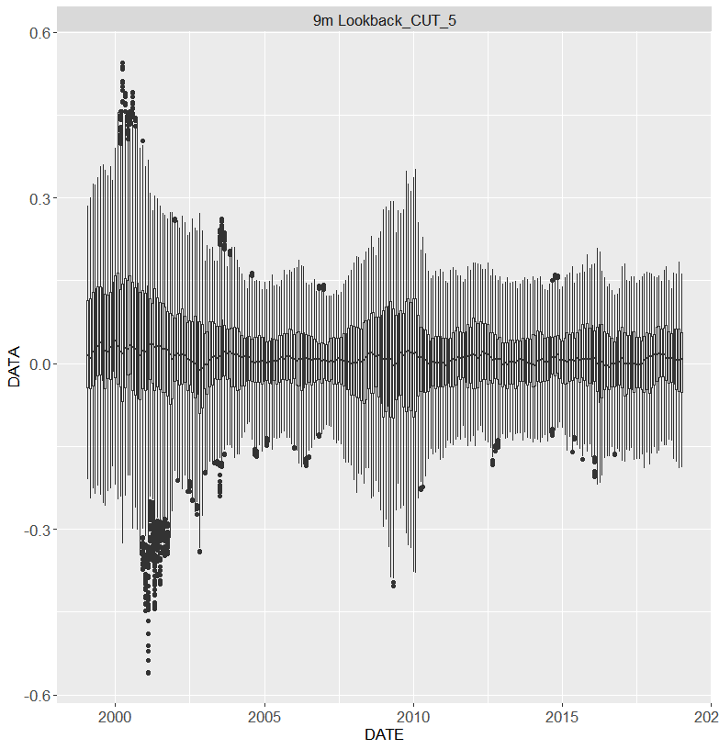
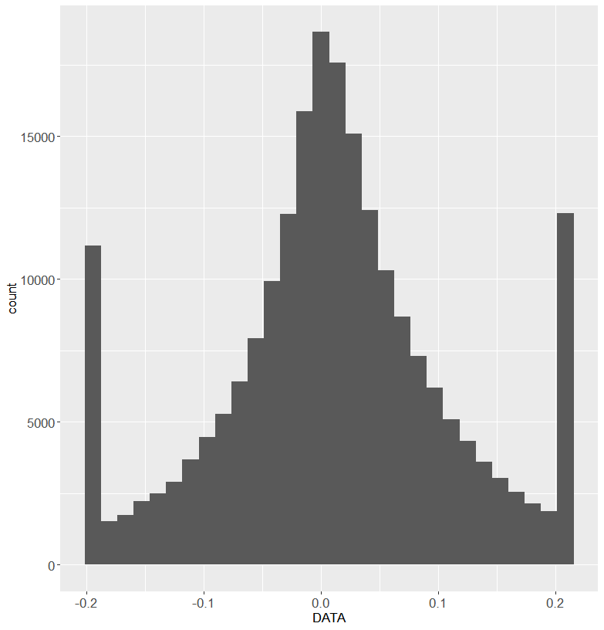
Signal Distribution
Raw signal distribution is fairly symmetrical and centered near 0, with a handful of outliers
Increased dispersion during tech bubble and GFT periods.
Signal will undergo rank + inverse norm transformation to form alpha

Slide 47
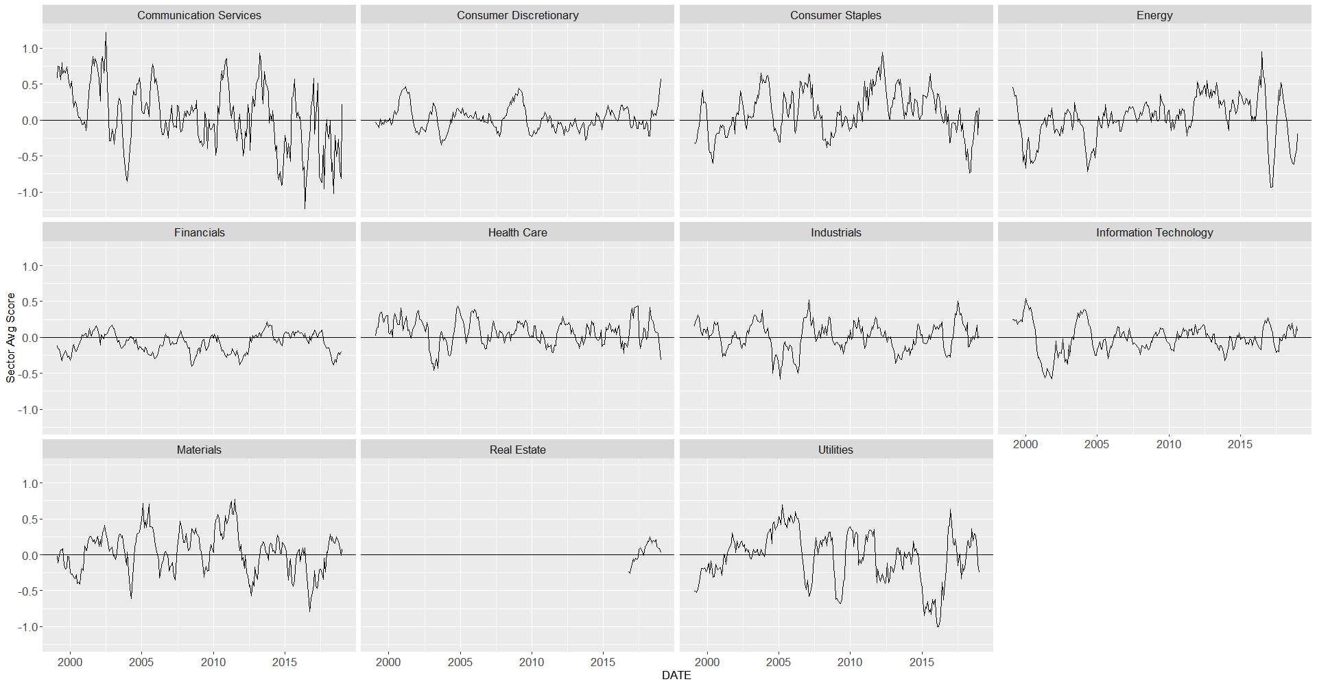
Sector Tilts

Slide 48
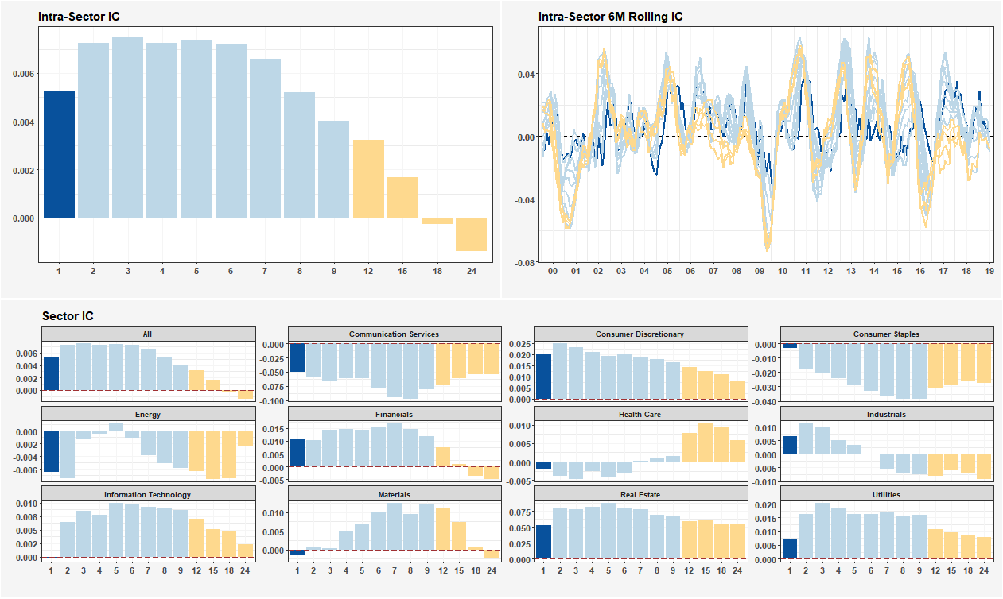
Sector ICs
The signal’s performance is weaker intrasector than fully cross sectional
Most sector’s show positive ICs except Energy, Communication Serv., and Healthcare
Large dips in IC seen in 2000, 2009, and 2016.

Slide 49
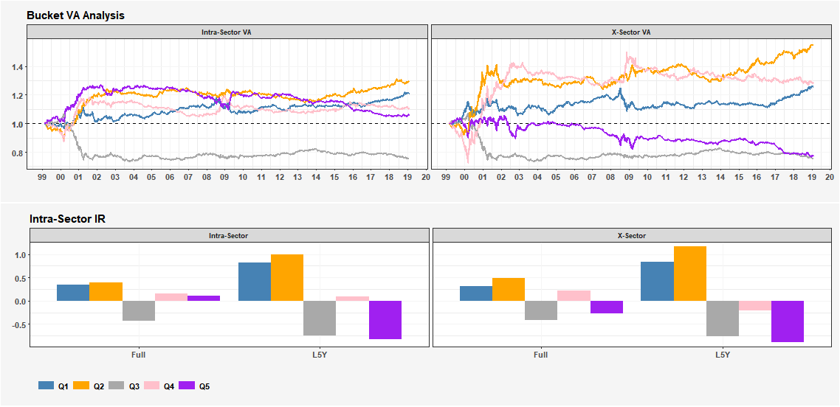
Quintile Performance
The signal does not behave monotonically as Q2 outperforms Q1 and Q4 outperforms Q3.
However this may largely be due to outsized volatility in the quintiles during the tech bubble period.

Slide 50
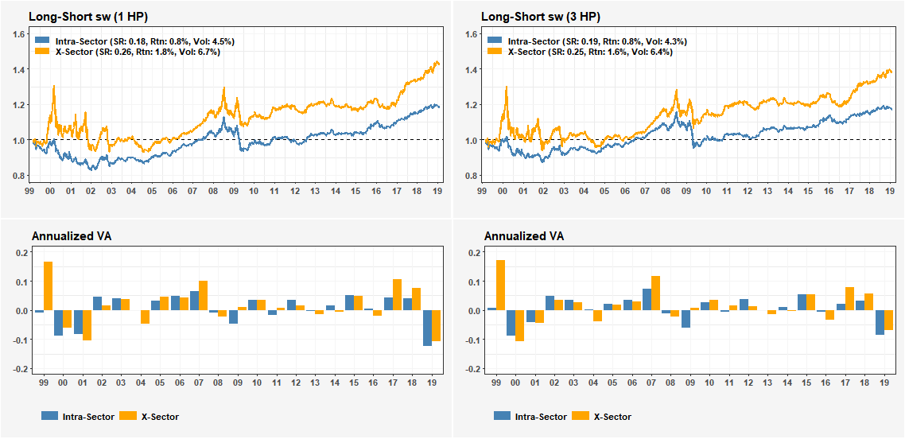
Score Weight Portfolio Performance
The signal shows moderate score-weight cross-sectional performance with SR of 0.25.
The intrasector portfolio shows lower volatility, returns, and SR.
We see drawdowns in early 2000’s, 2009, and 2016.
With 3 month holding period, we still find similar performance for the signal.

Slide 51
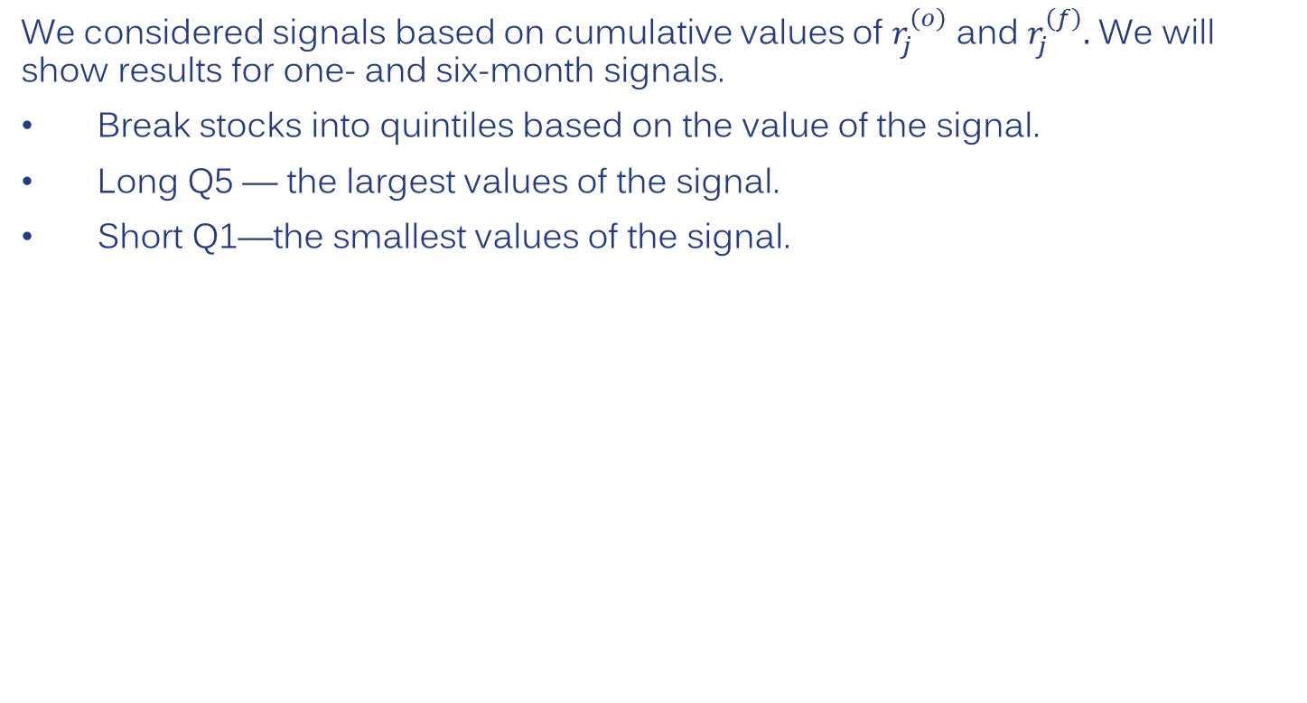
Fundamental and Industry Momentum
We considered signals based on cumulative values of $r_{j}^{\left(o\right)}$ and $r_{j}^{\left(f\right)}.$ We will show results for one- and six-month signals.
Break stocks into quintiles based on the value of the signal.
Long Q5 — the largest values of the signal.
Short Q1—the smallest values of the signal.

Slide 52
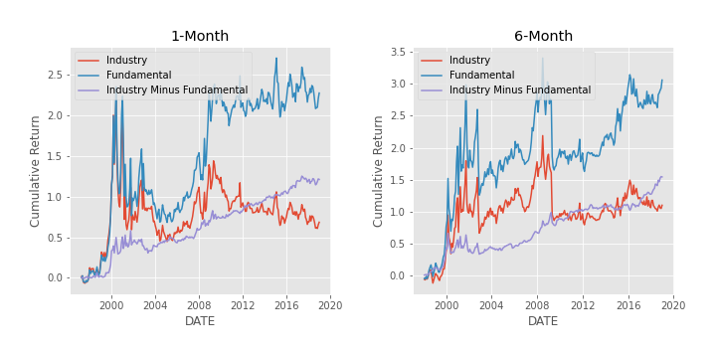
Fundamental and Industry Momentum

Slide 53
Return Statistics 1997-2018
One-Month Signal (Return Statistics Annualized)
 | Mean Return | SD | Sharpe (excess of riskfree) | Sharpe
Industry | 5.0% | 23.0% | 0.13 | 0.22
Fundamental | 8.3% | 23.7% | 0.26 | 0.35
Six-Month Signal (Return Statistics Annualized)
 | Mean Return | SD | Sharpe (excess of riskfree) | Sharpe
Industry | 6.0% | 22.1% | 0.19 | 0.27
Fundamental | 9.4% | 23.1% | 0.32 | 0.41

Slide 54
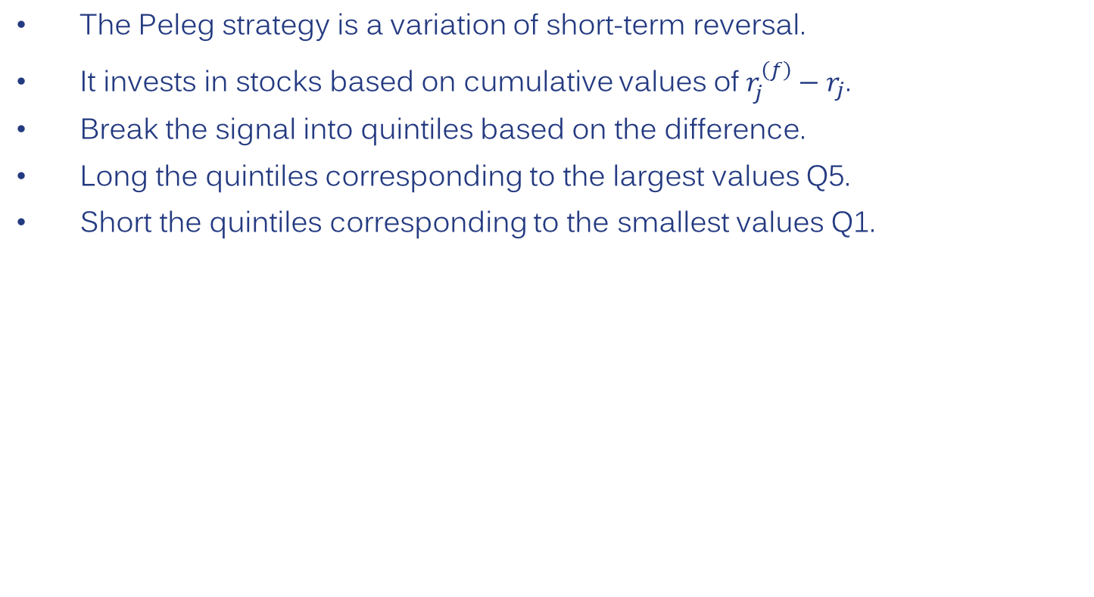
Peleg Strategy
The Peleg strategy is a variation of short-term reversal.
It invests in stocks based on cumulative values of $r_{j}^{\left(f\right)}−r_{j}$.
Break the signal into quintiles based on the difference.
Long the quintiles corresponding to the largest values Q5.
Short the quintiles corresponding to the smallest values Q1.

Slide 55
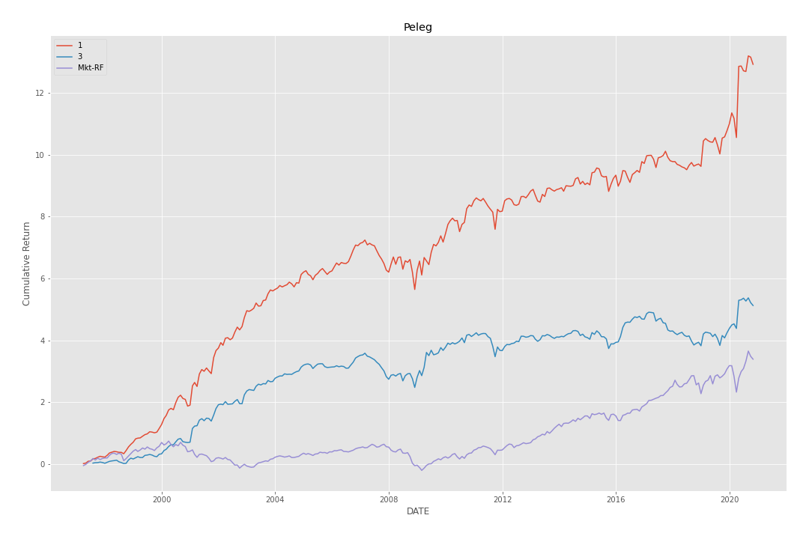
Peleg Strategy 1997-2018

Slide 56
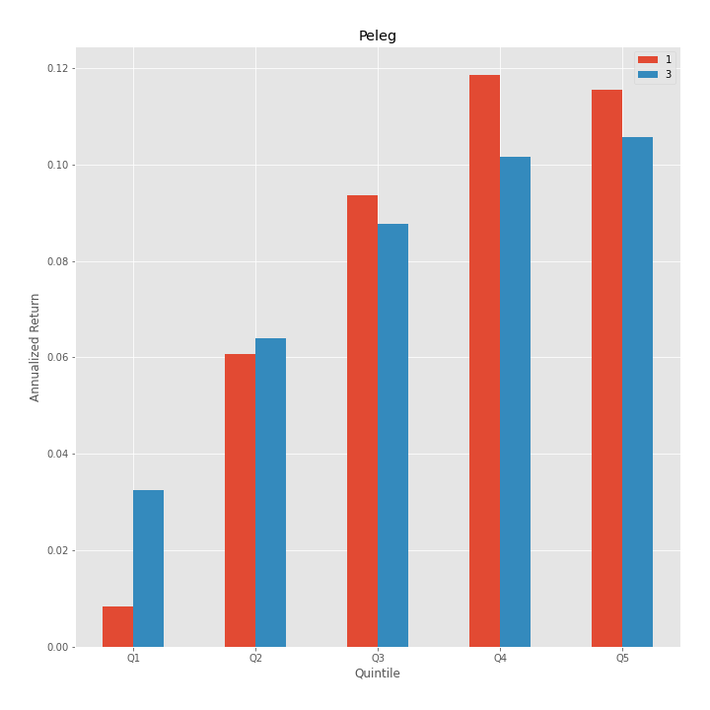
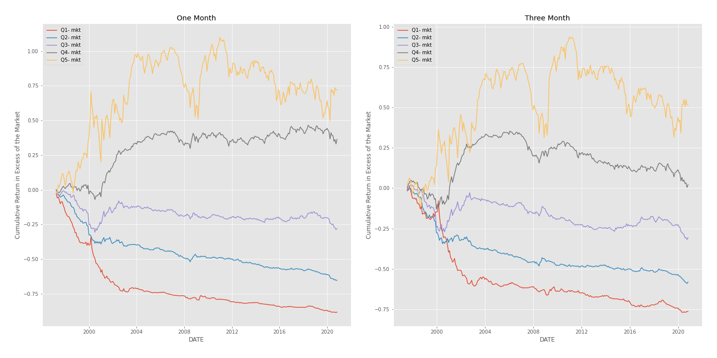
Peleg Return Statistics 1997-2018
 | Mean Return | SD | Sharpe (excess of riskfree) | Sharpe
1-Month Signal | 11.8% | 11.3% | 0.87 | 1.04
3-Month Signal | 8.4% | 11.7% | 0.57 | 0.72

