Slide 1
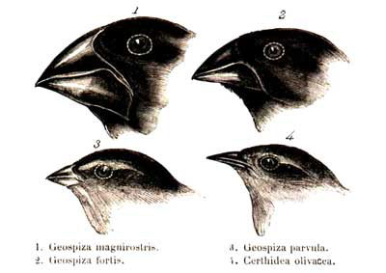
Variation
Selection

Slide 2
Horizontal
transfert
Stochasticity of
gene expression
DNA repair
Sex
Mutator
genes
Variation
Selection
Network
modularity
Transposable
elements
Niche
construction
Resource cycling

Slide 3
(1)
(3)
(2)
Neutral mutation
Beneficial mutation

Slide 4
(A) The scientific method
(B) Proof-of-concept models
Observe nature and build hypotheses
Gather evidence
Pick assumptions and build a model
Analyze evidence
Analyze the model
Evaluate hypotheses and propose new directions

Slide 5
(A) Probability Pa(x) for a mutation
of normalized size x to be favorable
(B) Successive fixed mutations
of a population evolving towards z_{opt}
Fixed mutations
P_{a}(x) = 1 - Φ(x)
z_{opt}
Character 1
Character 2
x

Slide 6
Genotype
Genotype space
Projection
(mapping)
tuple (n-dimensional) space
bag of tuples

Slide 7
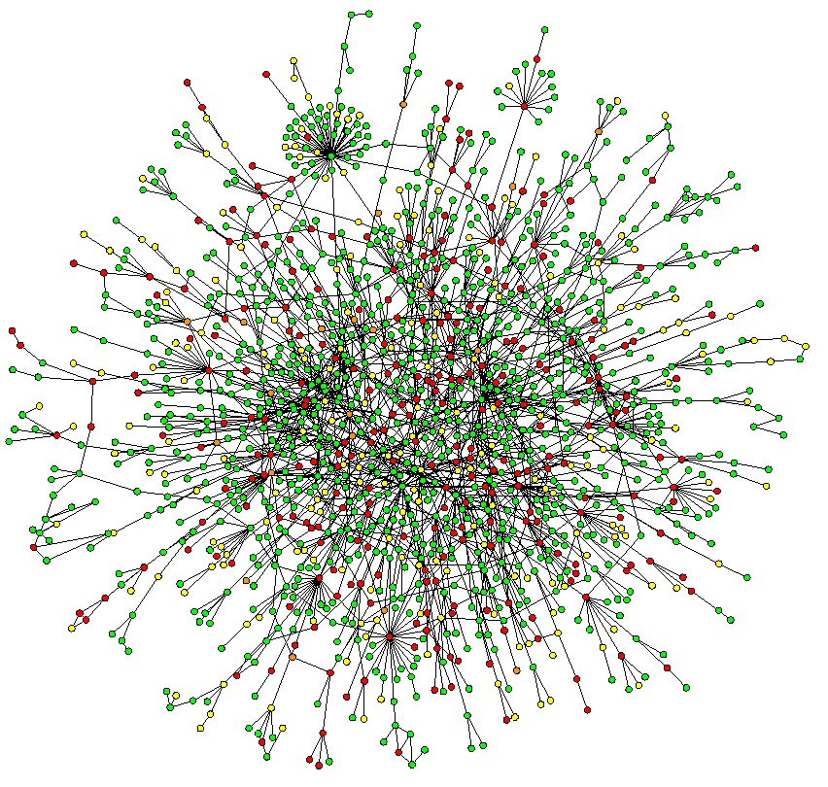
(1) The set of tuples defines a set of reaction rules R
Genome data-structure
(c)
(d)
(b)
Tuples
set
(a)
(2) The set of tuples defines products of genes and are possibly compounds or catalysts of a subset of reactions in R

Slide 8
Genotype–to-phenotype mapping
Genome
GRN
Metabolism
Population
Ecosystem
Aevol
R-Aevol
Pearls-on-a-String
Pearls-on-a-String
with resource cycling
Virtual Cell
Integrated multi-level model (?)

Slide 9
end product
(c)
(e)
(a)
anabolic
A_{in}
A_{out}
(d)
(b)
catabolic
X
TF
TF
(f)

Slide 10
(d)
(b)
(c)
(a) Chromosome
(g)
(f)
(e)

