Slide 1
Model payoff
Medawar
zone
Model complexity

Slide 2
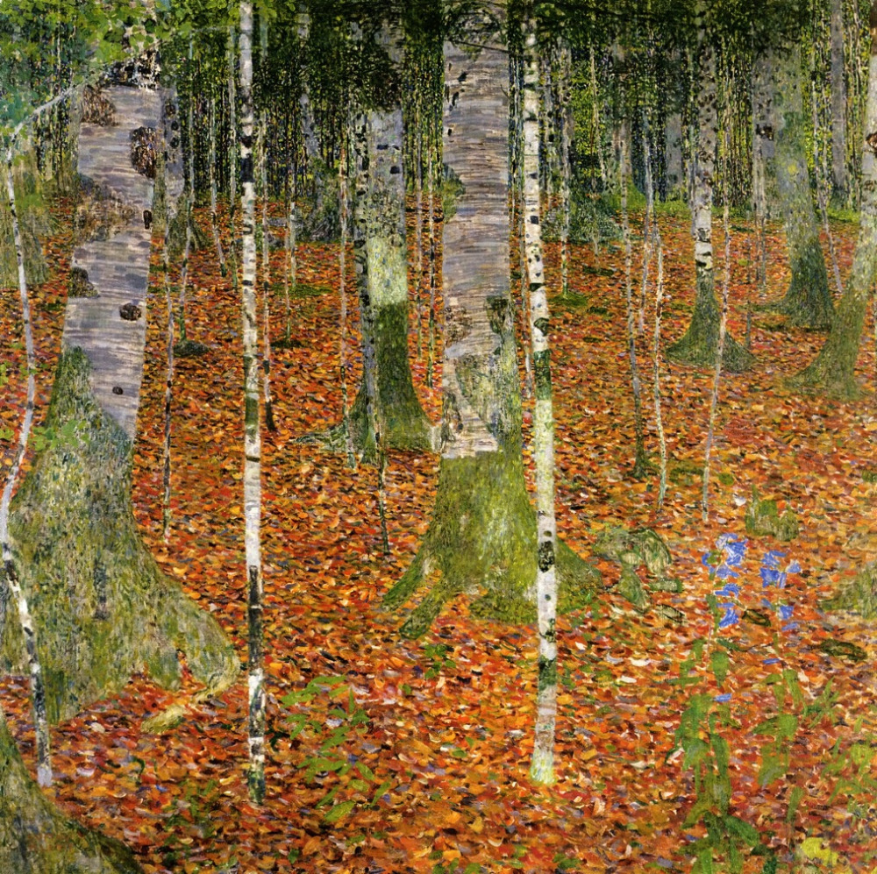




Slide 3
NC
E
TF

Slide 4
NC
E
TF

Slide 5
a. Some functional combinations of genetic units
NC
E
NC
NC
E
TF
functional region
functional region
NC
E
E
NC
functional region
b. Some non functional combinations of genetic units
NC
NC
E
NC
NC
TF
NC

Slide 6
c. Typical structure of a functional region
NC
Enhancer site, made of one binding site
Promoter
Operator site, made of two binding sites
Circular single
strand genome
TF
Two genes (one coding for a transcription factor and one for an enzyme), constituting an operon
E
NC

Slide 8
a. Duplication
b. Deletion
copy
cut
insert
c. Translocation
d. Inversion
cut
revert
copy
insert

Slide 11


a. Genotype-to-phenotype mapping
NC
(a.4)
(a.6)
Non essential metabolite
TF₂
Essential metabolite
(a.3)
E₃
Toxicity threshold (T)
E₂
Toxicity region
TF₁
Concentration
T
TF₁
E₄
E₅
E₁
(a.2)
E₁
Internal metabolic
concentrations ( )
(a.5)
NC
(a.1)
Score function:
Circular single-strand
genome
Genetic regulatory
network
Metabolic
network
Score
b. Population-environment level
(b.2)
Population
(b.1)
spot
spot
spot
Diffusion
spot
spot
spot
spot
Metabolite influx
Environment
Degradation
and/or
Rinse
Diffusion on the grid
At death, cytoplasm content is released
Daughters share cytoplasm
Roulette wheel selection

Slide 12
2
3
0
1
ENV

Slide 13
Time
Lineage tree
Phylogenetic tree
a. End of
step t
3
3
CA
MRCA
3
CA
MRCA
0
1
2
4
0
2
4
2
2
2
2
b. Step t+1 events
3
3
CA
MRCA
3
CA
MRCA
0
1
2
4
0
2
4
2
5
2
5
2
2
2
2
c. Pruning
and
Shortening
(end of step t+1)
CA
MRCA
4
CA
MRCA
4
0
1
2
2
5
0
2
5
2
2
2
2

