Slide 1
Build model
G
Ribosome
Protein

Slide 2

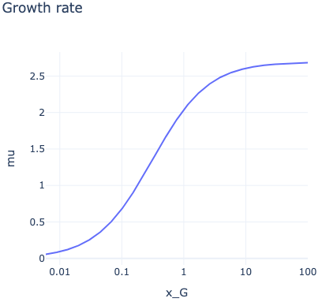

Optimize
model
toy.ods
toy_optimization_data.csv

