Slide 1

GBApy

Slide 2

GBAcpp

Slide 3


SBML
STEP 1
Collect data
• Proteins
• Metabolites
• Reactions
• Kinetic parameters
kinetic
parameters
genome
assembly
manual
curation

Slide 4
SBML
STEP 1
STEP 2
Collect data
• Proteins
• Metabolites
• Reactions
• Kinetic parameters
Check consistency
• Unproduced metabolites
• Infeasible loops
• Isolated metabolites
kinetic
parameters
genome
assembly
manual
curation

Slide 5
SBML
STEP 1
STEP 2
STEP 3
Collect data
• Proteins
• Metabolites
• Reactions
• Kinetic parameters
Check consistency
• Unproduced metabolites
• Infeasible loops
• Isolated metabolites
Edit / compress model
• Rename variables
• Delete pathways
• Compress pathways
kinetic
parameters
genome
assembly
manual
curation

Slide 6
STEP 1
STEP 2
STEP 3
Collect data
• Proteins
• Metabolites
• Reactions
• Kinetic parameters
Check model consistency
• Unproduced metabolites
• Infeasible loops
• Isolated metabolites
Edit / compress model
• Rename variables
• Delete pathways
• Compress pathways
SBML
kinetic
parameters
Build GBA model
• Check mass balance
• Ribosomal reaction
• Activation/inactivation
• External conditions
• Constant reactions
• Find initial solution
genome
assembly
manual
curation
STEP 4

Slide 7
STEP 1
STEP 2
STEP 3
Collect data
• Proteins
• Metabolites
• Reactions
• Kinetic parameters
Check model consistency
• Unproduced metabolites
• Infeasible loops
• Isolated metabolites
Edit / compress model
• Rename variables
• Delete pathways
• Compress pathways
SBML
kinetic
parameters
Build GBA model
• Check mass balance
• Ribosomal reaction
• Activation/inactivation
• External conditions
• Constant reactions
• Find initial solution
Optional:
Reduce to full-column rank problem
• Find reference EFM
• Reduce the GBA model
• Find initial solution
genome
assembly
manual
curation
STEP 4
STEP 5

Slide 8
STEP 1
STEP 2
STEP 3
Collect data
• Proteins
• Metabolites
• Reactions
• Kinetic parameters
Check model consistency
• Unproduced metabolites
• Infeasible loops
• Isolated metabolites
Edit / compress model
• Rename variables
• Delete pathways
• Compress pathways
SBML
kinetic
parameters
Build GBA model
• Check mass balance
• Ribosomal reaction
• Activation/inactivation
• External conditions
• Constant reactions
• Find initial solution
Optional:
Reduce to full-column rank problem
• Find reference EFM
• Reduce the GBA model
• Find initial solution
genome
assembly
Consistent
genome-scale
GBA model
🎉
manual
curation
STEP 4
STEP 5

Slide 9

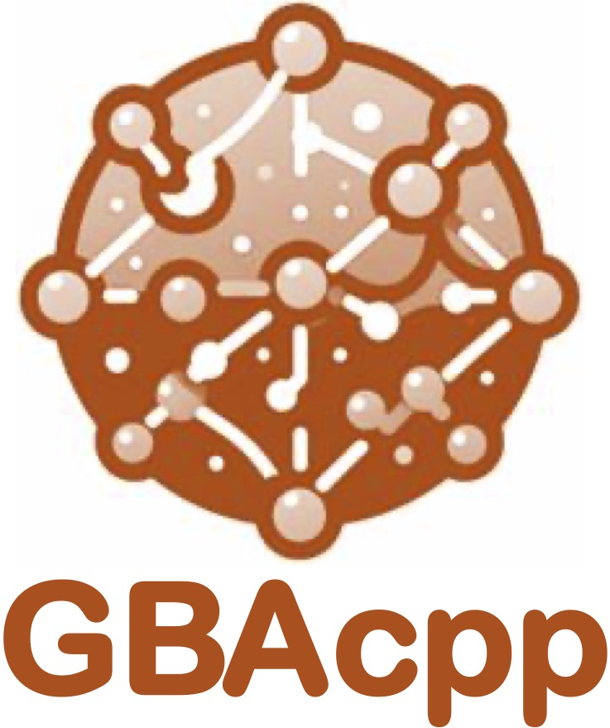
Software usage
STEP 1
STEP 2
STEP 3
Collect
data
Check model consistency
Edit / compress model
SBML
kinetic
parameters
Consistent
genome-scale
GBA model
Build GBA model
Optional: Reduce to full-column rank problem
genome
assembly
manual
curation
STEP 4
STEP 5

Slide 10
MMSYN tutorials organization
Tutorial 1:
Collect data
Tutorial 2:
Check mass conservation
Tutorial 3:
Edit the model
Tutorial 6:
Edit and simplify
the model
Tutorial 4:
Build complete
GBA model
Tutorial 5:
Build full column-rank
GBA model
Tutorial 7:
Build complete
GBA model
Tutorial 8:
Build full column-rank
GBA model

Slide 11
MMSYN tutorials organization
Tutorial 1:
Collect data
Tutorial 2:
Check mass conservation
Tutorial 3:
Edit and simplify
the model
Tutorial 4:
Build complete
GBA model
Tutorial 5:
Build full column-rank
GBA model

