Slide 1
CS 541 Project Video Captioning
Ruojun Li
Tesia Shizume
Chao Wang
4/24/2019

Slide 2
Introduction
Video captioning
Automatically generate one sentence to describe the content of a specific short video interval in natural language
This work combines the CNN and RNN to describe a video with sentence
Importance
A crucial achievement towards machine intelligence and also the support of a number of potential applications
Bringing together vision and language to leverage for video retrieval
Enhance content search on video sharing and streaming platforms, as well as to generate automatic subtitles
Help visually impaired people to get an insight of the content of a video

Slide 3
Data-set
MSR-VTT
Collected by Microsoft for research bridging video and language
Provides 10,000 diverse clips with at least 200 frames per video
Has an good amount of previous research with enough metric based evaluations to have a good baseline
Other video data-set are too long (movie) or too short
Dataset | Classes | Videos | Avg. len. (sec) | clips | sentences | words | Vocab | Len(hrs)
MSR-VTT | 20 | 7,180 | 20 | 10,000 | 200,000 | 1,856,523 | 29,316 | 4

Slide 4
Pipeline
Preprocess:
Remove Videos with caption shorter than 5 words.
Encode the label caption by GloVe6B word vectors.
Zero-pad the sentence vectors
Squeeze 30 frames from each video
Feature Extraction
Test raw video and ResNet as input in experiments and compare with research on other CNN
Choose VGG16 as the CNN for our final model
Using pre-trained VGG-16 model to extract the trimmed video’s features
Training
Features vector from video or CNN is the input into the RNN
Sentence vector is the label
Loss
Try the L2-Loss first, we found it’s easily effected by the zero-padding.
Use Softmax instead
GloVe6B is a word vector dataset collected by Stanford NLP group.

Slide 5
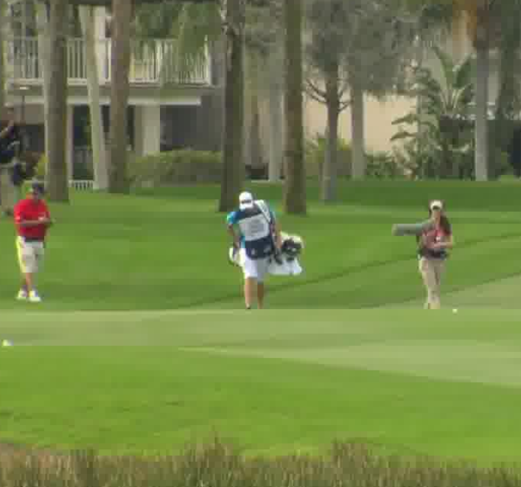

Implementation
Data Pre-process
Features Extraction
Natural Language Process
Clips-INPUT
30 Frames Each Video
Encoder
Decoder
……
……
LSTM
LSTM
LSTM
LSTM
LSTM
LSTM
30×4096
GloVe 6B 50(size 50*50)
……
$$Pretrained$$
$VGG$-16
A
group
/end/
……
/start/
A
group
field

Slide 6
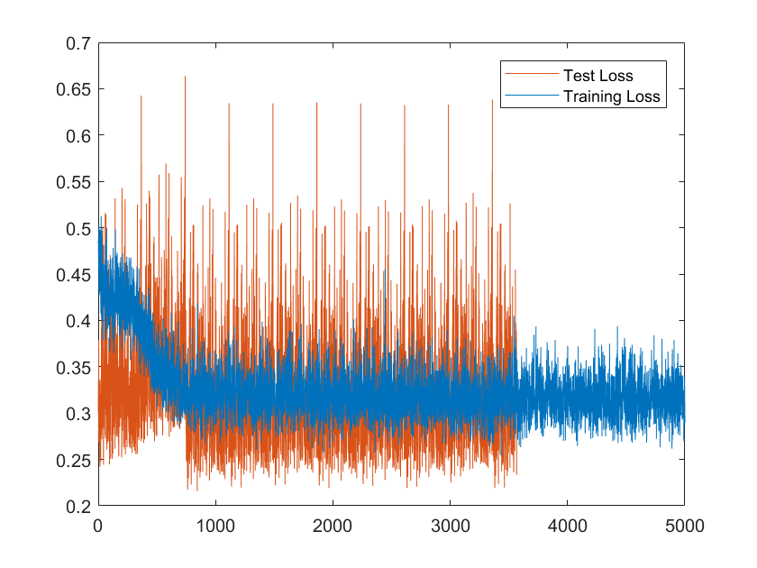
Performance Metrics & Results
Model | KNN METEOR | RNN METEOR
Alex-Net | 14.1% | 26.3%
Google-Net | 15.2% | 27.5%
VGG-16 | 15.5% | 28.6%
VGG-19 | 14.5% | 28.7%
Our VGG-16 |  | 20.2%
METEOR (Metric for Evaluation of Translation with Explicit Ordering). Higher METEOR means better performance.
The baselines to the left are given in the paper:
Msr-vtt: A large video description dataset for bridging video and language. In The IEEE Conference on Computer Vision and Pattern Recognition (CVPR), June 2016 Xu, Jun, Mei, Tao, Yao, Ting, and Rui, Yong.
Since the VGG16 outperform others, we use VGG16 in our final architecture.
L2 Loss
Demo Video:
https://youtu.be/ehScpXFLV2k
Mini-batch Iteration

Slide 7
Question & Answer Thank you!

