Slide 1


Word for Thesis Writing
Malcolm Morgan
University of Cambridge
2013
It looks like you are trying to write a thesis

Slide 2


Warnings & Caveats
Useful but not interesting
Will make slides and Word template available
No on-going support
No feature requests
No bug fixes
Office 2007, 2010, 2013
No Macs
Live demonstrations often fail
This is not the only way to do a thesis

Slide 3


MS Office is Powerful
More than 90% of feature request for office…
are already in office
That thing you really wish you office could do
Has been in office for years

Slide 4
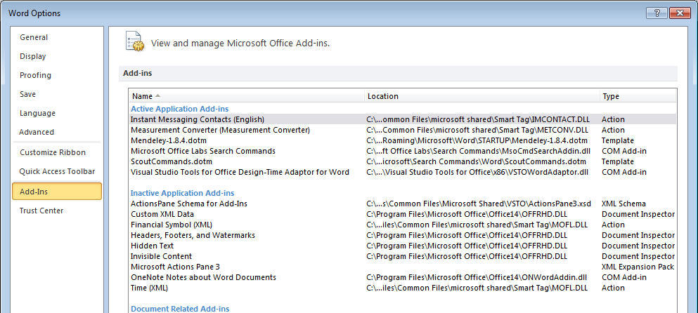
The one feature that isn’t
Search Commands for Office 2007 & 2010
http://www.microsoft.com/en-gb/download/details.aspx?id=28559

Slide 5
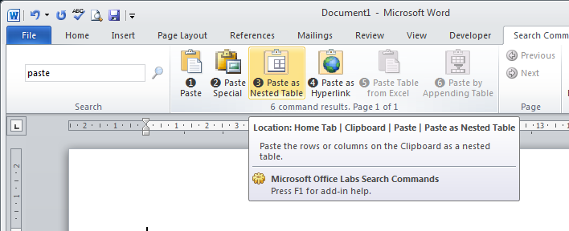
The one feature that isn’t
Allows you to search for features of office programmes
Mouse over to find out where the button is usually

Slide 6

Office Web Apps
Skydrive.com
Login with a Microsoft account
Hotmail, Windows Live, Outlook.com
Free versions of Word, Excel, PowerPoint, OneNote for editing and viewing
Reduced features so some of the advanced features will not work
Better than Google Docs in many ways
7 GB of free storage (With Dropbox style syncing)

Slide 7
7 Ps
Proper Planning and Preparation Prevents Piss Poor Performance
Property setting up your Word document will save hours in editing an formatting
Kayla and I have spent hours putting together this template

Slide 8


Slide 9
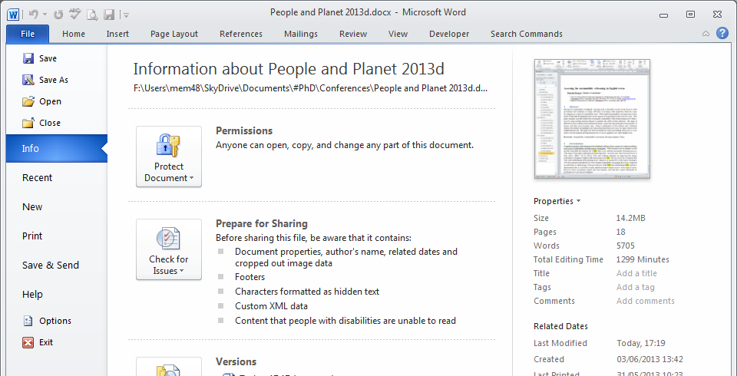
Spelling and Grammar
Enable the advanced proofing options, to get more help on grammar and style

Slide 10
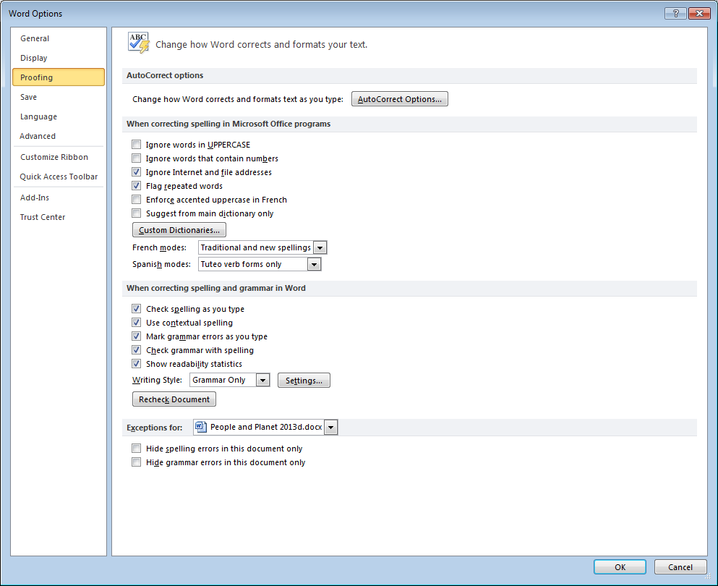
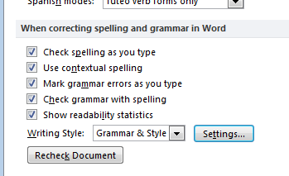
Spelling and Grammar
Change to checking Grammar & Style

Slide 11
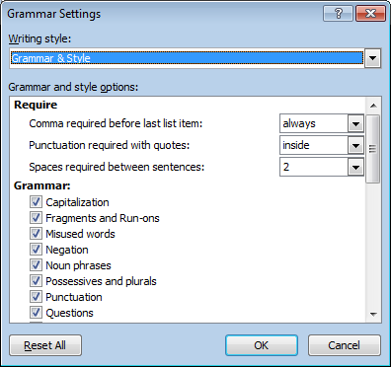
Spelling and Grammar
Change the three require settings from don’t check
Untick Passive Sentences
Tick Use of the First Person
Click OK, then Recheck Document

Slide 12
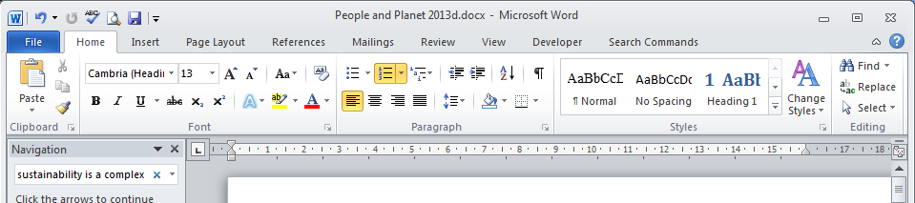
Styles
All your text should all be styled
Don’t format text directly
Create styles which reflect how you want the text to be formatted.

Slide 13
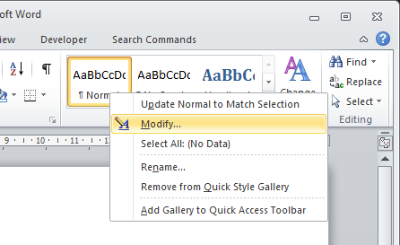
Styles
Word has some default style sets
Styles cover types of text
Normal
Headings
Quotes

Slide 14
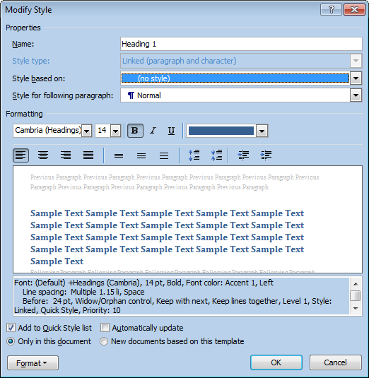
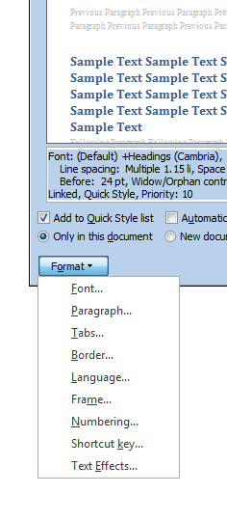
Styles

Slide 15

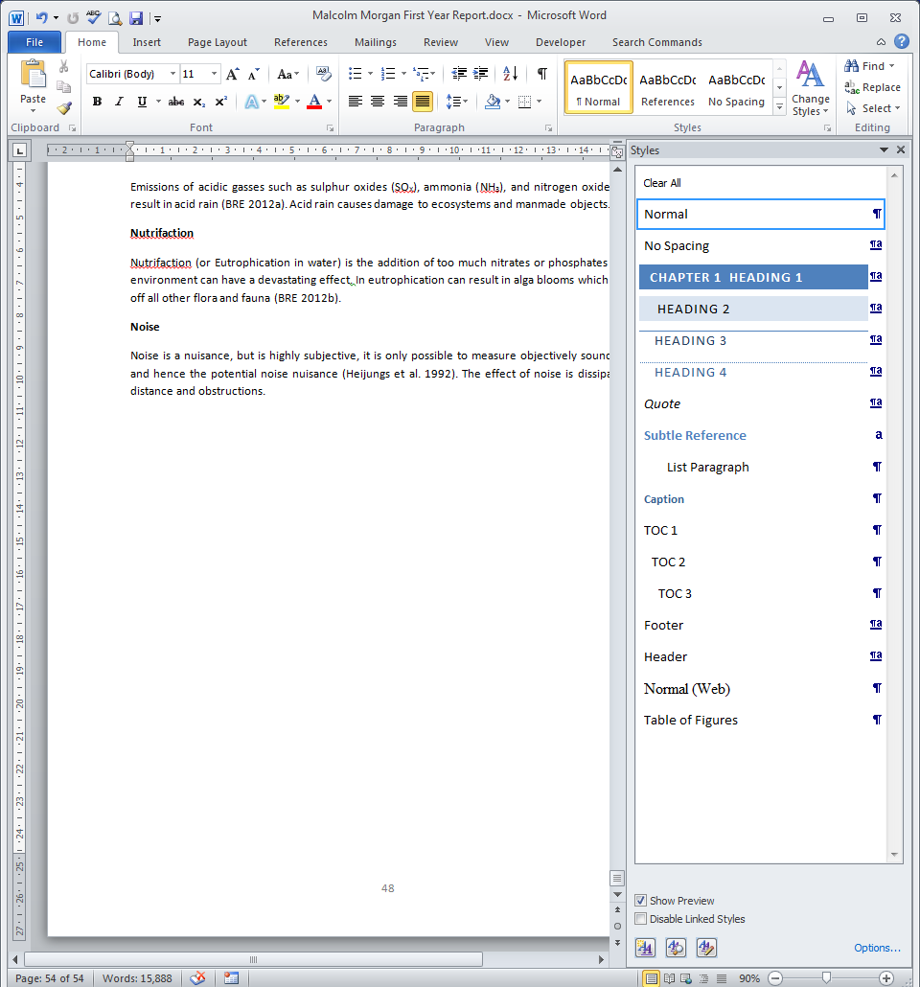
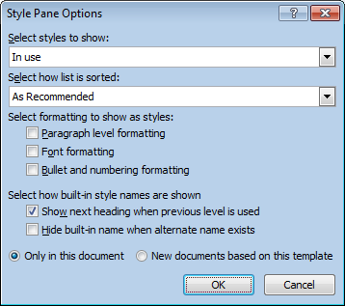
Styles
Change to In use see the full list of different styles you are using.

Slide 16
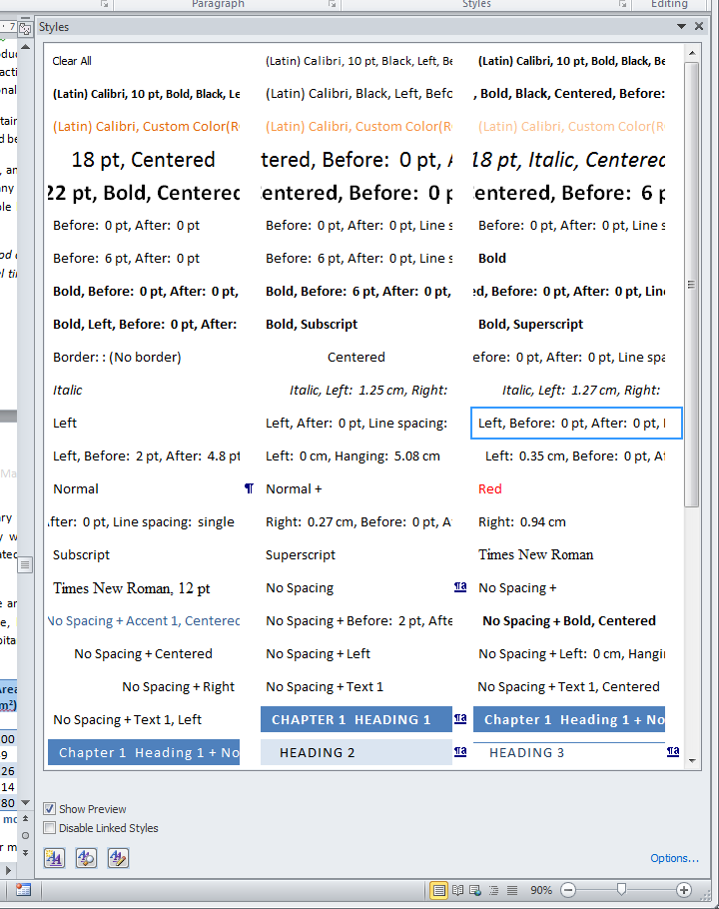
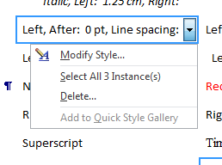
Styles
A badly styled document

Slide 17
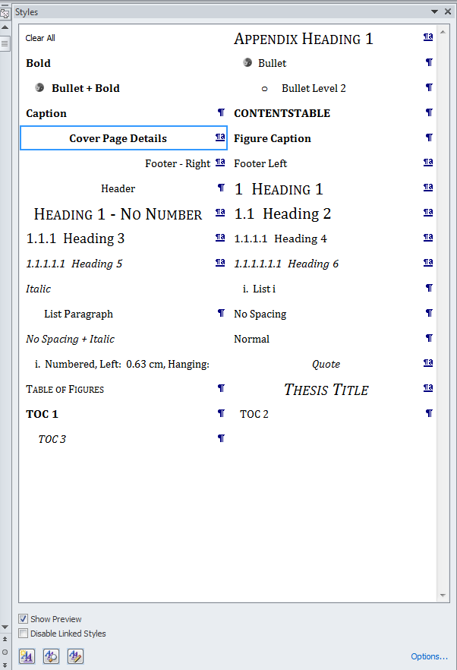
The CSD Template
Because the template starts with the correct themes, there a far fewer in use.
This mean that the text is consistent throughout the whole document

Slide 18
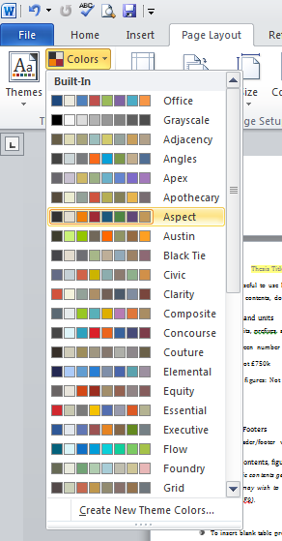
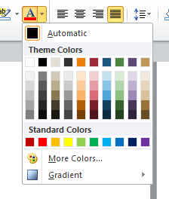
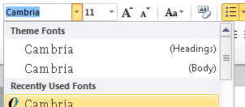
Themes
Create a constant colour/font palette
Charts and Diagrams will change when pasted from PowerPoint / Excel
Unless pasted as images!
Can use themes in PowerPoint / Excel
On Camtools

Slide 19
Heading Numbers
1 Main Section
1.1 Subsection
1.2 Subsection
1.2.1 Sub-Sub Section
2 Main Section

Slide 20
Heading Numbers
Right Click on Heading 1 Style
Click on modify
Change to no style
Click Ok

Slide 21
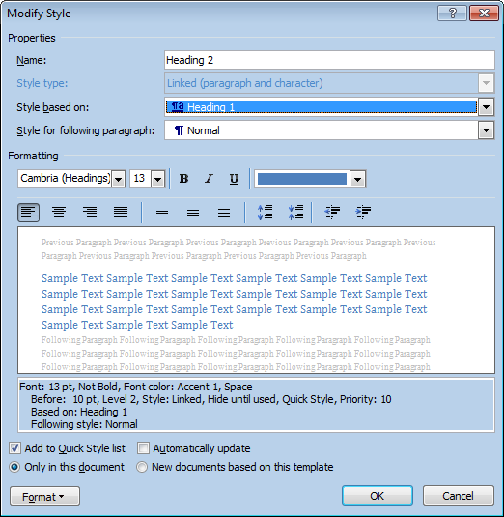
Heading Numbers
Right Click on Heading 1 Style
Click on modify
Change to Heading 1
Click Ok
Do for all heading 1-9 changing the based on the heading above.
i.e. Heading 4 is based on Heading 3

Slide 22
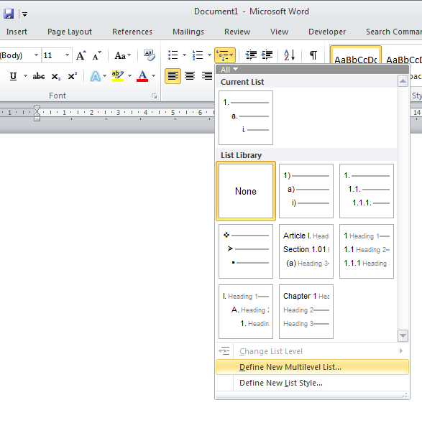

Heading Numbers

Slide 23
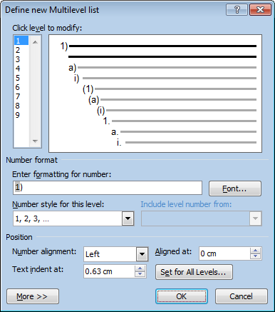
Heading Numbers

Slide 24
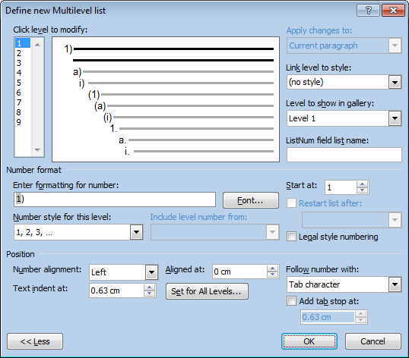
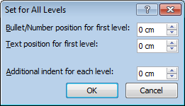
Heading Numbers
Set all to 0 and click OK

Slide 25
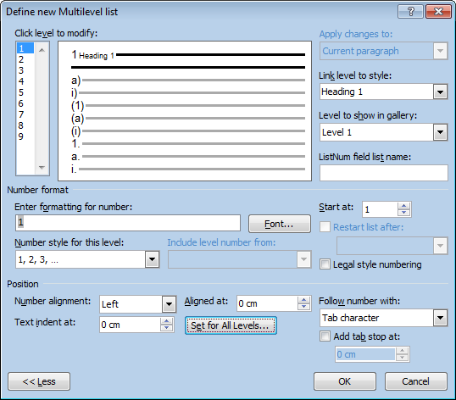
Heading Numbers
For each level, set to the corresponding heading
e.g. Level 2 = Heading 2
For each level, set to
Number Style
1, 2, 3, ….

Slide 26
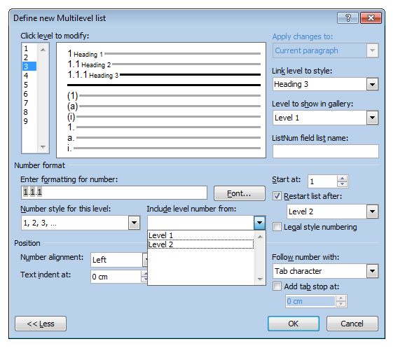
Heading Numbers
For each level, include the number from all the levels above
You need to click on each one
You can also modify the formatting adding punctuation marks between the numbers

Slide 27
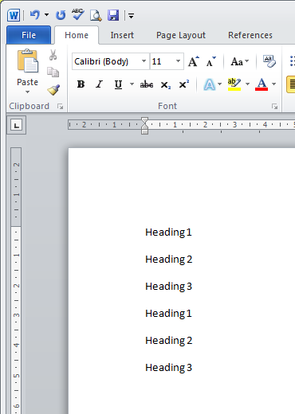
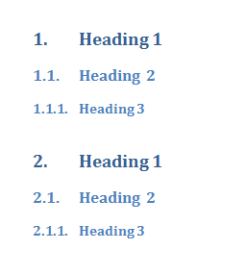
Heading Numbers
Highlight and click on the correct style

Slide 28
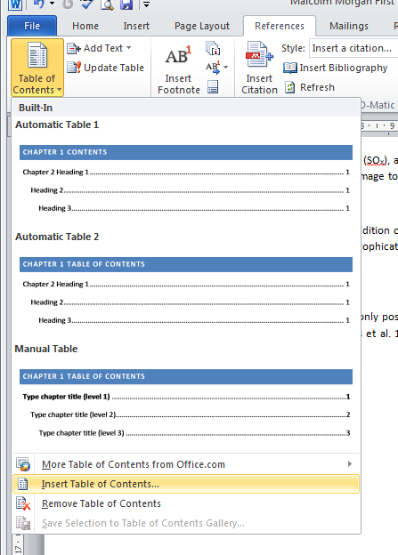
Tables of Contents

Slide 29
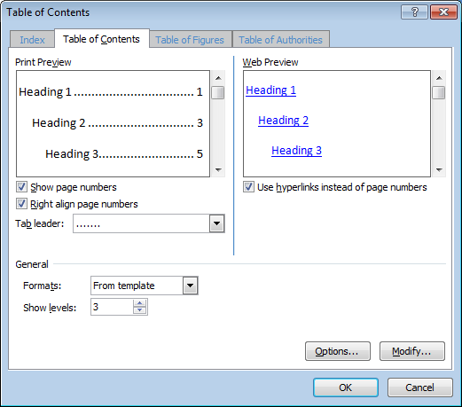
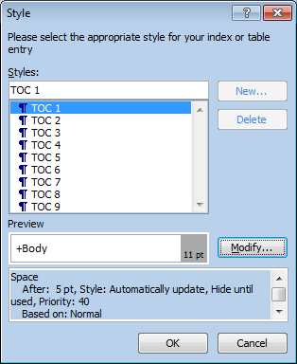
Tables of Contents
For each style
Choose the number of levels to show

Slide 30
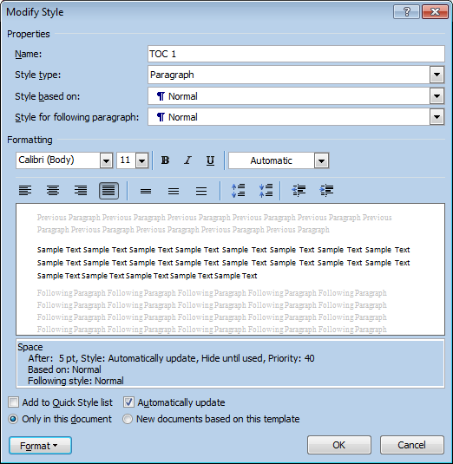
Tables of Contents

Slide 31
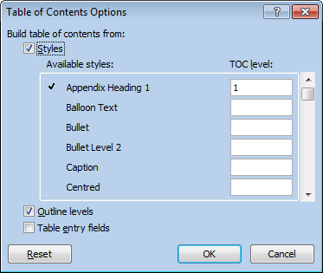
Table of Contents
Options
Choose what appears in ToC and in what order
Possible to have multiple differently configured tables of contents

Slide 32
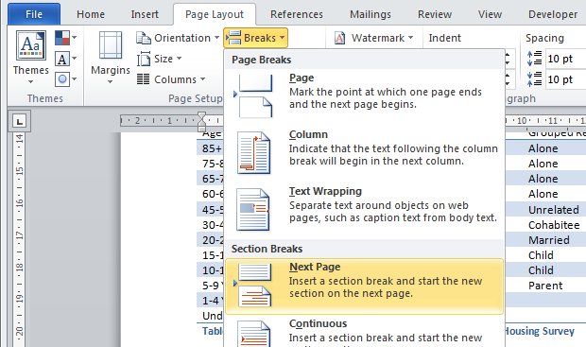
Sections
Tell Word that the document is changing
e.g. separate a cover page from the rest of the document

Slide 33
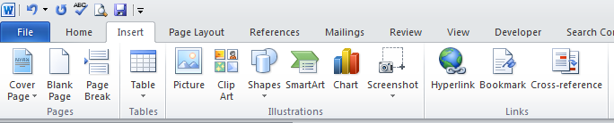
Page Breaks
For new page without a new section

Slide 34
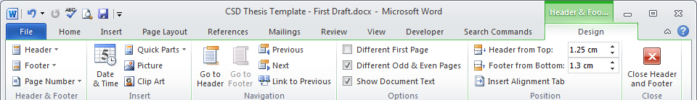
Headers and Footers
Different Odd & Even Pages
Allows you to put page number on different sides for odd and even pages

Slide 35
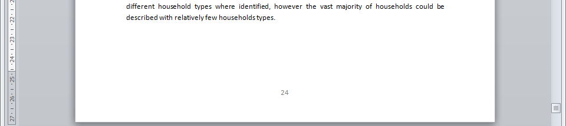
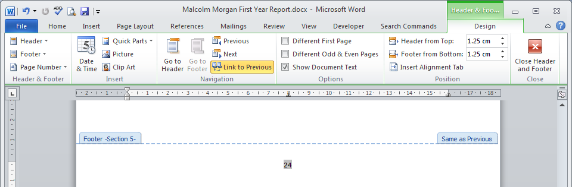
Page Numbers
Double click at the bottom of the page

Slide 36
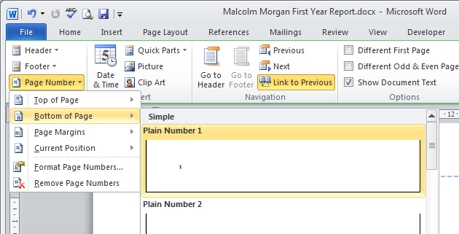
Page Numbers

Slide 37
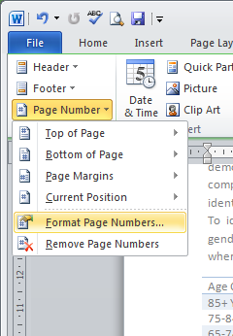
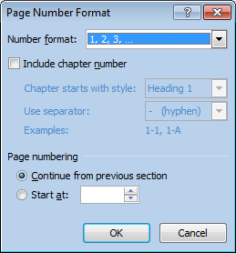
Page Number
If you want different numbering in different sections use this

Slide 38
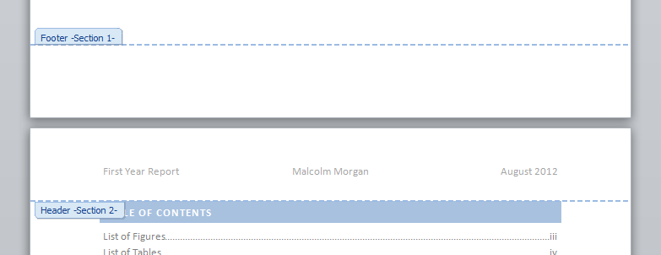
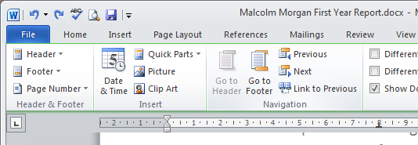
Page Numbers
Using Sections
Unselect Link to previous to have different page numbering on different sections

Slide 39
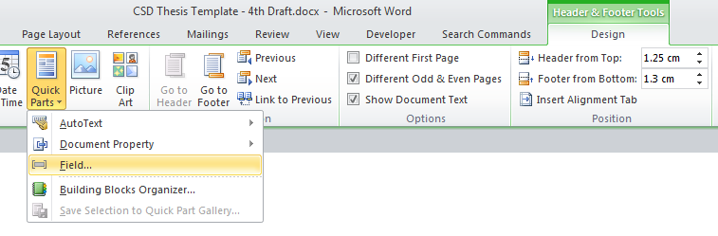
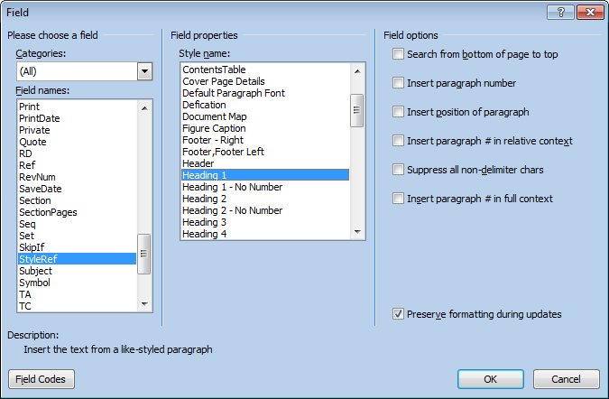
Chapter Title in Header/Footer

Slide 40
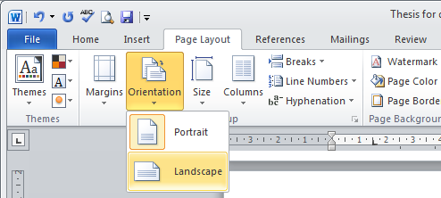
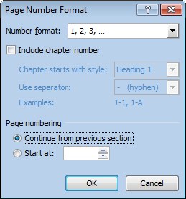
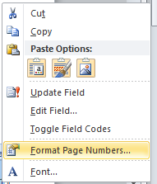
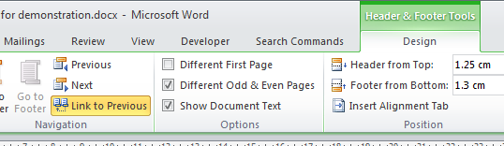
The Landscape Page
Insert Section Breaks Before and After Page
Re-link headers and footers

Slide 41
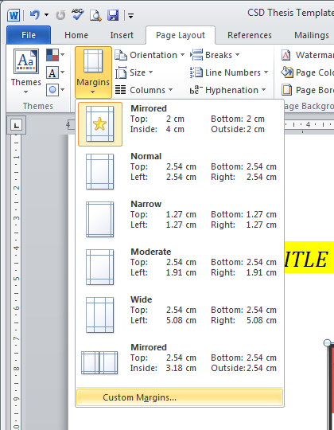
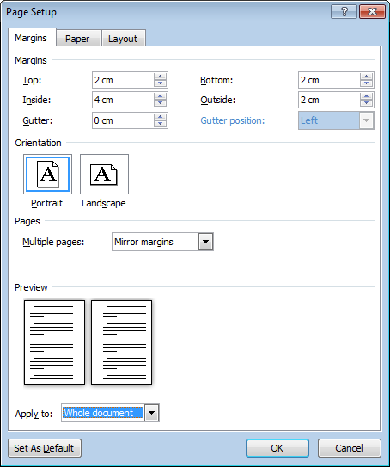
Margins
Set up asymmetrical margins for printing and binding thesis

Slide 42

Diagrams
Draw them in Power Point
Easier to draw in power point
Copy and paste into word as a picture
No more diagrams falling apart
Paste as a picture
Save your power point in case you want to edit your diagrams later

Slide 43

Edit Images

Slide 44


Compress Images

Slide 45

Captions

Slide 46


Positioning Image
Wont’ move captions
So select image and caption
Insert > Text Box > Draw Text Box
Remove text box margin to avoid misalignments
Remove text box fill and boarder
Best done at end to avoid image creep

Slide 47


Captions
Add a caption, don’t delete the figure number
Can also change to table, equation
And change the position of the caption
If you would like your caption numbering to include the section number tick the box

Slide 48


Equations
May like to copy and paste as a image to preserve compatibility with older version of word and PDF

Slide 49


Table of Figures
Change to get table of tables, equations etc

Slide 50



Table of Appendices

Slide 51


Cross Reference

Slide 52

Special Paste
Keep Source Formatting
Same formatting as where it came from.
Merge Formatting
Same formatting as where it is going to
Text Only
Plain text
Useful when copying text from other documents to avoid bringing in unwanted styles.
Use when migrating to the CSD template

Slide 53

Update All
Select All (Ctrl – A)
Press F9
Worth saving before you do this
May be asked if you want to update tables or just table numbers, multiple times

Slide 54



Referencing
Must use reference manager

Slide 55

Document Checker

Slide 56


Document Checker
You don’t want to remove headers and footers

Slide 57
Conclusions
Lots to do to set up a thesis
Starting early avoids later pain
Thesis Template has been designed to produce a great looking thesis easily
Feel free to modify to add your own personalisations
In thesis acknowledgements to Kayla and Malcolm appreciated

