Slide 1
Online Car Rental System
Ragchaabazar Bud – 987063
Khaliun Samdanjamts – 962084
Williert Charles – 986763
Wilfrid Jules - 986709

Slide 2
Online Car Rental System’s Topic
Vision Document
Use Case Diagram
Use Case Description
Architectural Analysis
Sequence Diagrams
Testing
Project

Slide 3


I. Vision Document
Stakeholders

Slide 4
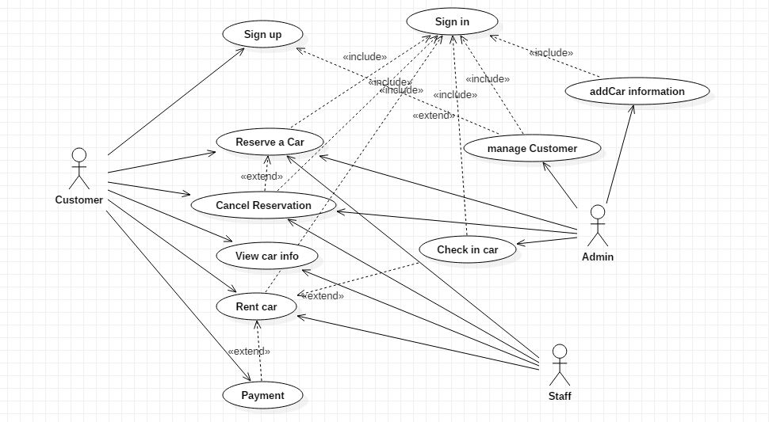
II.Use-Case Diagram

Slide 5
III. Use-Case Description
3.4. Name: ReserveCar
3.4.1. Brief Description
This use case allows the customer request for a booking a car
3.4.2. Actors: Customer/Staff
3.4.3. Pre-Conditions:
The customer and staff must logged in to the system
3.4.4. Flow of events
3.4.5. Post-Conditions: The status of the car will be changed, and the booking detail will be persisted on database
3.4.6. Business Rules:
Total cost of booking must not exceed the customer's current balance
3.4.7. Nonfunctional requirement: None
User Actions | System Actions
The customer selects a car and press "View Detail" button | The system displays detail of the selected car
The customer view car detail, fill rent duration and press button | The system checks if the input is valid and displays confirmation page. The system displays appropriate error message and redirect the user on the same page

Slide 6
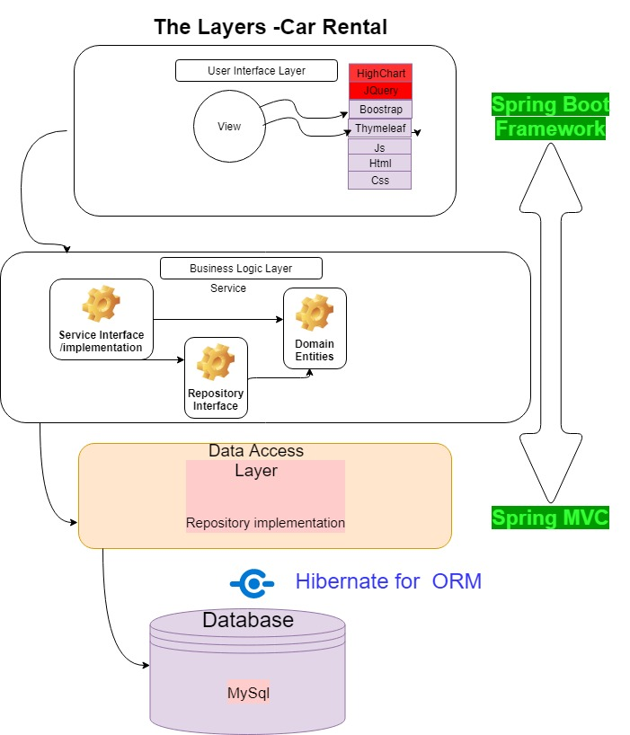
IV. Architectural Analysis

Slide 7
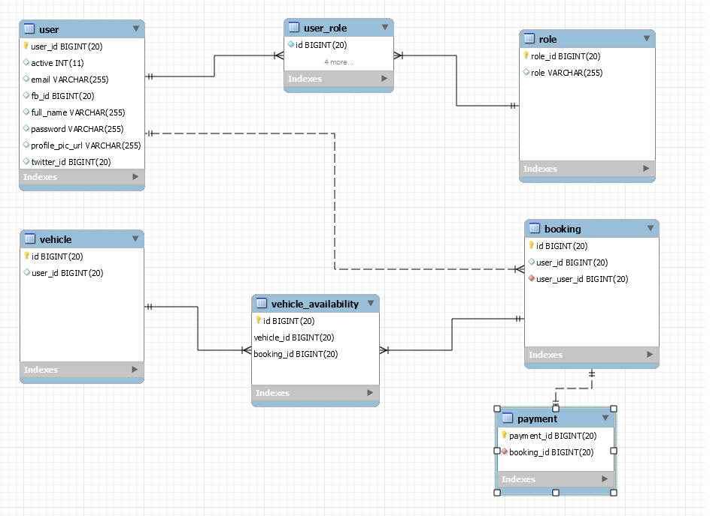
DataBase Schema

Slide 8
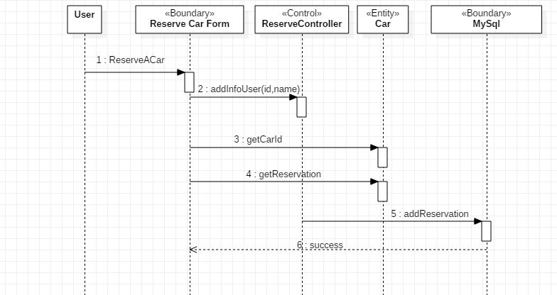

5.2. reserveCar Sequence Diagram
V. Sequence Diagram

Slide 9
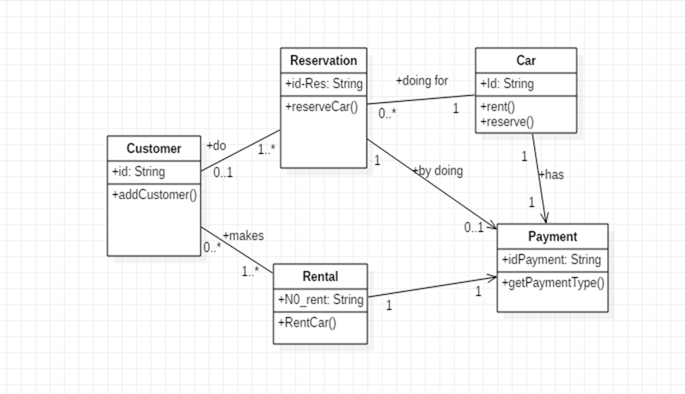
Class diagram

Slide 10
Thank you for your attention ☺

