Slide 1
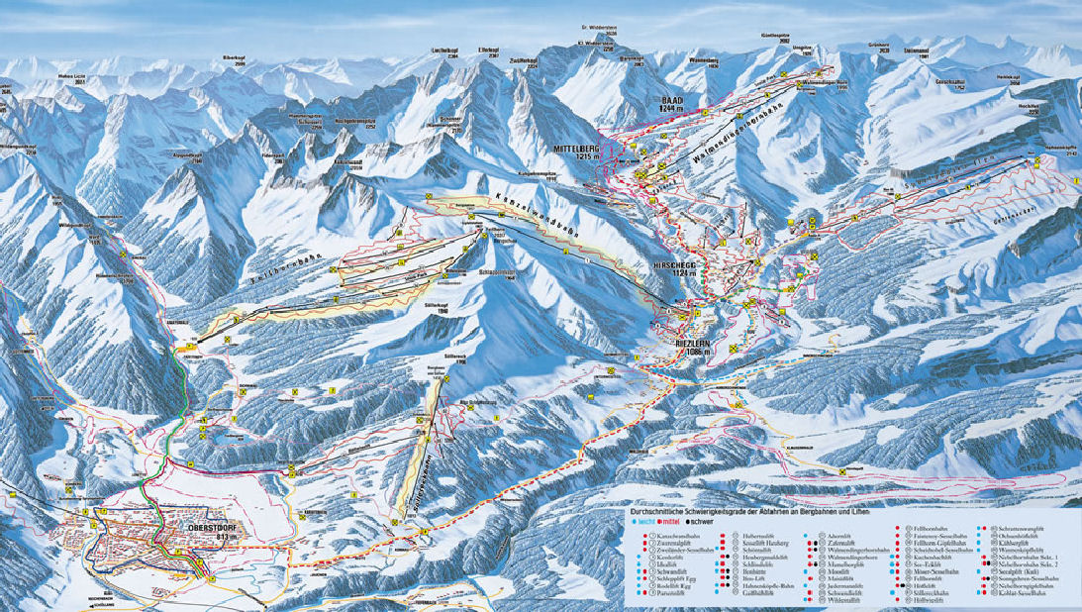

Word Statistics
Bruno, Charles and Sigrid

Slide 2
analyzed corpus of texts
Project Gutenberg: https://www.gutenberg.org/
Analyzed languages:
English
German
French
Portuguese
Manual preprocessing: delete project license and text in other languages
→ Only raw text
selection of texts from different authors, periods and genres​

Slide 3
Computing frequency statistics
NLTK-Toolkit
Tokenize raw data into words
Frequency statistics of words
Words ={, . : ; + letters}
Collocations
Problem with unicode characters

Slide 4
Computing frequency statistics
NLTK-Toolkit
Custom-made code
Tokenize raw data into words
Frequency statistics of words
Words ={, . : ; + letters}
Collocations
Problem with unicode characters
Custom set of letters:
{abcdefghijklmnopqrstuvwxyzßàáâãäåæçèéêëìíîïðñòóôõöøùúûüýþāăąćĉċčďđēĕėęěĝğġģĥħĩīĭįıĳĵķĹĻĽĿŁŃŅŇŉŋōŏőœŕŗřśŝşšţťŧũūŭůűųŵ}
Custom end of words and sentences
Frequency of letter tuples

Slide 5
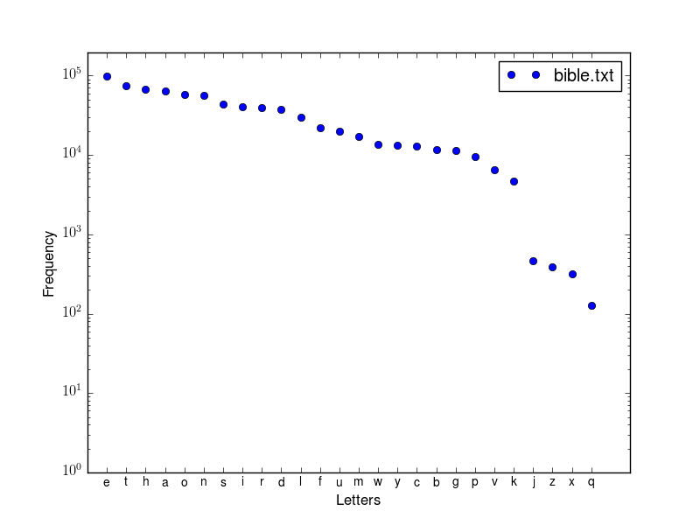
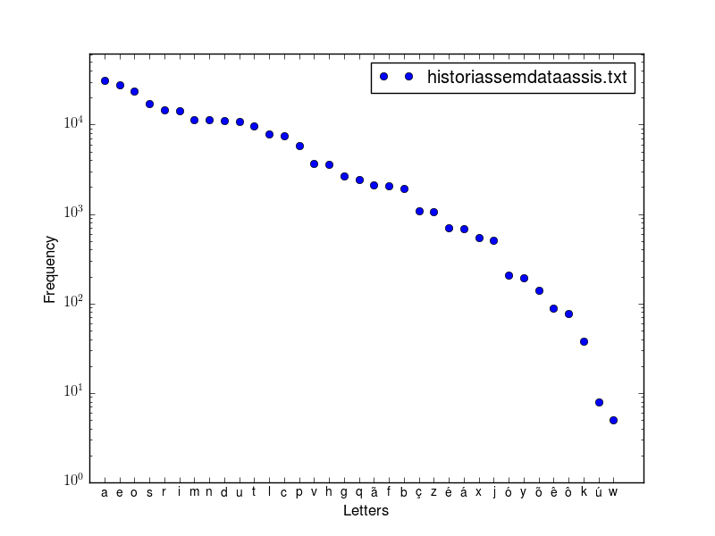
Letter frequencies

Slide 6
Letter frequencies

Slide 7
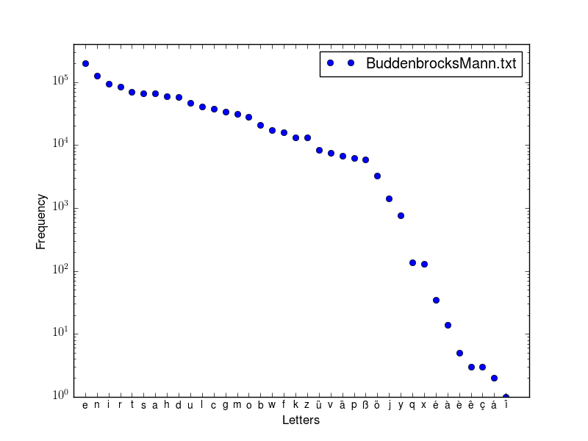
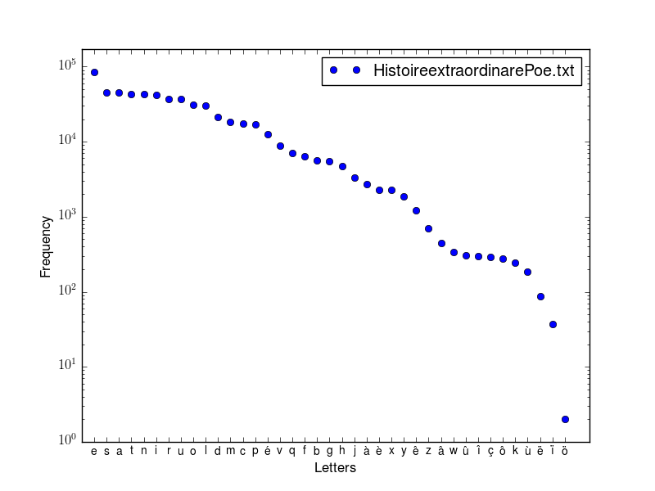

Slide 9
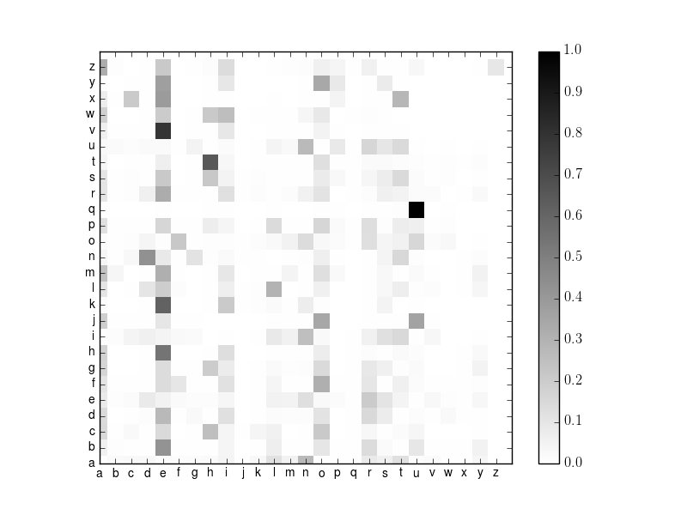

Slide 10
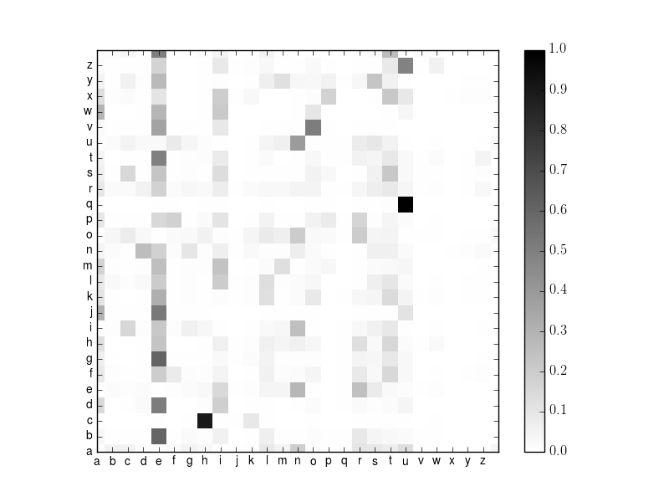

Slide 11
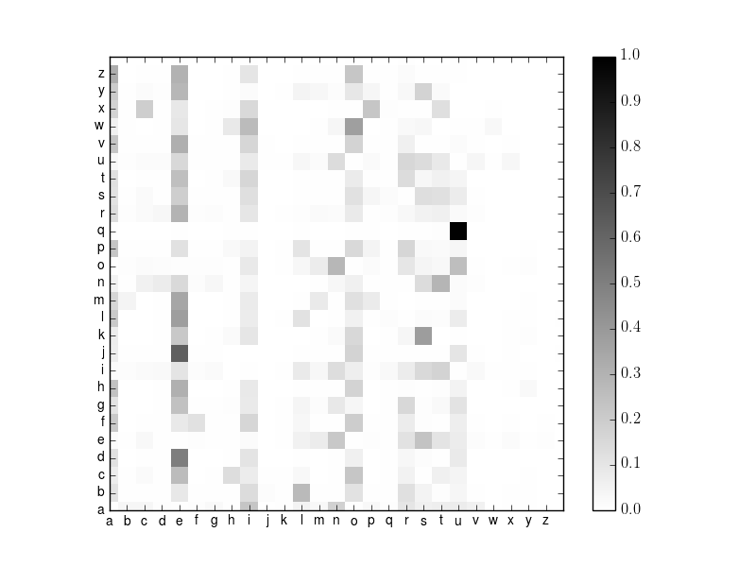

Slide 12
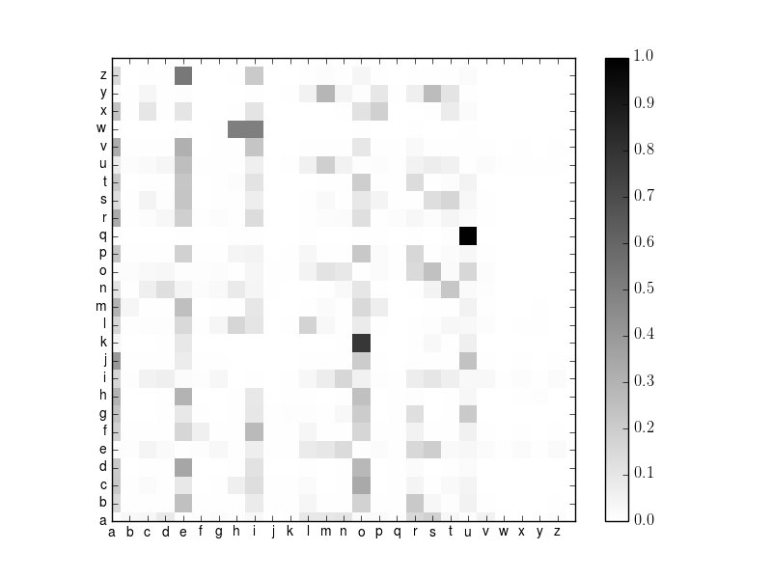

Slide 13
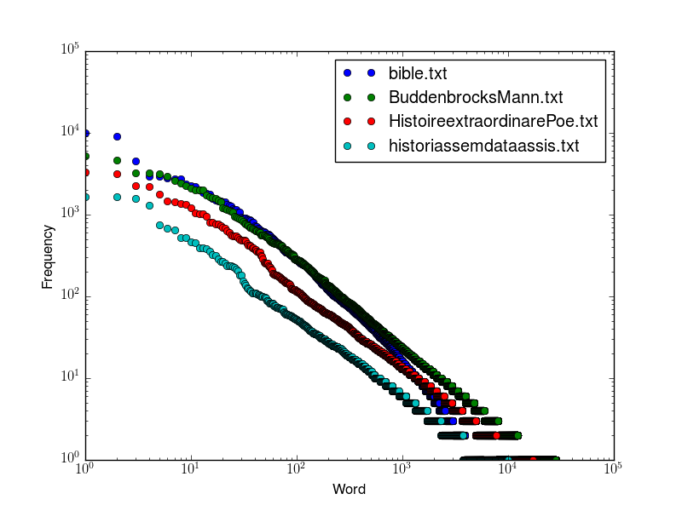
Word frequencies

Slide 14
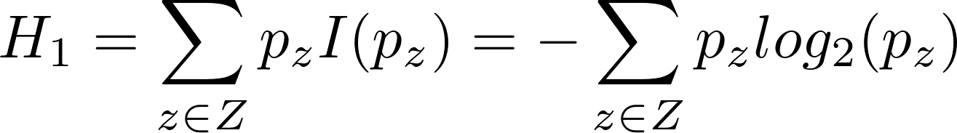
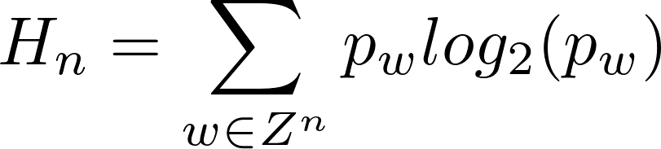
Entropy
Letter entropy
Z = set of all characters
Word entropy
Z = set of all words
Entropy for words of length n
(conditional entropy)

Slide 15
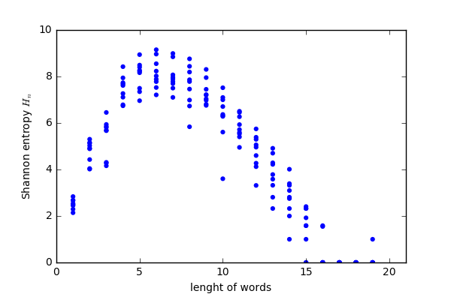
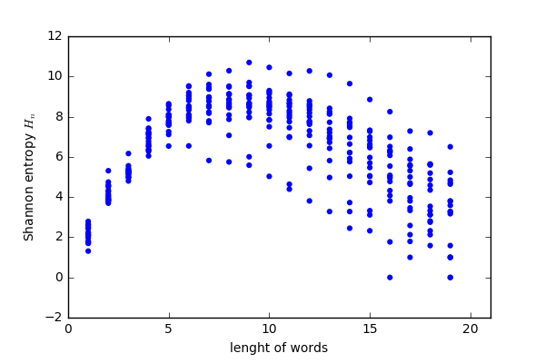
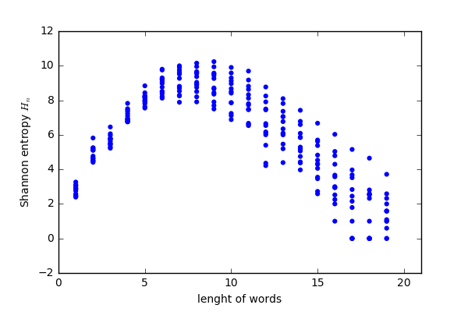
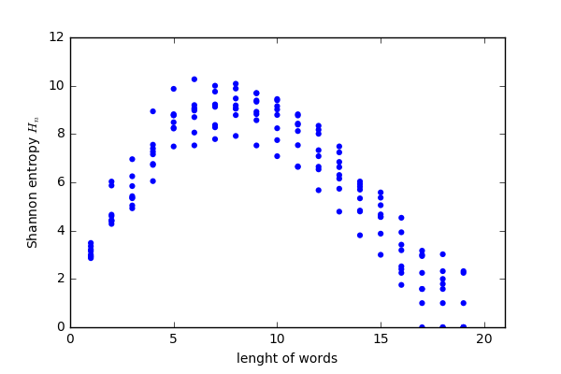
Word of length N - Entropy
English
French
German
Portuguese

Slide 16
English Bibles
Many different versions exist
We can compare the verses
Old versions are translated from different texts
Written in old English

Slide 17
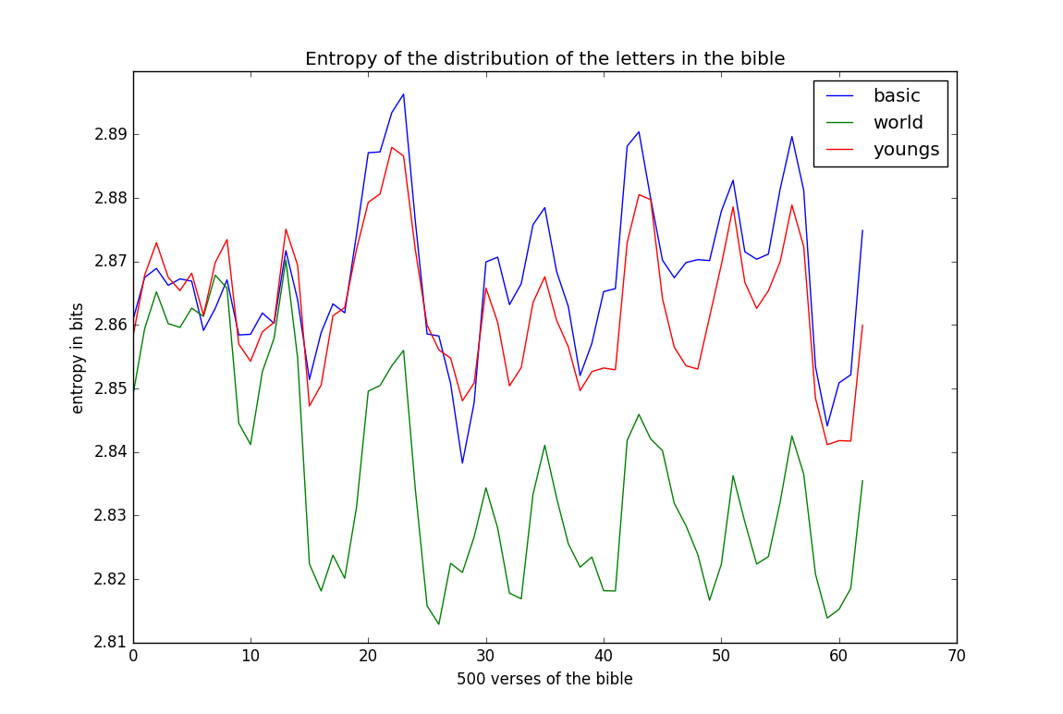
Time-dependent letter entropy for different bible versions

Slide 18
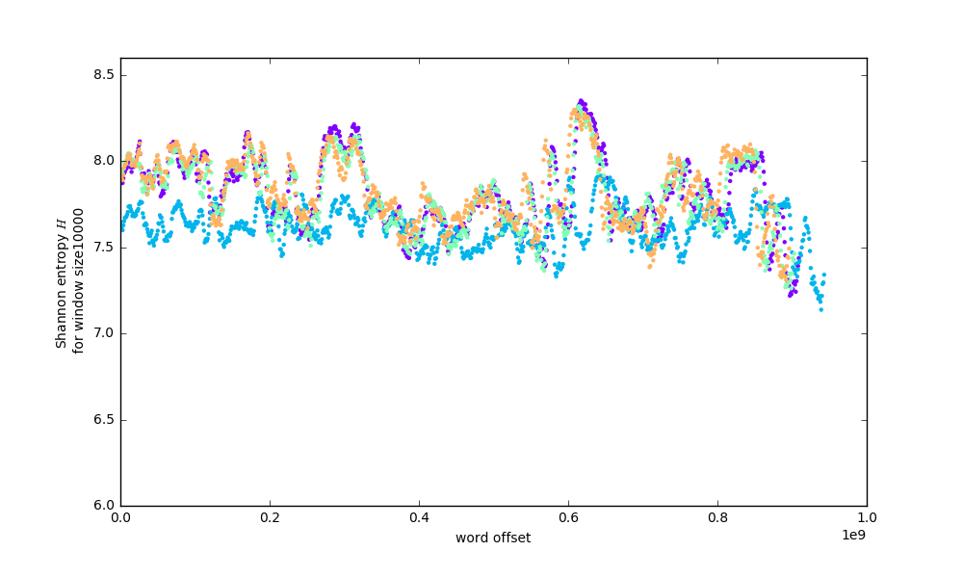
Time-dependent word entropy for different bible versions
American Standard Version
Basic
Darby
World

