Slide 1
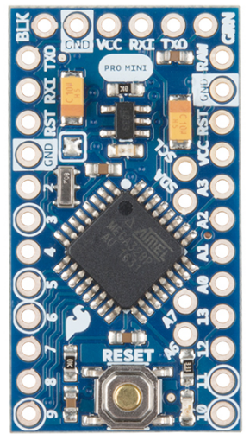
Arduino Pro Mini (3.3V)
Battery Voltage
3.3V Regulated
Photoresist 2
Photoresist 1
Servo1
Servo2
ADMP401 – AVD Pin
https://learn.sparkfun.com/tutorials/using-the-arduino-pro-mini-33v

