Slide 1
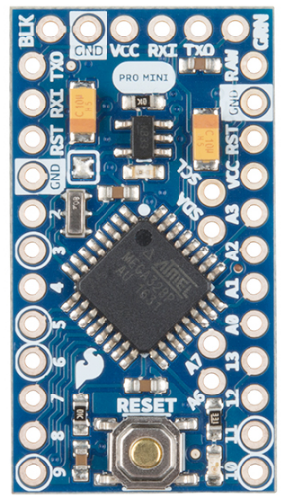
Arduino Pro Mini (3.3V)
Battery Voltage
3.3V Regulated
Photoresist 2
Photoresist 1
Servo1
Servo2
ADMP401 – AVD Pin
https://learn.sparkfun.com/tutorials/using-the-arduino-pro-mini-33v

Slide 2
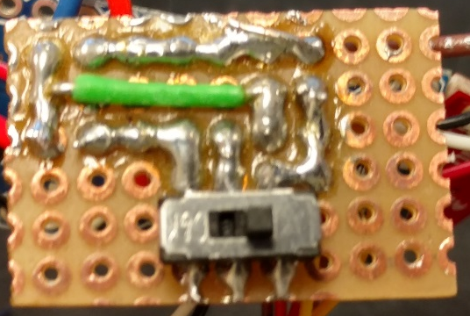
GND
3.3V Line
10kOhm
PR
10kOhm
PR
A5
A4

Slide 3
Batt in GND
GND
Arduino VCC
Not connected
On
Off
Batt V+
When switch is open
Batt V+

