Slide 1
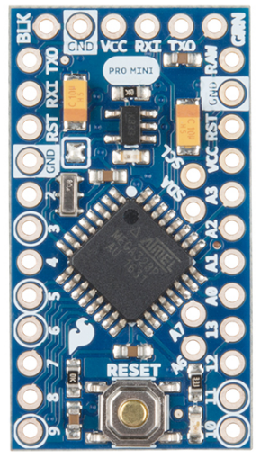
Arduino Pro Mini (3.3V)
Battery Voltage
3.3V Regulated
Photoresist 2
Photoresist 1
Servo1
Servo2
ADMP401 – AVD Pin
https://learn.sparkfun.com/tutorials/using-the-arduino-pro-mini-33v

Slide 2
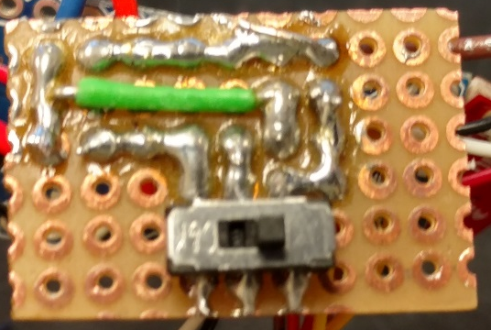
GND
3.3V Line
10kOhm
PR
10kOhm
PR
A5
A4

Slide 3
Batt in GND
GND
Arduino VCC
Not connected
On
Off
Batt V+
When switch is open
Batt V+

Slide 4
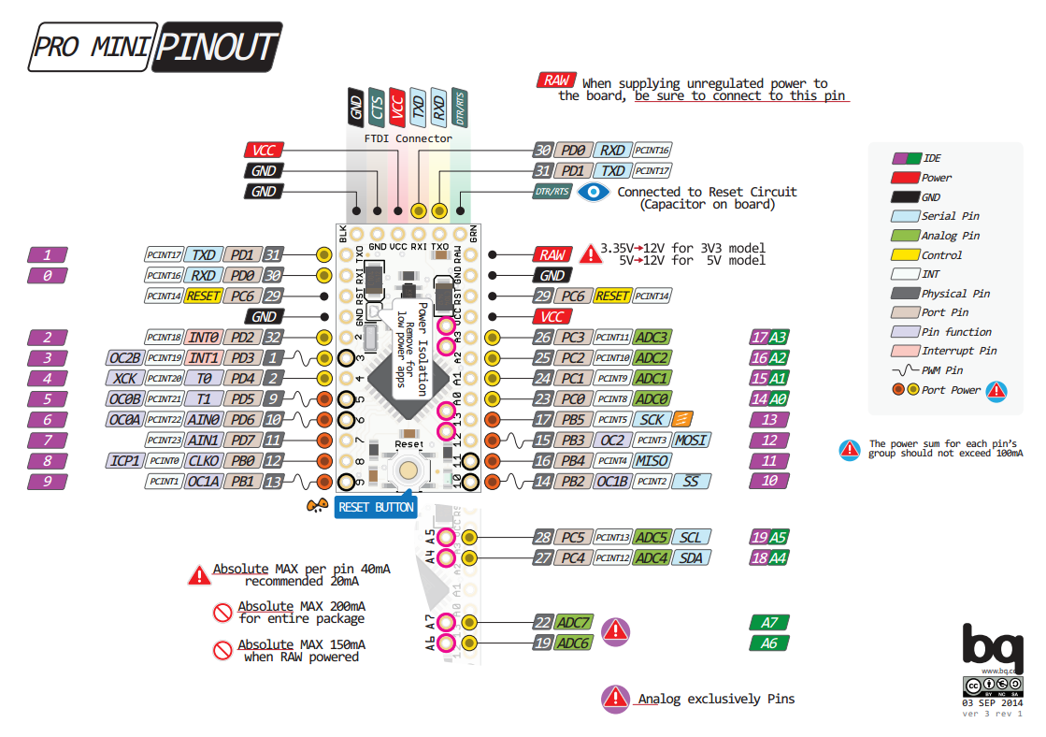
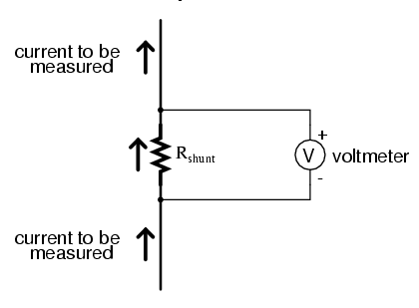
Stress sensing resistor

Slide 5
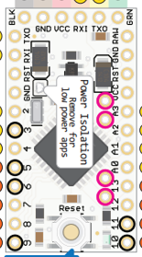
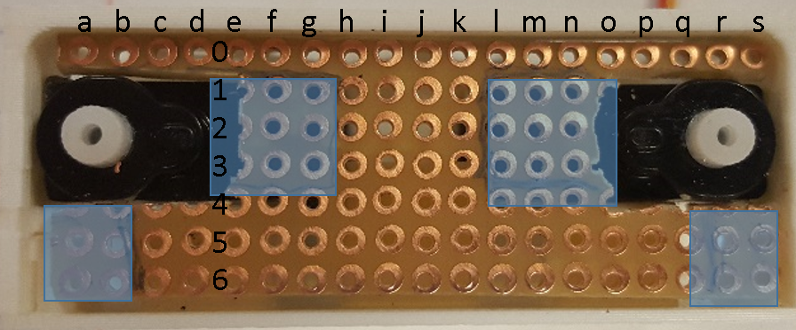
CLEAN SLIDE DON’T EDIT!!
Microphone
Analog
Microphone
Stress sensing
Random seed pin (empty)
FRONT
Power
Batt 3.3v pin
Microphone
Servo 1
Servo 2
Gnd
Stress sensing
Servo 1
Servo 2
Microphone
SERVO 1
SERVO 2
BACK

Slide 6
Microphone
(a0/5) = servo1 sig
(c0/3) = servo2 sig
(h0/A3) = stress
(g0/A2) = mic
(e0/A0)=light1
(f0/A1)=light2
Analog
Microphone
Stress sensing
Random seed pin (empty)
FRONT
Power
Batt 3.3v pin
Microphone
Servo 1
Servo 2
Gnd
Stress sensing
Servo 1
Servo 2
Microphone
GND
SERVO 1
SERVO 2
RAW
GND
RAW
BACK

Slide 7
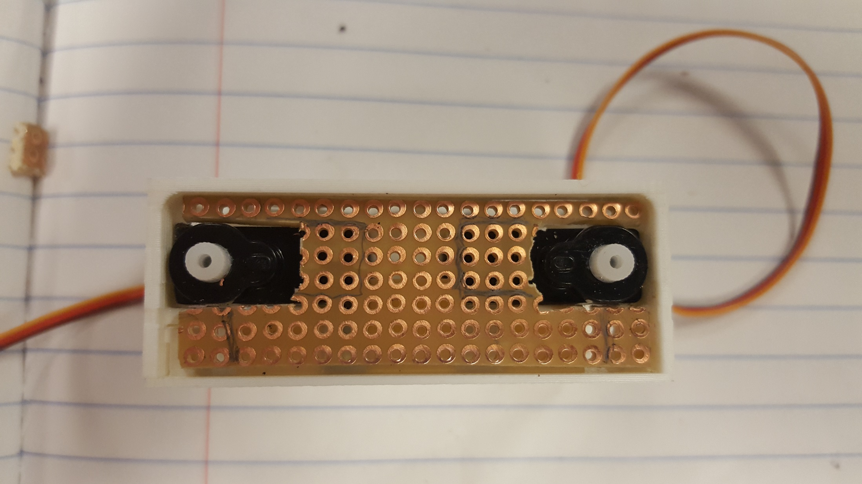
a
b
c
d
e
f
g
h
i
j
k
l
m
n
o
p
q
r
s
0
1
2
3
4
5
6

