Slide 1

Parallel Debugging Tools:
TotalView and DDT
Xiaopeng Xu
KAUST April 22, 2014

Slide 2
Introduction to Parallel Debugging Tools
Problems with debugging for Parallel programs:
All problems of serial programming
Additional problems
Difficult to verify correctness of program
Difficult to debug N parallel processes
New parallel problems: deadlocks, race conditions, etc.
Parallel Debugging Tools:
TotalView
DDT

Slide 3
TotalView: Introduction
What is TotalView?
GUI-based debugging tool by Rogue Wave Software, Inc.
full-featured, source-level, multi-process, multi-thread graphical debugger
Languages supported
C, C++, Fortran, assembler, etc.
Parallel programming models supported
OpenMP, OpenACC, pthreads, CUDA GPU, Xeon Phi, etc.
Systems and Platforms supported
Unix, Linux, OS X, Windows
Integrated Memory Debugging

Slide 4
TotalView: Basic operations
Data examination
view data in the variable windows
change the values of variables
modify display of the variables
visualize data
Action points
breakpoints and barriers (static or conditional)
watchpoints
evaluation of expressions

Slide 5
TotalView: Usage
Compile binary with debugging information
flag –g g77 –g test.f –o test
if use fork() or execve(), link ... g77 –g –L/.../totalview/linux-x86-64/lib –ldbfork
test.f –o test
Run Totalview totalview executable totalview executable core_file

Slide 6
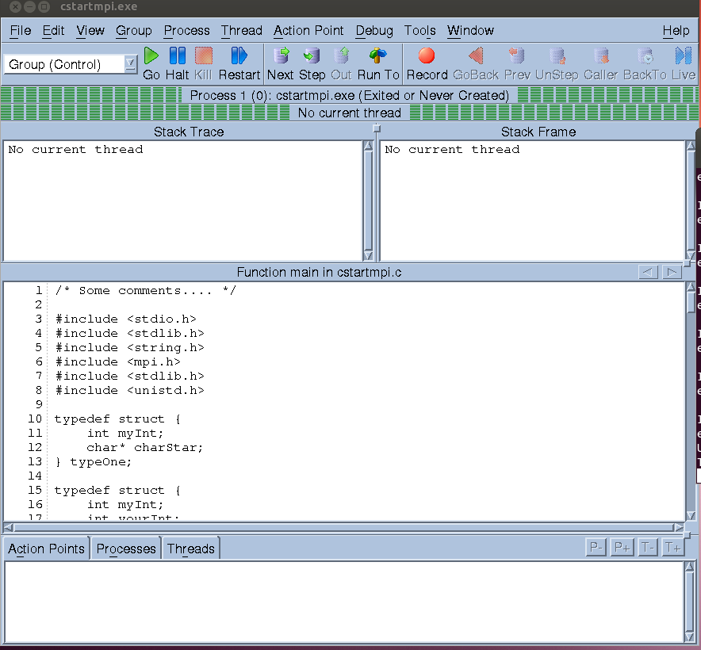
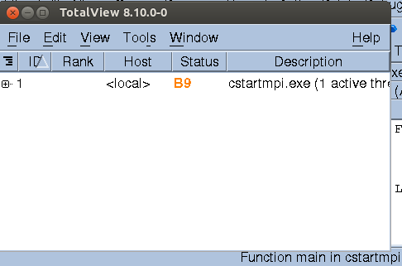
TotalView: Window

Slide 7
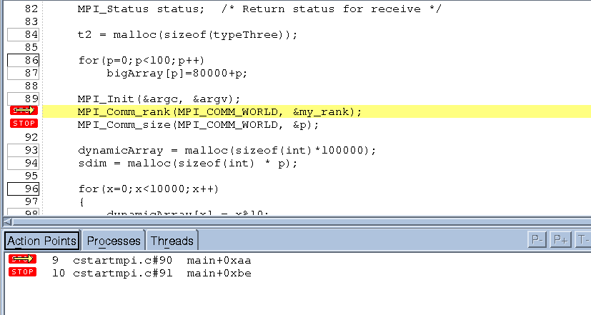
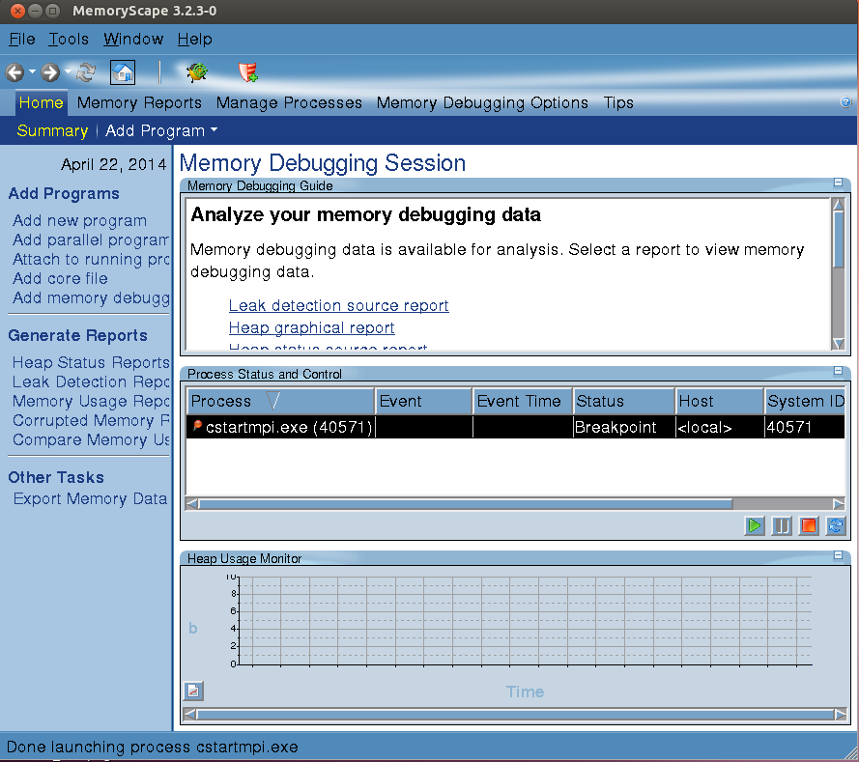
TotalView: Window

Slide 8
DDT: Introduction
What is DDT?
GUI-based debugging tool
Languages supported
C, C++, Fortran 90
Parallel programming models supported
pthreads, MPI, OpenMP, CUDA GPU, HMPP
Systems and Platforms supported
Unix, Linux, OS X, Windows
Good Visualization
Easy to use, intuitive

Slide 9
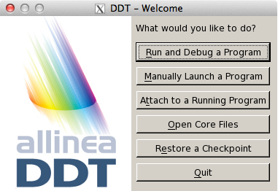
DDT: Overview
Compile code with -g flag
On linux systems:
module load ddt
ddt &
Can run it within interactive job, or have DDT launch job

Slide 10
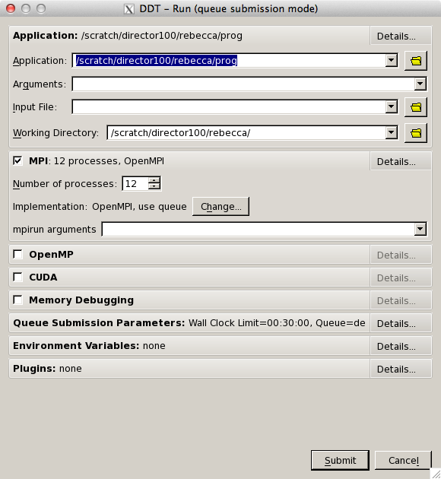
DDT: Overview
Running a job
Enter application name
Can have DDT launch job, or run interactive job
Set arguments as necessary

Slide 11
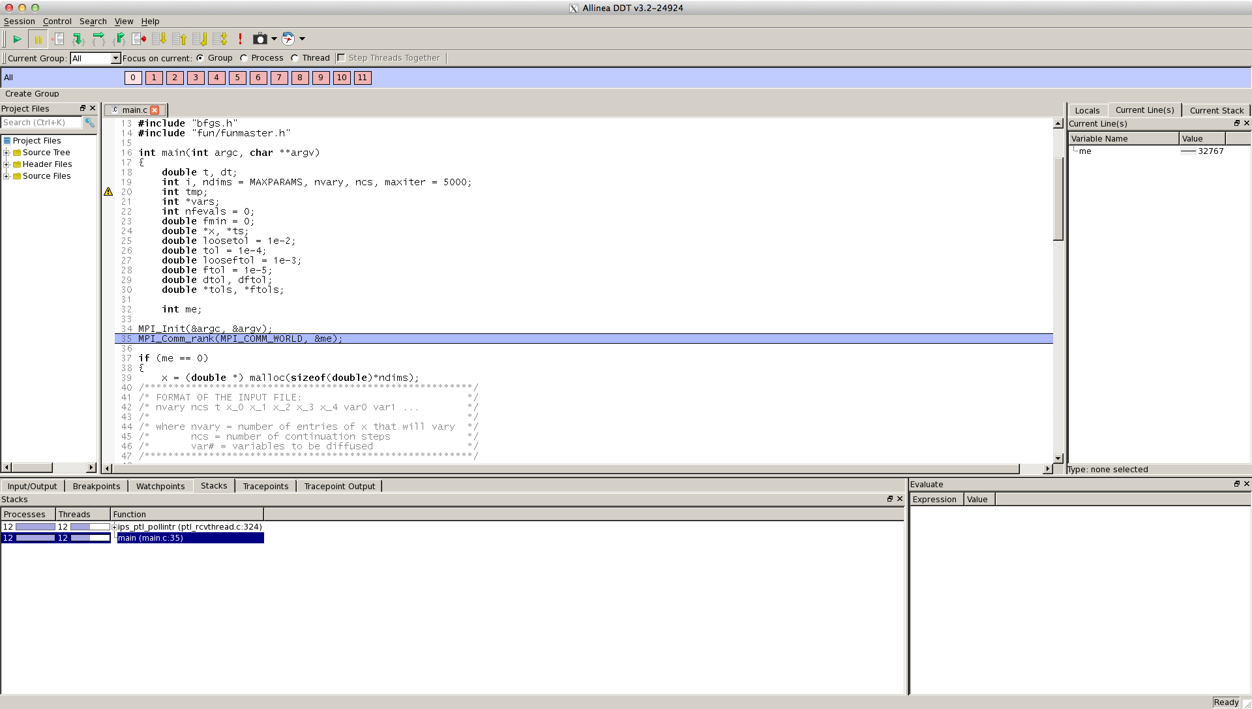
DDT: Overview
Opening Screen

Slide 12
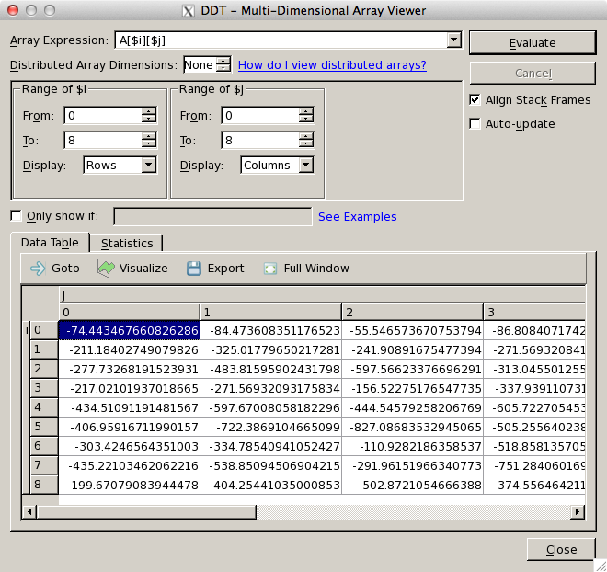
DDT: Overview
Array Viewer

Slide 13
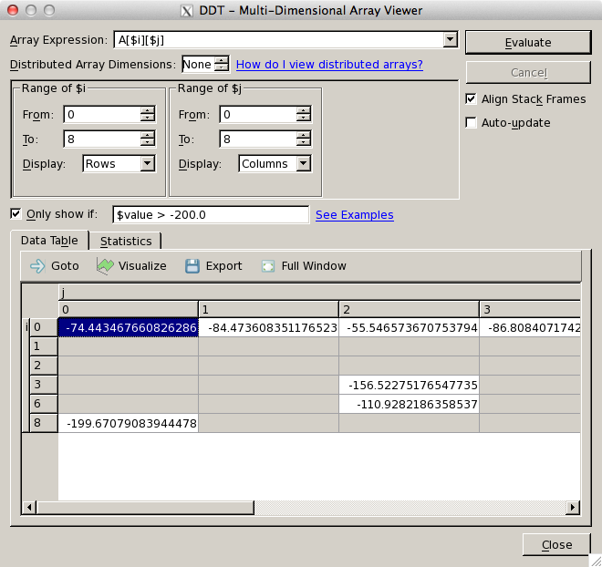
DDT: Overview
Array Viewer – see all A[i][j] > -200.0

Slide 14
DDT: Usage - Steps
Using DDT: Step 1 -- Compiling
• Compile your code with the usual compiler and -g flag
• If optimizations are on, line numbers may be misaligned or inexact
Using DDT: Step 2 -- Running
• You must have logged in with flags to allow X-forwarding
• ssh -X user@epic.ivec.org (linux)
• ssh -Y user@epic.ivec.org (mac)
• DDT can launch parallel interactive jobs for You
• Or, you can launch the interactive job and run DDT inside

Slide 15
DDT: Usage-Steps
Running from Interactive Job
• qsub -I -V -X -lwalltime=00:30:00 -W group_list=yourgroup -q debugq"
• -I = interactive
• -V = keep environment variables (useful if ddt module already loaded) • -X = allow X-forwarding
• Once job is running, invoke ddt: ddt &”
Using DDT: Step 3 -- Debugging
• Set breakpoints
• Start/Pause/restart
• Look at variables
• Look at state of program on each processor
• Run program until condition occurs (i.e., stop when x=6)

Slide 16
Thanks!
Any questions?

