Slide 1
Can classification place new books?
Charles Zange
INFO634-900
2019
…and his
assistant, RedText
(Spoiler alert: Probably, but not this time)

Slide 2
Overview: project goals and workflow
1. Take a dataset of frequently checked out items from Seattle Public Library
2. Split 2/3 vs. 1/3 to simulate 2/3 ‘existing collection’ vs. 1/3 ‘new acquisitions’
3. Train Random Forest on 2/3 to classify ‘ItemLocation’ of existing collection
4. Test Random Forest on 1/3 to predict where new acquisitions will be placed within ItemLocation
This is the most important slide

Slide 3
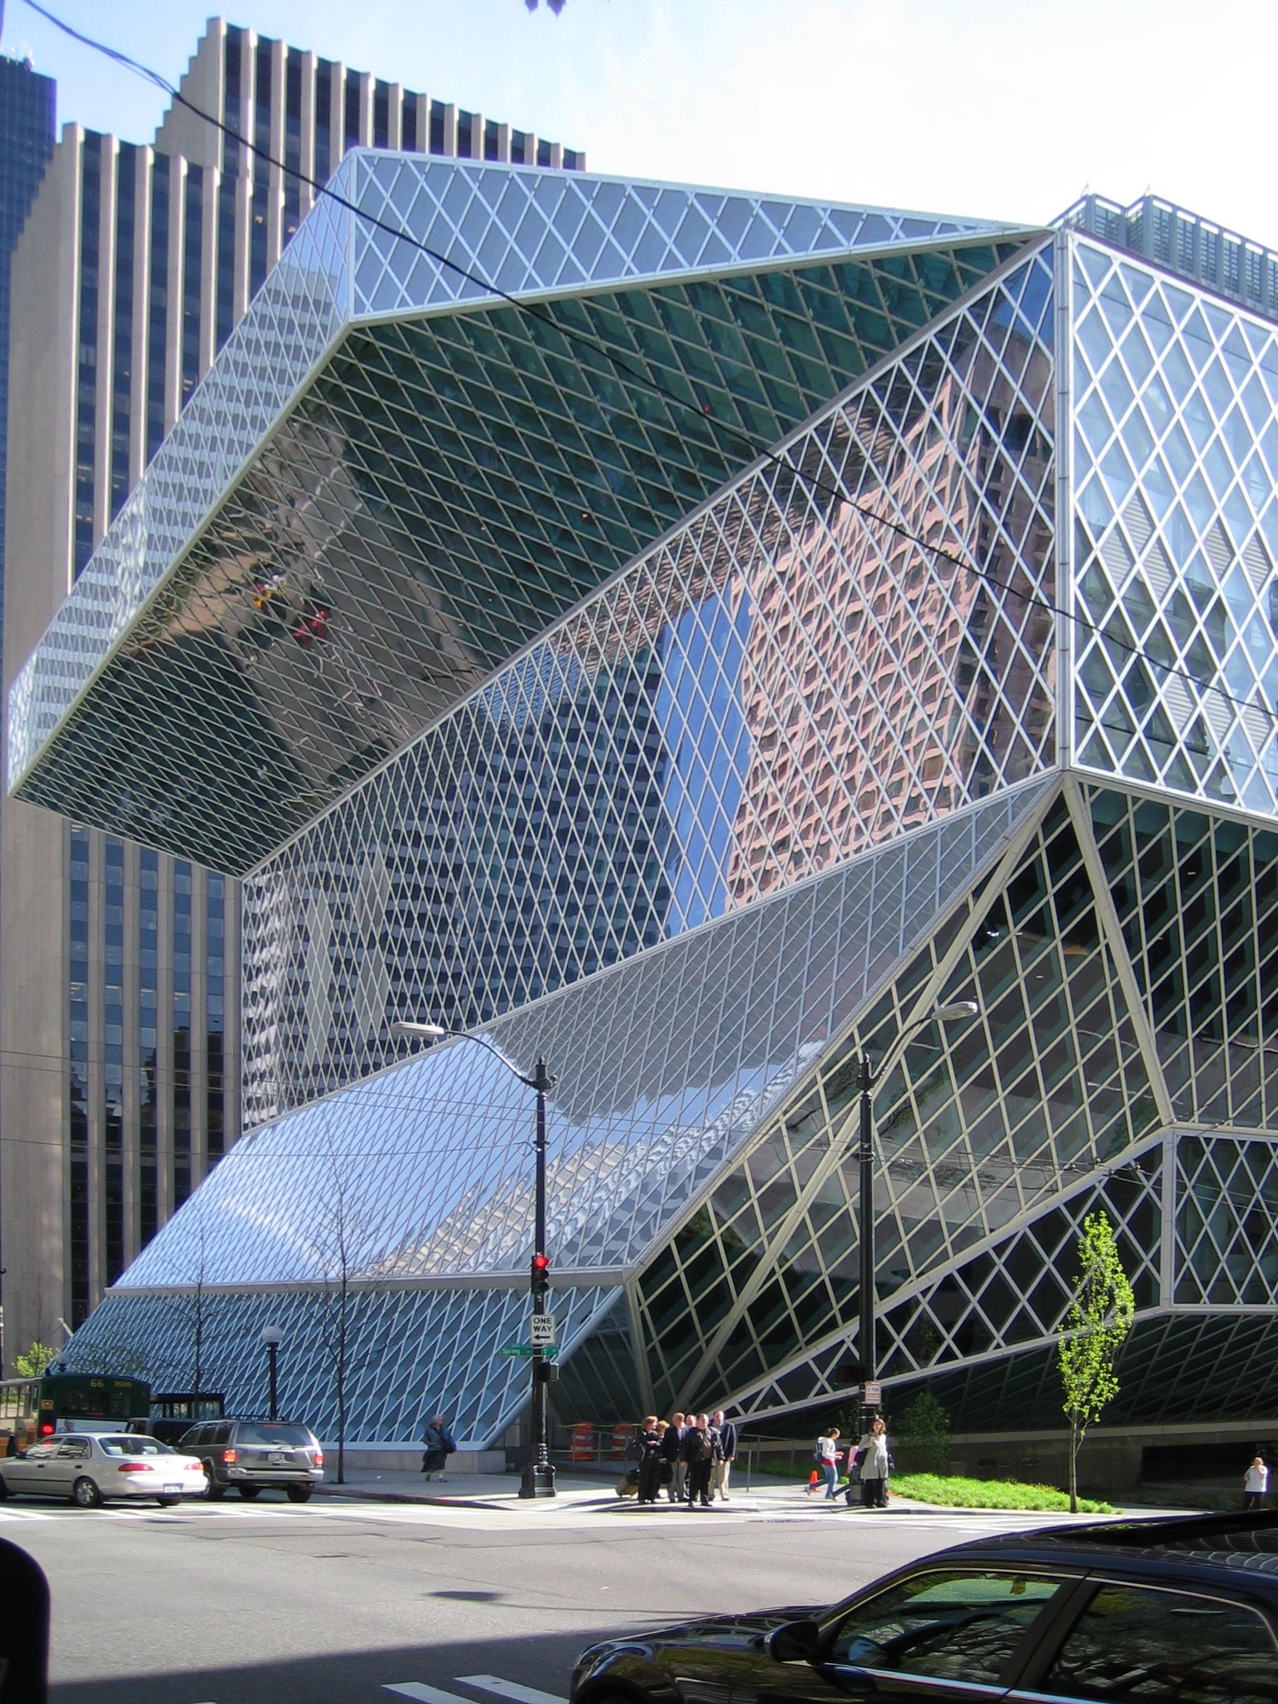
Seattle Public Library
Huge collection
Inventory estimate: 26.8 million items
One central library (shown on the left)
Dozens of satellite locations/other libraries
Publicly available data
City of Seattle
Kaggle
Books are cool
Photo source: https://upload.wikimedia.org/wikipedia/commons/8/8a/Seattle_Central_Library%2C_Seattle%2C_Washington_-_20060418.jpg. Photo by ‘DVD R W’, CC BY-SA 3.0, photographed 18 April 2006

Slide 4
Dataset: Description
Physical checkout items from 2005-2017
= frequently requested items
= 2.69 million observation subset of total Seattle Public Library inventory
Includes ‘FloatingItems’ that have multiple potential locations
Removed these for simplicity
Focused in on generalizable features and not ‘per item’ features
The whole point is to predict the placement of new books like those already in stock
instead of
placing new books with the same titles as those already in stock

Slide 5
Dataset: Features
You don’t have to read all of this
Qualified? | Feature | Why the feature did/did not qualify
Qualified | Author | Authors shared between books may impact placement.
 | PublicationYear | Books of the same age may be placed together, especially in historical collections.
 | Publisher | Historical publishers that are no longer active may help clue in the algorithm on the placement of books.
 | Subjects | Multi-item feature that establishes ‘like with like’ matching.
 | ItemType | Media type and adult vs. children audiences affect storage needs, impacting the algorithm.
 | ItemCollection | Distinctions between Reference and non-Reference collections impact the algorithm.
 | ItemLocation | Target class.
 | FloatingItem | Removes items with multiple locations from consideration. Used for filtering, but not included in the final model
Did not qualify | BibNum | Specific on a per-item basis, does not fit spirit of exercise.
 | Title | While a Title can be shared across multiple media (books, films, etc.), the Title feature was ultimately dropped to reduce the per-item specificity of the analysis.
 | ISBN | Specific on a per-item basis, does not fit spirit of exercise.
 | ReportDate | This date refers to when the data were pulled from the database and not specifically to the items in SPL’s holdings.
 | ItemCount | The count of items per line did not fit into this testing model.
This one is
important, though

Slide 6
Target classification feature
ItemLocation
Type: Nominal, encoded, single-value
Description: Location that owned the item at the time of snapshot. 3-letter code. Note: as of 2017, some items are "FLOATING" which means they don't necessarily belong to a specific branch. Location of given copy could change based on where the item is returned.
Count: 2687149 | Unique: 33
Most frequent value: Central Library, 1000 4TH AV (1080480 count)
Note: This is an encoded feature. In the source dataset, ItemLocation is listed in codes like “cen” and “net” presumably to save on the storage footprint of the total collection. These are somewhat interpretable from first sight (“cen” ➔ “Central Library”), however the data dictionary makes substitution straightforward for use in the dataset. Each observation belongs to only one ItemLocation.
-3 when FloatingItems
and nulls are removed
(told you it was
Important)

Slide 7
Cultural collections + anticipated challenges
Cultural object acquisition is not a scientific process. It is a human process
Not all storage spaces are created equal
Cultural object placement is a logical process. It is not, however, universally replicable
There is randomness in all human decision-making
There are missing features in this dataset.
Is this storage area full? Can it handle film? Etc.
Different Librarians make different choices on where things go

Slide 8
Resources
Python 3 | All pre-processing and machine learning was written in this programming language. Python was also used to generate confusion matrices.
Scikit | Python’s scikit.learn library provided the machine learning tools.
NumPy | Python’s mathematical library performed vectorized operations and prepared data for the Random Forest algorithm.
Pandas | SPL’s data were loaded into Pandas dataframes for processing.
Jupyter Lab | Jupyter Lab, built from the Anaconda distribution of Python 3, provided the coding environment.
Tableau | Tableau was used to create some of the visualizations.
Any other
Jupyter fans?

Slide 9
Project Timeline
Data exploration/pre-processing (2 weeks) | Get a better sense of the data beyond the basic descriptive statistics
Data visualization (1 week) | Visualize the results of data exploration
Random Forest (1 week) | Perform machine learning
Recording/documenting results (2 weeks) | Compile the results of the classification and visualizations into a final report
+ ANN + Adaboost but
they were worse
3
This part took longer than expected

Slide 10

Timeline 1: Data exploration/pre-processing
According to ANOVA F-test variant “Accuracy Score” from Scikit-learn…
Feature | ‘Author’ | ‘PublicationYear’ | ‘Publisher’ | ‘Subjects’ | ‘ItemType’ | ‘ItemCollection’
Accuracy score | 3600.1039 | 302.0697 | 1659.1432 | 3518.2032 | 12.0839 | 43.4779
… ‘Author’ has the highest variance relative to the target feature ‘ItemLocation’
therefore
‘Author’ is likely to be an important predictor of ‘ItemLocation’

Slide 11
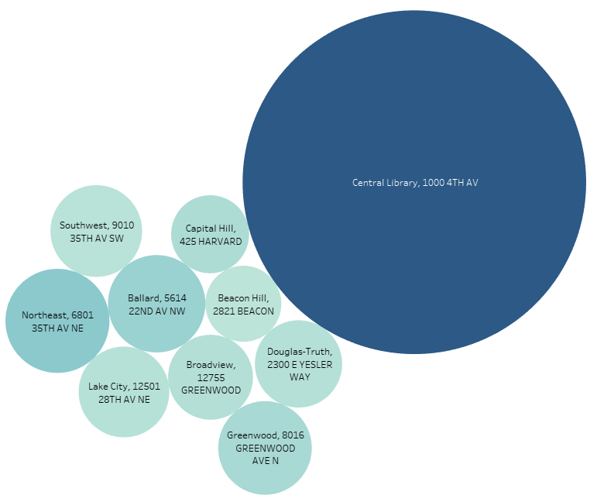

Timeline 2: Data visualization
Size = number of titles at that location
Central Lib
Satellite Libs
Color = average number of copies per title

Slide 12
Timeline 3: Random Forest
Two slices of the dataset
Test 1: All locations Random Forest (includes Central Library)
Test 2: Satellite libraries-only Random Forest
100% of total dataset
(minus nulls/FloatingItems)
~42.9% of total dataset
(minus nulls/FloatingItems)

Slide 13
Timeline 4: Recording/documenting results
Written paper summary
Code in Python
Source files
README
Also this presentation.

Slide 14
Built the code, tested the data
So what happened?

Slide 15
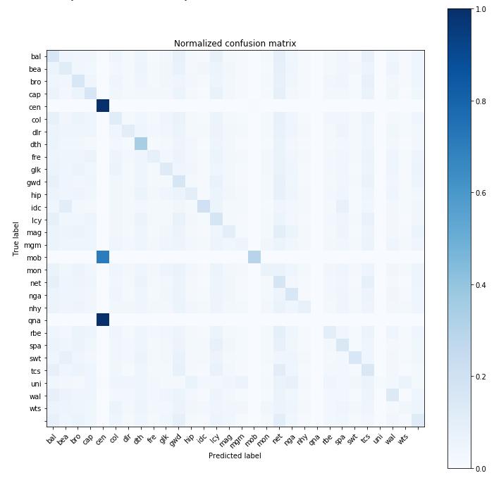
Results: test 1 All locations
This part
is OK
Diagonal should be all dark blue but it totally isn’t
Color = percentage(%) of guesses of the category
In a word: Not.
In two words: Not good.
Explain yourselves

Slide 16
Results: test 1 All locations
 | Author | PublicationYear | Publisher | Subjects | ItemType | ItemCollection
Gini Importance | 0.1535 | 0.1003 | 0.1267 | 0.1550 | 0.070 | 0.3950
This tells us how the Random Forest measures the importance
of each feature it used for training
ItemCollection = most important?
How? That was supposed to be ‘Author’…

Slide 17

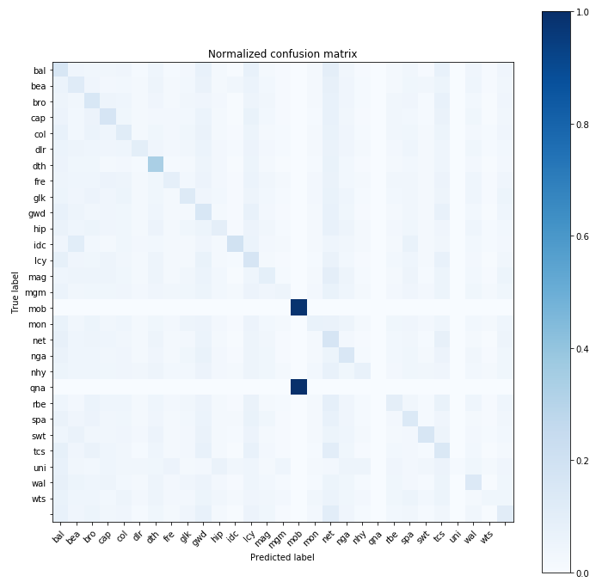
Results: test 2 Satellites only
“See, there’s yer problem right there.”
This text highlights a diagonal lack of improvement
Explain
yourselves
again
“Yer algorithm can’t split the satellite libraries apart.
All them places look the same to yer fancy science.”

Slide 18



Results: compiled
Test | Overall accuracy
T1 – total dataset of 2.6 million rows (2/3 1/3 split) | 51.329%
T2 – Satellite libraries-only dataset of approx. 1.1 million rows (2/3 1/3 split) | 15.401%

Slide 19
Analysis
Correct Central Library classifications were the bulk of accurate predictions
Low accuracy outside the Central Library suggests that the collections of satellite libraries are insufficiently distinct to be separable by the algorithm
Subtext: everything else was worse
But what if that’s the point….

Slide 20
Discussion: what went wrong
The assumption that created the question was wrong
I’ll take it from here
It was wrong to assume that the satellite libraries had inherently different collections.
In fact, they have similar collections.
NEW HYPOTHESIS: Differentiating book placement in satellite libraries based purely on collections data fails ➔BECAUSE ➔ the purpose of satellite libraries is to have similar offerings for all constituents in Seattle Public Library’s community

Slide 21
Discussion: what can we do next?
Work with the model
01
Try the model again with Central Library vs. All rather than all vs. all multi-class
Get new data
02
Research the placement process better
Shift focus
03
Comparative analysis of satellite library collections
How similar are those collections?
What differences exist, and why do they exist?
Looks good to me

Slide 22

Bibliography
Rebecca A. Buck and Jean Allman Gilmore, eds. (2010). Museum Registration Methods 5th Edition. The American Association of Museums Press
City of Seattle (2019a). Seattle Checkouts by Title: From City of Seattle Open Data. Retrieved from https://www.kaggle.com/city-of-seattle/seattle-checkouts-by-title
City of Seattle (2019b). Seattle Library Collection Inventory: From City of Seattle Open Data. Retrieved from https://www.kaggle.com/city-of-seattle/seattle-library-collection-inventory
City of Seattle (2019c). Checkouts by Title. Retrieved from https://data.seattle.gov/Community/Checkouts-by-Title/tmmm-ytt6
City of Seattle (2019d). Checkouts by Title (Physical Items). Retrieved from https://data.seattle.gov/dataset/Checkouts-by-Title-Physical-Items-/3h5r-qv5w
City of Seattle (2019e). Integrated Library System (ILS) Data Dictionary. Retrieved from https://data.seattle.gov/Community/Integrated-Library-System-ILS-Data-Dictionary/pbt3-ytbc
City of Seattle (2019f). Library Collection Inventory. Retrieved from https://data.seattle.gov/Community/Library-Collection-Inventory/6vkj-f5xf
City of Seattle (2019g). Seattle Integrated Library System (ILS) Dictionary: From City of Seattle Open Data. Retrieved from https://www.kaggle.com/city-of-seattle/seattle-integrated-library-system-ils-dictionary
The Minitab Blog (2016). Understanding Analysis of Variance (ANOVA) and the F-test. Retrieved from https://blog.minitab.com/blog/adventures-in-statistics-2/understanding-analysis-of-variance-anova-and-the-f-test
Dan Murphy (2019). Review of Seattle Library Checkout Records. Retrieved from https://www.kaggle.com/murphydan/review-of-seattle-library-checkout-records
Dan Ofer (2019). Library Checkouts EDA. Retrieved from https://www.kaggle.com/danofer/library-checkouts-eda
Seattle Public Library (2017). Seattle Library Checkout Records: Twelve years of checkout records. Retrieved from https://www.kaggle.com/seattle-public-library/seattle-library-checkout-records
Marcellus Turner (n.d.). Welcome: Welcome to The Seattle Public Library. Retrieved from https://www.spl.org/about-us/the-organization/leadership/welcome
Scikit-learn (2019). Model evaluation: Accuracy score. Retrieved from https://scikit-learn.org/stable/modules/model_evaluation.html#accuracy-score
Thanks!

