Slide 1


Slide 2
8.4 million US Citizens sleepwalk each year
-CBS NEWS

Slide 3
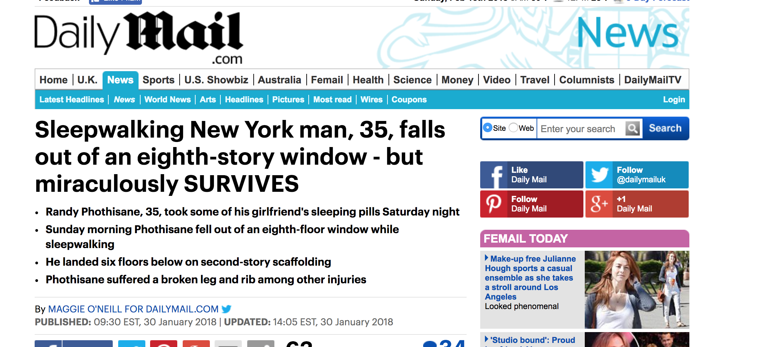

Slide 4
What is sleepsafe?
Sleepsafe is a security device that warns caregivers and prevents the injuries that arise due to sleepwalking.

Slide 5
ASPECTS OF OUR DESIGN
Gives immediate audio warning to sleepwalker
Emails notifications to notify caregivers
Determines the location of the sleepwalker
Gives information to the user and caregiver about time elapsed

Slide 6
Built with:
Arduino UNO
Modules used: Force sensor, 7 seg display, piezo speaker
Python for sending email notifications

Slide 7
THE DEMO

