Slide 1
Developing A Multi-Agent and Self-Adaptive Framework with Deep Reinforcement Learning for Dynamic Portfolio Risk Management
Paper Sharing:
Presenter: Qiwen Xiao
Department of Computer Science and Engineering, SUSTech
Mar. 2024

Slide 2
Table of Contents
Preliminaries
RL; DRL; Why DRL; DDPG; TD3
Introduction
RL in CF; Pitfalls
Approach
Market Observer; RL-based Agent; Solver-based Agent; Rewards; Overall
Implementation
Results
4 Performance Metrics; Value & Risks; Ablation Study
More on RL for Finance
FinRL; TradeMaster

Slide 3

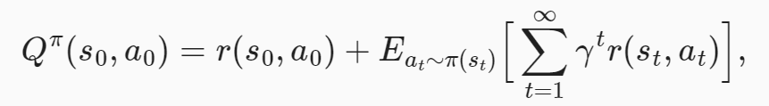

Preliminaries: RL
Reinforcement Learning (RL) is a suite of techniques that allows us to build machine learning systems that take decisions sequentially.
Action-value: Q

Slide 4
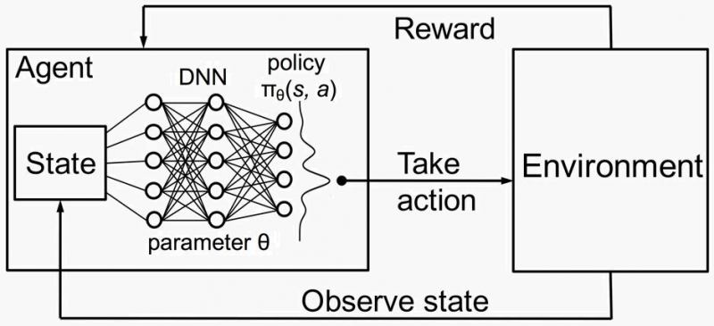
Preliminaries: DRL

Slide 5
Preliminaries: Why DRL?
1
DRL vs. Modern Portfolio Theory (MPT)
MPT performs not so well on in out-of-sample data.
MPT is very sensitive to outliers.
MPT is calculated only based on stock returns, if we want to take other relevant factors into account, for example, some of the technical indicators like Moving Average Convergence Divergence (MACD), and Relative Strength Index (RSI), MPT may not be able to combine this information together well.
[1] https://towardsdatascience.com/deep-reinforcement-learning-for-automated-stock-trading-f1dad0126a02

Slide 6
Preliminaries: Why DRL?
DRL vs. Supervised ML
DRL doesn’t need large labeled training datasets.
DRL uses a reward function to optimize future rewards, in contrast to an ML regression/classification model that predicts the probability of future outcomes.

Slide 7

Preliminaries: Why DRL?
Rationale of DRL for stock trading
Common goal: maximizing returns (reward)
Stock trading is a continuous process of testing new ideas, getting feedback from the market, and trying to optimize trading strategies over time.$→$ Markov Decision Process

Slide 8
Preliminaries: Why DRL?
Other advantages of DRL
The stock market provides sequential feedback. DRL can sequentially increase the model performance during the training process.
Experience replay is able to overcome the correlated samples issue.

Slide 9
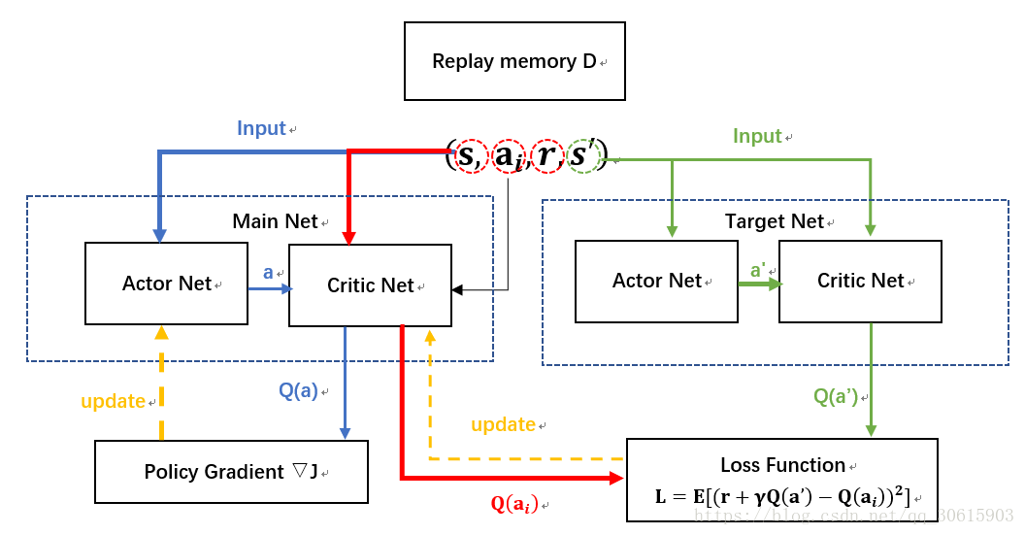
Preliminaries: DDPG
1
Deep Deterministic Policy Gradient
2
[1] Continuous Control with Deep Reinforcement Learning
[2] https://blog.csdn.net/qq_30615903/article/details/80776715

Slide 10


Preliminaries: DDPG
Deep Deterministic Policy Gradient
Basic Elements:
Actor-Critic
Replay Buffer: <$obs, act, reward, obs_{next}$>
Action
Q (How good the action is)
$$Q=r+γQ_{next}$$
Actor
Critic
Observation
Observation
Action

Slide 11

Preliminaries: DDPG
Training
Actor: $\text{minimize}(−Q)$
Critic: $\text{minimize}||\hat{Q}−Q|{|_{2}^{2}}_{}$

Slide 12
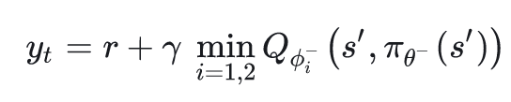
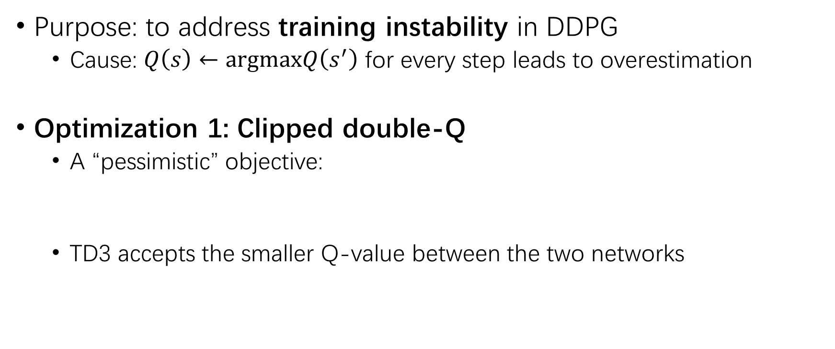
Preliminaries: Twin Delayed DDPG
Purpose: to address training instability in DDPG
Cause: $Q\left(s\right)←\text{argmax}Q\left(s^{′}\right)$ for every step leads to overestimation
Optimization 1: Clipped double-Q
A “pessimistic” objective:
TD3 accepts the smaller Q-value between the two networks

Slide 13
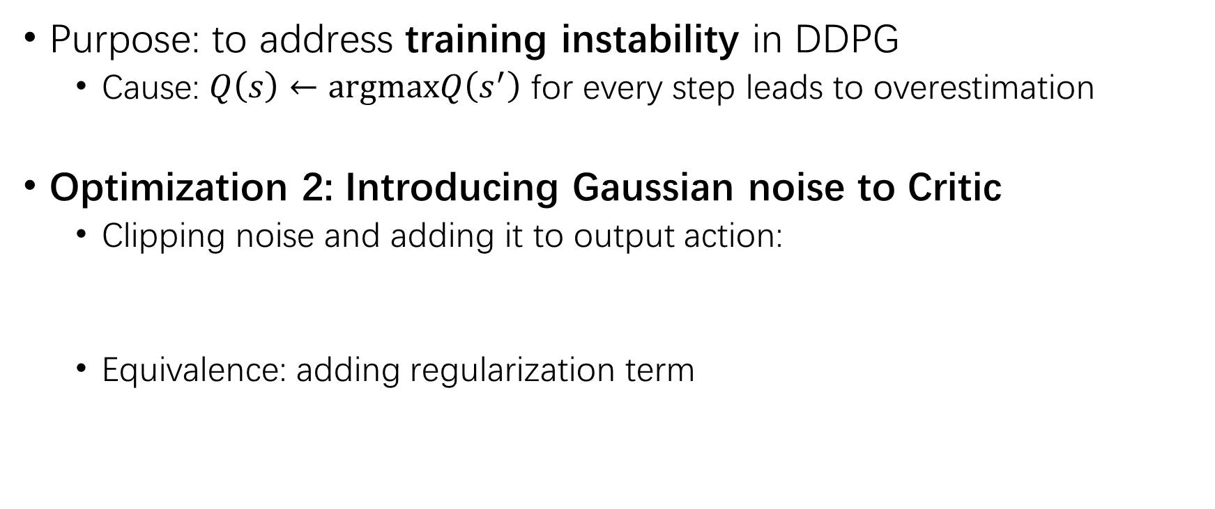
Preliminaries: Twin Delayed DDPG
Purpose: to address training instability in DDPG
Cause: $Q\left(s\right)←\text{argmax}Q\left(s^{′}\right)$ for every step leads to overestimation
Optimization 2: Introducing Gaussian noise to Critic
Clipping noise and adding it to output action:
Equivalence: adding regularization term

Slide 14
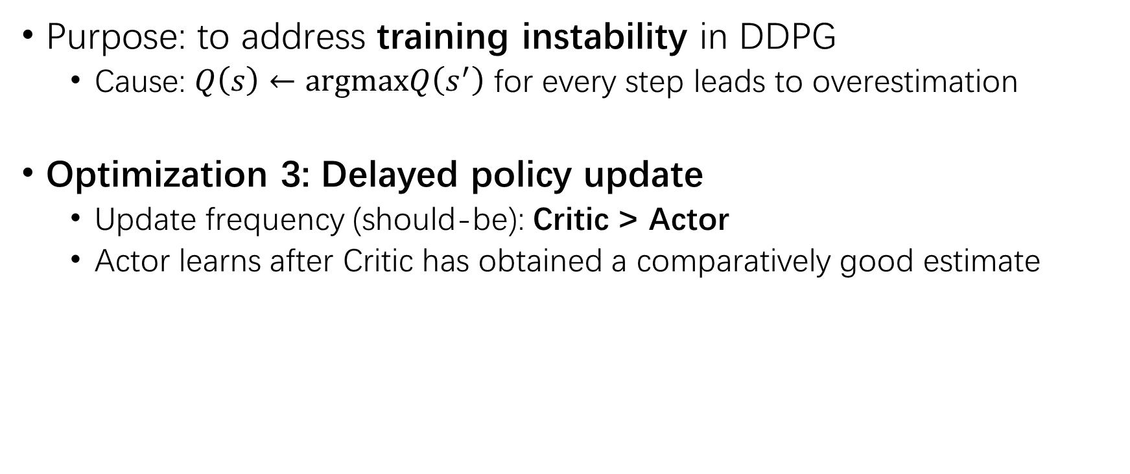
Preliminaries: Twin Delayed DDPG
Purpose: to address training instability in DDPG
Cause: $Q\left(s\right)←\text{argmax}Q\left(s^{′}\right)$ for every step leads to overestimation
Optimization 3: Delayed policy update
Update frequency (should-be): Critic > Actor
Actor learns after Critic has obtained a comparatively good estimate

Slide 15
Introduction: RL in CF
Machine Learning Approaches:
Support Vector Machine
Deep Learning
Reinforcement Learning
DRL: (in this paper) Twin Delayed DDPG (TD3)

Slide 16
Introduction: Pitfalls
Conventional objective: maximizing total returns
Pitfalls: ignoring potential risks
Unpredictable & sudden changes brought by:
Pandemic, natural disasters, local conflicts, etc.

Slide 17
Introduction: Pitfalls
Conventional objective: maximizing total returns
Pitfalls: ignoring potential risks
Unpredictable & sudden changes brought by:
Pandemic, natural disasters, local conflicts, etc.
Is there a way that tends to both sides?

Slide 18
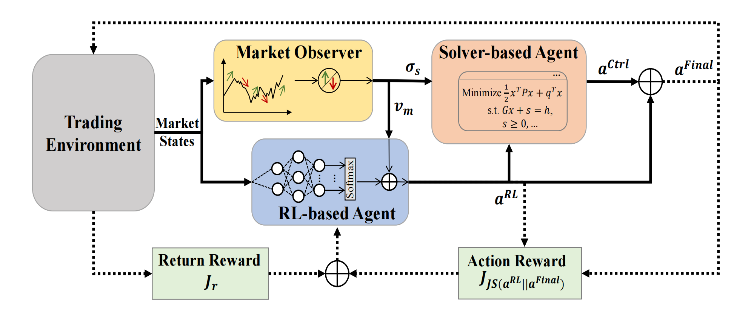
Introduction: MASA
Muti-agent and self-adaptive

Slide 19
Introduction: MASA
Multi-agent (three agents):
Market Observer
RL-based Agent
Solver-based Agent
Purpose:
Trade-off between
returns & risks

Slide 20
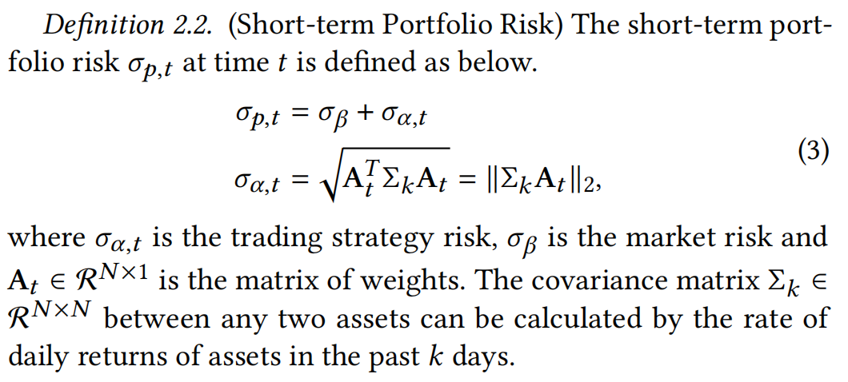
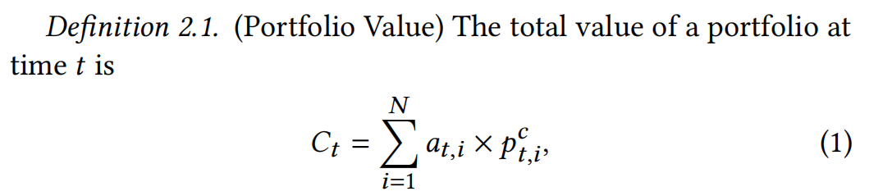
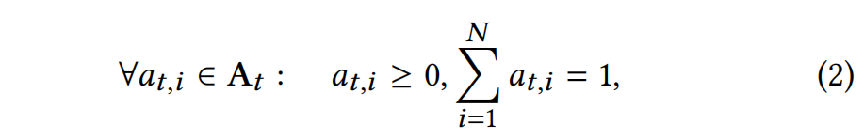
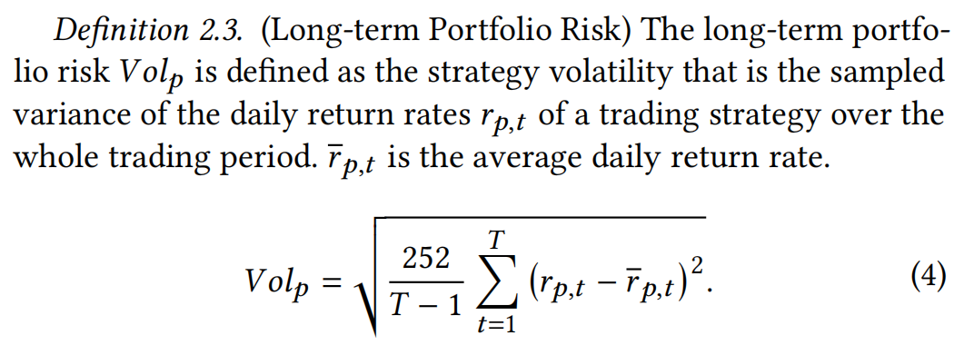
Definitions Ahead…

Slide 21
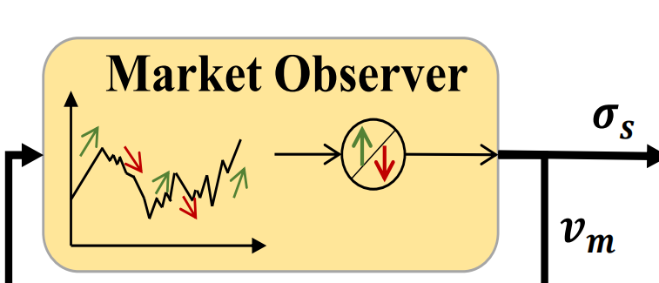

Approach: Market Observer
Backbone:
Deep neural network
Input:
Market states
Output:
Suggested risk boundary: $σ_{s}$
Market vector: $v_{m}$

Slide 22
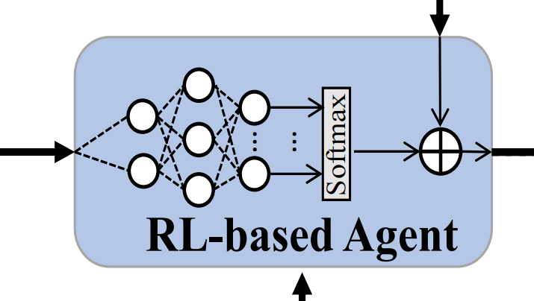
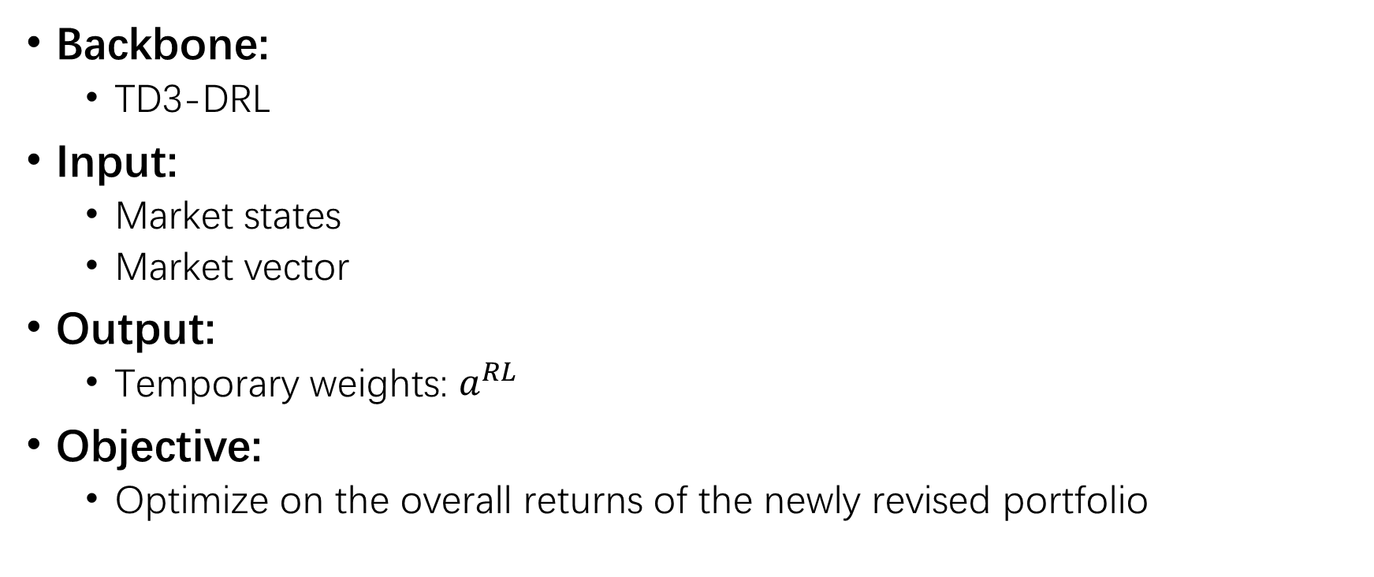
Approach: RL-based Agent
Backbone:
TD3-DRL
Input:
Market states
Market vector
Output:
Temporary weights: $a^{RL}$
Objective:
Optimize on the overall returns of the newly revised portfolio

Slide 23
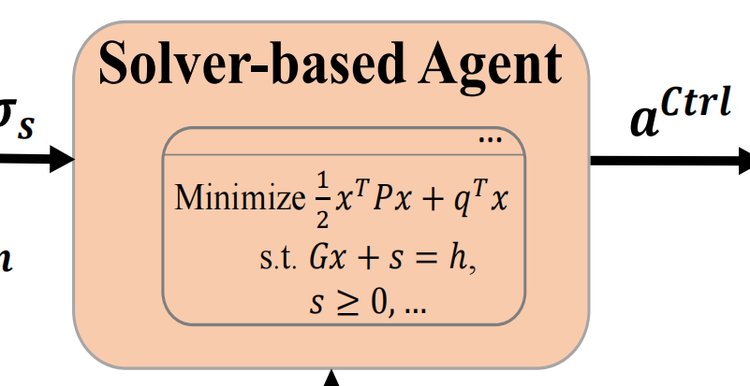
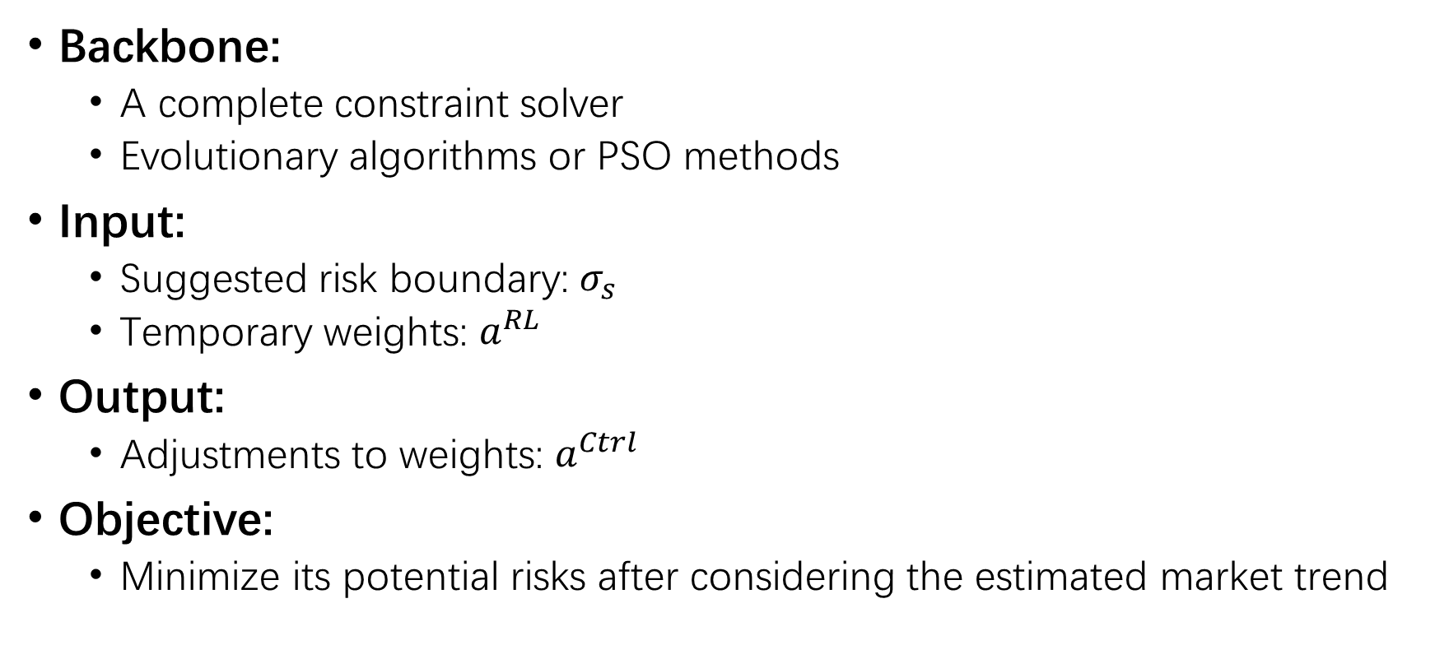
Approach: Solver-based Agent
Backbone:
A complete constraint solver
Evolutionary algorithms or PSO methods
Input:
Suggested risk boundary: $σ_{s}$
Temporary weights: $a^{RL}$
Output:
Adjustments to weights: $a^{Ctrl}$
Objective:
Minimize its potential risks after considering the estimated market trend

Slide 24
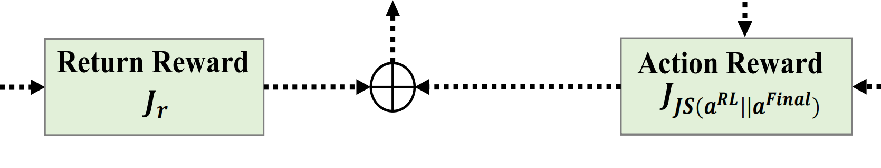
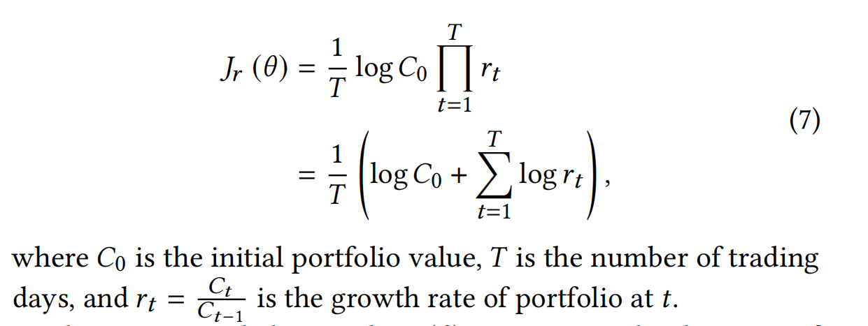
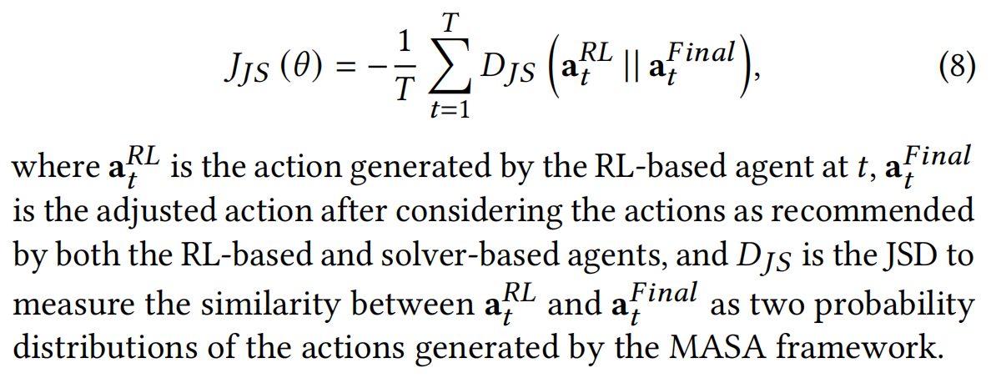
Approach: Rewards

Slide 25
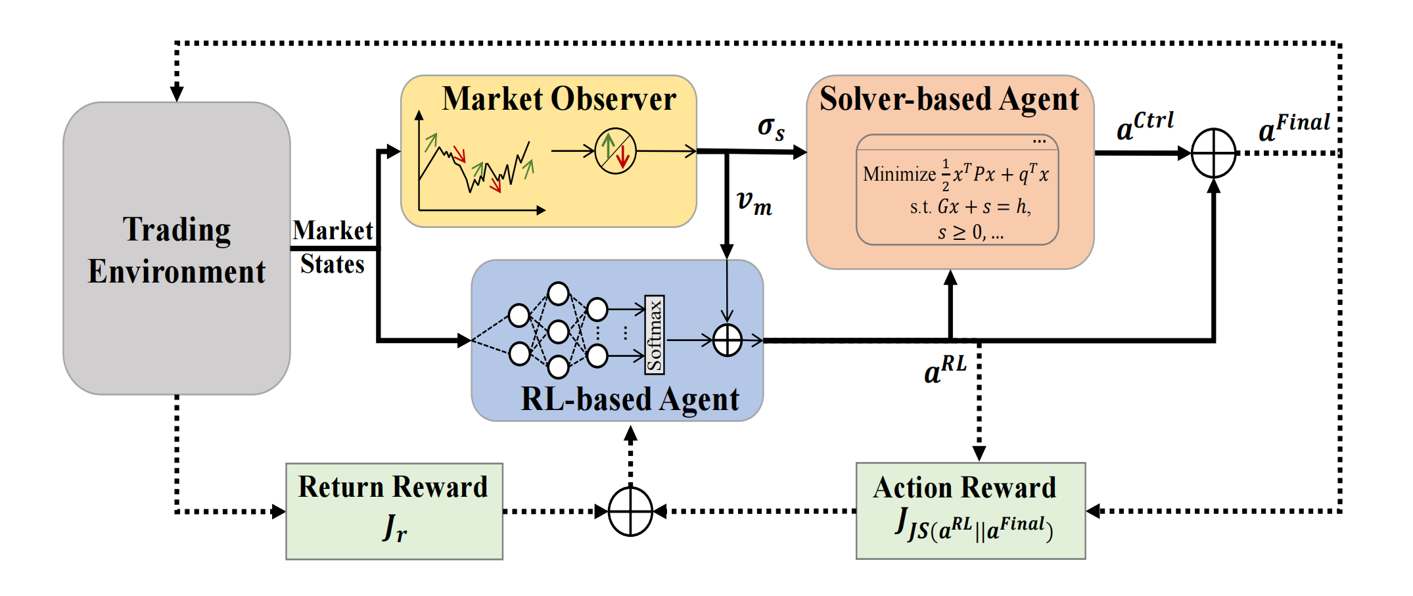
Approach: Overall

Slide 26
Implementation
Datasets: (Sep. 2013 ~ Aug. 2023)
CSI 300
Dow Jones Industrial Average (DJIA)
S&P 500
5y to train, 2y to validate, 3y to evaluate

Slide 27
Implementation
Comparative Methods:
Constant Rebalanced Portfolio (CRP)
Exponential Gradient (EG)
Online Moving Average Reversion (OLMAR)
Passive Aggressive Mean Reversion (PAMR)
Robust Median Reversion (RMR)
Correlation-driven Nonparametric Learning Strategy (CORN)
Ensemble of Identical Independent Evaluators (EIIE, CNN-based)
Portfolio Policy Network (PPN, RCNN-based)
Relation-Aware Transformer (RAT)
TD3-Profit

Slide 28
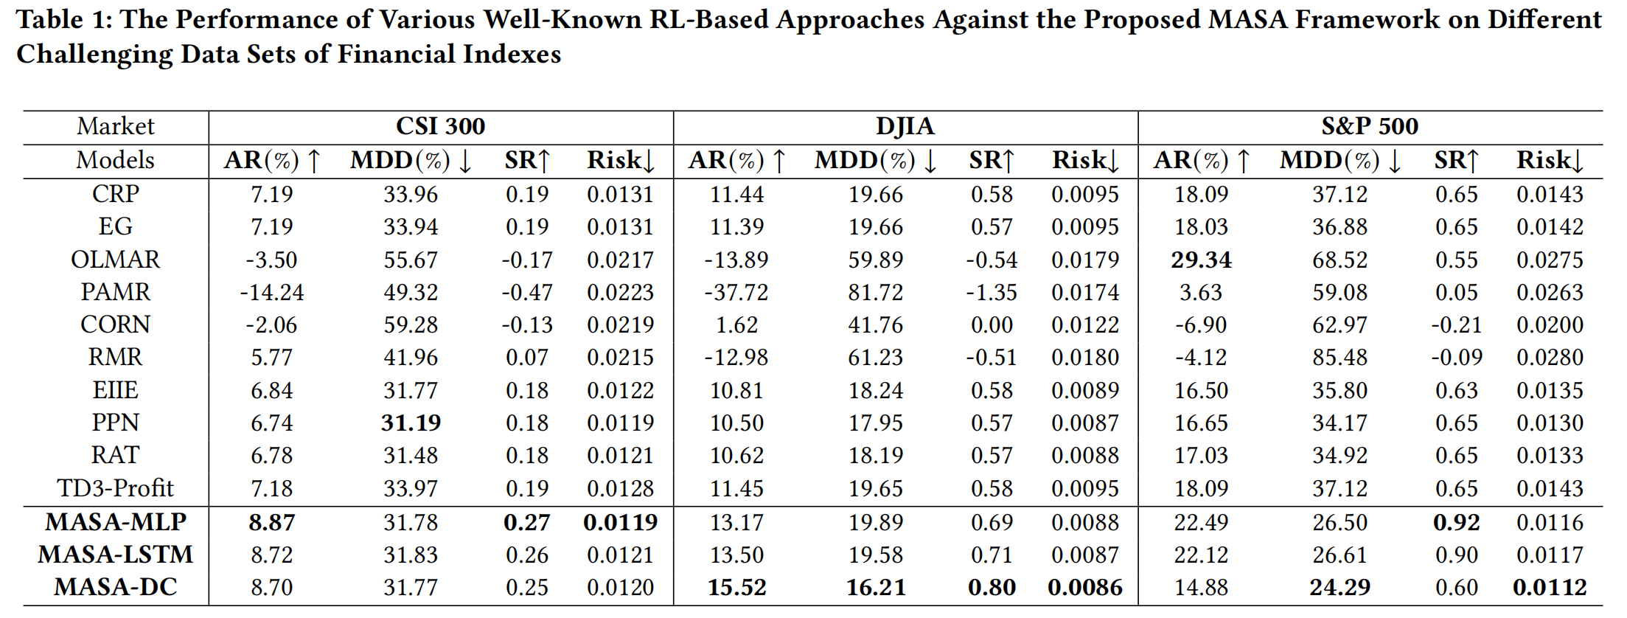
Results: 4 Performance Metrics
Annual Return, Maximum Drawdown, Sharpe Ratio, Short-term Portfolio Risk

Slide 29
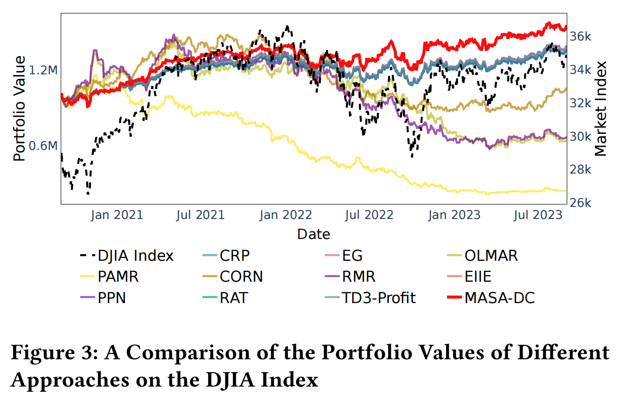
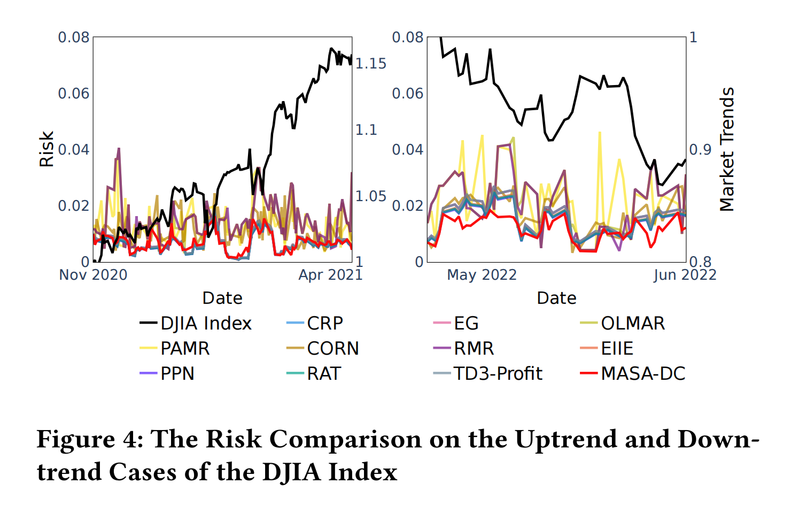
Results: Value & Risk

Slide 30
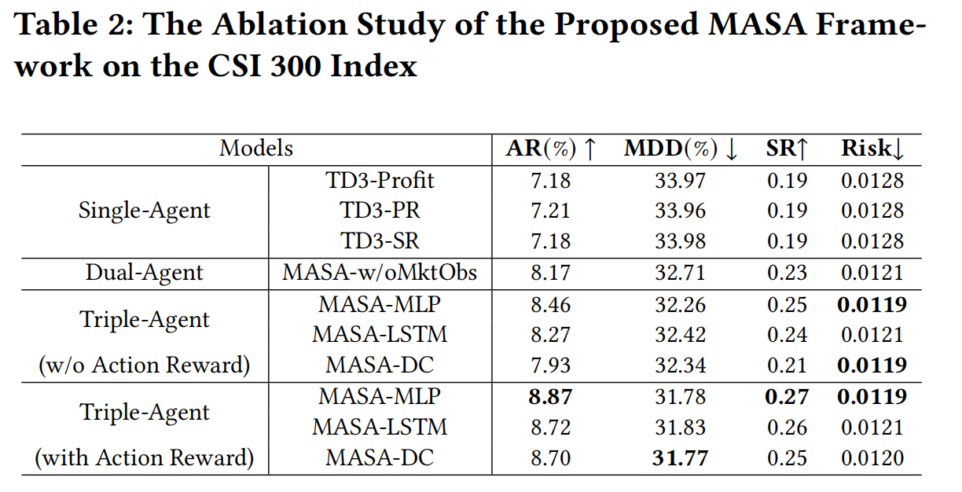
Results: Ablation Study

Slide 31

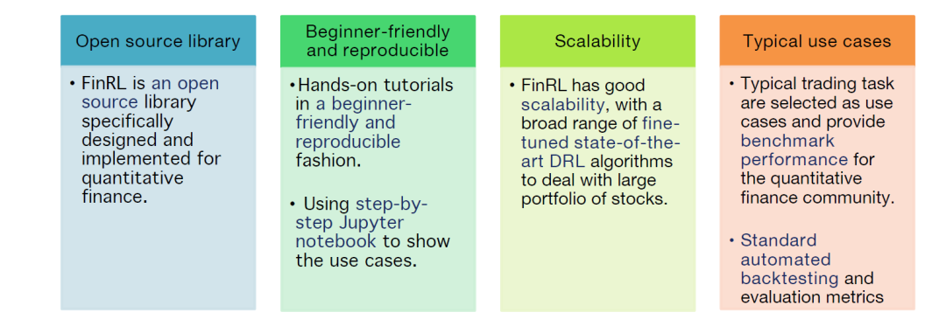
More on RL for Finance
1
FinRL : the first open-source framework for financial reinforcement learning.
[1] https://github.com/AI4Finance-Foundation/FinRL

Slide 32
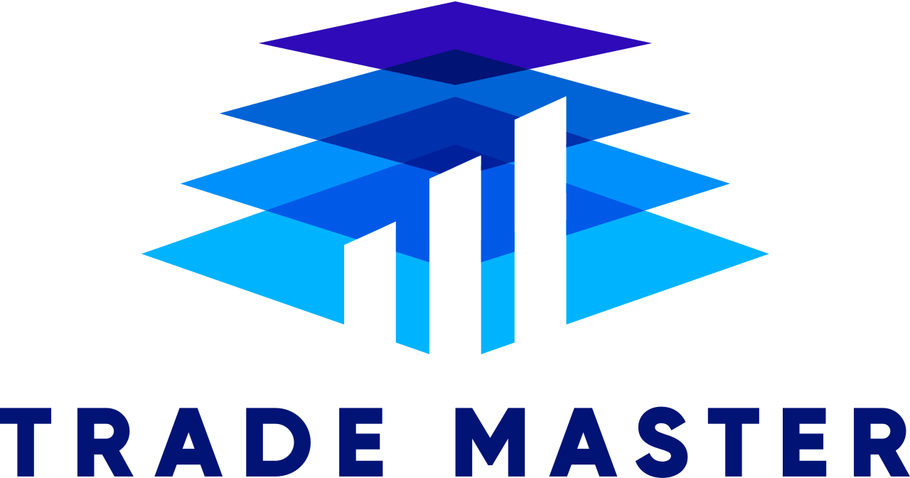
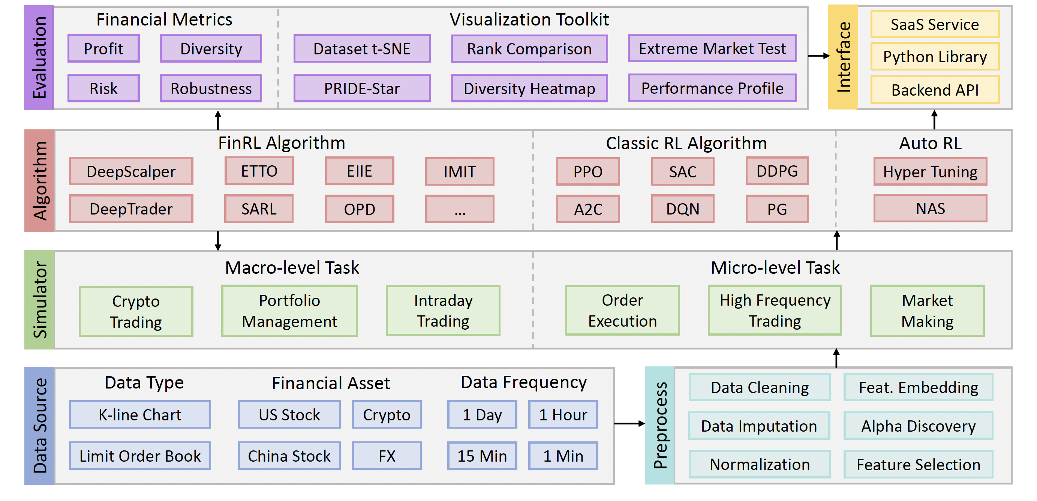
More on RL for Finance
1
TradeMaster : best-in-class open-source platform for quantitative trading (QT) empowered by reinforcement learning (RL)
[1] https://github.com/TradeMaster-NTU/TradeMaster

Slide 33
Thank you for your attention!
The slides are available at:
https://charleyhut.github.io/rl4fin.pptx

