Slide 1

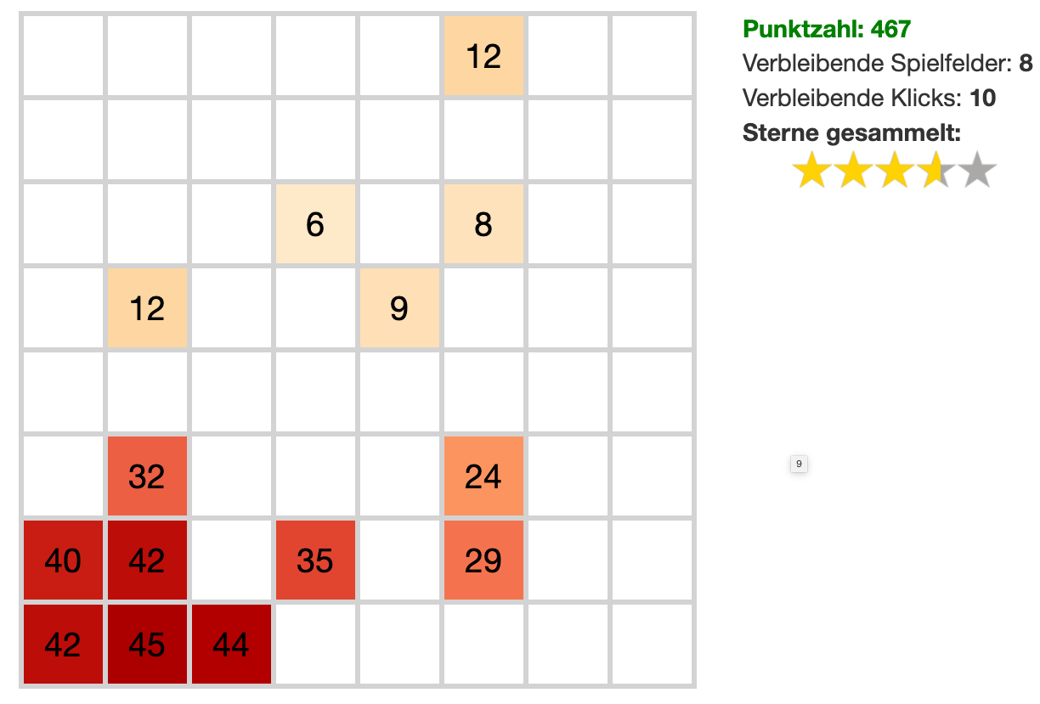
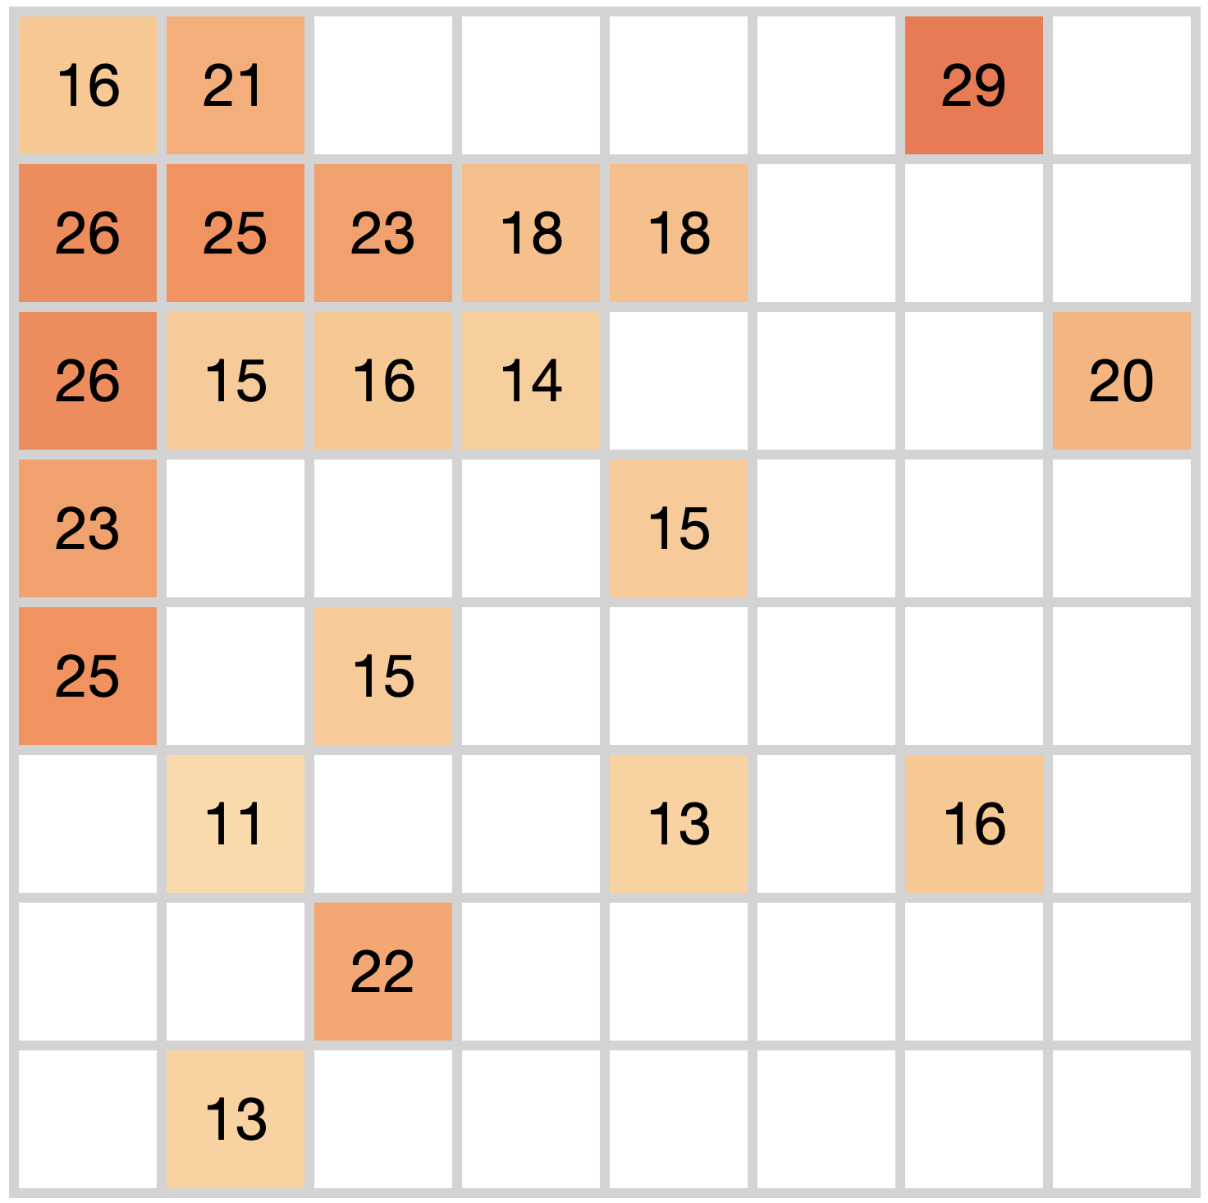
Task
Procedure
Example environments
Tutorial
round
12
Points: 476
Remaining rounds: 8
Remaining clicks: 10
Stars collected:
6
8
Time
12
9
8 rounds of search
32
24
40
42
35
29
25 clicks in each round
42
45
44
”Bonus round” with reward predictions

Slide 2
Points: 476
Remaining rounds: 8
Remaining clicks: 10
Stars collected:

Slide 3
Task
Procedure
Environments
Tutorial
round
12
6
8
Time
12
9
8 rounds of search
32
24
40
42
35
29
25 clicks in each round
42
45
44
”Bonus round” with reward predictions

Slide 4
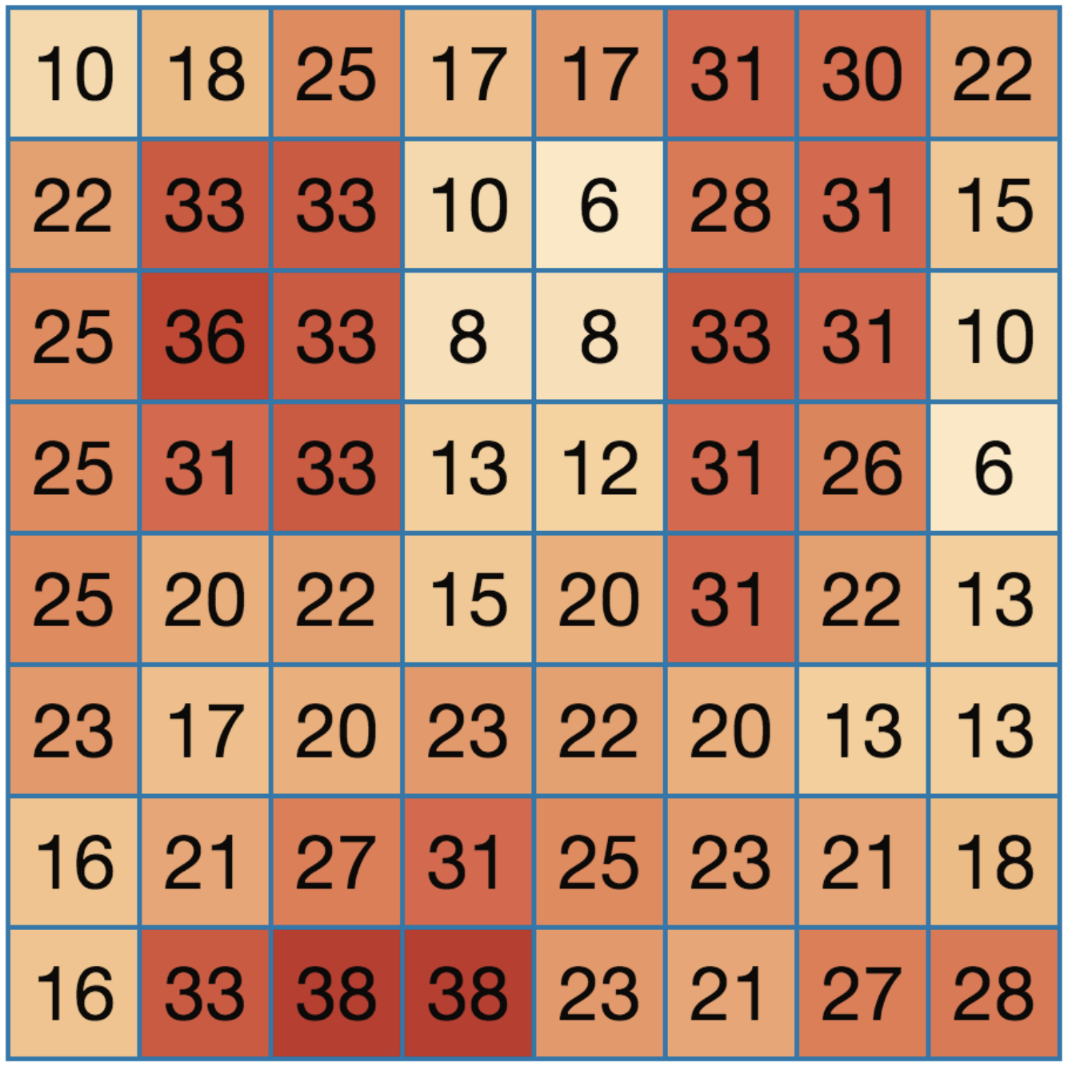
Task
Procedure
Environments
Tutorial
round
Time
8 rounds of search
The right panel shows nine example environments.
25 clicks in each round
”Bonus round” with reward predictions

