Slide 1
Curiosity, Connections, and Creating Value
Exercise #1
Charlie Coleman

Slide 2
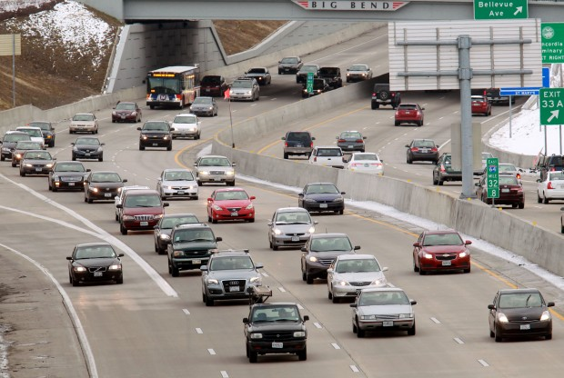
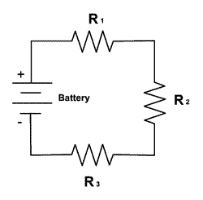
What types of electrical and non-electrical systems may be modeled using resistors and dependent sources?
Traffic is one such system that can be modeled using resistors and dependent sources

Slide 3
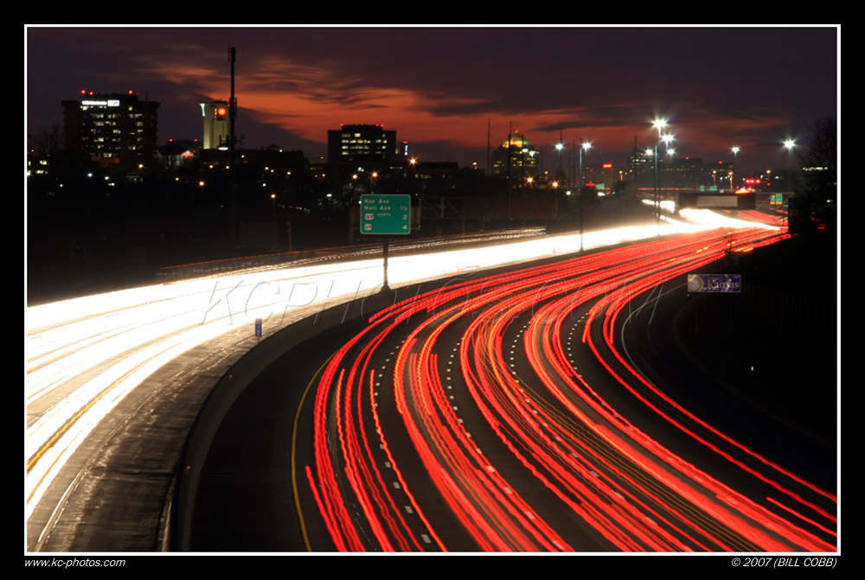
Charge
In this analogy, the cars on the road are the charge in the circuit.
The movement of the cars is similar to current, or charge moving through the circuit.

Slide 4
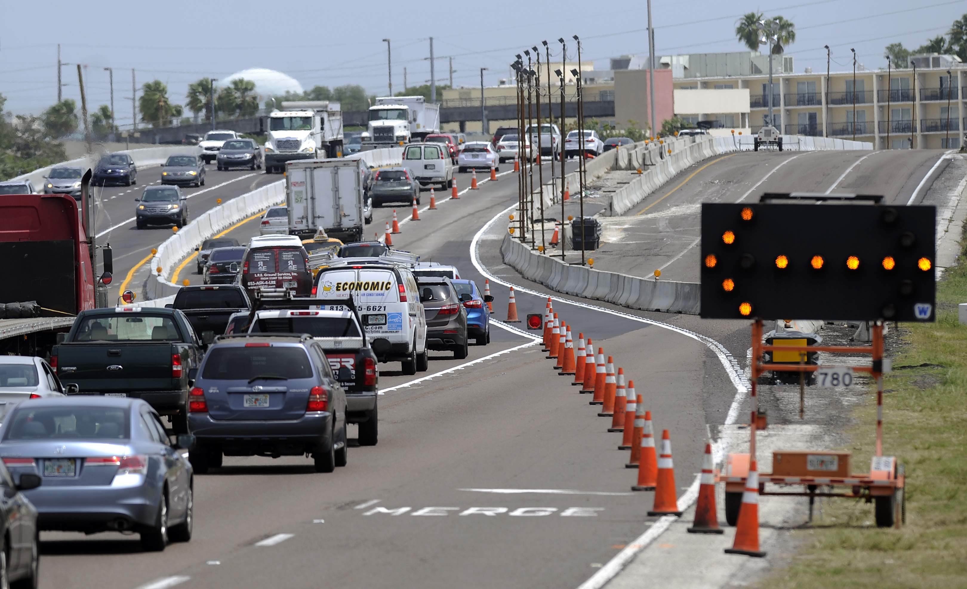
Resistors
Resistance can be compared to the lanes on the road.
A road with few lanes restricts the flow of traffic, and is comparable to a higher resistance.
A road with many lanes allows traffic to flow freely, and is therefore similar to very low resistances.

Slide 5
Voltage Sources
Parking lots and highway off ramps are simliar to voltage sources when looking at the road network
These things supply more cars that need to move throughout the network, similar to voltage sources adding charge into the circuit.

Slide 6
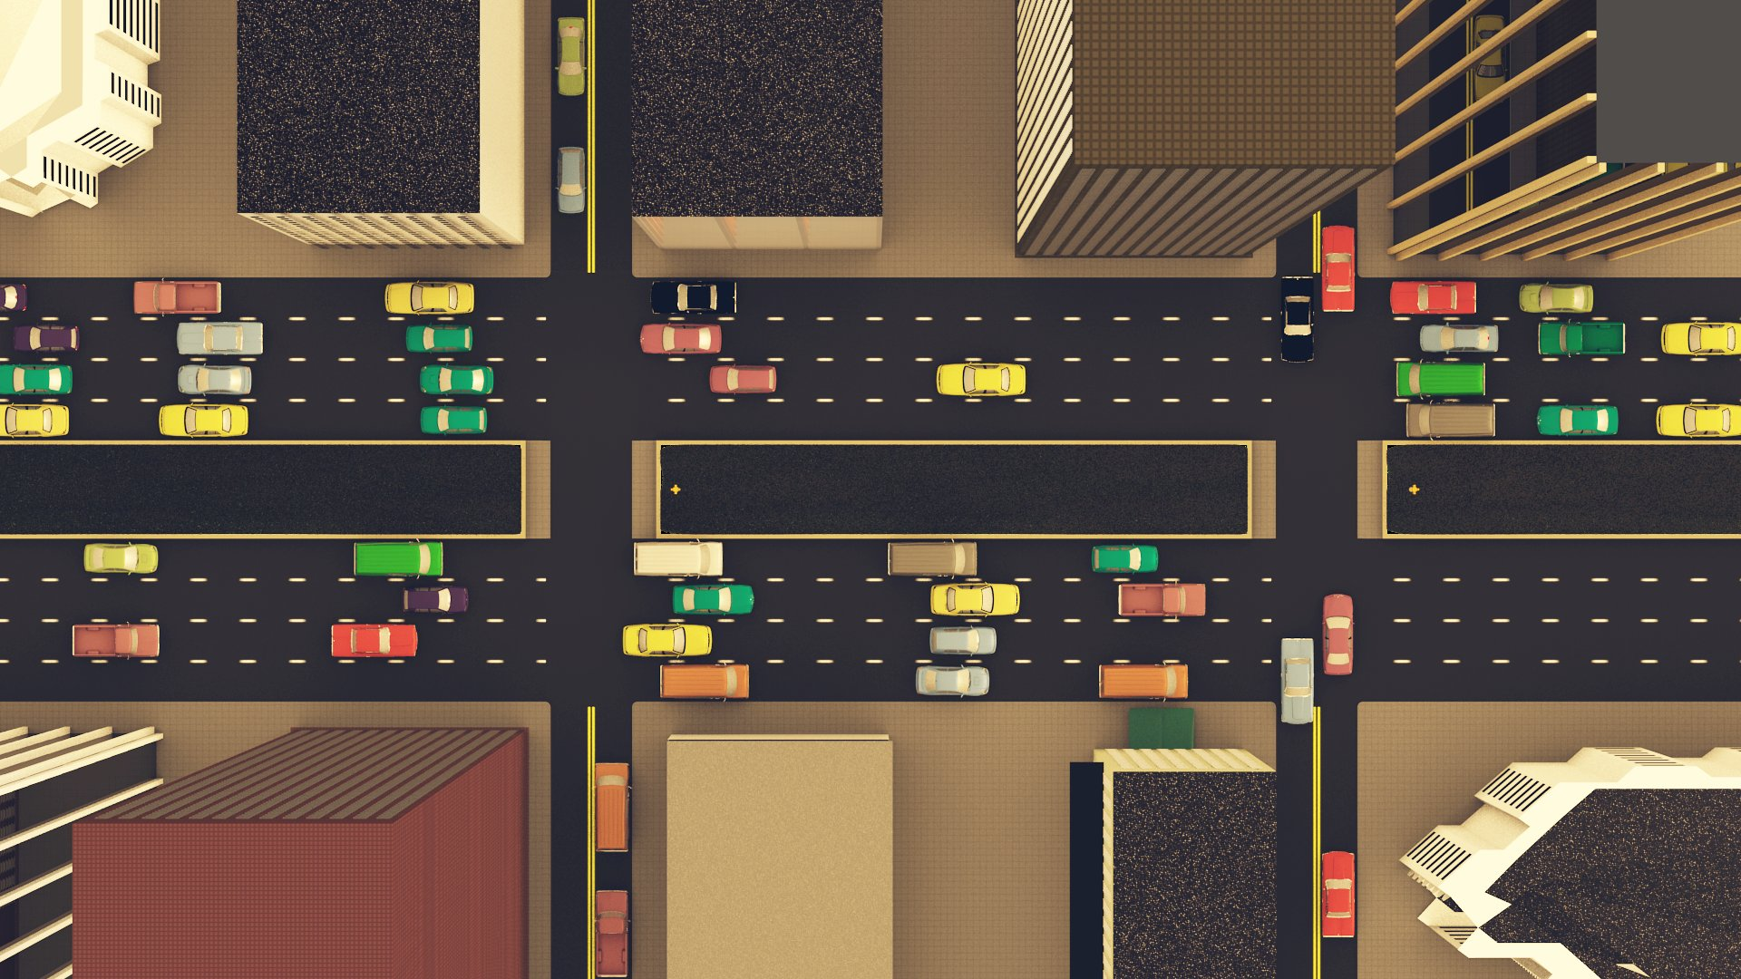
Why this helps
This view of circuits and traffics helps to better understand how the circuit elements actually perform
It also helps to see a simpler concept of traffic flow, which can be useful in designing road structures

Slide 7
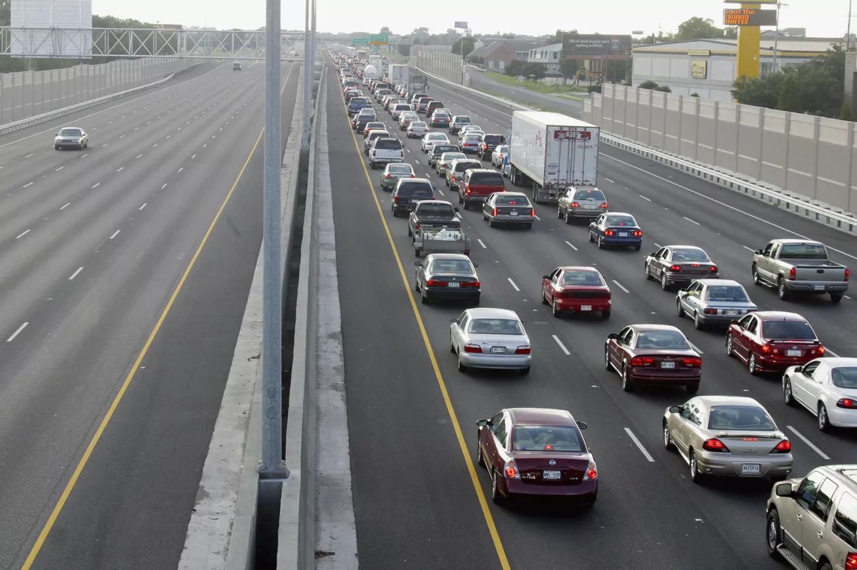
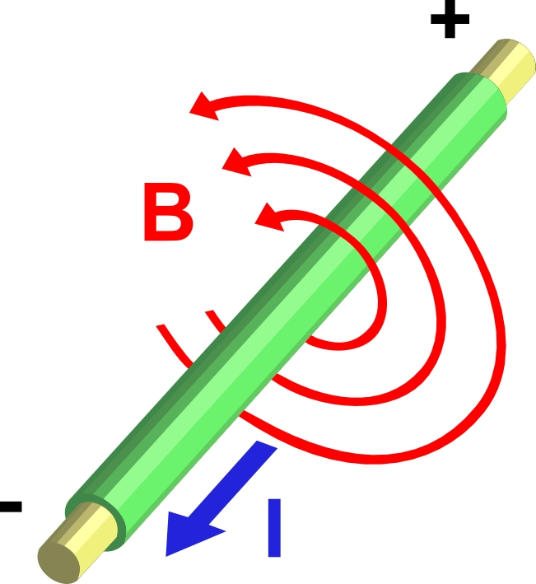
Why this doesn't help
This analogy falls apart when considering the human errors in the roadways, causing traffic where there is no real reason.
It also falls apart when more advanced concepts such as magnetic fields are introduced.

Slide 8
Sources
"Resistance and Ohm Law." Petervaldivia. N.p., n.d. Web. 14 Nov. 2016.
"Electricity Analogy - FrugalPhysics." Electricity Analogy - FrugalPhysics. N.p., n.d. Web. 14 Nov. 2016.

