Slide 1


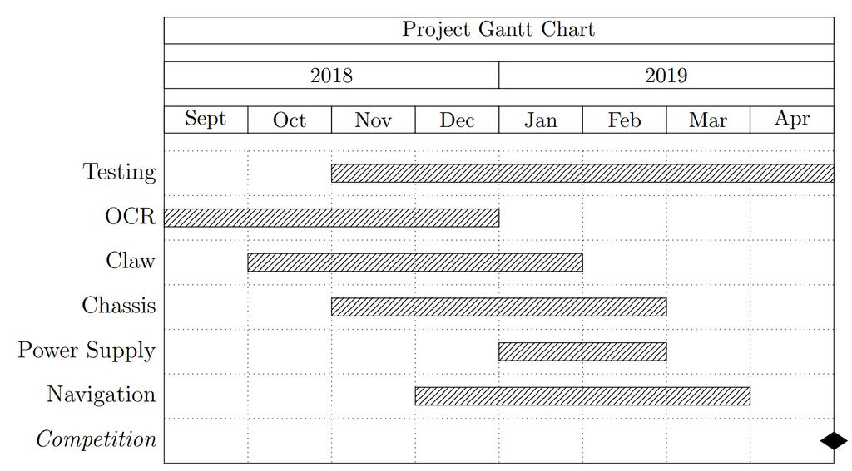
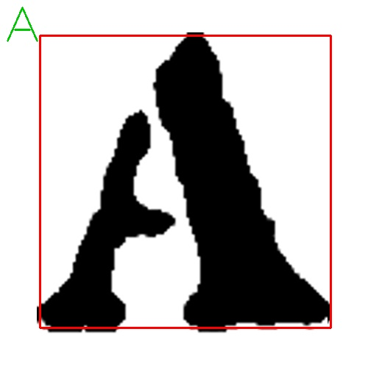
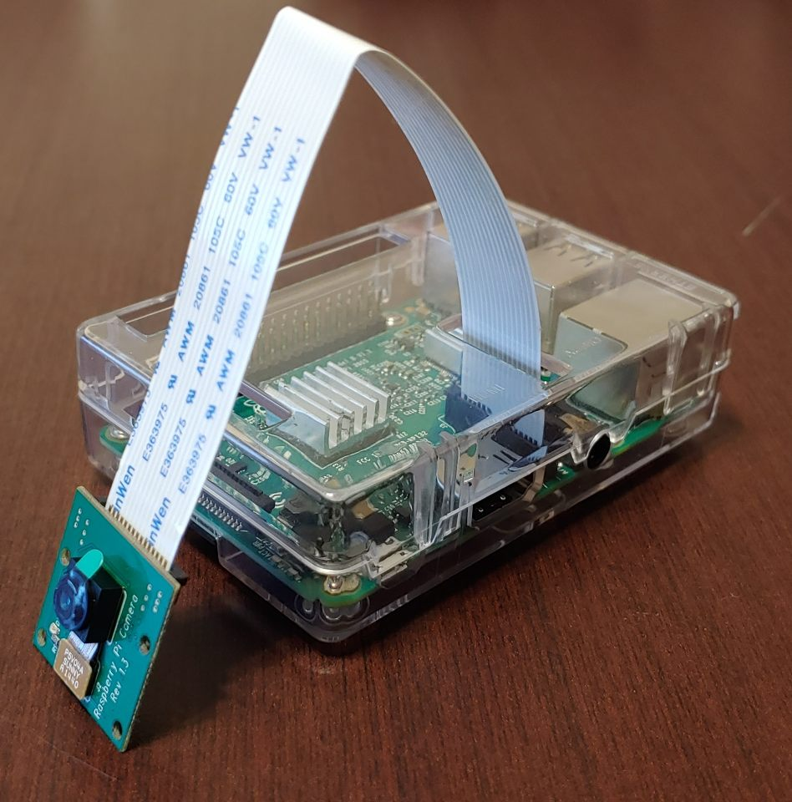
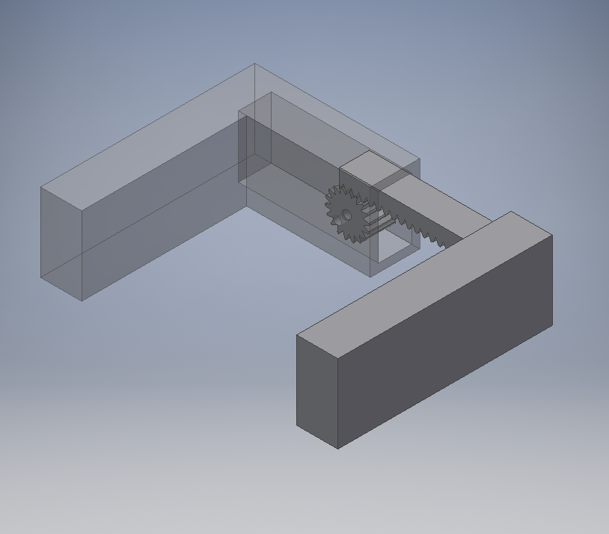


IEEE REGION 5 ROBOTICS COMPETITION
Charlie Coleman, Amy Guo, Heli Wang, Roobik Gharabagi Ph. D & Kyle Mitchell Ph. D
Saint Louis University
BACKGROUND
RESULTS
Institute of Electrical and Electronics Engineers (IEEE)
Region 5 Student Robotics Competition
  Sponsored by the Region 5 IEEE Committee.
  Region 5 includes over 90 students branches in the central United States.
    OCR has been achieved with good success using the OpenCV and Tesseract libraries. While the letters cannot be identified if they are more than around 20 degrees from their correct orientation, we can fix this problem by rotating the images by values less than 20 degrees and testing at each points. Once we implemented this in the detection code, the only remaining problems are with C & D. When C is upside down it is identified as a D, and vice versa for D. We have yet to find a solution to this problem. Overall, the OCR works as intended in the vast majority of situations, and it should provide a good basis for our design.
OBJECTIVE
Design a fully autonomous robot
  Sort cubes into slots with matching letters
  Pick up cubes, identify letters, navigate to mothership
  Drop cube in the correct slot
  Avoid obstacles placed pseudo-randomly throughout the competition board
  Return to starting location when all cubes have been put into their slots
  Achieve in the least amount of time possible
METHODS
OCR for Cube Character Recognition
Use image manipulation & OCR libraries such as OpenCV and Tesseract OCR OCR fails if letter is more than ~20 degrees off axis, so rotate image until successful
Utilize provided JSON file to navigate field
Exact cube position is unknown, so explore square until cube is found
Movement is done using a simple 4-wheeled chassis design
Use shape recognition to find obstacles
Obstacles are circularly symmetrical
Figure 3. Output of the OCR code highlights the shape then returns the character
REFERENCES
Robert Shapiro, IEEE Region 5 Website, 2018, http://ieeer5.org/.
IEEE Region 5 Robotics Competition, 2018, http://r5conferences.org/competitions/roboticscompetition/.
Kaehler, Adrian, and Gary R. Bradski. Learning OpenCV 3: Computer Vision in C++ with the OpenCV Library. 1st ed., vol. 1 1, O'Reilly Media, 2017.
MATERIALS
Raspberry Pi Model 3
Raspberry Pi Camera Module
Custom Claw - 3D printed (Coleman)
Chassis - Vex (Guo)
Battery (Wang)
Voltage Regulator (Wang)
Replica competition board, mothership, etc..
ACKNOWLEGEMENTS
Figure 1. 3D rendering of claw design using Autodesk Inventor
Figure 2. Raspberry Pi Model 3 connected to camera module
We would like to thank the Institute of Electrical and Electronics Engineers for sponsoring the competition and Saint Louis University for funding our project.

