Slide 1


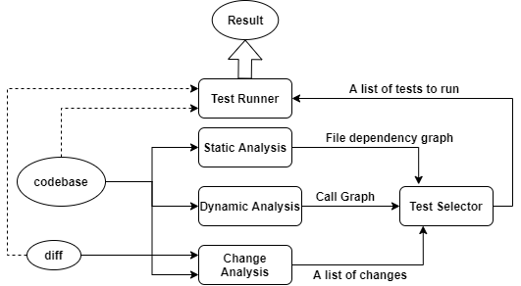
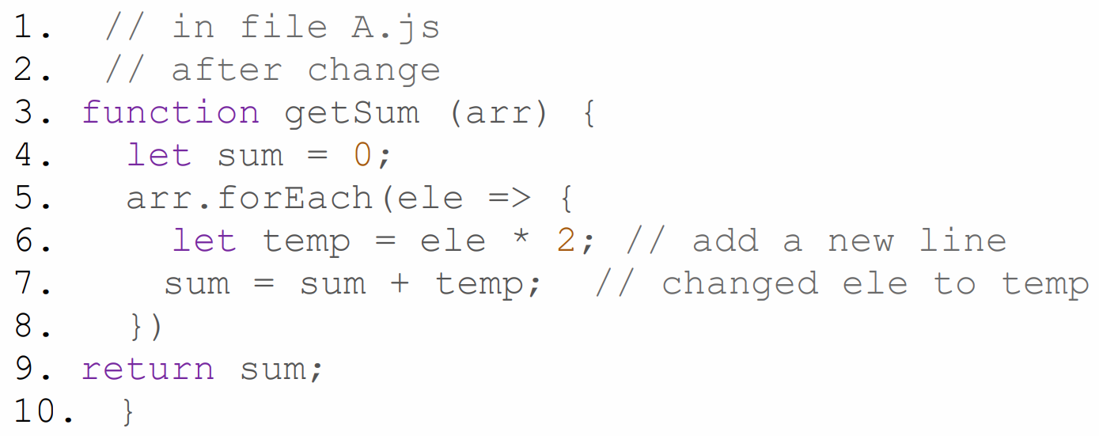
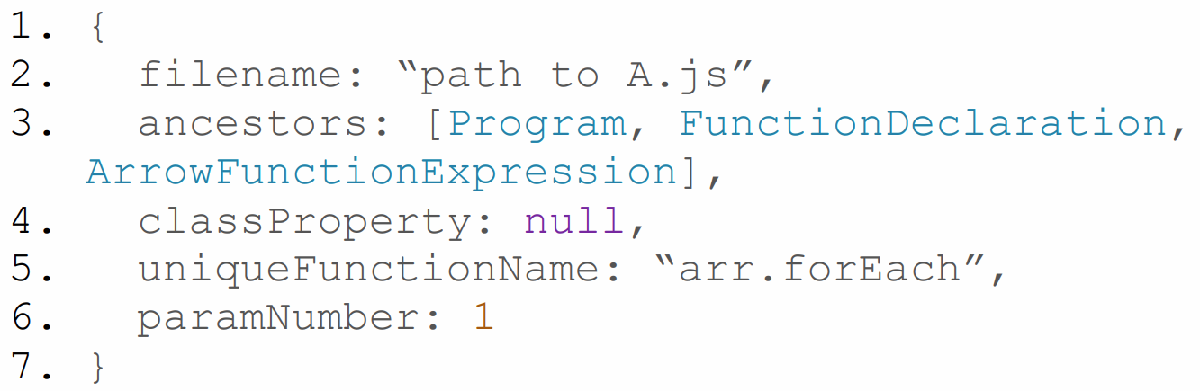
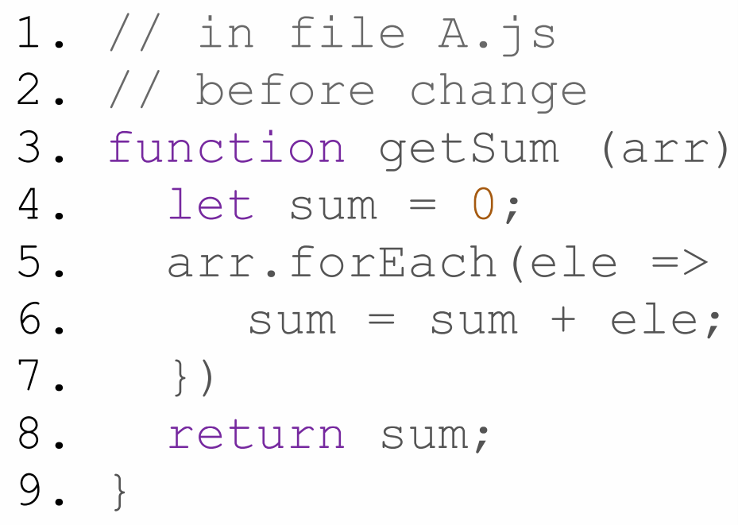
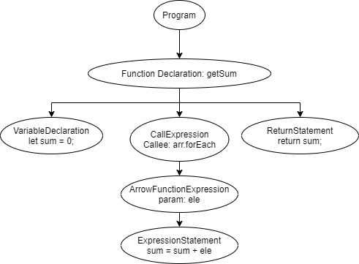

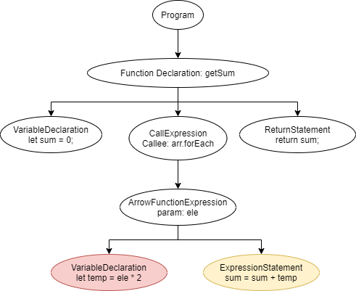

NodeSRT: A Selective Regression Testing Tool for Node.js Application
Yufeng Chen
University of British Columbia
yufengcy@student.ubc.ca
Motivation
As software systems mature, the cost of running their entire regression test suite can become significant.
Selective Regression Testing (SRT) is a technique that executes only a subset of tests the regression test suite can detect software failures more efficiently.
Previous SRT studies mainly focused on standard desktop applications. Node.js applications are considered heard to perform test reduction because of Node’s asynchronous, event-driven programming model and JavaScript is a dynamic pl.
We present NodeSRT, a Selective Regression Testing framework for Node.js applications.
Approach Overview
Our intuition for reducing the total running time is to improve the granularity of the selection technique to improve precision so that fewer tests are required to run when the regression suite is executed.
Empirical Evaluation
Experiment subject: Uppy (112k lines of code, 216 unit tests, 20% of code coverage) and Simorgh (698k lines of code, 2801 unit tests, 97% of code coverage)
We performed test selection on a total of 588 commits from the two subjects. For each commit, we generate a diff patch from the previous commit to serving as input to NodeSRT.
NodeSRT selection step for both projects is less than 5% of total running time
Comparing to Jest, NodeSRT selects 1.5 times fewer tests in Uppy, 5.3 times fewer tests in Simorgh
Although NodeSRT selects less tests in Uppy, Jest OnlyChange runs faster than NodeSRT. This is because Jest OnlyChange makes use of Jest’s own jest-haste map module and customized file system module: watchman. Future works can be done for NodeSRT in this part. For project with high code coverage: Simorgh, NodeSRT selected fewer tests and runs 2.7 times faster
Selective Regression Testing
Test Selection Granularity
File-level: builds a relationship between tests and files in the system and selects tests that reflect changed files.
Method-level: builds a relationship between tests and methods.
Two Phases in Selective Regression Test
Test Selection phase: select tests based on dependency graph and changes
Test running phase: execute selected tests
SRT technique metrics
Inclusiveness: the extend to which SRT technique chooses tests that are affected by the change
Precision: the ability that the SRT technique omits tests that are not affected by the change
Efficiency: the time and space complexity
Generality: ability to function in a comprehensive and practical range of situation
* We say a selection technique is safe if it achieves 100% inclusiveness
Comparison on Selected Test running time
Project Name | Total Round | Retest all time (s) | Avg. Selection time (ms) | Avg. NodeSRT selected test number | Avg. Jest selected test number | Avg. NodeSRT total running time | Avg. Jest total running time
Uppy | 480 | 69.3 | 490 | 8.4 % | 20.7 % | 50.2 % | 23.6 %
Simorgh | 108 | 450.7 | 2256 | 2.7 % | 17.2 % | 8.1 % | 30.2 %
Fig. 1. NodeSRT Architecture
Change Analysis Module
Empirical Study Result
Changed functions and their ancestors
Generate a “Unique Function Name” if it’s anonymous function
Jest OnlyChange
Current industry-standard SRT technique for Node.js application
Test selection at File-level
Static file dependency analysis with jest-haste-map module
Fast, light-weighted, but not precise enough
Changed file + diff
Links:
Preprint: https://arxiv.org/abs/2104.00142
NodeSRT: https://github.com/charlie-cyf/nodeSRT
Uppy: https://github.com/transloadit/uppy
Simorgh: https://github.com/bbc/simorgh
AST before after change
pre-print

