Slide 1
IXIS Assessment
Charlie Gallagher

Slide 2
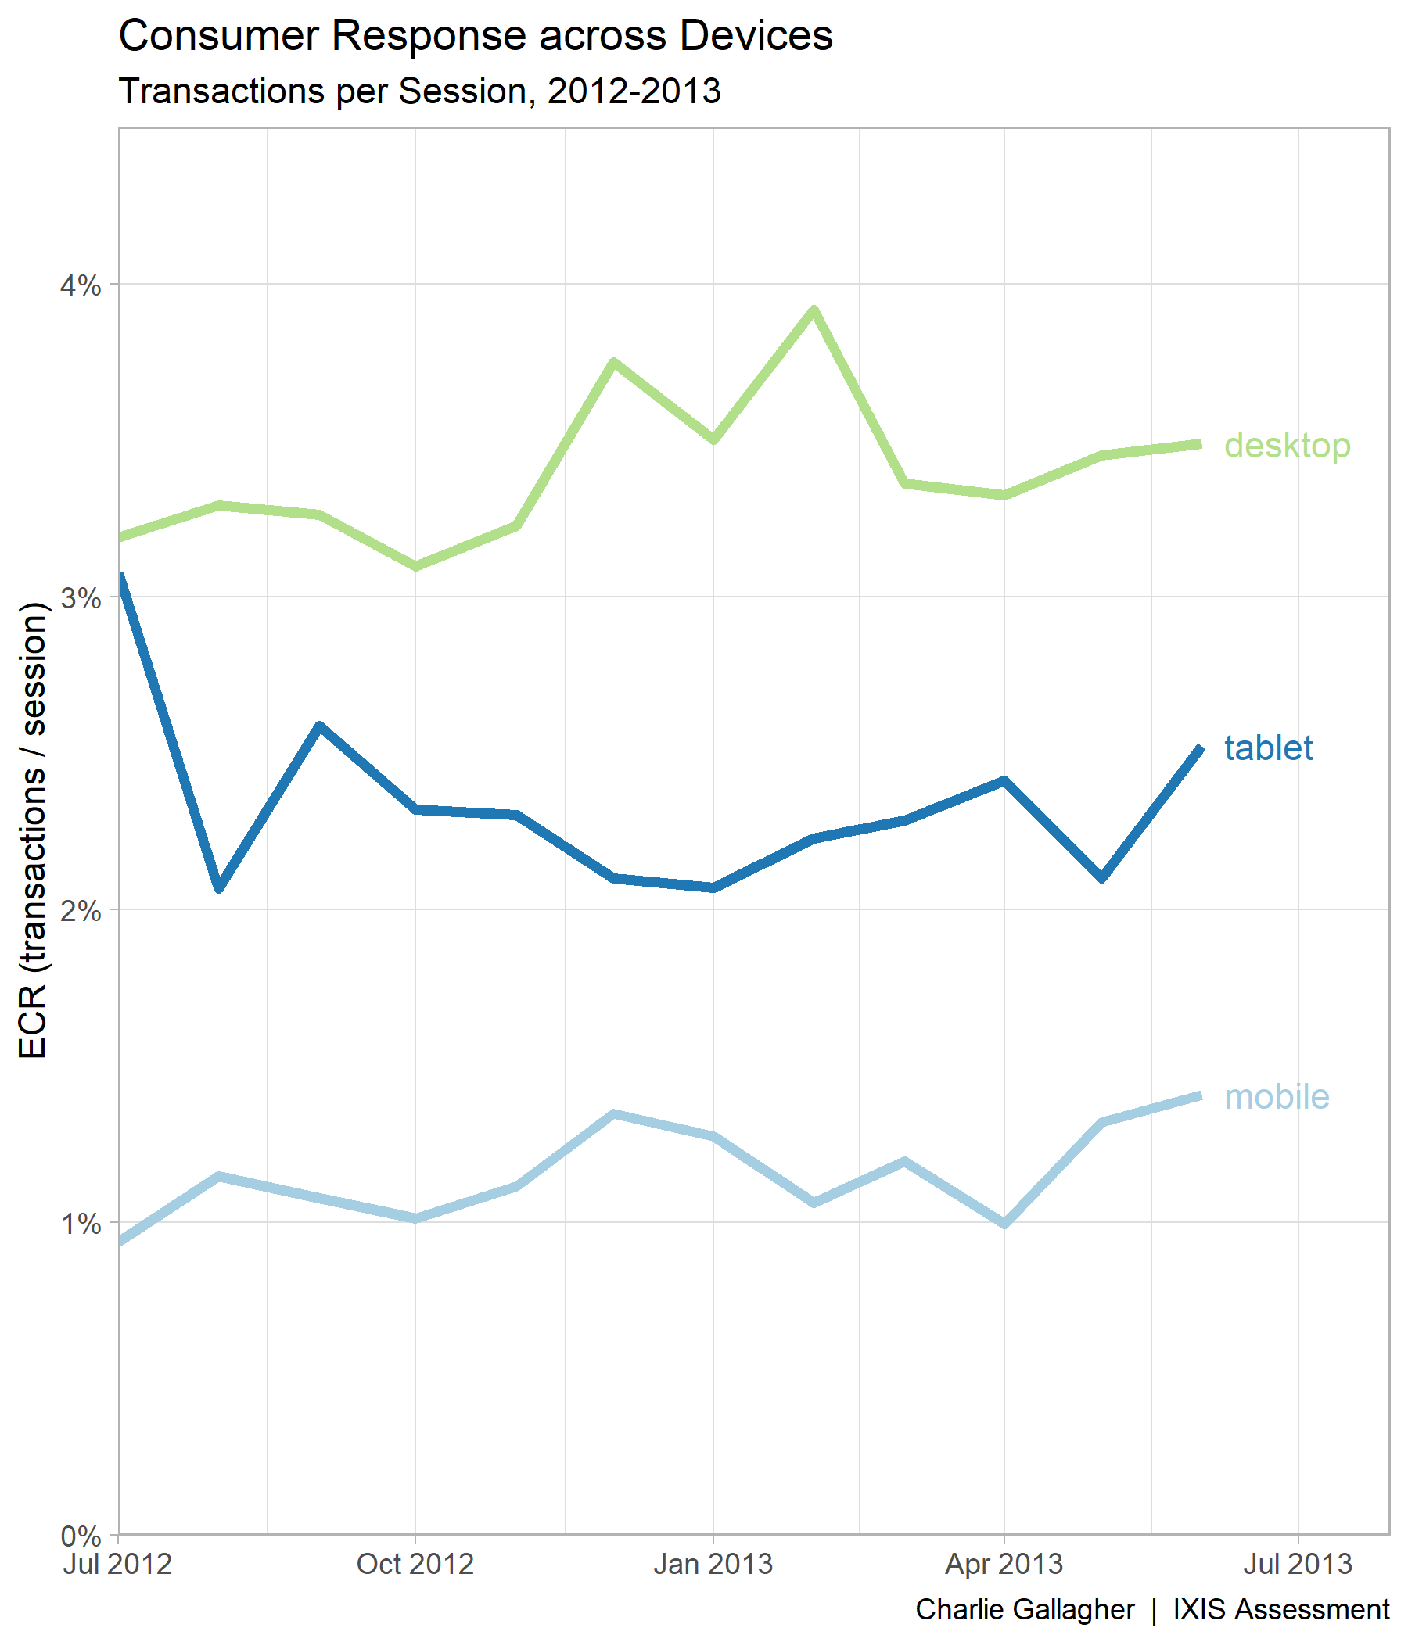
Transactions per Session
Users on desktops are more likely to make transactions than either tablet or mobile users.

Slide 3
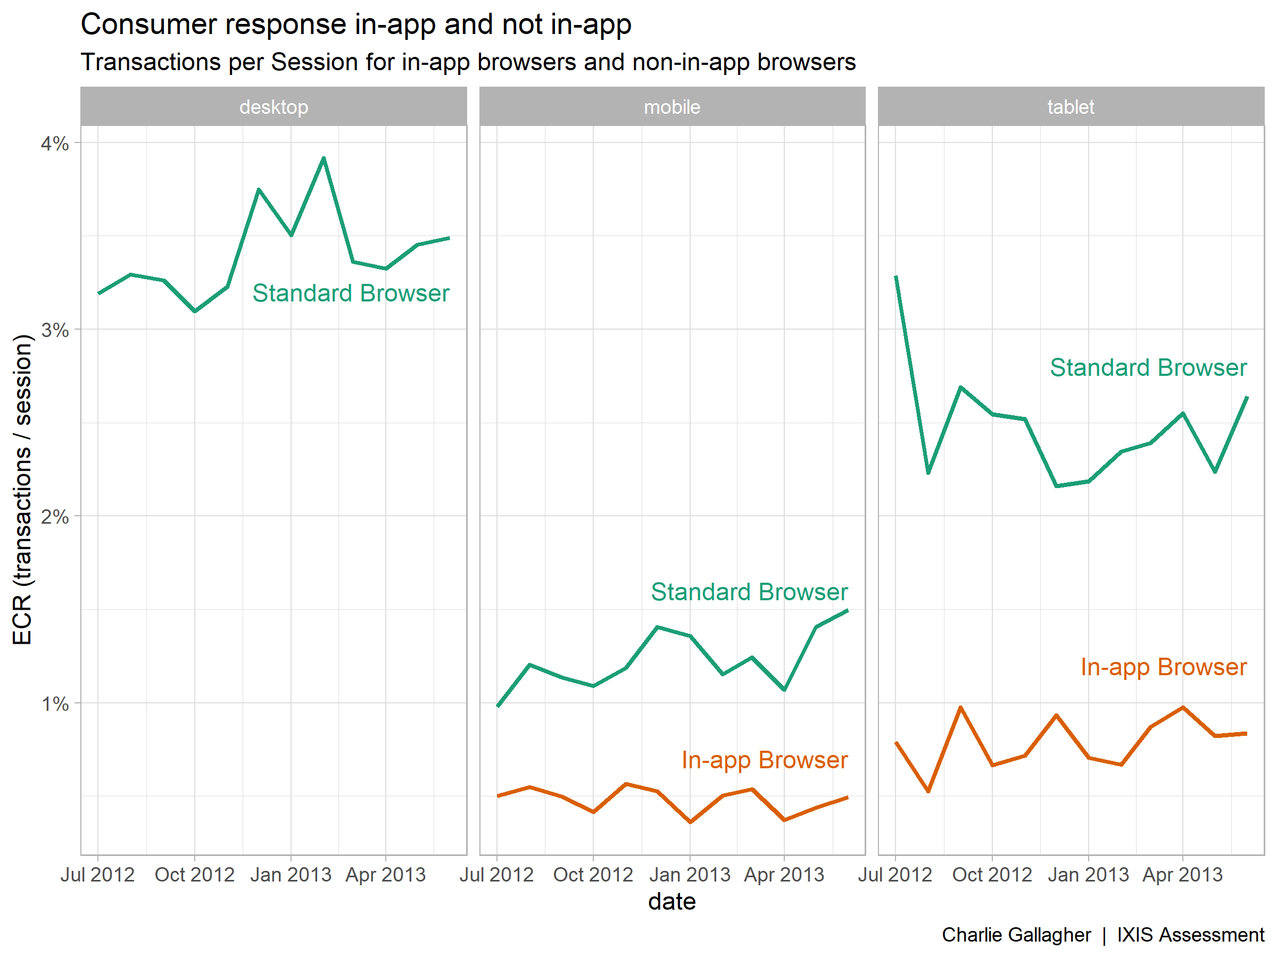
In-app Transactions
When users access the site through an app like Twitter or Instagram, they use an in-app browser.
Customers using in-app browsers have significantly lower transaction rates, especially among tablet users.
Ads targeting apps should be reduced in favor of standard browser targeting.
In-app sessions make up
9% of mobile sessions
8% of tablet sessions
Note

Slide 4
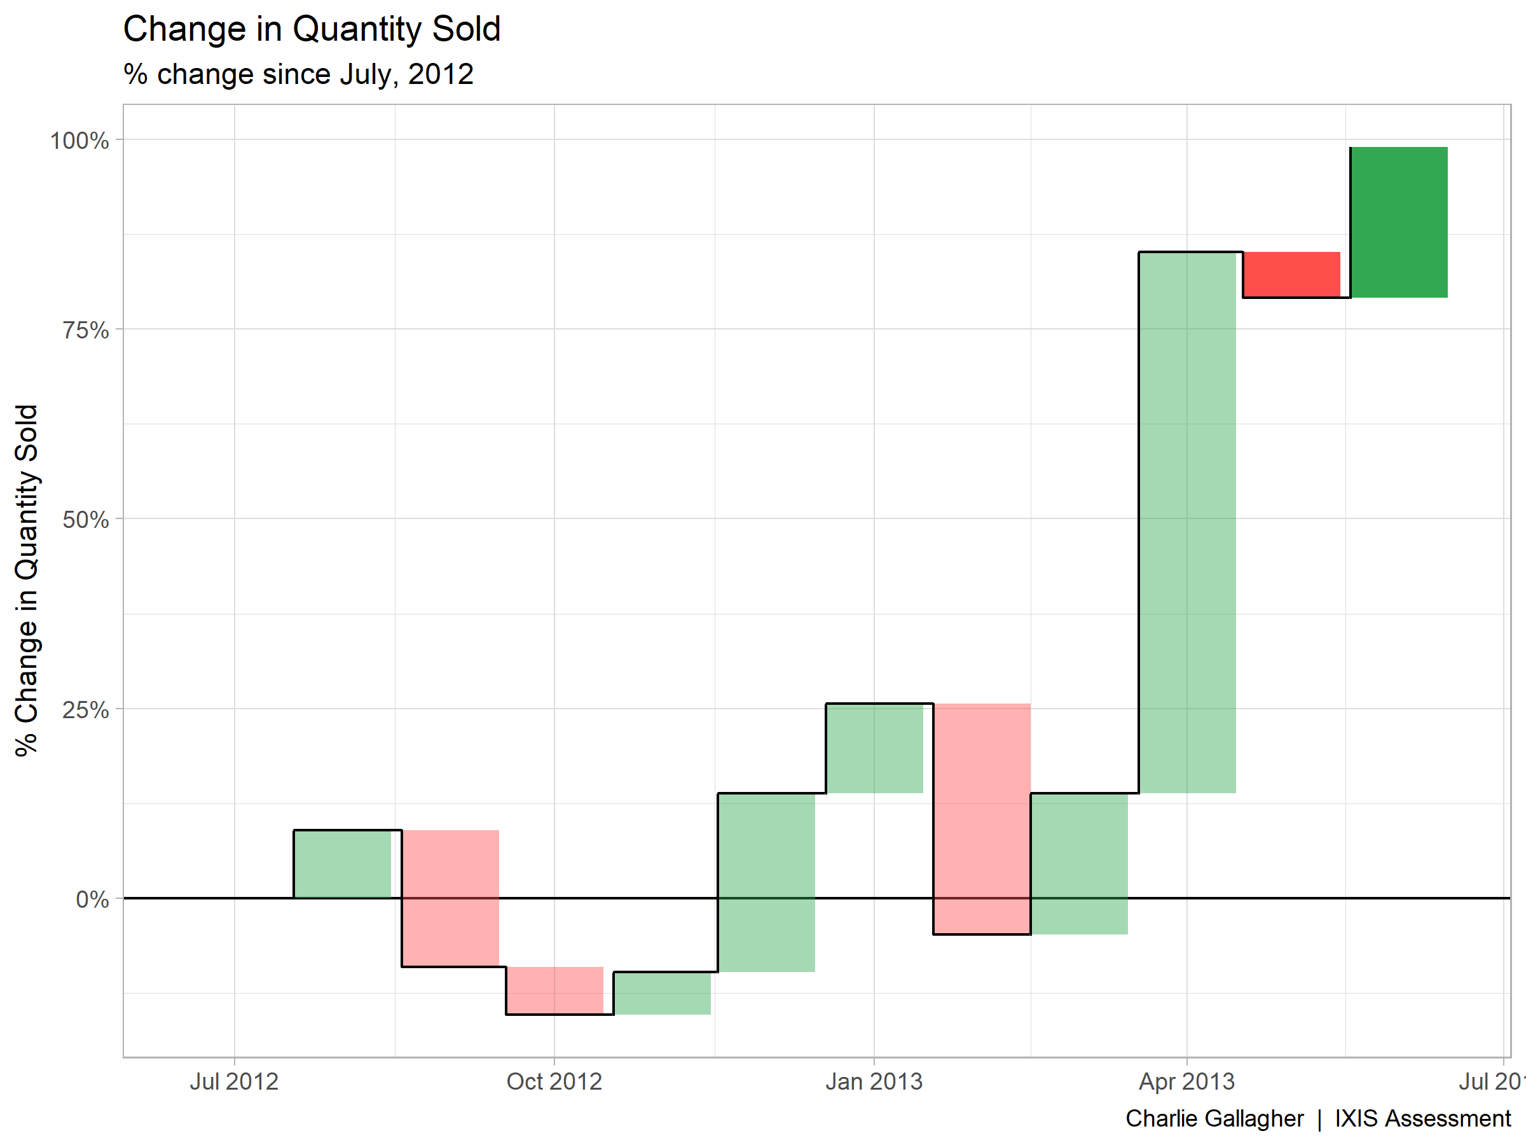
Recent Sales Growth
Sales are up nearly 100% since July 2012 and around 20% since last month
Most of the growth occurred in 2013
Last two
months

