Slide 1
Data Analyst Practical Exam
Pens and Printers -
New Products Sales Performance
Notes:
Hello, I will present the results from my analysis of the performance of Pens and Printers' sales methods.
We will be looking at their performance over the first 6 weeks after the launch of Pens and Printers' new products.

Slide 2
Project Overview
New Products launched by Pens and Printers
Sales Methods used during first 6 weeks since launch:
Email sent at launch; minimal team effort.
Call: 30-minute calls per customer; labour-intensive.
Email + Call: email + 10-min follow-up call 1 week later
Notes:
- Let us quickly remind everyone that there have been 3 different sales methods over these first 6 weeks.
- The first consisted in sending out an email at the launch of the new products and sending out a follow-up email 3 weeks later. This required minimal effort from the sales team.
- The second consisted in a call to the customer. This was usually a 30-minute call per customer which is rather labour-intensive
- The third method was a combined approach where an email was sent with a follow-up call a week later that generally lasted around 10 minutes.

Slide 3
Business Goals
How many customers were there for each approach?
What does the spread of the revenue look like overall? And for each method?
Was there any difference in revenue over time for each of the methods?
Which method would I recommend we continue to use? Some of these methods take more time from the team so they may not be the best for us to use if the results are similar.
Notes:
- Our goals here are to:
- understand how many customers there were for each approach,
- check the spread of the revenue, both overall and for each sales method
- find out if there are any differences in revenue over time for each of the methods
- and most importantly, to determine which methods the sales team should continue to use.

Slide 4
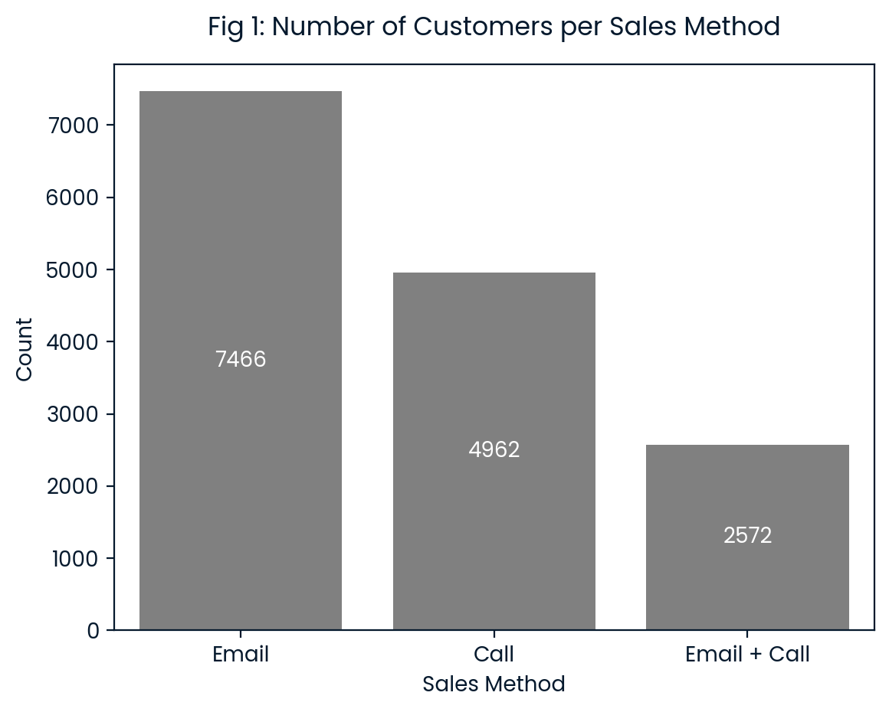
How many customers were there for each approach?
How many customers were there for each approach?
Notes:
- We see here our answer to our first question: How many customers were there for each approach?
- The Email method acquired the most customers—over 7,400—while Email + Call reached the fewest, around 2,500.

Slide 5
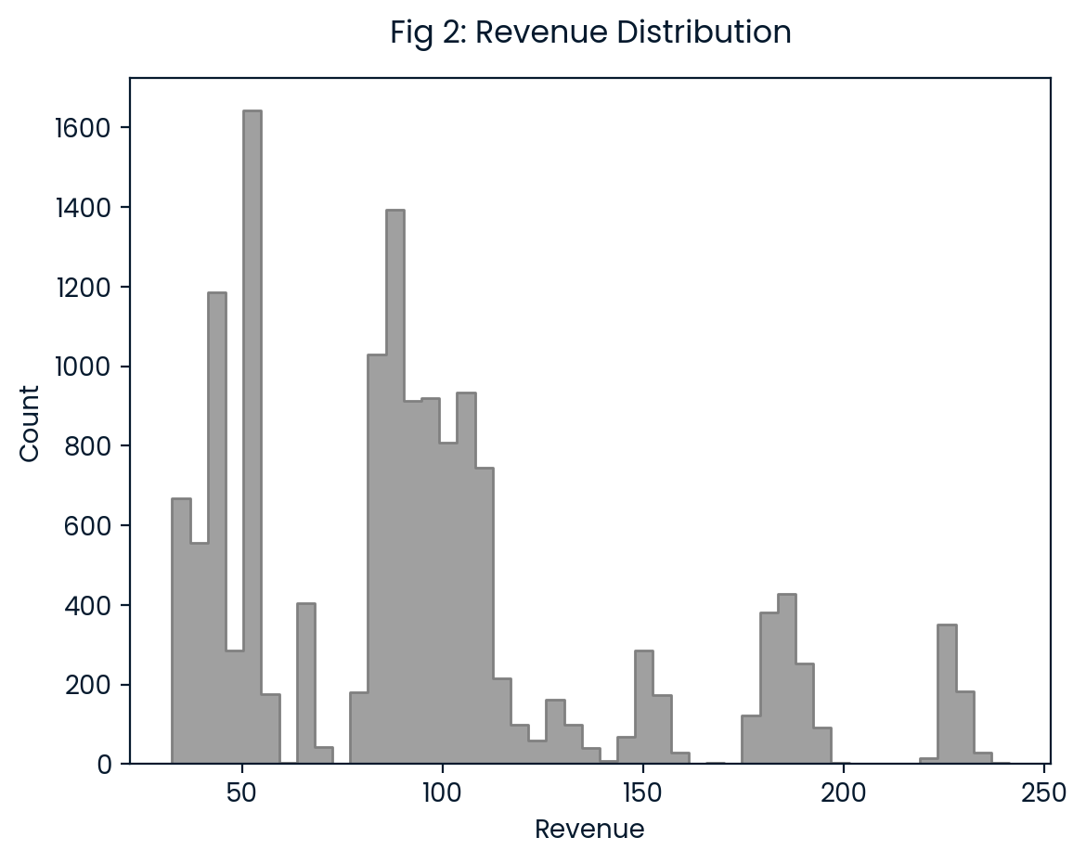
What does the spread of the revenue look like overall?
Overall Distribution of revenue
Multimodal
Min: 32.54
Max: 241.20
Notes:
2nd Question: What does the spread of the revenue look like overall?
- Here we see the overall distribution of revenue across the 3 methods and the 6 weeks
- It ranges from about 32 to just over 241 and is multimodal or it has several peaks.

Slide 6
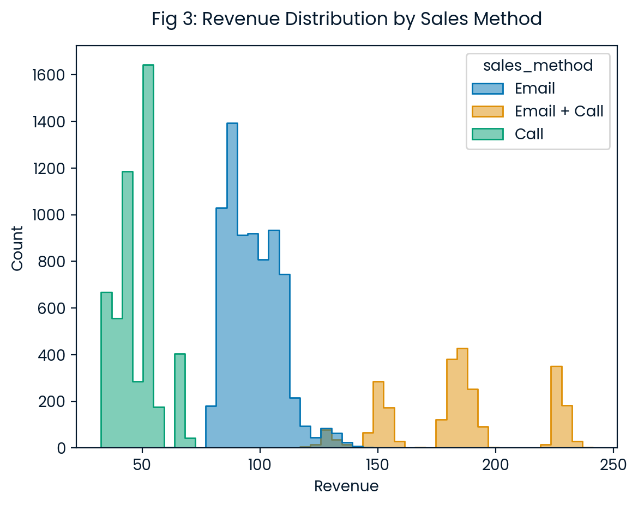
What does the spread of the revenue look like for each method?
What does the spread of the revenue look like for each method?
Email + Call: Higher revenue range.
Call: Lower revenue range
Notes:
Here we see the revenue distribution for each method
This histogram shows that the combined method of Email + Call consistently yields the highest revenues per sale, while the Call method is at the lower end.

Slide 7
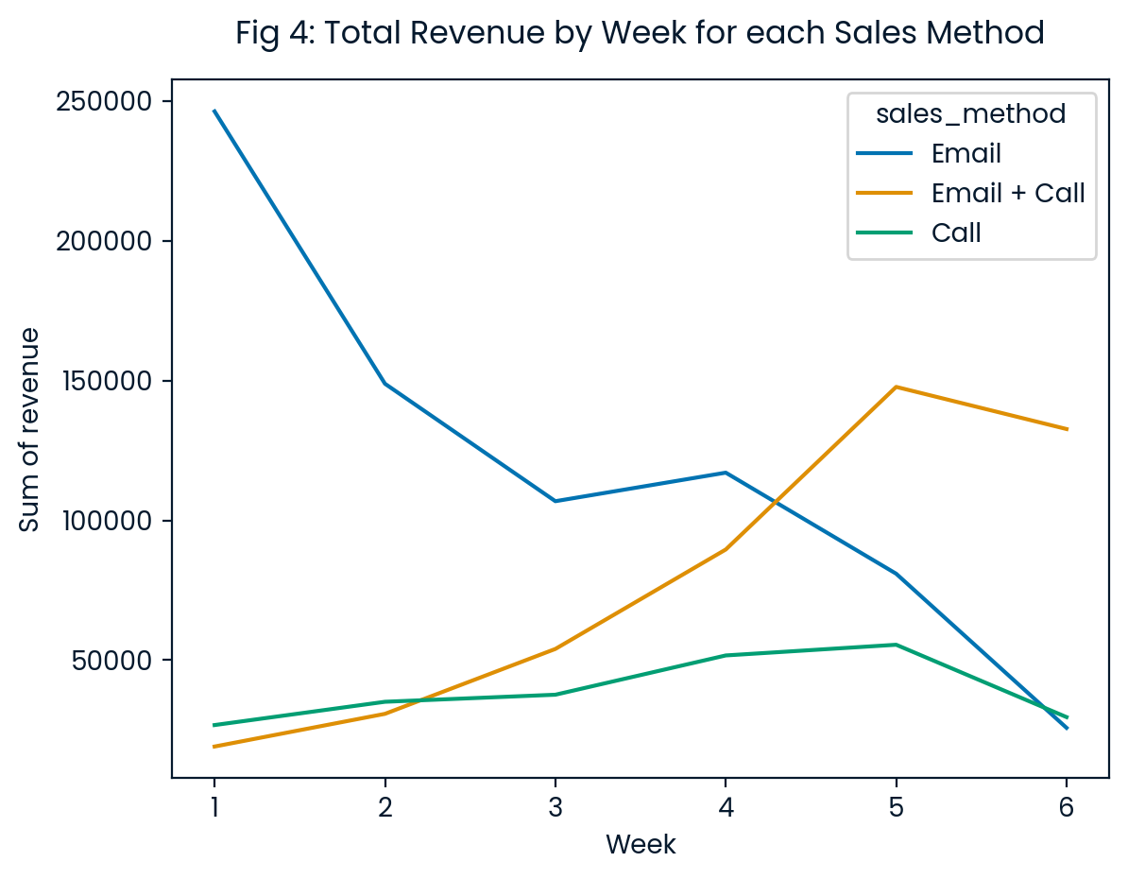
Was there any difference in revenue over time for each of the methods?
Total revenue
Notes:
- How has revenue evolved over time for each method?
- Here we look at total revenue.
- Over the 6 weeks, the Email method started very strong in week 1 but faded thereafter, with a slight boost, most likely from follow-up emails, in Week 4.
- The Call method had the lowest total revenue over the full 6 weeks.
- The combined Email + Call method steadily grew in impact, peaking in Week 5.

Slide 8
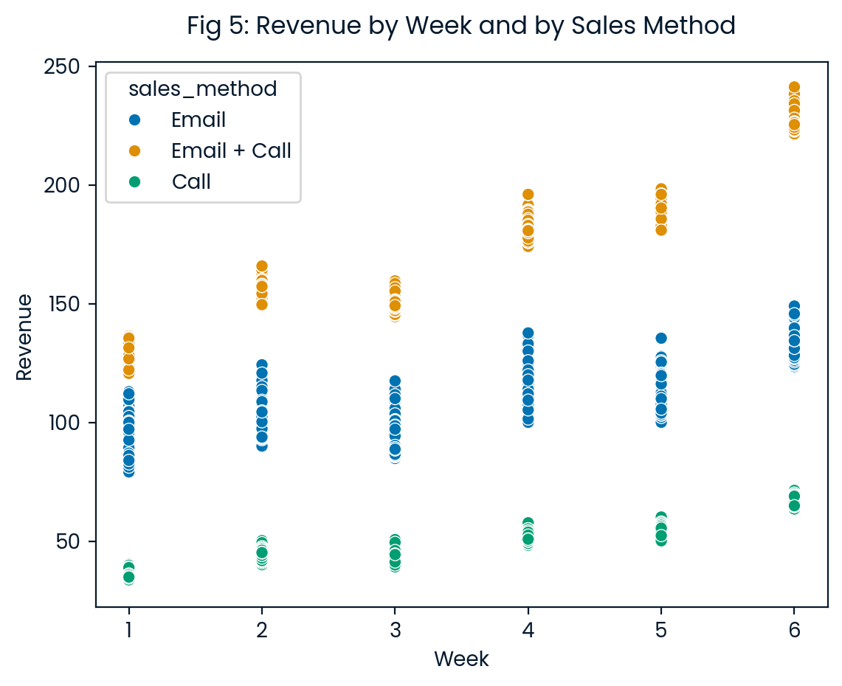
Was there any difference in revenue over time for each of the methods?
Revenue per customer
Notes:
Let’s now look at the evolution of revenue per customer
While the average revenue generally increased for all 3 methods over the 6 weeks, it is mainly due to the number of new products sold per customer increasing

Slide 9
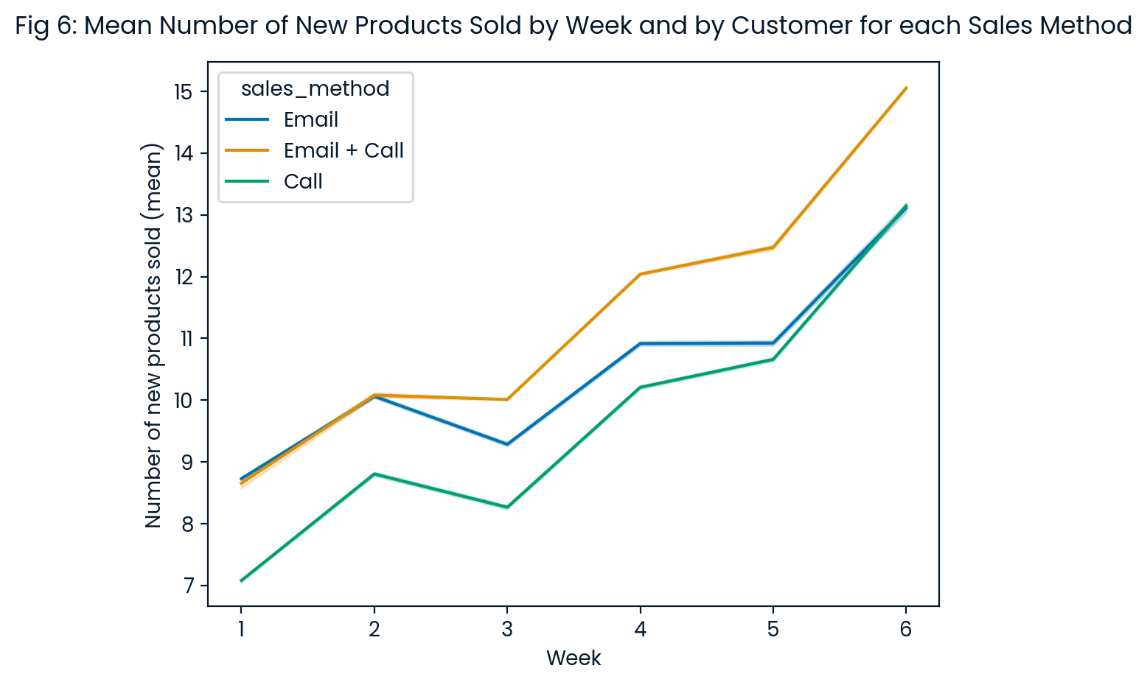
Was there any difference in revenue over time for each of the methods?
Average number of new products sold per customer
Notes:
as seen here.

Slide 10
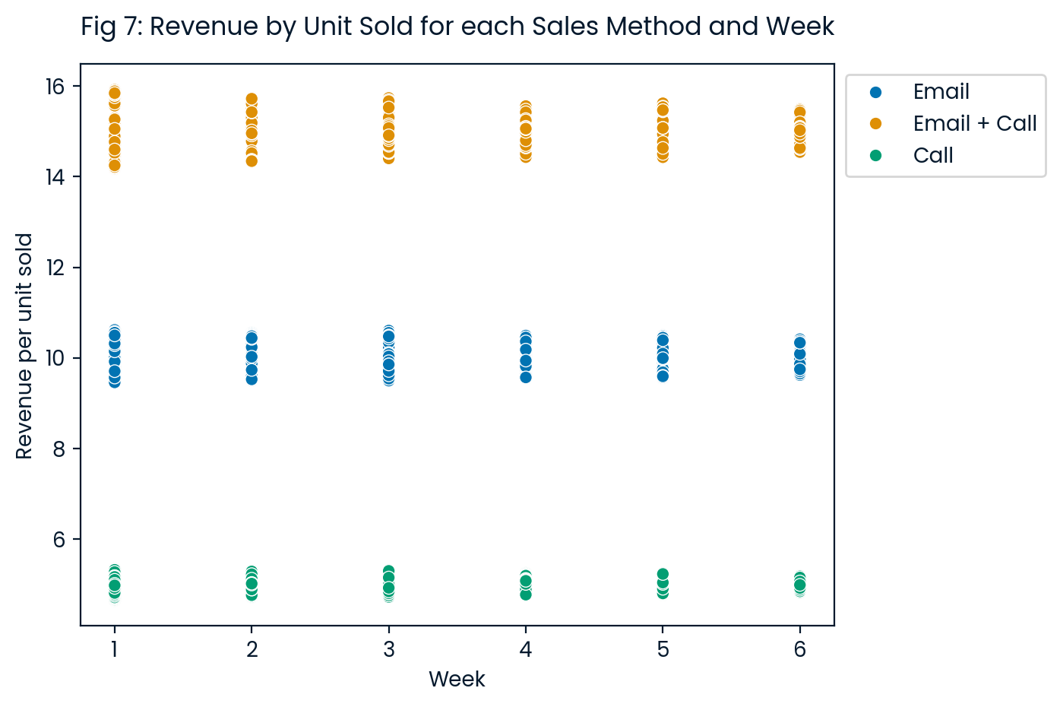
Was there any difference in revenue over time for each of the methods?
Revenue per unit sold
Notes:
For if we divide the revenue per customer by the number of new products sold per customer, we get the revenue per unit sold for which, as we can see here, the mean remained fairly steady over the 6 weeks for all three sales methods.

Slide 11
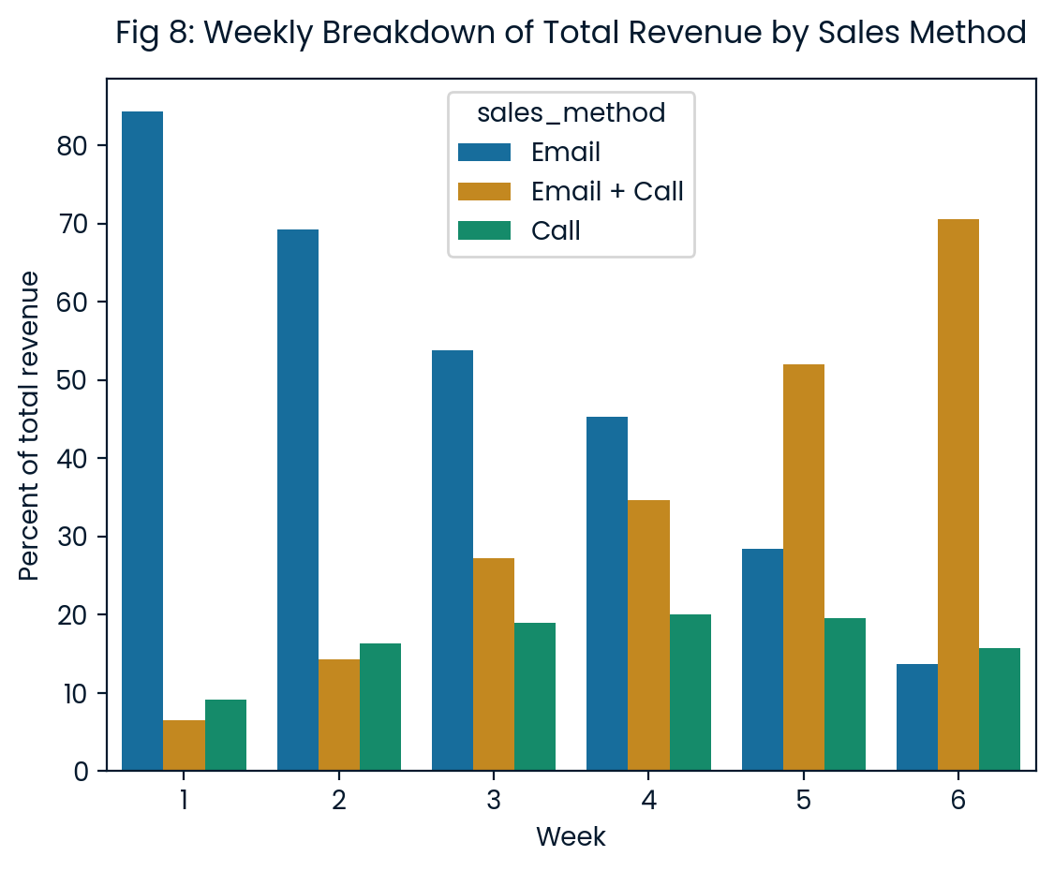
Key Findings
Business Metrics:
Percentage of total revenue by week.
Ignores the variations in total revenue and focuses on the combined strengths of each method:
Number of customers
Revenue per customer
Notes:
- Since our goal is to understand which combination of sales methods is best and how they evolve over time, I would recommend we use the percentage of total revenue by week that each sales method represents as our metrics to assess the evolution of the perfomance of each sales method and thus its relevance going forwards.
- We see how this metric for each of the sales methods over the first 6 weeks after launch shows the complementary strengths over time of the Email and the Email + call methods.

Slide 12
Recommendations
Key Recommendations:
Drop Call: Low revenue and time-intensive.
Keep Email: Wide reach.
Keep Email + Call: High revenue per unit.
Improve data collection for deeper analysis.
Notes:
To optimize sales, I recommend dropping the Call method—it’s time-intensive and generates low revenue.
Focus on Email + Call for high returns and Email for reaching more customers.
Start collecting data on work time spent on each sale to a customer for a more in-depth analysis from a time and cost perspective

Slide 13
Thank you

