Slide 1
THE COST OF INNOVATION
Ashley Wyatt
Charlie Street
Darius Hente
Joe Faulls
Melvyn Mathews
Vlad Toncu

Slide 2


Slide 3

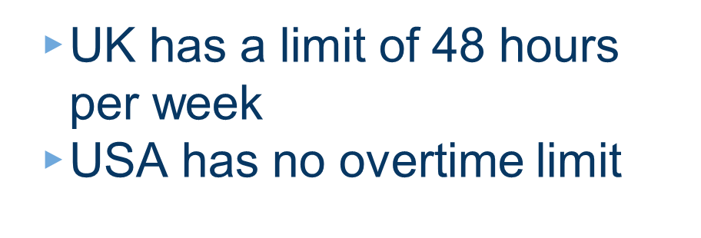


Slide 4

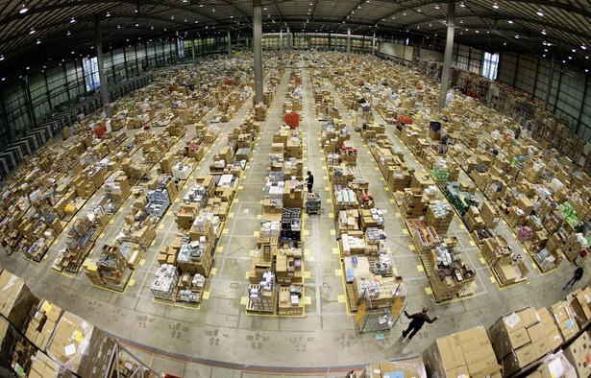


Slide 5
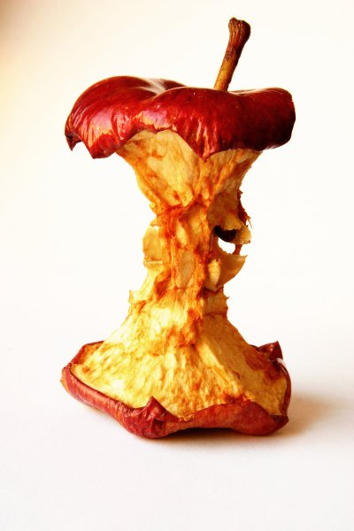
APPLE INC
Massive profit margins
Bad treatment of employees

Slide 6

Tian Fulei

Slide 7
“No more than 8 individuals shall occupy one dormitory sleeping room”
“All overtime must strictly be voluntary”
“We limit work weeks to 60 hours”
- Apple Inc

Slide 8

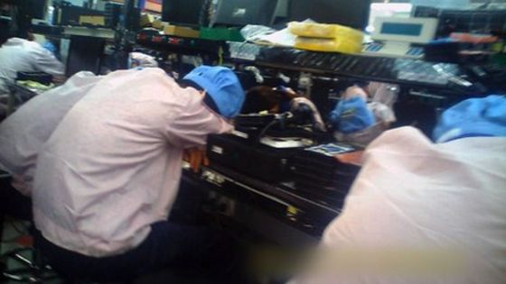

Slide 9
$50,000,000,000
Apple Inc’s revenue from the last quarter.

Slide 10


THE GAMES INDUSTRY

Slide 11
$15,400,000,000
155,000,000
48.6%
That’s a lot of money
And a lot of gamers
Nearly half!

Slide 12


Erin Hoffman

Slide 13

\CRUNCH
The period of time, usually before a game release, where working hours are increased.

Slide 14
“If they don’t like it, they can work some place else”
– EA 2004

Slide 15
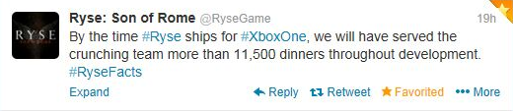

Slide 16


Slide 17
THE EXCITING WORLD OF START UPS
“Everyone else who works at a start up has the same drive and excitement for creation as you do.”
“The entrepreneurial spirit in a start up is contagious and if you don’t feel it or catch it then you’re actively avoiding it.”
Kerrin Sheldon
(Co-founder of Xeno Productions)

Slide 18
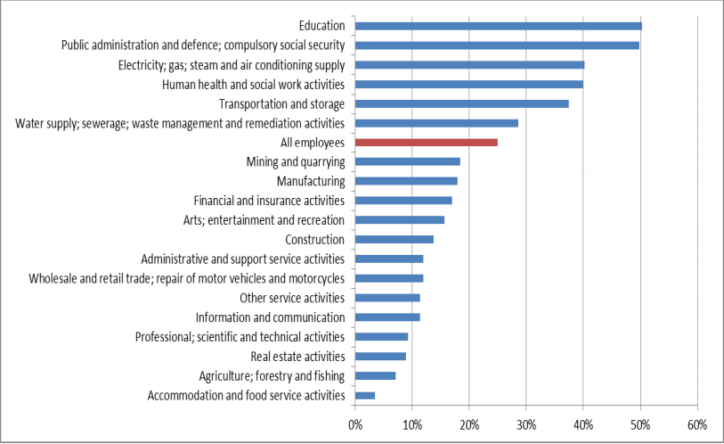
What can be done about it?
% workers in trade unions by sector

Slide 19

THANKS!
Any questions?

