Slide 1
平行計算HW5
電機110 楊信一 40675026H

Slide 2
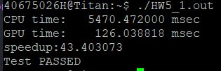

version1
one block
Matrix size:1024x1024

Slide 3
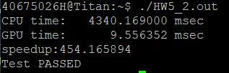

version2
Multiple blocks

Slide 4
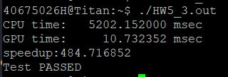
version3
+Tile algorithm

Slide 5
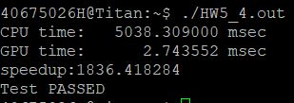
version4
+shared memory

Slide 6
result

