Slide 1
平行計算 期中報告
電機110 40675026h 楊信一

Slide 2
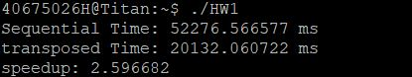
HW1
matrix size：2000x2000
對矩陣做轉置
結果：

Slide 3
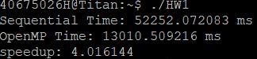
HW1
OpenMP平行化
結果：

Slide 4

HW1
轉置加OpenMP平行化
結果：

Slide 5
HW1
(ms)
(array size)

Slide 6
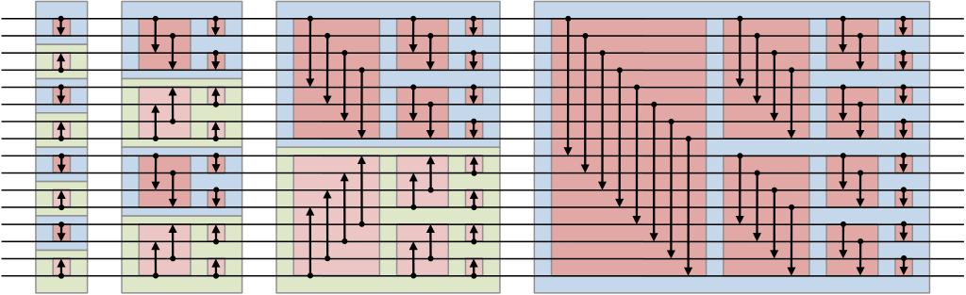
HW2 bitonic sort
時間複雜度 sequential：Θ( n log( n )²)
parallel：Θ( log( n )²)
排序過程：隨機序列 雙調序列 排序完成

Slide 7
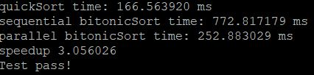

HW2
array size：1048576($2^{20}$)
平行方式：轉成雙調序列處使用OpenMP
對照quick sort( Θ( n log( n ) ) )
結果：

Slide 8
HW2
(ms)
(array size)

Slide 9






HW3 1D
Matrix size： ${10}^{7}$
one block, multiple threads
multiple blocks, each has one thread
multiple blocks , multiple threads

Slide 10





HW3 2D
Matrix size： ${10}^{7}$
one block with two dimensional threads
two dimensional blocks, each block has one thread
two dimensional blocks, each block has two dimensional threads

Slide 11
HW3 結果
1 dimension
2 dimension
1.OBMT | 2.MBOT | 3.MBMT
4.465120ms | 22.193377ms | 0.487008ms
4.OBMT | 5.MBOT | 6.MBMT
4.464192ms | 22.253153ms | 0.482560ms

Slide 12
Hw4
Kernel size不變
用HW3.3(multiple blocks with multiple threads)的方式加速

Slide 13
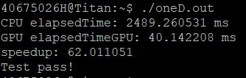

Hw4
1D convolution
(N)

Slide 14
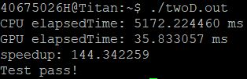
Hw4
2D convolution
(width1)

Slide 15
~END~

