Slide 1
GUDA Introduction
林政宏
國立台灣師範大學電機系

Slide 2
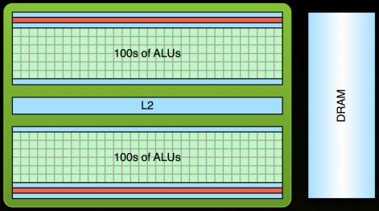
GPU Computing
GPU: Graphics Processing Unit
Traditionally used for real-time rendering
High computational density (100s of ALUs) and memory bandwidth (100+ GB/s)
Throughput processor: 1000s of concurrent threads to hide latency (vs. large fast caches)

Slide 3
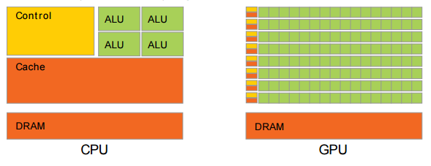
The GPU Devotes More Transistors to Data Processing

Slide 4
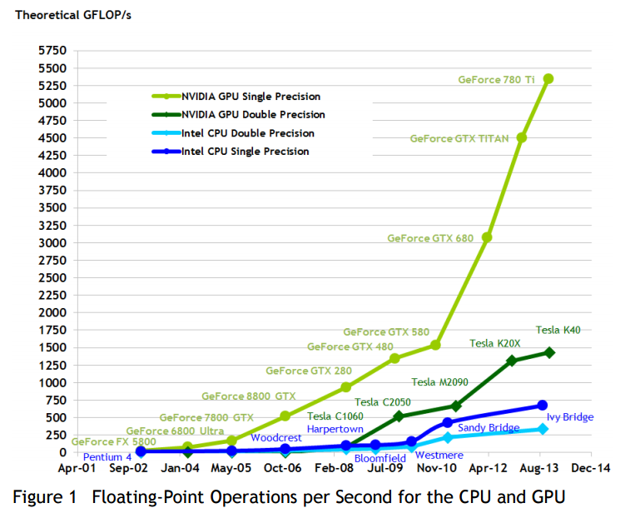
Floating-Point Operations per Second for the CPU and GPU

Slide 5
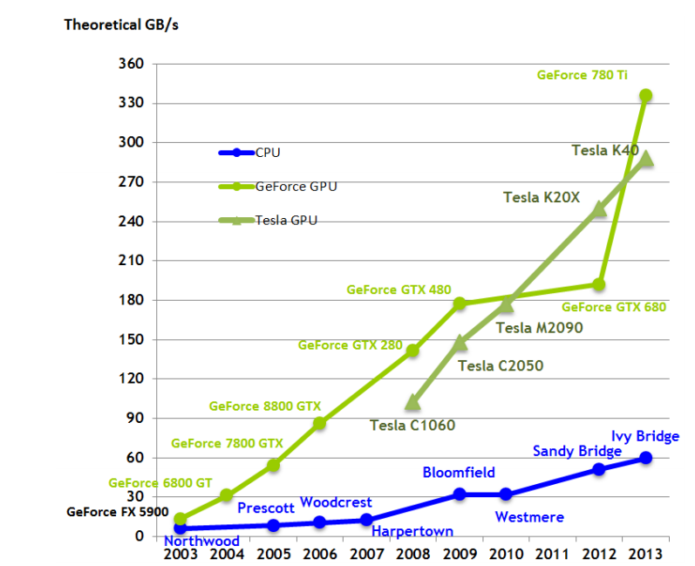
Memory Bandwidth for the CPU and GPU

Slide 6
CUDA ™: A General-Purpose Parallel Computing Platform and Programming Model
CUDA : Compute Unified Device Architecture
CUDA is a compiler and toolkit for programming NVIDIA GPUs
Enable heterogeneous computing and horsepower of GPUs
CUDA API extends the C/C++ programming language
Express SIMD parallelism
Give a high level abstraction from hardware

Slide 7
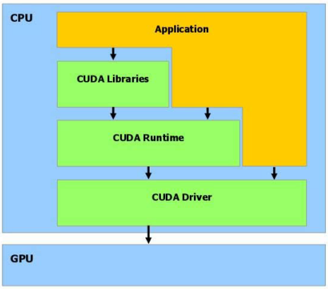
CUDA software stack
CUDA library
Programming language function API
CUDA runtime
High-level API
CUDA driver
Low-level API

Slide 8
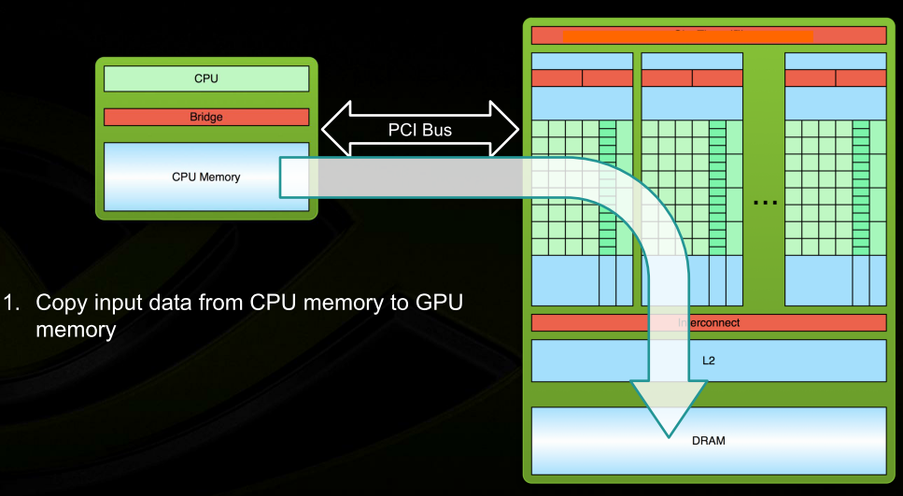
CUDA Program Flow

Slide 9
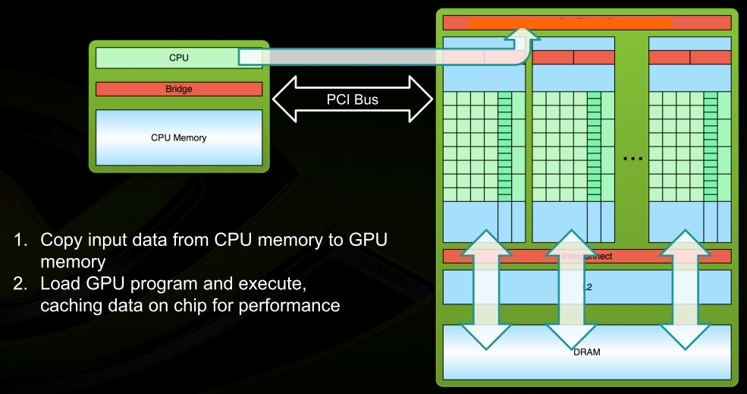
CUDA Program Flow

Slide 10
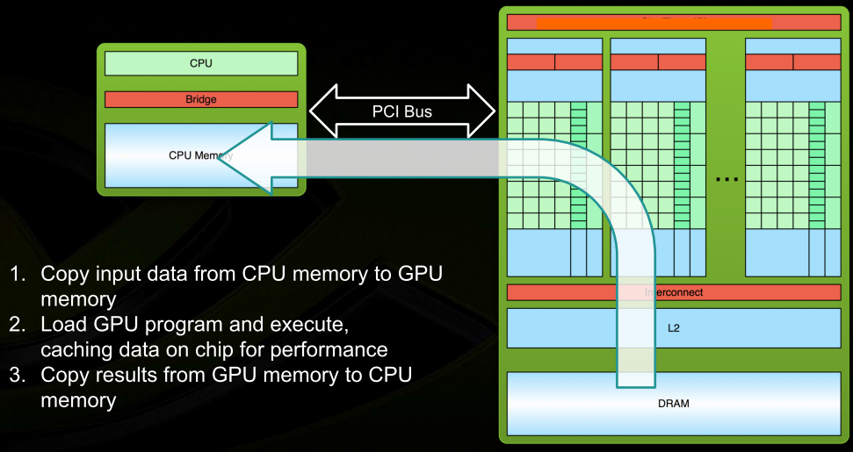
CUDA Program Flow

Slide 11
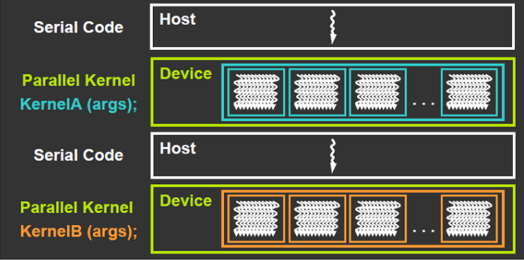
CUDA Programming Model
CUDA = serial program with parallel kernels, all in C
Serial C code executes in a host thread (i.e. CPU thread)
Parallel kernel C code executes in many devices threads across multiple processing elements (i.e. GPU threads)

Slide 12
CUDA program framework
#include <cuda_runtime.h>
__global__ void my_kernel(…) { … }
int main() { … cudaMalloc(…) cudaMemcpy(…) … my_kernel<<<nblock,blocksize>>>(…) … cudaMemcpy(…) … }
GPU code (parallel)
CPU code
(serial or parallel if
p-thread/OpenMP/T
BB/MPI is used.)

Slide 13
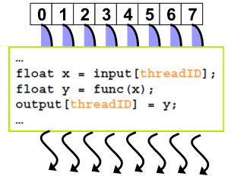
Kernel = Many Concurrent Threads
One kernel is executed at a time on the device
Many thread execute each kernel
Each thread executes the same code
… on the different data based on its threadID
CUDA thread might be
Physical threads
As on NVIDIA GPUs
GPU thread creation and context switching are essentially free
Or virtual threads
E.g. 1 CPU core might execute multiple CUDA threads

Slide 14
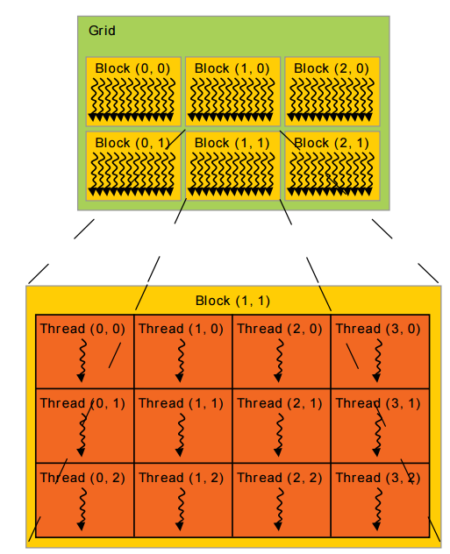
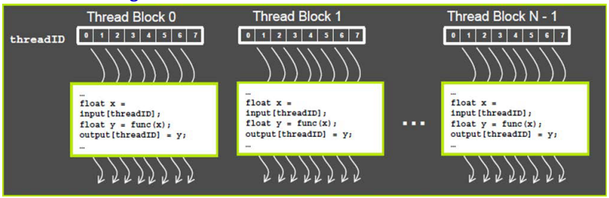
Thread Hierarchy
Threads are grouped into thread blocks
Kernel = gird of thread blocks
By definition, threads in the same block may synchronized with barriers, but not between blocks

Slide 15
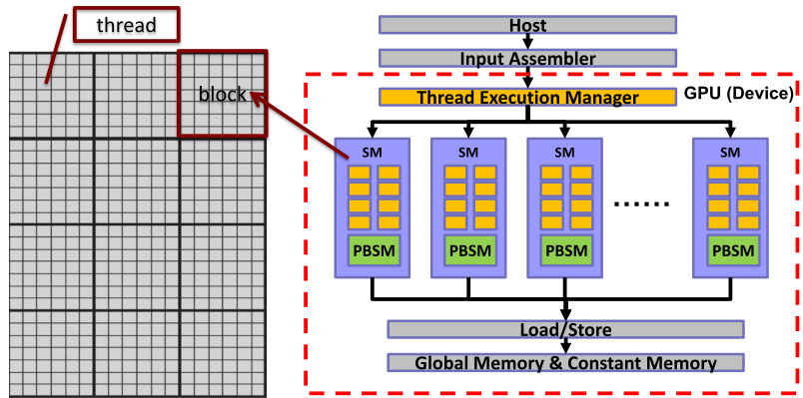
Software Mapping
Software: grid → blocks → threads
Hardware: GPU(device) → SM(multicore processor) → core

Slide 16
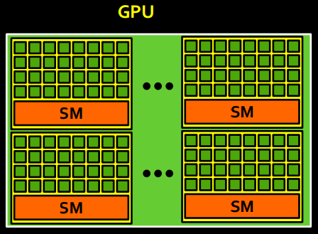
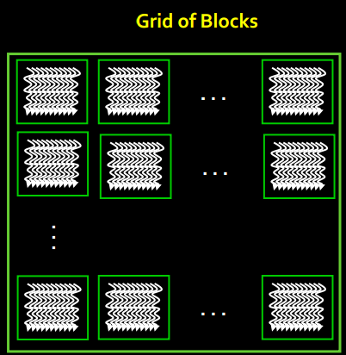
Scheduling Thread Blocks
Hardware dispatches thread blocks to available processor (streaming multiprocessor)

Slide 17
Scheduling Thread Blocks
A GPU has lots of processors (streaming multiprocessors)
Each processor (streaming multiprocessors) can execute multiple blocks concurrently
Programmers need to ensure that kernel launches creates enough thread blocks to keep machine busy
Hardware dispatches a block when resources become available, typically when a previous block completes
No specific order in which blocks are dispatched and executed
Design algorithms to be insensitive to block execution order

Slide 18
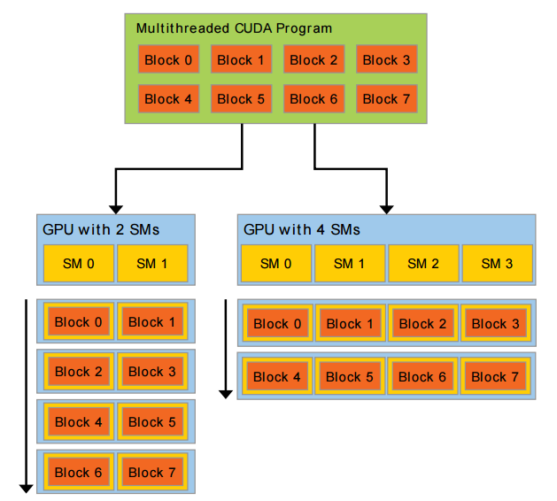
Automatic Scalability
Thread blocks cannot synchronize
So they can run in any order, concurrently or sequentially
This independence gives scalability:
A kernel scales across any number of parallel cores

Slide 19
Some Restrictions First
All threads in a grid execute the same kernel function
A grid is organized as a 3D array of blocks (gridDim.x and gridDim.y, gridDim.z)
Each block is organized as 3D array of threads (blockDim.x, blockDim.y, and blockDim.z)
Once a kernel is launched, its dimensions cannot change.
All blocks in a grid have the same dimension
Once assigned to the SM, the block must be fully executed by the SM.

Slide 20
Thread group limits
The maximum number of threads per block is limited
512 before CUDA 2.0
1024 after CUDA 2.0
The maximum number of blocks is limited
65535 before CUDA 3
2 ³¹ -1 after CUDA 3
Total number of threads = threads per block * number of blocks

Slide 21
GPU parameters
Name: GeForce GTX 680
Compute capability: 3.0
Clock rate: 1084500
Device copy overlap: Enabled
Kernel execution timeout : Disabled
--- Memory Information for device 0 ---
Total global mem: 2147155968
Total constant Mem: 65536
Max mem pitch: 2147483647
Texture Alignment: 512
--- MP Information for device 0 ---
Multiprocessor count: 8
Shared mem per mp: 49152
Registers per mp: 65536
Threads in warp: 32
Max threads per block: 1024
Max thread dimensions: (1024, 1024, 64)
Max grid dimensions: (2147483647, 65535, 65535)
Name: GeForce GTX 480
Compute capability: 2.0
Clock rate: 1401000
Device copy overlap: Enabled
Kernel execution timeout : Disabled
--- Memory Information for device 1 ---
Total global mem: 1545732096
Total constant Mem: 65536
Max mem pitch: 2147483647
Texture Alignment: 512
--- MP Information for device 1 ---
Multiprocessor count: 15
Shared mem per mp: 49152
Registers per mp: 32768
Threads in warp: 32
Max threads per block: 1024
Max thread dimensions: (1024, 1024, 64)
Max grid dimensions: (65535, 65535, 65535)

Slide 22


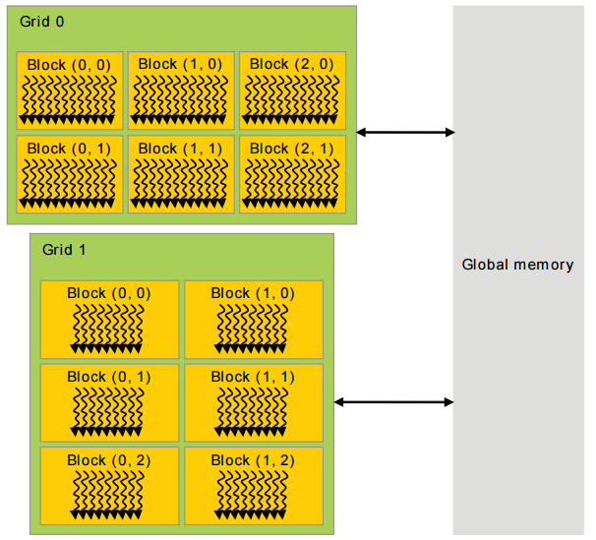
Memory Hierarchy

Slide 23
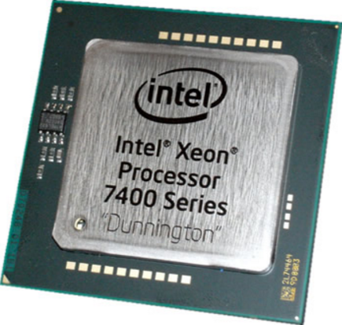
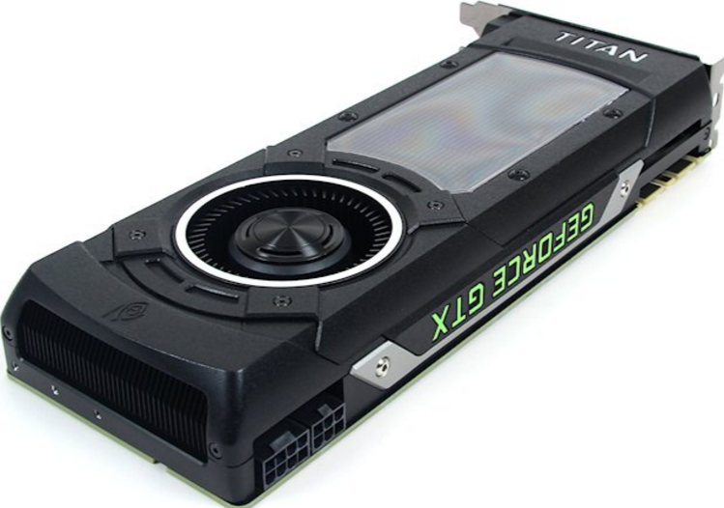
Heterogeneous Computing
Terminology:
Host: The CPU and its memory (host memory)
Device: The GPU and its memory (device memory)
Host
Device

Slide 24
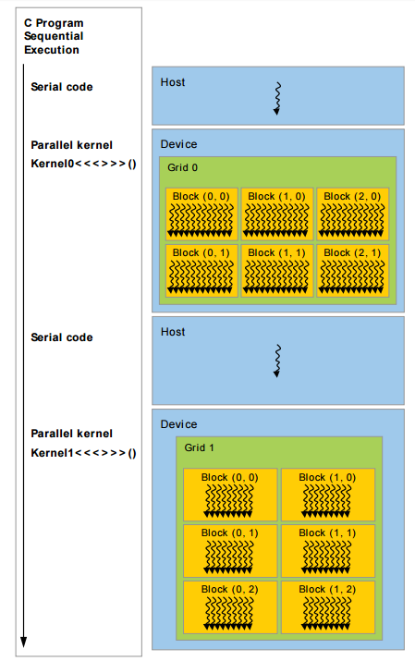
Heterogeneous Programming
Host : CPU
Device : GPU
Kernel : functions executed on GPU
Thread : the basic execution unit
Block : a group of threads
Grid : a group of blocks

Slide 25
CUDA Language
Philosophy: provide minimal set of extensions necessary
Kernel launch
kernelFunc<<< nB, nT, nS, Sid >>>(…); // nS and Sid are optional
nB：number of blocks per grid (grid size)
nT：number of threads per block (block size)
nS：shared memory size (in bytes)
Sid： stream ID, default is 0
Build-in device variables
threadIdx; blockIdx; blockDim; gridDim
Intrinsic functions that expose operations in kernel code
__syncthreads();
Declaration specifier to indicate where things live
__global__ void KernelFunc(…); // kernel function, run on device
__device__ void GlobalVar; // variable in device memory
__shared__ void SharedVar; // variable in per-block shared memory

Slide 26
Block IDs and Thread IDs
Each block and thread uses IDs to decide what data to work on
dim3 blockIdx;
blockIdx.x, blockIdx.y, blockIdx.z
dim3 threadIdx;
threadIdx.x, threadIdx.y, threadIdx.z
dim3 gridDim;
gridDim.x, gridDim.y, gridDim.z
dim3 blockDim;
blockDim.x, blockDim.y, blockDim.z

Slide 27
Function Qualifiers
Function qualifiers | limitations
__device__ function | Executed on the device Callable from the device only
__global__ function | Executed on the device Callable from the host only (must have void return type!)
__host__ function | Executed on the host Callable from the host only
Functions without qualifiers | Compiled for the host only
__host__ __device__ function | Compiled for both the host and the device

Slide 28
Variable Type Qualifiers
Variable qualifiers | limitations
__device__ var | Resides in device’s global memory space Has the lifetime of an application Is accessible from all the threads within the grid and from the host through the runtime library
__constant__ var | Resides in device’s constant memory space
__shared__ var | Resides in the shared memory space of a thread block Has the lifetime of the block Is only accessible from all the threads within the block

Slide 29
CUDA Runtime API
Device management
cudaGetDeviceCount(), cudaGetDeviceProperties()
Device memory management
cudaMalloc(), cudaFree(), cudaMemcpy()
Graphic interoprability
cudaGLMapBufferObject(), cudaD3DMapResources()
Texture management
cudaBindTexture(), cudaBindTextureToArray()

Slide 30
Device memory operations
Three functions:
cudaMalloc(), cudaFree(), cudaMemcpy()
Similar to the C’s malloc(), free(), memcpy()
cudaMalloc(void **devPtr, size_t size)
devPtr : return the address of the allocated device memory
size : the allocated memory size (bytes)
cudaFree (void *devPtr)
cudaMemcpy( void *dst, const void *src, size_t count, enum cudaMemcpyKind kind)
count : size in bytes to copy

Slide 31
cudaMemcpyKind
one of the following four values
cudaMemcpyKind | Meaning | dst | src
cudaMemcpyHostToHost | Host → Host | host | host
cudaMemcpyHostToDevice | Host → Device | Device | Host
cudaMemcpyDeviceToHost | Device → Host | Host | Device
cudaMemcpyDeviceToDevice | Device → Device | Device | Device
host to host has the same effect as memcpy()

Slide 32
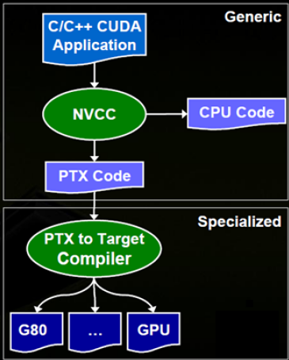
Program Compilation
Any source file containing CUDA language must be compiled with NVCC
NVCC separates code running on the host from code running on the device
Two-stage complication:
Virtual ISA
PTX: Parallel Threads eXecutions
Device-specific binary object

Slide 33
Example 1: Hello World!
Two new syntactic elements…
1. __global__ indicates a function that runs on the device and is called from host code
2. mykernel<<<1,1>>>();
Triple angle brackets mark a call from host code to device code, which is called a “kernel launch”.
__global__ void mykernel(void) {
}
int main(void) {
mykernel<<<1,1>>>();
printf("Hello World!\n");
return 0;
}

Slide 34
Example 2: add 2 numbers
This does not work!!
int ha, hb, hc are in the host memory (DRAM), which cannot be used by device (GPU).
We need to allocate variables in “device memory”.
__global__ void add(int *a, int *b, int *c) {
*c = *a + *b;
}
int main(void) {
int ha=1,hb=2,hc;
add<<<1,1>>>(&ha, &hb, &hc);
printf(“c=%d\n”,hc);
return 0;
}
x

Slide 35
The correct main()
int main(void) {
int a=1, b=2, c; // host copies of a, b, c
int *d_a, *d_b, *d_c; // device copies of a, b, c
// Allocate space for device copies of a, b, c
cudaMalloc((void **)&d_a, sizeof(int));
cudaMalloc((void **)&d_b, sizeof(int));
cudaMalloc((void **)&d_c, sizeof(int));
// Copy inputs to device
cudaMemcpy(d_a,&a,sizeof(int),cudaMemcpyHostToDevice);
cudaMemcpy(d_b,&b,sizeof(int),cudaMemcpyHostToDevice);
// Launch add() kernel on GPU
add<<<1,1>>>(d_a, d_b, d_c);
// Copy result back to host
cudaMemcpy(&c, d_c, size, cudaMemcpyDeviceToHost);
// Cleanup
cudaFree(d_a); cudaFree(d_b); cudaFree(d_c);
return 0;
}


Slide 36
Example 3: add 2 vectors
Let’s first look at the sequential code!
// function definition
void VecAdd(int N, float* A, float* B, float* C)
{
for(int i = 0; i<N; i++)
C[i] = A[i] + B[i];
}
int main()
{ ...
VecAdd (N, Ah, Bh, Ch);
...
}

Slide 37
Parallel CUDA code
Use threadIdx.x as the index of the arrays
Each thread processes 1 addition, for the elements indexed at threadIdx.x .
// Kernel definition
__global__ void VecAdd(float* A, float* B, float* C)
{
int i = threadIdx.x;
C[i] = A[i] + B[i];
}
int main()
{ ...
// Kernel invocation with N threads
VecAdd<<<1, N>>>(Ah, Bh, Ch); ...
}
What is the limit of N?

Slide 38
N=4 case
Thread 0
Four threads can be executed in parallel.
Each thread has a unique threadIdx , starting from 0.
threadIdx is a build-in variable, which is a structure of 3 members: x , y , and z .
struct unit3 { x; y; z; };
struct dim3 { x; y; z; };
c[0] = a[0] + b[0]
Thread 1
c[1] = a[1] + b[1]
Thread 2
c[2] = a[2] + b[2]
Thread 3
c[3] = a[3] + b[3]

Slide 39
Alternative implementation
Using parallel thread instead
N blocks and each block has 1 thread.
Which one is better?
Threads in the same block can communicate, synchronize with others, but the number of threads per block is limited.
__global__ void add(int *a, int *b, int *c) {
c[blockIdx.x] = a[blockIdx.x] + b[blockIdx.x];
}
int main(void) {
int a[N], b[N], c[N];
int *d_a, *d_b, *d_c;
...
add<<< N, 1 >>>(d_a, d_b, d_c);
...
}

Slide 40
3rd implementation
Using multiple threads and multiple blocks
Suppose N=16, grid size = 4, and block size = 4
How to index 16 elements of an array?
Method 1: index = blockIdx.x*4+threadIdx.x
Method 2: index = threadIdx.x*4+blockIdx.x
Which one is better?
blockIdx.x = 0
blockIdx.x = 1
blockIdx.x = 2
blockIdx.x = 3
threadIdx.x=
threadIdx.x=
threadIdx.x=
threadIdx.x=
0
1
2
3
0
1
2
3
0
1
2
3
0
1
2
3
0
1
2
3
4
5
6
7
8
9
10
11
12
13
14
15

Slide 41
3rd implementation
Using multiple threads and multiple blocks
Suppose N=16, grid size = 4, and block size = 4
How to index 16 elements of an array?
Method 1: index = blockIdx.x*4+threadIdx.x
Method 2: index = threadIdx.x*4+blockIdx.x
Which one is better?
blockIdx.x = 0
blockIdx.x = 1
blockIdx.x = 2
blockIdx.x = 3
threadIdx.x=
threadIdx.x=
threadIdx.x=
threadIdx.x=
0
1
2
3
0
1
2
3
0
1
2
3
0
1
2
3
0
1
2
3
4
5
6
7
8
9
10
11
12
13
14
15
memory coalesced

Slide 42
The general case
Use the built-in variable blockDim.x for threads per block.
BS is block size (number of threads per block)
__global__ void add(int *a, int *b, int *c) {
int index = threadIdx.x + blockIdx.x * blockDim.x;
c[index] = a[index] + b[index];
}
int main(void) {
int a[N], b[N], c[N];
int *d_a, *d_b, *d_c;
...
add<<< N/BS,BS>>>(d_a, d_b, d_c);
...
}
What if N is not a
multiple of BS ?

Slide 43
A even more general case
The kernel function can have branches, but with a price to pay…
__global__ void add(int *a, int *b, int *c, int n) {
int index = threadIdx.x + blockIdx.x * blockDim.x;
if (index < n)
c[index] = a[index] + b[index];
}
int main(void) {
int a[N], b[N], c[N];
int *d_a, *d_b, *d_c;
...
add<<< (N+BS-1)/BS, BS>>>(d_a, d_b, d_c, N);
...
}

Slide 44
Execution time: in host
CUDA provides functions to measure the execution time between events.
cudaError_t cudaEventElapsedTime( float* ms, cudaEvent_t start, cudaEvent_t end)
ms: time between start and end in ms
start: starting event
end: ending event
The time unit is milliseconds, whose resolution is 0.5 microseconds

Slide 45
CUDA event
Data type：cudaEvent_t
cudaError_t cudaEventCreate(cudaEvent_t* event)
Create CUDA event
cudaError_t cudaEventRecord(cudaEvent_t event, cudaStream_t stream = 0)
Record CUDA event
If stream is non-zero, the event is recorded after all preceding operations in the stream have been completed
Since operation is asynchronous, cudaEventQuery() and/or cudaEventSynchronize() must be used to determine when the event has actually been recorded
cudaError_t cudaEventSynchronize(cudaEvent_t event)
Wait until the completion of all device work preceding the most recent call to cudaEventRecord()

Slide 46
Example
1. cudaEvent_t start, stop;
2. cudaEventCreate(&start);
3. cudaEventCreate(&stop);
4. cudaEventRecord(start);
5. kernel<<<block, thread>>>();
6. cudaEventRecord(stop);
7. cudaEventSynchronize(stop);
8. float time;
9. cudaEventElapsedTime(&time, start, stop);

Slide 47
Device information
Query device information by
cudaGetDeviceProperties(struct cudaDeviceProp *prop, int device)
cudaDeviceProp is a structure, which specifies properties for the queried device
char name[256];
int maxThreadsPerBlock;
int maxThreadsDim[3];
int maxGridSize[3];
int clockRate;
...
Device is the device number, specifying which device’s information is queried (used in multi-GPU environment)

Slide 48
Host and device sync
Kernel launches are asynchronous
Control returns to the CPU immediately
CPU needs to synchronize before consuming the results.
cudaDeviceSynchronize() blocks the CPU until all preceding CUDA calls have completed
cudaMemcpy() blocks the CPU until the copy is complete
Copy begins when all preceding CUDA calls have completed
Using cudaMemcpyAsync() to perform asynchronous memory copy, which does not block the CPU

Slide 49
Reporting errors
All CUDA calls return an error code cudaError_t
Error in the API call itself OR Error in an earlier asynchronous operation (e.g. kernel)
Get the error code for the last error:
cudaError_t cudaGetLastError(void)
Get a string to describe the error:
char *cudaGetErrorString(cudaError_t)

Slide 50
Device Management
Application can query and select GPUs
cudaGetDeviceCount(int *count)
cudaSetDevice(int device)
cudaGetDevice(int *device)
cudaGetDeviceProperties(cudaDeviceProp *prop, int device)
Multiple CPU threads can share a device
A single CPU thread can manage multiple devices
cudaSetDevice(i) to select current device
cudaMemcpy(…) for peer-to-peer copies

Slide 51
Occupancy
Occupancy: number of concurrent threads per SM
Expressed as either:
the number of threads (or warps)
percentage of maximum threads
Determined by several factors
(refer to Occupancy Calculator, CUDA Programming Guide for full details)
Registers per thread
SM registers are partitioned among the threads
Shared memory per block
SM shared memory is partitioned among the blocks
Threads per block
Threads are allocated at threadblock granularity

Slide 52
Occupancy and Performance
Note that 100% occupancy isn’t needed to reach maximum performance
Sufficient occupancy to hide latency, higher occupancy will not improve performance
“Sufficient” occupancy depends on the code
More independent work per thread → less occupancy is needed
Memory-bound codes tend to need higher occupancy
Higher latency (than for arithmetic) needs more work

Slide 53
CUDA LAB 1: Vector Addition

Slide 54
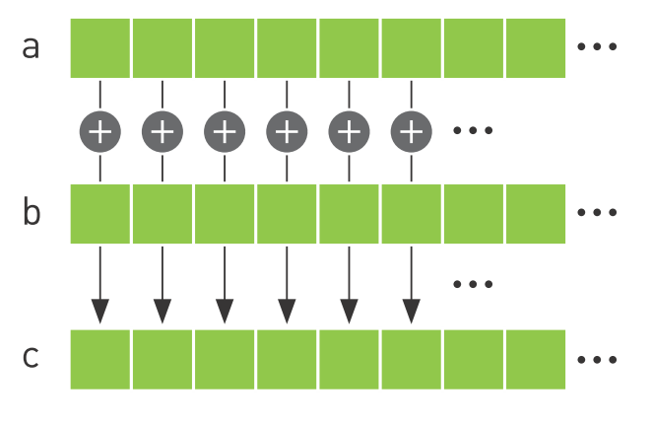
Vector Addition

Slide 55
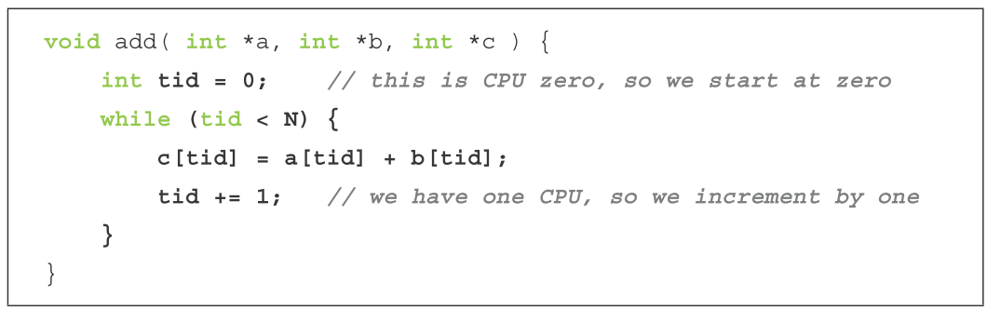
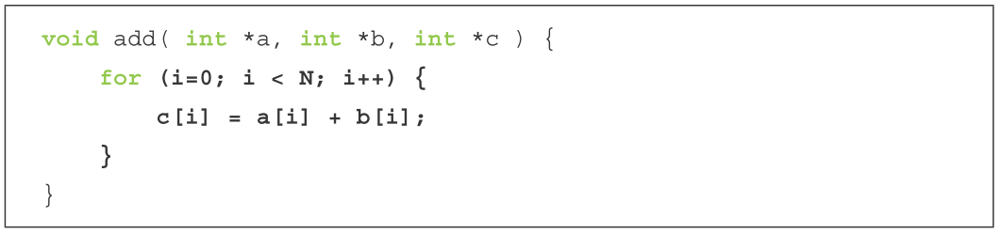
CPU Version

Slide 56
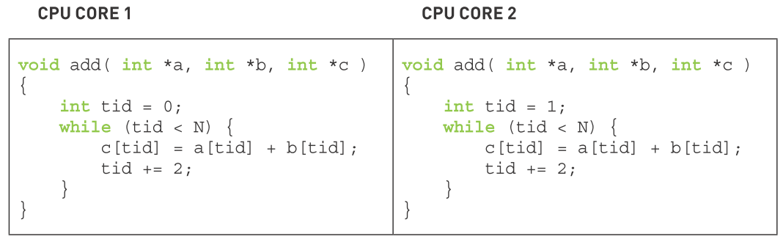
Dual Core Version

Slide 57
CUDA Built-in Variables
dim3 gridDim;
Dimensions of the grid in blocks
gridDim.x, gridDim.y, gridDim.z
dim3 blockDim;
Dimensions of the block in threads
blockDim.x, blockDim.y, blockDim.z
dim3 blockIdx;
Block index within the grid
blockIdx.x, blockIdx.y, blockIdx.z
dim3 threadIdx;
Thread index within the block
threadIdx.x, threadIdx.y, threadIdx.z

Slide 58
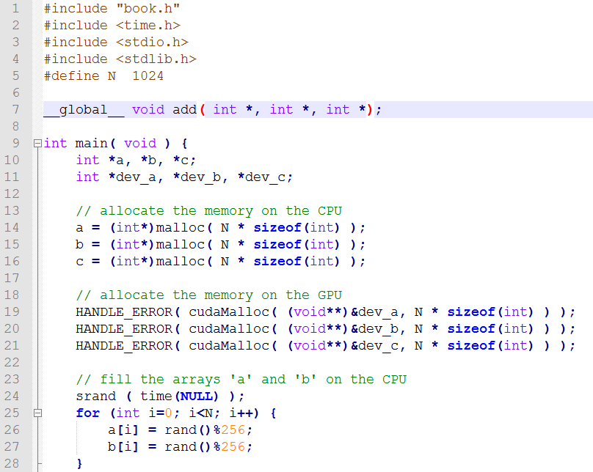
First GPU vector addition

Slide 59
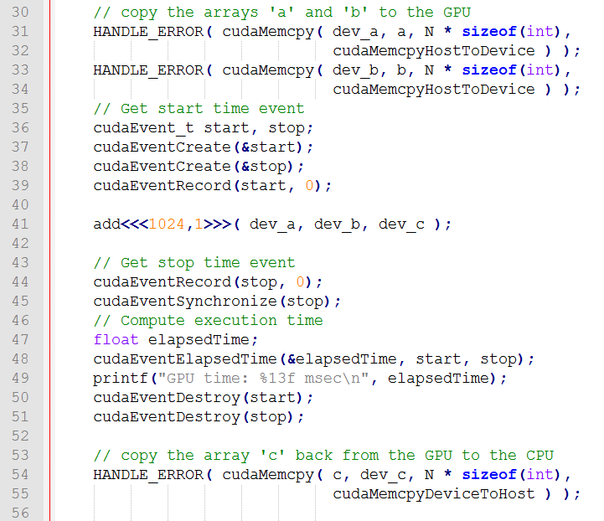

Slide 60
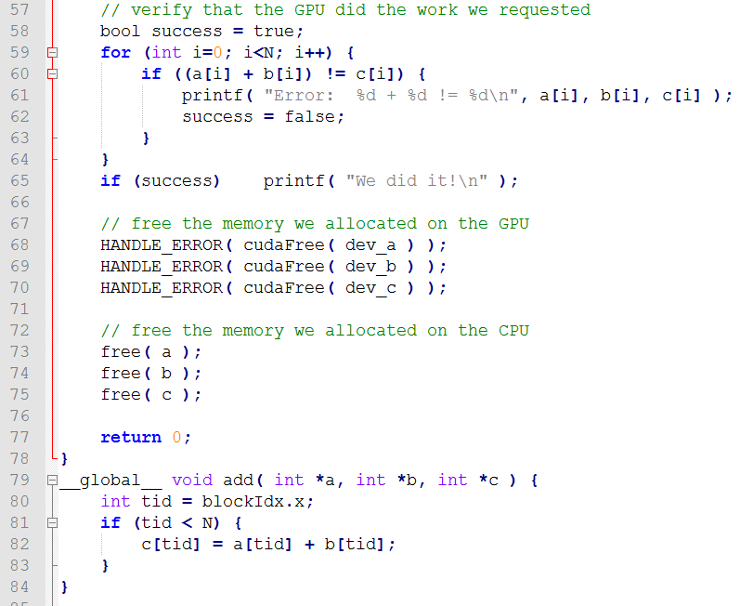

Slide 61
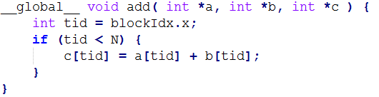
Multiple Blocks Single Thread
add<<<N,1>>>( dev_a, dev_b, dev_c );
N blocks x 1 thread/block = N parallel threads
Block 0
Block 1
c[0] = a[0] + b[0];
c[1] = a[1] + b[1];
Block 2
Block 3
……
c[2] = a[2] + b[2];
c[3] = a[3] + b[3];

Slide 62
Problem
N is changed to 1024x1024
Increase the number of blocks
What is the limitation of blocks???
Each block must handle more than one position.
……
……
……
……
……

Slide 63
ANS
add<<<N, 1>>>( dev_a, dev_b, dev_c );
N blocks x 1 thread/block = N parallel threads
__global__ void add( int *a, int *b, int *c ) {
int tid = blockIdx.x;
while (tid < N)
c[tid] = a[tid] + b[tid];
tid += gridDim.x;
}
……

Slide 64
Single Block Multiple Threads
Terminology: a block can be split into parallel threads
add<<<1, N>>>( dev _ a, dev _ b, dev _ c );
__global__ void add( int *a, int *b, int *c ) {
int tid = threadIdx.x;
if (tid < N)
c[tid] = a[tid] + b[tid];
}
Thread 0
Thread 1
c[0] = a[0] + b[0];
c[1] = a[1] + b[1];
……
Thread 2
Thread 3
c[2] = a[2] + b[2];
c[3] = a[3] + b[3];

Slide 65
Problem
N is changed to 1024x1024
Increase the number of threads per block???
What is the limitation of threads per blocks???
Each thread must handle more than one position.
……
……
……
……
……

Slide 66
ANS
add<<<1, N>>>( dev _ a, dev _ b, dev _ c );
__global__ void add( int *a, int *b, int *c ) {
int tid = threadIdx.x;
while (tid < N)
c[tid] = a[tid] + b[tid];
tid += blockDim.x;
}
……

Slide 67
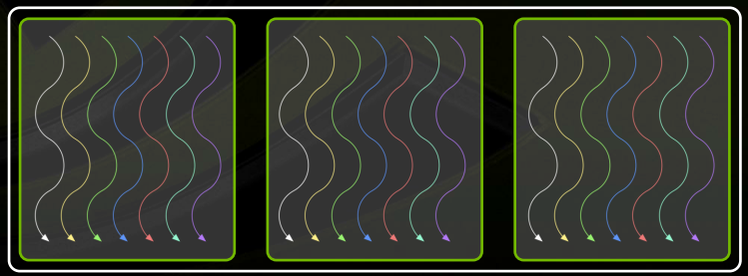
Combining Blocks and Threads
We’ve seen parallel vector addition using:
Many blocks with one thread each
One block with many threads
Let’s adapt vector addition to use both blocks and threads

Slide 68
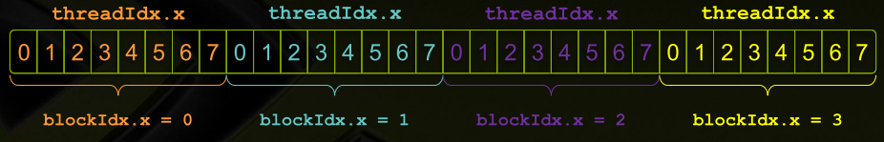
Indexing Arrays with Blocks and Threads
No longer as simple as using blockIdx.x and threadIdx.x
Consider indexing an array with one element per thread (8 threads/block)
With M threads/block a unique index for each thread is given by:
int index = threadIdx.x + blockIdx.x * M (blockDim.x);

Slide 69
Multiple Blocks Multiple Threads
add<<< 1024/32, 32>>>( dev _ a, dev _ b, dev _ c );
int tid = threadIdx.x + blockIdx.x * blockDim.x;
__global__ void add( int *a, int *b, int *c ) {
int tid = threadIdx.x + blockIdx.x * blockDim.x;
if (tid < N) {
c[tid] = a[tid] + b[tid];
}
}
……
……
……
……

Slide 70
Problem
N is changed to 1024x1024
Increase the number of blocks
What is the limitation of blocks???
Each thread must handle more than one position.
……
……
……
……
……
……
……
……
……
……
……
……

Slide 71
ANS
unsigned int threadsPerBlock = 32; //最大為1024
unsigned int blocksPerGrid = (N + threadsPerBlock - 1)/threadsPerBlock;
add <<< blocksPerGrid, threadsPerBlock >>> ( dev_a, dev_b, dev_c );
__global__ void add( int *a, int *b, int *c ) {
int tid = threadIdx.x + blockIdx.x * blockDim.x;
while (tid < N) {
c[tid] = a[tid] + b[tid];
tid += blockDim.x * gridDim.x;
}
}
……
……
……
……

Slide 72
Note
blocksPerGrid cannot exceed the maximum gridDim.x
因此total最大的thread數量將會是2147483647 x 1024
如果N大於2147483647 x 1024 ???

Slide 73
Time counting on Linux
struct timespec t_start, t_end; double elapsedTime; // start time clock_gettime( CLOCK_REALTIME, &t_start); // do something // stop time clock_gettime( CLOCK_REALTIME, &t_end); // compute and print the elapsed time in millisec elapsedTime = (t_end.tv_sec - t_start.tv_sec) * 1000.0; elapsedTime += (t_end.tv_nsec - t_start.tv_nsec) / 1000000.0; printf("elapsedTime: %lf ms\n", elapsedTime);
Linux:// compile with -lrt #include <time.h>

Slide 74
GPU time counting
// Get start time event
cudaEvent_t start, stop;
cudaEventCreate(&start);
cudaEventCreate(&stop);
cudaEventRecord(start, 0);
// Invoke kernel here
// Get stop time event
cudaEventRecord(stop, 0);
cudaEventSynchronize(stop);
// Compute execution time
float elapsedTime;
cudaEventElapsedTime(&elapsedTime, start, stop);
printf("GPU time: %13f msec\n", elapsedTime);
cudaEventDestroy(start);
cudaEventDestroy(stop);

Slide 75
CUDA LAB 2: Vector Dot Product

Slide 76
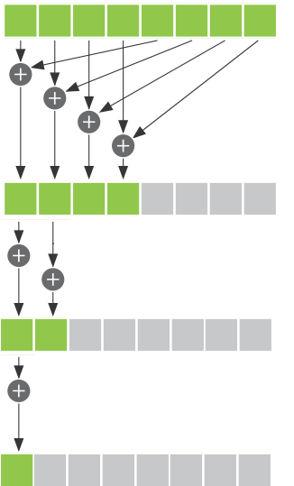

Dot Product

Slide 77
__global__ void dot( int *a, int *b, int *c ) {
int tid = threadIdx.x;
if (tid < N) {
c[tid] = a[tid] * b[tid];
}
__syncthreads();
int i = N / 2;
while (i != 0) {
if (tid < i){
c[tid] += c[tid + i];
}
__syncthreads();
i /= 2;
}
}
const int N = 1024;
const int threadsPerBlock = 1024;
const int blocksPerGrid = 1;

Slide 78
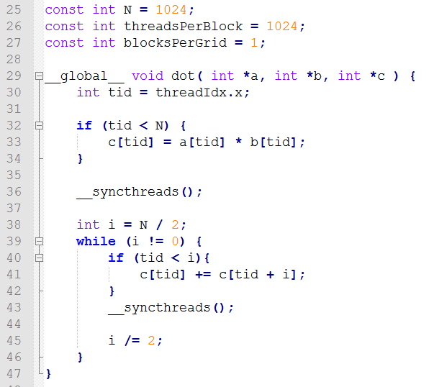
Single Block Multiple Thread
……

Slide 79
Problem
N is changed to 1024x1024
Each thread must handle more than one position.
……

Slide 80
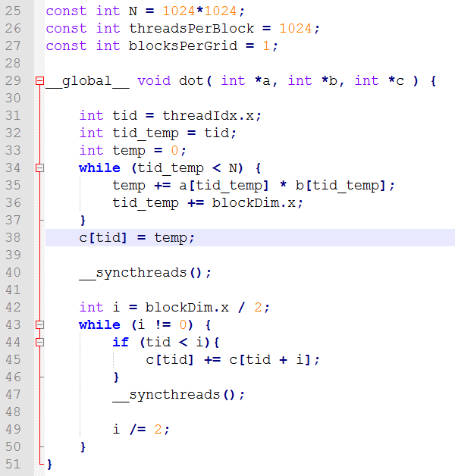
ANS

Slide 81
Thinking
May we modify the above code using multiple block multiple thread?
……
……
……
……

Slide 82
const int N = 1024 *1024;
const int threadsPerBlock = 1024;
const int blocksPerGrid = N / 1024;
__global__ void dot( int *a, int *b, int *c ) {
__shared__ int cache[threadsPerBlock];
int tid = threadIdx.x + blockIdx.x * blockDim.x;
int cacheIndex = threadIdx.x;
cache[cacheIndex] = a[tid] * b[tid];
__syncthreads();
int i = blockDim.x/2;
while (i != 0) {
if (cacheIndex < i)
cache[cacheIndex] += cache[cacheIndex + i];
__syncthreads();
i /= 2;
}
if (cacheIndex == 0)
c[blockIdx.x] = cache[0];
}

Slide 83
Thinking
If N = 64 *1024 *1024
const int blocksPerGrid = N / 1024;
blocksPerGrid will exceed 65535 (the maximum blocks for GTX480)
How to modify the example code?

Slide 84
const int N = 64 * 1024 * 1024;
const int threadsPerBlock = 1024;
const int blocksPerGrid = 1024;
__global__ void dot( int *a, int *b, int *c ) {
__shared__ int cache[threadsPerBlock];
int tid = threadIdx.x + blockIdx.x * blockDim.x;
int cacheIndex = threadIdx.x;
int temp = 0;
while (tid < N) {
temp += a[tid] * b[tid];
tid += blockDim.x * gridDim.x;
}
// set the cache values
cache[cacheIndex] = temp;
__syncthreads();

Slide 85
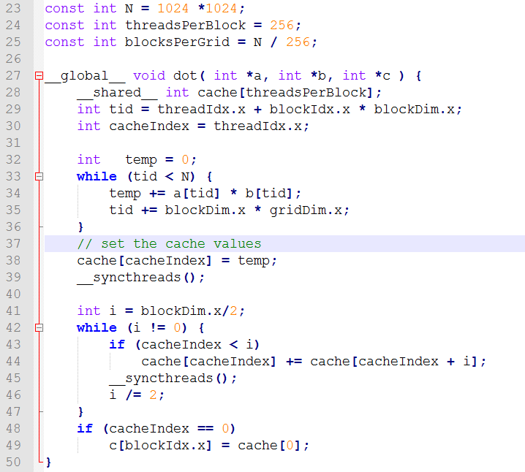
Optimized version using shared memory

Slide 86
CUDA LAB 3: Matrix Multiplication

Slide 87
Square Matrix Multiplication
P = M * N of size WIDTH x WIDTH
One thread calculates one element of P
M and N are loaded WIDTH times from global memory
N
WIDTH
M
P
WIDTH
WIDTH
WIDTH

Slide 88
Memory Layout of a Matrix in C
M_{0,0}
M_{1,0}
M_{2,0}
M_{3,0}
M_{0,1}
M_{1,1}
M_{2,1}
M_{3,1}
M_{0,2}
M_{1,2}
M_{2,2}
M_{3,2}
M_{0,3}
M_{1,3}
M_{2,3}
M_{3,3}
M
M_{0,0}
M_{1,0}
M_{2,0}
M_{3,0}
M_{0,1}
M_{1,1}
M_{2,1}
M_{3,1}
M_{0,2}
M_{1,2}
M_{2,2}
M_{3,2}
M_{0,3}
M_{1,3}
M_{2,3}
M_{3,3}

Slide 89
A Single Thread Version in C
__global__ void MatMulKernel(float *Md, float *Nd, float *Pd, int width)
{
for(int i = 0; i < width; ++i){
for(int j = 0; j < width; ++j){
// Computes one element of P
float Pvalue = 0;
for(int k = 0; k < width; ++k){
float Melement = *(Md + i*width + k);
float Nelement = *(Nd + k*width + j);
Pvalue += Melement * Nelement;
}
*(Pd + i*width + j) = Pvalue;
}
}
}
N
k
j
WIDTH
M
P
i
WIDTH
k
WIDTH
WIDTH

Slide 90
Input Matrix Data Transfer
void MatMul(float *M, float *N, float *P, int width)
{
size_t size = width * width * sizeof(float);
float *Md, *Nd, *Pd;
// Allocate and Load M, N to device memory
cudaMalloc((void **)&Md, size);
cudaMemcpy(Md, M, size, cudaMemcpyHostToDevice);
cudaMalloc((void **)&Nd, size);
cudaMemcpy(Nd, N, size, cudaMemcpyHostToDevice);
// Allocate P on the device
cudaMalloc((void **)&Pd, size);

Slide 91
Output Matrix Data Transfer
// Invoke kernel & record time – to be shown later
......
// Read P from device memory
cudaMemcpy(P, Pd, size, cudaMemcpyDeviceToHost);
// Free device memory
cudaFree(Md);
cudaFree(Nd);
cudaFree(Pd);
}

Slide 92
Setting and Invoke kernel
// Setup the execution configuration
dim3 dimGrid(1, 1);
dim3 dimBlock(width, width);
// Get start time event
cudaEvent_t start, stop;
cudaEventCreate(&start);
cudaEventCreate(&stop);
cudaEventRecord(start, 0);
// Invoke kernel
// Get stop time event
cudaEventRecord(stop, 0);
cudaEventSynchronize(stop);
MatMulKernel<<<dimGrid, dimBlock>>>(Md, Nd, Pd, width);

Slide 93
Timing
// Setup the execution configuration
dim3 dimGrid(1, 1);
dim3 dimBlock(width, width);
// Get start time event
cudaEvent_t start, stop;
cudaEventCreate(&start);
cudaEventCreate(&stop);
cudaEventRecord(start, 0);
// Invoke kernel
// Get stop time event
cudaEventRecord(stop, 0);
cudaEventSynchronize(stop);
// Compute execution time
float elapsedTime;
cudaEventElapsedTime(&elapsedTime,start,stop);
printf("GPU time: %13f msec\n", elapsedTime);
cudaEventDestroy(start);
cudaEventDestroy(stop);
MatMulKernel<<<dimGrid, dimBlock>>>(Md, Nd, Pd, width);

Slide 94
Kernel Function
__global__ void MatMulKernel(float *Md, float *Nd, float *Pd, int width)
{
int row = threadIdx.y;
int col = threadIdx.x;
float Pvalue = 0;
for (int k = 0; k < width; ++k) {
float Melement = *(Md + row*width + k);
float Nelement = *(Nd + k*width + col);
Pvalue += Melement * Nelement;
}
*(Pd + row*width + col) = Pvalue;
}
N
k
col
WIDTH
M
P
row
WIDTH
k
WIDTH
WIDTH

Slide 95
Only One Thread Block Used
Nd
One Block of threads compute matrix Pd
Each thread computes one element of Pd
Each thread
Loads a row of matrix Md
Loads a column of matrix Nd
Perform one multiply and addition for each pair of Md and Nd elements
Compute to off-chip memory access ratio close to 1:1 (not very high)‏
Size of matrix limited by the number of threads allowed in a thread block
Grid 1
Block 1
Thread
(2, 2)‏
48
WIDTH
Md
Pd

Slide 96
Matrix Multiplication Using Multiple Blocks
bx
0
1
2
tx
0
TILE_WIDTH-1
1
2
Nd
Break-up Pd into tiles
Each block calculates one tile
Each thread calculates one element in a tile
Block size equal tile size
WIDTH
Md
Pd
0
0
Pd_{sub}
1
by
ty
2
WIDTH
1
TILE_WIDTHE
TILE_WIDTH-1
2
TILE_WIDTH
WIDTH
WIDTH

Slide 97
A Small Example
Block(0,0)
Block(1,0)
Nd_{0,0}
Nd_{1,0}
P_{0,0}
P_{1,0}
P_{2,0}
P_{3,0}
Nd_{0,1}
Nd_{1,1}
TILE_WIDTH = 2
P_{0,1}
P_{1,1}
P_{2,1}
P_{3,1}
Nd_{0,2}
Nd_{1,2}
P_{0,2}
P_{1,2}
P_{2,2}
P_{3,2}
Nd_{0,3}
Nd_{1,3}
P_{0,3}
P_{1,3}
P_{2,3}
P_{3,3}
Md_{0,0}
Md_{1,0}
Md_{2,0}
Md_{3,0}
Pd_{0,0}
Pd_{1,0}
Pd_{2,0}
Pd_{3,0}
Block(0,1)
Block(1,1)
Md_{0,1}
Md_{1,1}
Md_{2,1}
Md_{3,1}
Pd_{0,1}
Pd_{1,1}
Pd_{2,1}
Pd_{3,1}
Pd_{0,2}
Pd_{1,2}
Pd_{2,2}
Pd_{3,2}
Pd_{0,3}
Pd_{1,3}
Pd_{2,3}
Pd_{3,3}

Slide 98
// Setup the execution configuration
dim3 dimBlock(16, 16);
dim3 dimGrid(width/16, width/16);
// Invoke kernel
MatMulKernel<<<dimGrid, dimBlock>>>(Md, Nd, Pd, width);
__global__ void MatMulKernel(float *Md, float *Nd, float *Pd, int width)
{
// Thread row and column within matrix
int row = blockIdx.y * blockDim.y + threadIdx.y;
int col = blockIdx.x * blockDim.x + threadIdx.x;

Slide 99
// Matrix multiplication kernel called by MatMul()
__global__ void MatMulKernel(float *Md, float *Nd, float *Pd, int width)
{
// Thread row and column within matrix
int row = blockIdx.y * blockDim.y + threadIdx.y;
int col = blockIdx.x * blockDim.x + threadIdx.x;
// Each thread computes one element of P
// by accumulating results into Pvalue
float Pvalue = 0;
// Multiply M and N
for (int k = 0; k < width; ++k) {
float Melement = *(Md + row*width + k);
float Nelement = *(Nd + k*width + col);
Pvalue += Melement * Nelement;
}
// Write Pvalue to device memory
// Each thread writes one element
*(Pd + row*width + col) = Pvalue;
}

Slide 100
Tiled Multiply
bx
0
1
2
tx
0
TILE_WIDTH-1
1
2
Break up the execution of the kernel into phases so that the data accesses in each phase is focused on one subset (tile) of Md and Nd
Each block computes one square sub-matrix Pd_{sub} of size TILE_WIDTH
Each thread computes one element of Pd_{sub}
Nd
m
TILE_WIDTH
bx
k
WIDTH
TILE_WIDTH
Md
Pd
by
0
m
0
k
Pd_{sub}
1
by
1
ty
2
WIDTH
TILE_WIDTHE
TILE_WIDTH-1
2
TILE_WIDTH
TILE_WIDTH
TILE_WIDTH
WIDTH
WIDTH

Slide 101
// Matrix multiplication kernel called by MatMul()
__global__ void MatMulKernel(float *Md, float *Nd, float *Pd, int width)
{
// Block row and column
int blockRow = blockIdx.y;
int blockCol = blockIdx.x;
// Each block computes one sub-matrix Psub of P
float *Pd_sub = GetSubMatrix(Pd, blockRow, blockCol, width);
// Thread row and column within sub-matrix
int row = threadIdx.y;
int col = threadIdx.x;
// Each thread computes one element of Psub
// by accumulating results into Pvalue
float Pvalue = 0;

Slide 102
// Loop over all the sub-matrices of M and N that are
// required to compute Psub
for (int m = 0; m < (width / TILE_WIDTH); ++m) {
// Get sub-matrix Msub of M and N
float *Md_sub = GetSubMatrix(Md, blockRow, m, width);
float *Nd_sub = GetSubMatrix(Nd, m, blockCol, width);
// Multiply Msub and Nsub together
for (int k = 0; k < TILE_WIDTH; ++k) {
float Melement = GetElement(Md_sub, row, k, width);
float Nelement = GetElement(Nd_sub, k, col, width);
Pvalue += Melement * Nelement;
}
//Synchronize
__syncthreads();
}
// Write Psub to device memory
// Each thread writes one element
SetElement(Pd_sub, row, col, width, Pvalue);
}

Slide 103
Performance Comparison
Multiple Block Multiplication
Each thread: WIDTH*2 load from global memory (2 for M and N memory access)
Each thread: WIDTH*2 mul/add operation (2 for mul and add)
load:operation=1:1
Tiled Algorithm with shared memory
Each tile: TILE_WIDTH²*2 load from global memory
Each tile: TILE_WIDTH²*2*TILE_WIDTH mul/add operation
Because each tile has TILE_WIDTH² threads →
Each thread: 2 load from global memory
Each thread: 2*TILE_WIDTH mul/add operation
load:operation=1:TILE_WIDTH
Notes:
Tile width with shard memory的最大差異在load data from global memory to shared memory

Slide 104
Invoke Tiled CUDA Kernel
size_t size = width * width * sizeof(float);
size_t shared_size = TILE_WIDTH * TILE_WIDTH * sizeof(float) * 2;
float *Md, *Nd, *Pd;
// Setup the execution configuration
dim3 dimGrid(width/TILE_WIDTH, width/TILE_WIDTH);
dim3 dimBlock(TILE_WIDTH, TILE_WIDTH);
// Invoke kernel
MatMulKernel<<<dimGrid, dimBlock, shared_size>>>(Md, Nd, Pd, width);

Slide 105
Functions May be Used
// Get a matrix element
__device__ float GetElement(float *matrix, int row, int col, int width)
{
return *(matrix + row*width + col);
}
// Set a matrix element
__device__ void SetElement(float *matrix, int row, int col, int width, float value)
{
*(matrix + row*width + col) = value;
}
// Get the TILE_WIDTHxTILE_WIDTH sub-matrix matsub of matrix that is
// located col sub-matrices to the right and row sub-matrices down
// from the upper-left corner of matrix
__device__ float *GetSubMatrix(float *matrix, int blockrow, int col, int blockwidth)
{
return (matrix + blockrow*TILE_WIDTH*width + blockcol*TILE_WIDTH);
}

Slide 106
Tiled Matrix Multiplication Kernel
__global__ void MatMulKernel(float *Md, float *Nd, float *Pd, int width) {
int blockRow = blockIdx.y; int blockCol = blockIdx.x;
float *Pd_sub = GetSubMatrix(Pd, blockRow, blockCol, width);
int row = threadIdx.y; int col = threadIdx.x;
float Pvalue = 0;
__shared__ float Mds[TILE_WIDTH][TILE_WIDTH];
__shared__ float Nds[TILE_WIDTH][TILE_WIDTH];
for (int m = 0; m < (width / TILE_WIDTH); ++m) {
float *Md_sub = GetSubMatrix(Md, blockRow, m, width);
float *Nd_sub = GetSubMatrix(Nd, m, blockCol, width);
Mds[row][col] = GetElement(Md_sub, row, col, width); // put Md_sub into shared memory
Nds[row][col] = GetElement(Nd_sub, row, col, width); // put Nd_sub into shared memory
__syncthreads();
for (int k = 0; k < TILE_WIDTH; ++k)
Pvalue += Mds[row][k] * Nds[k][col];
__syncthreads();
}
SetElement(Pd_sub, row, col, width, Pvalue);
}

Slide 107
Parallel Prefix Sum
The all-prefix-sums operation takes a binary associative operator ⊕, and an array of n elements [a₀ , a₁ , …, a_{n-1} ], and returns the array
[a₀ , (a₀ ⊕ a₁ ), …, (a₀ ⊕ a₁ ⊕ … ⊕ a_{n-1} )].
For example, given an array [3 1 7 0 4 1 6 3],
prefix sum would return [3 4 11 11 14 16 22 25].

Slide 108
Sequential Scan
void scan( float* output, float* input, int length)
{
output[0] = 0; // since this is a prescan, not a scan
for(int j = 1; j < length; ++j)
{
output[j] = input[j-1] + output[j-1];
}
}

Slide 109
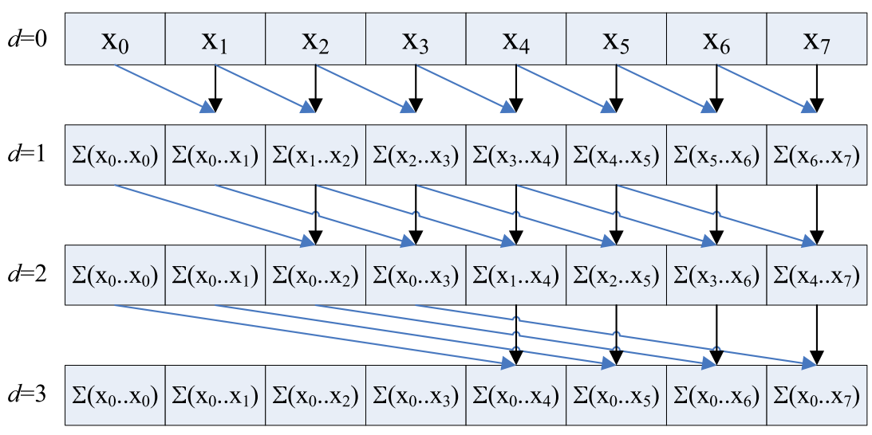
Naïve Scan Algorithm

Slide 110
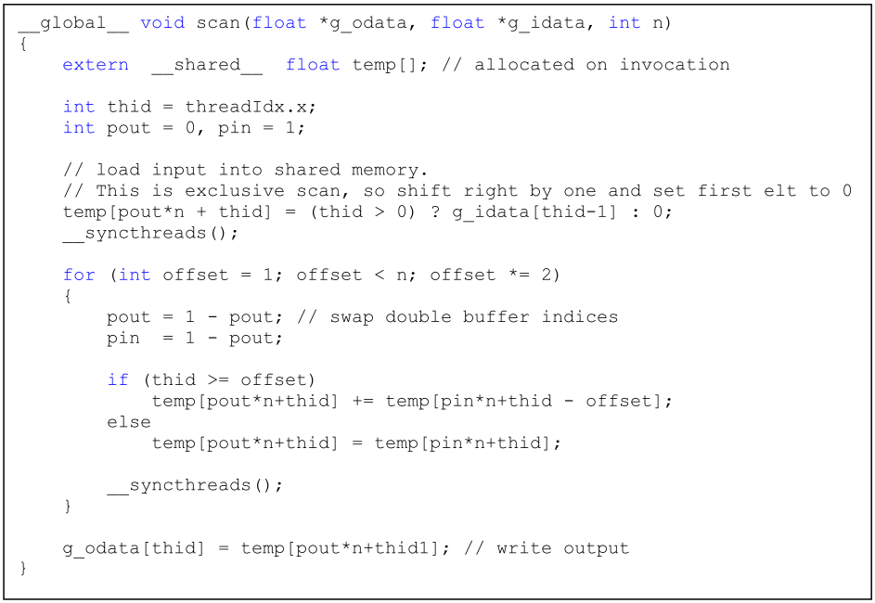

Slide 111
Thrust - Introduction
Containers
thrust::host_vector
thrust::device_vector
Algorithms
thrust::sort()
thrust::reduce()
thrust::inclusive_scan()

