Slide 1
GUDA Introduction III Multi-GPU
林政宏
國立台灣師範大學電機系

Slide 2
Outline
Multi-GPU
Single thread multi-GPUs
Multiple threads multi-GPUs
Multiple nodes multi-GPUs
Dynamic Parallelism

Slide 3
The need of multi-GPU
Working set is decomposed across GPUs
To speedup computation
Memory addressing between GPUs or between GPU and CPU
Inter-GPU communication is needed
Two cases:
GPUs within a single network node
GPUs across network nodes

Slide 4
Multi-GPUs within a node
GPUs can be controlled by:
A single CPU thread, multiple GPU
Multiple CPU threads belonging to the same process, such as pthread or openMP
The unified virtual addressing (UVA)
In 64 bit systems, all the address spaces (CPU, GPUs) can be treated as one
This can be used to simplify the data communication between GPUs, and CPU←→ GPUs

Slide 5
GPU cluster
Multiple GPUs on multiple nodes
Need to go through network API, such as MPI
Hybrid system
A cluster contains multiple nodes, and each node has multiple GPUs.
Hybrid of MPI and pthread or OpenMP

Slide 6
Single thread multi-GPUs
All CUDA calls are issued to the current GPU
cudaSetDevice() sets the current GPU
Asynchronous calls (kernels, memcopies) don’t block switching the GPU
//Run independent kernel on each CUDA device
int bynDevs = 0;
cudaGetNumDevices(&numDevs);
for(int d= 0; d<numDevs; d++){
cudaSetDevice(d);
kernel<<<blocks, threads>>>(args);
}
cudaSetDevice( 0 );
kernel<<<...>>>(...);
cudaSetDevice( 1 );
kernel<<<...>>>(...);

Slide 7
Sharing data between GPUs
Options
1. Explicit copies via host
2. Zero-copy shared host array
3. Peer-to-peer memory copy
With Unified Virtual Address (UVA)
1. Zero-copy shared host array
2. Peer-to-peer memory copy
3. Peer-to-peer memory access

Slide 8
1. Explicit copies via host
CPU explicitly copies data from device A to device B
Example:
CPU
cudaSetDevice(0);
cudaMemcpy(DM1,HM,n,D2H);
cudaSetDevice(1);
cudaMemcpy(HM,DM2,n,H2D);
PCIe
GPU A
data
GPU B

Slide 9
2. Using zero-copy
“Zero-copy” refers to direct device access to host memory
Device threads can read directly from host memory over PCI-e without using cudaMemcpy H2D or D2H
CPU
data
PCIe
GPU A
data
data
GPU B

Slide 10
Example: zero-copy
// Create input and output arrays
cudaHostAlloc(&in, bytes, cudaHostAllocMapped | cudaHostAllocPortable);
cudaHostAlloc(&out, bytes, cudaHostAllocMapped | cudaHostAllocPortable);
cudaSetDevice(0);
cudaHostGetDevicePointer(&dout[0], out, 0);
cudaHostGetDevicePointer(&din[0], in, 0);
ker1<<<b, t>>>(dout[0], din[0], otherArgs);
cudaSetDevice(1);
cudaHostGetDevicePointer(&dout[1], out, 0);
cudaHostGetDevicePointer(&din[1], in, 0);
ker2<<<b, t>>>(dout[1], din[1], otherArgs);

Slide 11
cudaHostAlloc
cudaHostAlloc() : allocates page-locked host memory
Pageable memory cannot be directly accessed by the GPU
To access page-locked host memory from device
1. Allocate or register with cudaHostAllocMapped flag
2. Map a device pointer to it using cudaHostGetDevicePointer()
To access page-locked host memory from all devices, also add the cudaHostAllocPortable flag

Slide 12
Pitfalls of using zero-copy
PCI-e is lower in bandwidth and higher in latency than GPU global memory
access speed is slower than global memory
Use zero-copy if:
The data is only accessed once or few times
Generate data on the device and copy back to host without reuse
Kernel(s) that access the memory are compute bound

Slide 13
3. Peer-to-Peer Memcpy
Direct copy from pointer on GPU A to pointer on GPU B
Using two functions
cudaError_t cudaMemcpyPeer(void *dst, int dstDevice,
const void* src, int srcDevice, size_t count)
cudaError_t cudaMemcpyPeerAsync(void *dst, int
dstDevice, const void* src, int srcDevice, size_t
count, cuda_stream_t stream=0)

Slide 14
Example: P2P memcpy
cudaSetDevice(0); //set device 0 as current
float *p0;
size_t size = 1024*sizeof(float);
cudaMalloc(&p0, size);//allocate mem on device 0
cudaSetDevice(1); //set device 1 as current
float *p1;
cudaMalloc(&p1, size);//allocate mem on device 1
cudaSetDevice(0); //set device 0 as current
Kernel1<<<1000,128>>>(p0); //launch on dev 0
cudaSetDevice(1); //set device 1 as current
cudaMemcpyPeer(p1,1,p0,0,size); //copy p0 to p1
Kernel1<<<1000,128>>>(p1); //launch on dev 1

Slide 15
Unified Virtual Addressing (UVA)
Without UVA
With UVA
System memory
GPU0 Memory
GPU1 Memory
System memory
GPU0 Memory
GPU1 Memory
0x0000 0xFFFF
0x0000 0xFFFF
0x0000 0xFFFF
0x00000 0x0FFFF
0x10000 0x1FFFF
0x20000 0x2FFFF
CPU
GPU0
GPU1
CPU
GPU0
GPU1
PCIe
PCIe

Slide 16
Unified Virtual Addressing
CPU and GPU use a unified virtual address space
Each one (CPU, GPU) gets its own range of virtual addresses
Driver/device can determine from the address where data resides
Allocation still resides on a single device (can’t allocate one array across several GPUs)
Requires:
64-bit Linux or 64-bit Windows with TCC driver
Fermi or later architecture GPUs (compute capability
2.0 or higher)
CUDA 4.0 or later

Slide 17
1. Zero-copy with UVA
Pointers returned by cudaHostAlloc() can be used directly from within kernels running on UVA enabled devices
No need cudaHostAllocMapped, cudaHostAllocPortable flags
No need to obtain a device pointer via cudaHostGetDevicePointer()
Remember: must use cudaHostAlloc() , not regular host malloc/new

Slide 18
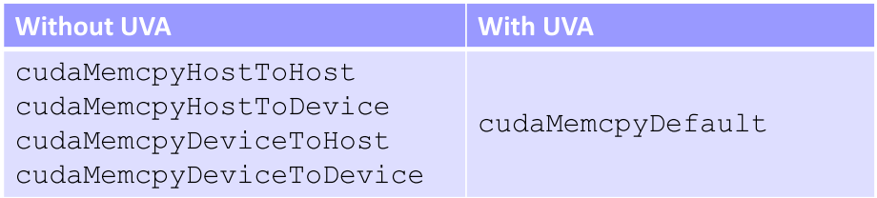
2. P2P Memory Copy with UVA
Copy without specifying which memory space are
Between host and multiple devices:
cudaMemcpy(gpu0, host, size, cudaMemcpyDefault)
cudaMemcpy(gpu1, host, size, cudaMemcpyDefault)
cudaMemcpy(host, gpu0, size, cudaMemcpyDefault)
cudaMemcpy(host, gpu1, size, cudaMemcpyDefault)
Between two devices:
cudaMemcpy(gpu0, gpu1, size, cudaMemcpyDefault)

Slide 19
3. P2P Memory Access with UVA
Pass pointer to memory on device A to kernel running on device B
Requires UVA, so just pass the pointers directly!
Must first enable peer access for each peer pair:
cudaDeviceEnablePeerAccess(int peerDev,0)
Enable current GPU to access addresses on peer GPU
cudaDeviceCanAccessPeer(&accessible, dev_X, dev_Y)
Checks whether dev_X can access memory of dev_Y
Returns 0/1 via the first argument
Peer-access is not available if:
One of the GPUs is pre-Fermi
GPUs are connected to different Intel IOH chips on the motherboard. QPI and PCIe protocols disagree on P2P.

Slide 20
Example: P2P mem access
int gpu1 = 0;
int gpu2 = 1;
cudaSetDevice( gpu1 );
cudaMalloc( &d_A, num_bytes );
int accessible = 0;
cudaDeviceCanAccessPeer(&accessible, gpu2, gpu1);
if( accessible ){
cudaSetDevice( gpu2 );
cudaDeviceEnablePeerAccess( gpu1, 0 );
kernel<<<...>>>( d_A);
}

Slide 21
Outline
Multi-GPUs
Single thread multi-GPUs
Multiple threads multi-GPUs: pthread, openMP
Multiple nodes multi-GPUs: MPI
Dynamic Parallelism

Slide 22
Using CUDA with pthread
Launch the kernel function for a GPU in a thread
void* GPUthread(void* arg){
struct HYBctx* ctx = (struct HYBctx*)arg;
int *dA, A[32]=…;
cudaMalloc((void**)&dA, sizeof(int)*32);
cudaMemcpy(dA, A, sizeof(int)*32, cudaMemcpyHostToDevice);
kernel<<<1, 32>>>(dA);
cudaMemcpy(A, dA, sizeof(int)*32, cudaMemcpyDeviceToHost);
cudaFree(dA);
cudaDown(ctx);
return NULL;
}

Slide 23
Using CUDA with OpenMP
Put CUDA functions inside the parallel region
General setting:
The number of CPU threads is the same as the number of CUDA devices. Each CPU thread controls a different device, processing its portion of the data.
It's possible to use more CPU threads than there are CUDA devices.
Several CPU threads will be allocating resources and launching kernel on the same device, which will slow down the performance.

Slide 24
Example: cudaOMP.cu
...
cudaGetDeviceCount(&num_gpus);
...
omp_set_num_threads(num_gpus);
// create as many CPU threads as there are CUDA devices
#pragma omp parallel
{
unsigned int cpu_thread_id = omp_get_thread_num();
unsigned int num_cpu_threads = omp_get_num_threads();
CUDA_SAFE_CALL(cudaSetDevice(cpu_thread_id));
int gpu_id = -1;
CUDA_SAFE_CALL(cudaGetDevice(&gpu_id));
printf("CPU thread %d (of %d) uses CUDA device %d\n",
cpu_thread_id, num_cpu_threads, gpu_id);
...
}

Slide 25
Using CUDA with MPI
int main(int argc, char* argv[]){
int rank, size;
int A[32];
int i;
MPI_Init(&argc, &argv);
MPI_Comm_rank(MPI_COMM_WORLD, &rank);
MPI_Comm_size(MPI_COMM_WORLD, &size);
printf(“I am %d of %d\n", rank, size);
for(i = 0; i< 32; i++) A[i] = rank+1;
launch(A); // a call to launch CUDA kernel
MPI_Barrier(MPI_COMM_WORLD);
MPI_Finalize();
return 0;
}

Slide 26
Example: launch(A)
extern "C"
void launch(int *A){
int *dA;
cudaMalloc((void**)&dA, sizeof(int)*32);
cudaMemcpy(dA, A, sizeof(int)*32, cudaMemcpyHostToDevice);
kernel<<<1, 32>>>(dA);
cudaMemcpy(A, dA, sizeof(int)*32, cudaMemcpyDeviceToHost);
cudaFree(dA);
}

Slide 27
Compilation and execution
Compilation
nvcc -c kernel.cu
mpicc -o mpicuda mpi.c kernel.o
-L /usr/local/cuda/lib –lcudart –I /usr/local/cuda/include
Execution
mpirun -l -np 4 ./mpicuda

Slide 28
Outline
Multi-GPUs
Single thread multi-GPUs
Multiple threads multi-GPUs: pthread, openMP
Multiple nodes multi-GPUs: MPI
Dynamic Parallelism

Slide 29
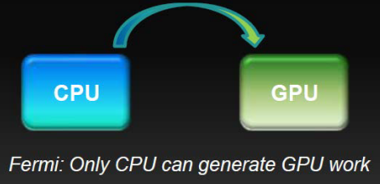
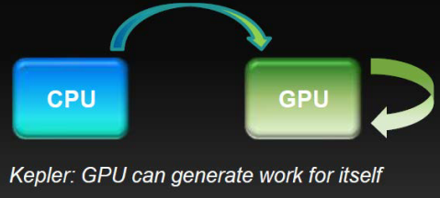
Dynamic parallelism
The ability to launch new grids from the GPU
Dynamically
Simultaneously
Independently
Supported from CUDA5.0 on devices of Compute Capability 3.5 or higher

Slide 30
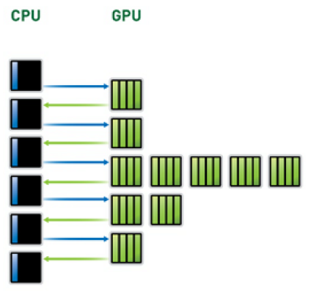
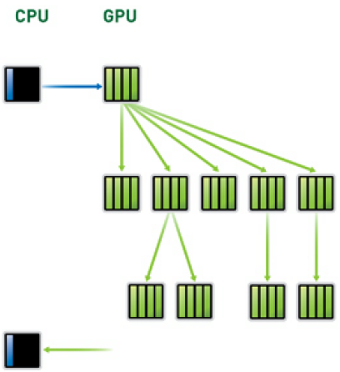
What does it mean?
Reduce the number of kernel launches
Dynamic parallelism

Slide 31
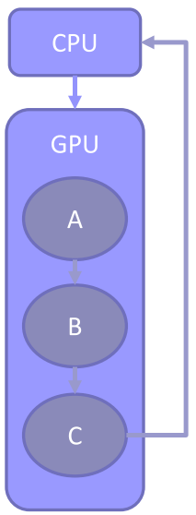
Dependency in CUDA
void main() {
float *data;
do_stuff(data);
A <<< ... >>> (data);
B <<< ... >>> (data);
C <<< ... >>> (data);
cudaDeviceSynchronize();
do_more_stuff(data);
}

Slide 32
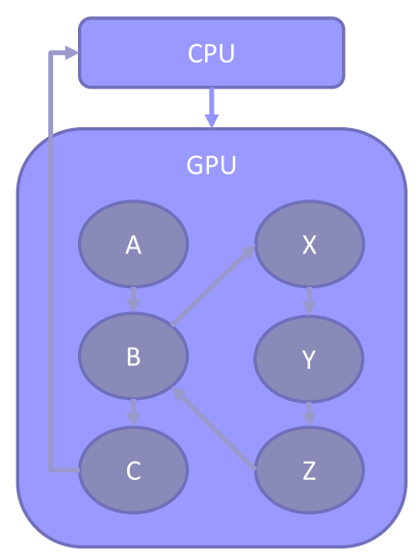
Nested dependency
void main() {
float *data;
do_stuff(data);
A <<< ... >>> (data);
B <<< ... >>> (data);
C <<< ... >>> (data);
cudaDeviceSynchronize();
do_more_stuff(data);
}
__global__ void B(float *data){
do_stuff(data);
X <<< ... >>> (data);
Y <<< ... >>> (data);
Z <<< ... >>> (data);
cudaDeviceSynchronize();
do_more_stuff(data);
}

Slide 33
What is DP good for?
Dynamic block size and grid size
Dynamic work generation
Nested parallelism
Library calls
Parallel recursion

Slide 34
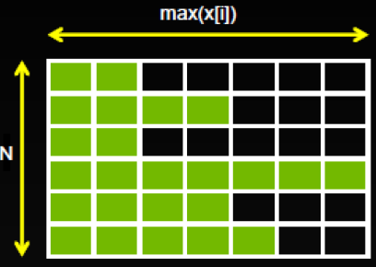
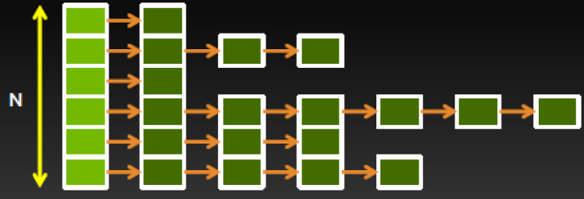
1. Dynamic block size and grid size
for i = 1 to N
for j = 1 to x[i]
convolution(i, j)
next j
next i

Slide 35
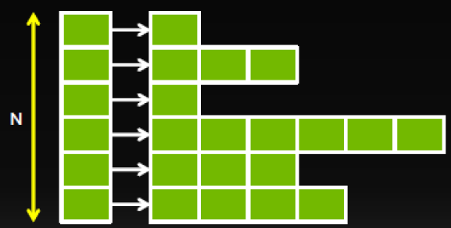
1. Dynamic block size with DP
__global__ void convolution(int x[]){
for j = 1 to x[blockIdx]
kernel<<< ... >>>(blockIdx, j)
}
...
convolution<<< N, 1 >>>(x);

