Slide 1
GUDA Introduction IV Performance (Memory) Optimization
林政宏
國立台灣師範大學電機系

Slide 2
APOD Process
Access
Understanding the end-user's requirements and constraints to determine the upper bound of performance improvement
Parallelize
Write the GPU code
Optimize
Optimize the implementation to improve performance.
Deploy
Compare the outcome with the original expectation
It is a cycle rather than a line.
Access
Deploy
Parallize
Optimize

Slide 3
Communication vs Computation
Peak performance for Kepler
The peak processing performance is 3935 Gflops.
The bandwidth is 250GB/s, which equals to 63G floating point data per second.
The ratio is about 60 times
Instruction execution
Each computation instruction takes 1~4 cycles
Each load/store instruction for global memory access takes 400~800 cycles
Memory access to shared memory can be 1~20 cycles
The ratio is about 100 times

Slide 4
Data Pre-fetch and Reuse
GPU has faster memory spaces (but smaller)
Shared memory / L1 cache
Register file
Solution:
Hardware: prefetch data to shared memory or registers for later computation (hardware)
Software/Programmer: minimize memory usage & reuse the data in shared memory or registers as many times as possible

Slide 5
Multitasking Model
Why do we need more (software) threads than (hardware) core?
Even with the price of context switch and resource contention…
Multitasking allows massive threads to cover the latency of communication and computation
If one thread (warp) is waiting for memory RW or computation dependency, other thread (warp) can fill in the idle time
Best scenario
All cores and memory bus are busy all the time.

Slide 6
Hardware Consideration
To get the peak performance of data transfer, should take care of the hardware properties
Reduce the number of data transfers
Maximize the bandwidth usage
Maximize the shared memory/register usage
Host memory ⬅➔Device memory
Pined memory
Asynchronous data transfer
Streams
Global memory ⬅➔ shared memory or register
Tiled algorithm
Memory coalescing
Shared memory ⬅➔ register
Bank conflicts avoidance
Register per threads
Register spilling

Slide 7
Optimization Flow
Design algorithm to use shared memory with the minimum number of data transfer
Decide the number of threads per block to hide the latency and to minimize register splitting
Design the data structure and access pattern to achieve memory coalescing and to avoid bank conflicts
Performance optimization for instruction execution

Slide 8
Outline
Host memory ⬅➔Device memory
Pined memory
Asynchronous data transfer
Streams
Global memory ⬅➔ shared memory or register
Tiled algorithm
Memory coalescing
Shared memory ⬅➔ register
Bank conflicts avoidance
Register per threads
Register spilling

Slide 9
Host-Device Data Transfer
Device to host memory bandwidth much lower than device to device bandwidth
8 GB/s peak (PCI-e x16 Gen 2) vs. 141 GB/s peak (GTX 280)
Minimize transfers
Intermediate data can be allocated, operated on, and deallocated without ever copying them to host memory
Group transfers
One large transfer much better than many small ones
Asynchronous data transfer
Overlap communication and computation time

Slide 10
Page-Locked Data Transfers
cudaMallocHost() allows allocation of pagelocked (“pinned”) host memory
Enables highest cudaMemcpy performance
3.2 GB/s on PCI-e x16 Gen1
5.2 GB/s on PCI-e x16 Gen2
Use with caution!!
Allocating too much page-locked memory can reduce overall system performance

Slide 11
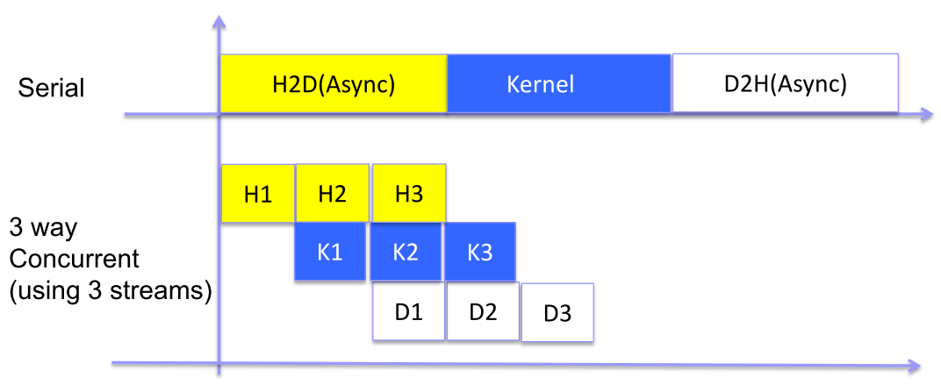
Overlapping Data Transfer & Computation
Async and Stream APIs allow overlap of H2D or D2H data transfers with computation

Slide 12
Asynchronous Functions
To facilitate concurrent execution between host and device, some function calls are asynchronous: Control is returned to the host thread before the device has completed the requested task. These are:
1. Kernel launches; <<< >>>
2. Memory copies between two addresses to the same device memory;
3. Memory copies from host to device of a memory block of 64 KB or less;
4. Memory copies performed by functions that are suffixed with Async;
5. Memory set function calls

Slide 13
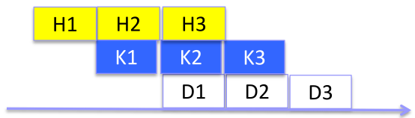
CUDA Streams
A sequence of operations that execute on the device in the order in which they are issued by the host code
Operations in different streams can be interleaved and, when possible, they can even run concurrently
A stream can be sequence of kernel launches and host-device memory copies
Can have several open streams to the same device at once
Need GPUs with concurrent transfer/execution capability
Potential performance improvement: can overlap transfer and computation

Slide 14
Default Stream (A.k.a Stream 0)
Stream used when no stream is specified
Completely synchronous w.r.t. host and device
As if cudaDeviceSynchronize() inserted before and after every CUDA operation
Exceptions – asynchronous w.r.t. host
Kernel launches in the default stream (dynamic parallelism)
cudaMemcpy*Async
cudaMemset*Async
cudaMemcpy within the same device
H2D cudaMemcpy of 64kB or less

Slide 15
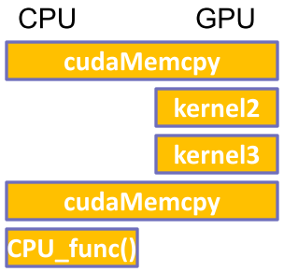
Synchronous (default stream)
cudaMalloc ( &dev1, size ) ;
double* host1 = (double*) malloc ( &host1, size ) ;
…
// cudaMemcpy blocks until copy is completed
cudaMemcpy ( dev1, host1, size, H2D ) ;
// two kernels are serialized and executed on device
kernel2 <<< grid, block>>> ( …, dev2, … ) ;
kernel3 <<< grid, block>>> ( …, dev3, … ) ;
// cudaMemcpy starts after kernels finish
// and blocks until copy is completed
cudaMemcpy ( host4, dev4, size, D2H ) ;
CPU_func();
All CUDA operations in the default stream are synchronous
But no overlap between kernel2&3

Slide 16
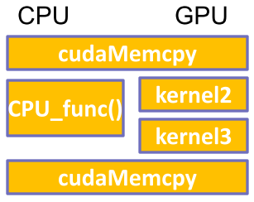
Asynchronous w/o Streams
cudaMalloc(&dev1, size) ;
double* host1=(double*) malloc (&host1, size);
...
cudaMemcpy (dev1, host1, size, H2D) ;
kernel2 <<< grid, block >>> ( …, dev2, … );
CPU_method ();
kernel3 <<< grid, block >>> ( …, dev3, … );
cudaMemcpy ( host4, dev4, size, D2H ) ;
...
GPU kernels are asynchronous with host by default

Slide 17
Asynchronous Data Transfers w/o Streams
Asynchronous host-device memory copy returns control immediately to CPU
cudaMemcpyAsync(dst, src, size, dir, stream);
requires pinned host memory (allocated by “cudaMallocHost”)
Overlap CPU computation with data transfer
0 = default stream
cudaMemcpyAsync(a_d, a_h, size, cudaMemcpyHostToDevice, 0);
kernel<<<grid, block>>>(a_d);
CPU_func();
overlapped

Slide 18
Multiple Streams
Different streams may execute their commands out of order with respect to one another or concurrently
Example
cudaStream_t stream[2];
cudaStreamCreate(&stream[0]);
cudaStreamCreate(&stream[1]);
cudaMallocHost(&hostPtr, 2 * size); // pined memory
for (int i = 0; i < 2; ++i) {
cudaMemcpyAsync(/*…*/, // async memcpy
cudaMemcpyHostToDevice, stream[i]);
kernel<<<100,512,0, stream[i] >>>(/*…*/);
cudaMemcpyAsync(/*…*/,
cudaMemcpyDeviceToHost, stream[i]);
}
cudaStreamDestroy(stream[0]);
cudaStreamDestroy(stream[1]);

Slide 19
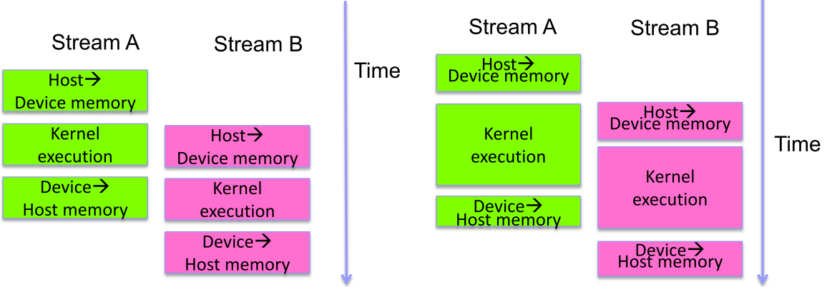
How the streams overlap?
Assume device is capable of:
Overlapping of data transfer and kernel execution
Concurrent kernel execution
Concurrent data transfer
But less benefit in unbalanced case

Slide 20
Explicit GPU/CPU Synchronization
Device based
cudaDeviceSynchronize()
Blocks host until all issued CUDA calls to a device complete
Context based
cudaThreadSynchronize()
Blocks host until all issued CUDA calls from a CPU thread complete
Stream based
cudaStreamSynchronize(stream-id)
Blocks host until all CUDA calls in stream stream-id complete
cudaStreamQuery(stream-id)
Indicates whether event has recorded
Returns cudaSuccess, cudaErrorNotReady
Does not block CPU thread

Slide 21
GPU/CPU Synchronization by Events
cudaEventRecord (event, stream-id )
Insert ‘events‘ in streams
Event is recorded when GPU reaches it in a stream
Record = assigned a timestamp (GPU clocktick)
Useful for timing
cudaEventSynchronize (event)
Blocks CPU thread until event is recorded
cudaEventQuery (stream-id, event)
Indicates whether event has recorded
Returns cudaSuccess, cudaErrorNotReady
Does not block CPU thread
cudaStreamWaitEvent (steam-id, event)
Block a GPU stream until event reports completion

Slide 22
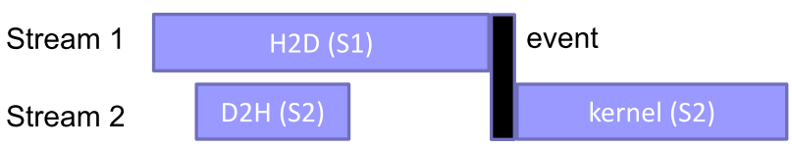
Example: Explicit Sync
cudaEvent_t event;
cudaEventCreate (&event); // create event
// 1) H2D copy of new input
cudaMemcpyAsync ( d_in, in, size, H2D, stream1 );
cudaEventRecord (event, stream1); // record event
// 2) D2H copy of previous result
cudaMemcpyAsync ( out, d_out, size, D2H, stream2 );
// wait for event in stream1
cudaStreamWaitEvent ( stream2, event );
// 3) must wait for 1 and 2
kernel <<< , , , stream2 >>> ( d_in, d_out );
asynchronousCPUmethod ( … ) // Async GPU method

Slide 23
Implicit Synchronization
These operations implicitly synchronize all other CUDA operations
1. Page-locked memory allocation
cudaMallocHost
cudaHostAlloc
2. Device memory allocation
cudaMalloc
3. Non-Async version of memory operations
cudaMemcpy* (no Async suffix)
cudaMemset* (no Async suffix)
4. Change to L1/shared memory configuration
cudaDeviceSetCacheConfig

Slide 24
Outline
Host memory ⬅➔Device memory
Pined memory
Asynchronous data transfer
Streams
Global memory ⬅➔ shared memory or register
Tiled algorithm
Memory coalescing
Shared memory ⬅➔ register
Bank conflicts avoidance
Register per threads
Register spilling

Slide 25
Example: Matrix Multiply
Compute C = A x B, where A, B, C are N by N matrices
Compute to Global Memory Access (CGMA) ratio
Compute = 1 multiplication + 1 addition; Memory access = 2
CGMA = 1
K20x (Kepler)
Compute = 3950 GFLOPs; Global memory BW = 250GB/s
Compute / Comm. = 3950x4/250 ≈ 64
CGMA must increase to 64!
For i = 1:N
For j = 1:N
For k = 1:N
C[i][j]+=A[i][k]*B[k][j]
Let each thread compute one element C[i][j]
Floating point takes 4 bytes

Slide 26
Version1: Load all data to shared mem.
Each thread loads 2 elements, and do 2N computations
Every element is re-used N times
If N>64 CGMA > 64
But in reality, shared memory is small (e.g. 48KB)
Suppose N=1024. The data are stored in 3N² matrices of integers or floats (3*1,024*1,024*4=12MB), which is much larger than the size of shared memory 48K
To compute C[i][j], it needs 2N data A[i][*] and B[*][j], which are 2*1024*4 = 8 K
For 48K shared memory, only 6 C[i][j] can be computed
Which part of data should be stored in shared memory for re-use?

