Slide 1
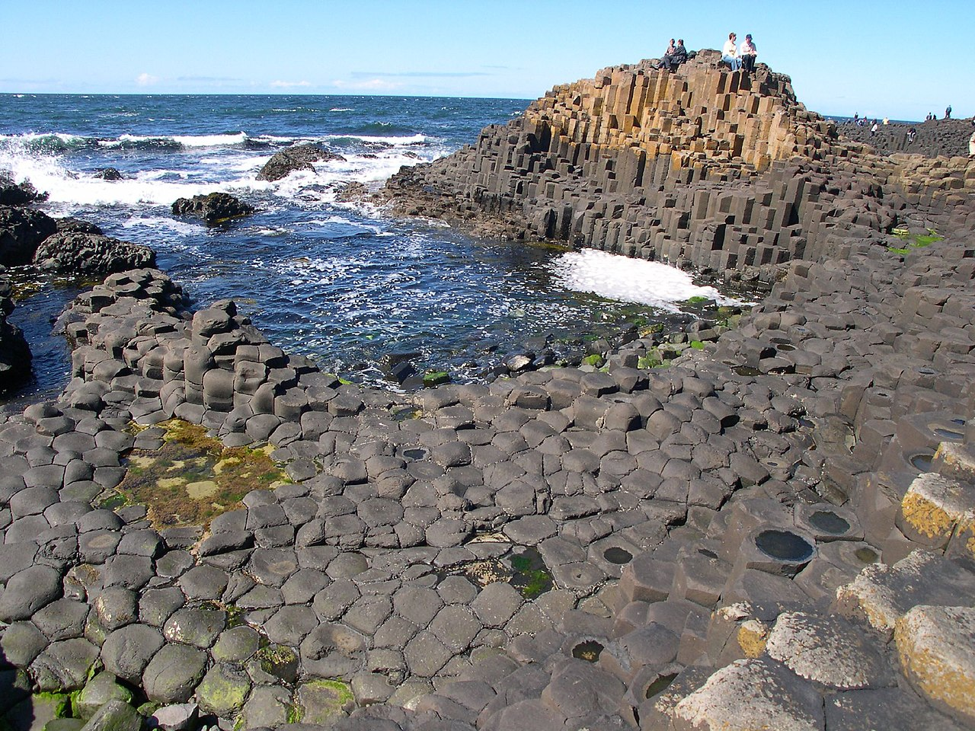
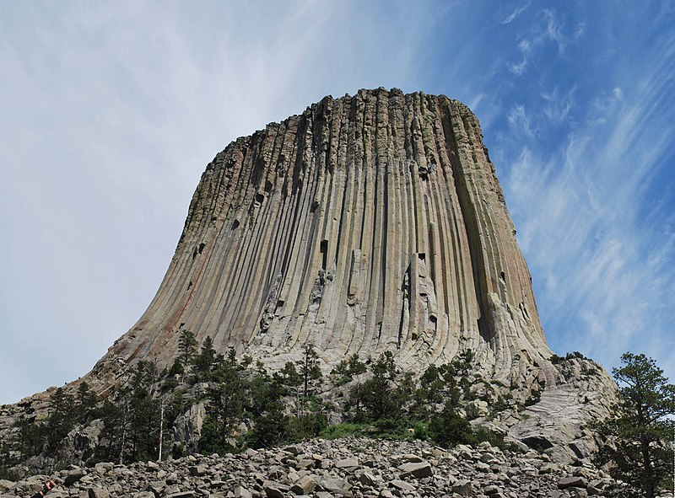
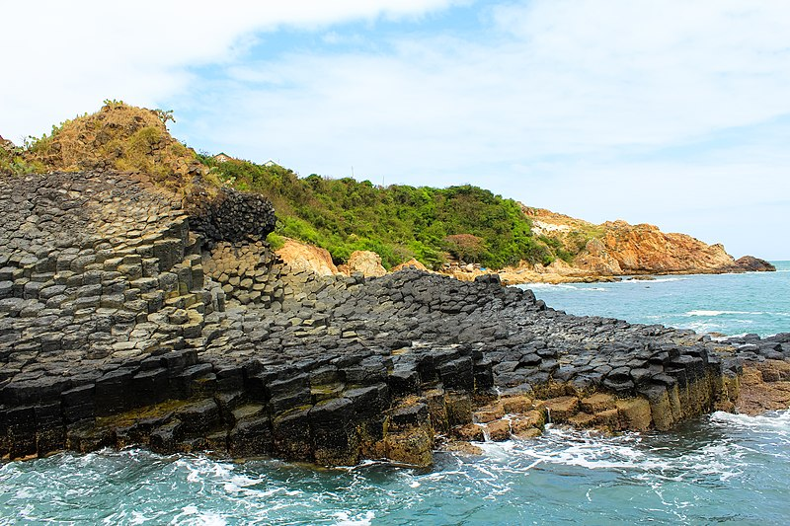
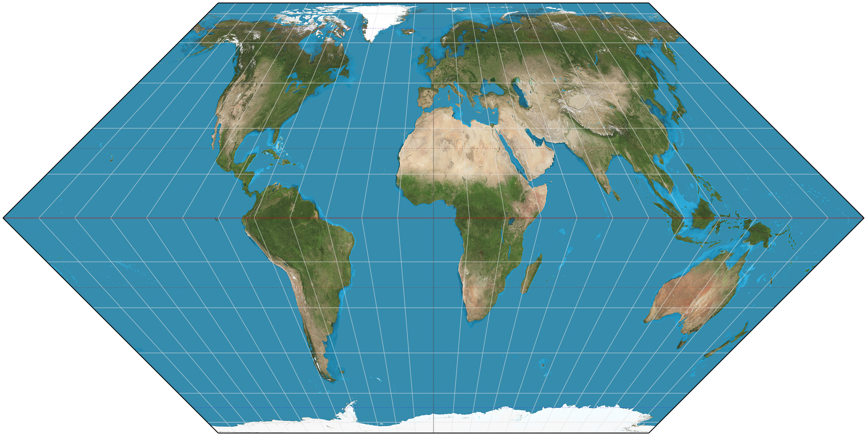
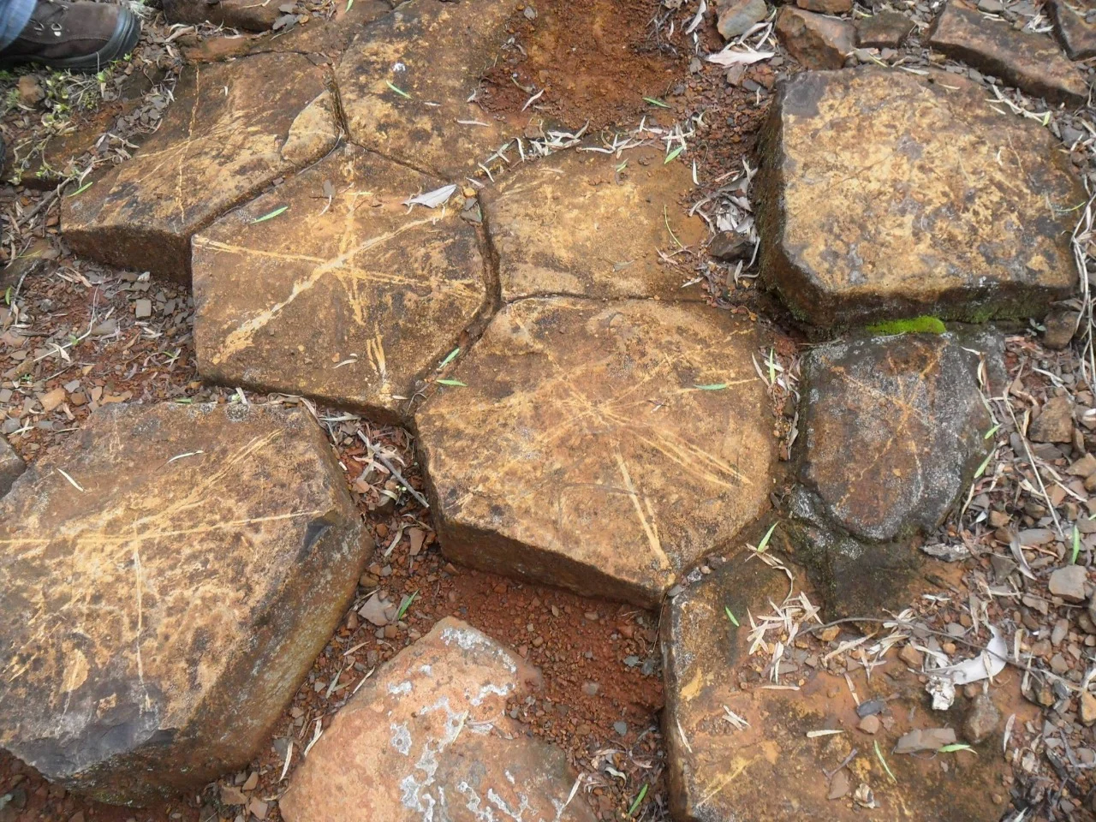
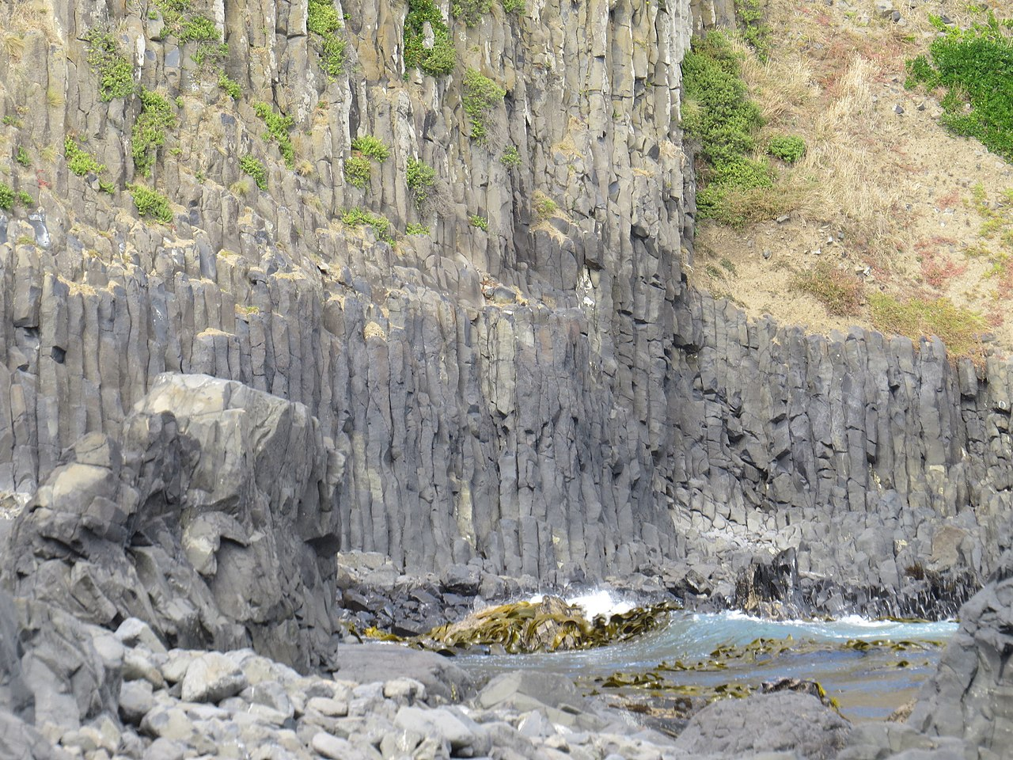
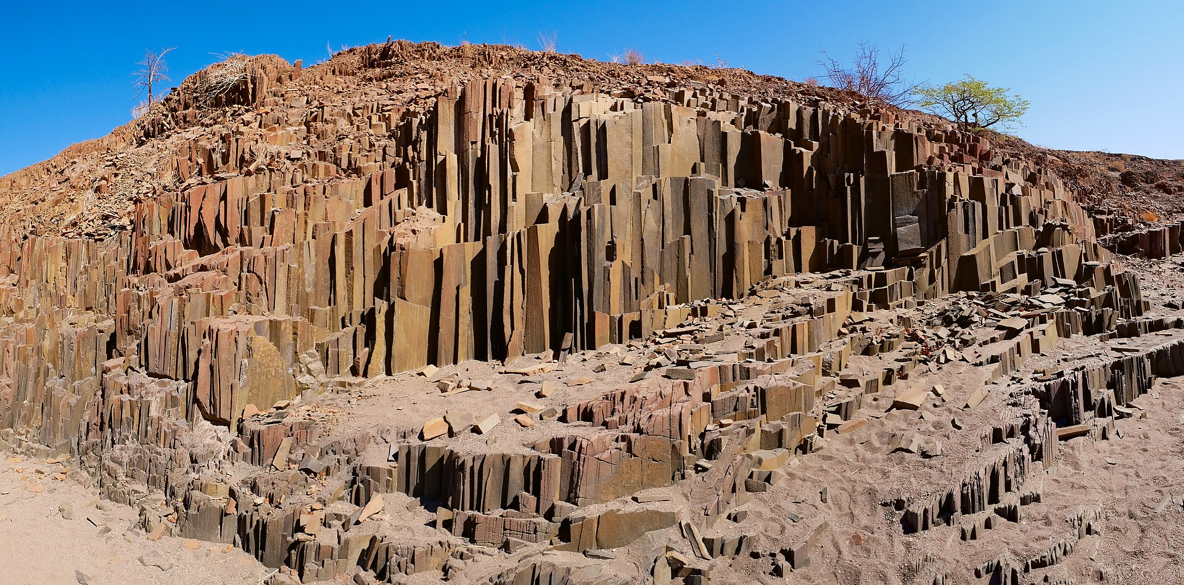
Giant’s Causeway, Northern Ireland, UK
Devils Tower, Wyoming, USA
The Cliff of Stone Plates, Phú Yên, Vietnam
Pedras do Cambira, Apucarana, Brazil
Blackhead, Dunedin, New Zealand
Organ Pipes, Twyfelfontein, Namibia

