Slide 1
MVP: Airbnb Price Estimator
Helping investors estimate nightly Airbnb rental income

Slide 2
Why price estimation?
Problem: Performing real estate comparisons by hand is time consuming and requires industry knowledge
Solution: To help everyday investors, MVP should take basic, readily available information about the property as input, and output a reasonable nightly rental estimate
Result: Product will save clients time and energy on the comps process and give them a reliable starting price point
Price data is often linearly correlated with many features
Square footage, number of bedrooms, location (latitude and longitude)

Slide 3
Multiple Linear Regression
Incorporates multiple features
Considers multiple relevant features simultaneously, such as the number of bedrooms, location, amenities, and more.
Valuable for predicting prices because property prices are often influenced by a combination of factors.
Quantifies feature relationships to price
By analyzing coefficients, we can determine the impact of each feature on the property's price.
For example, we can assess how the number of bedrooms, location, or amenities affect the rental price.
Promotes simplicity and interpretability
Provides interpretable results, making it easier to explain to property owners why a particular price prediction was made. This transparency is important as hosts may want to adjust their listings based on factors that drive pricing.

Slide 4
Part 1. Data Exploration and Preprocessing

Slide 5
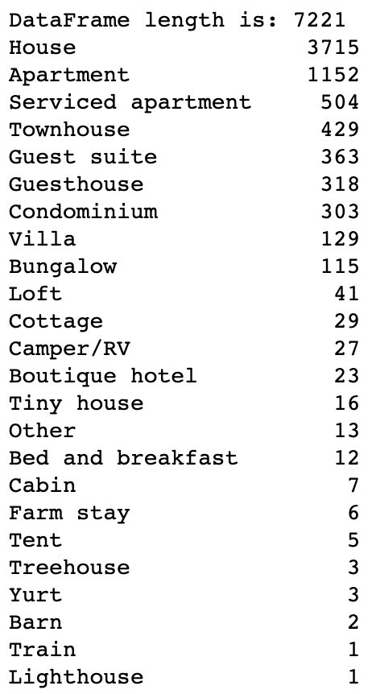
Focus on houses and apartments
Houses and apartments are the most common property types in the dataset: roughly 70%
Houses: 3715
Apartments: 1152
The other property types include "serviced apartments", guest houses, cabins, tents, yurts, and even trains
For this MVP, we will concentrate on the two most common property types: houses and apartments
Do not want model to suffer from data sparsity

Slide 6
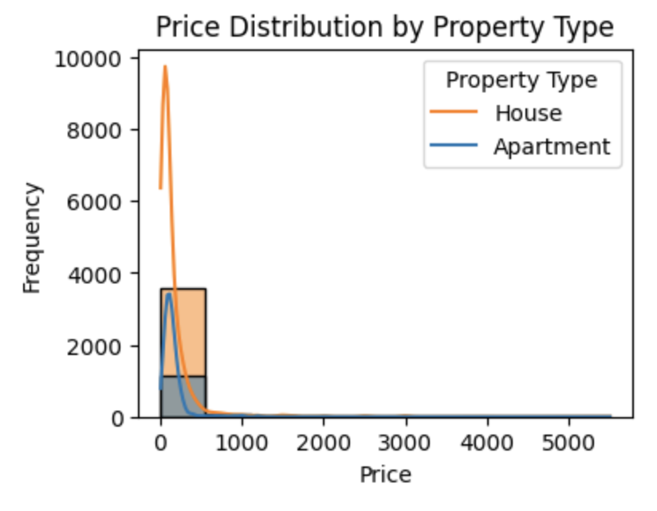
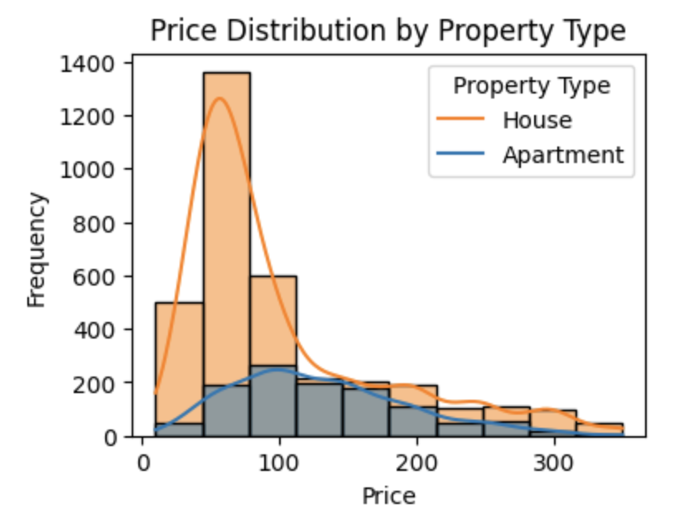
Price preprocessing and price outliers
BEFORE
Preprocess the price column by removing ',' and '$', and converting to numeric
Price column contains some major outliers that make the distribution almost impossible to interpret
A good threshold for model performance is to remove outlier prices of over $350
Price distribution becomes much more interpretable
AFTER

Slide 7
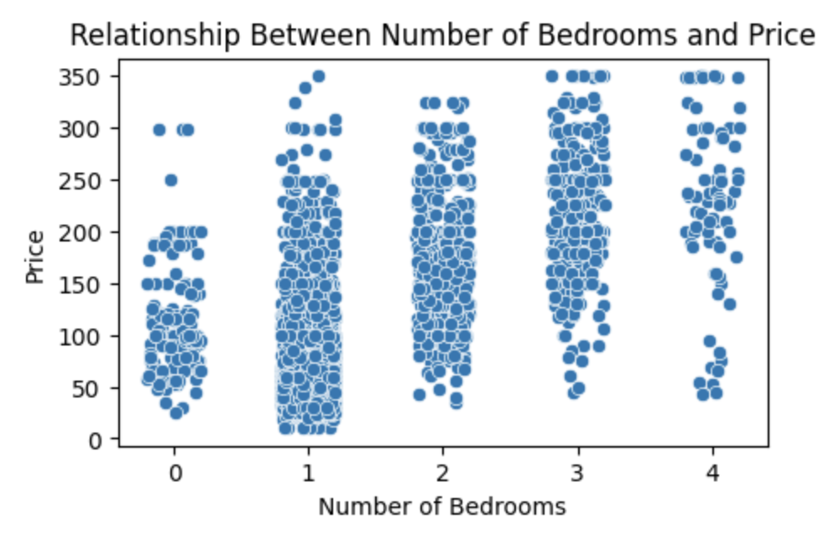
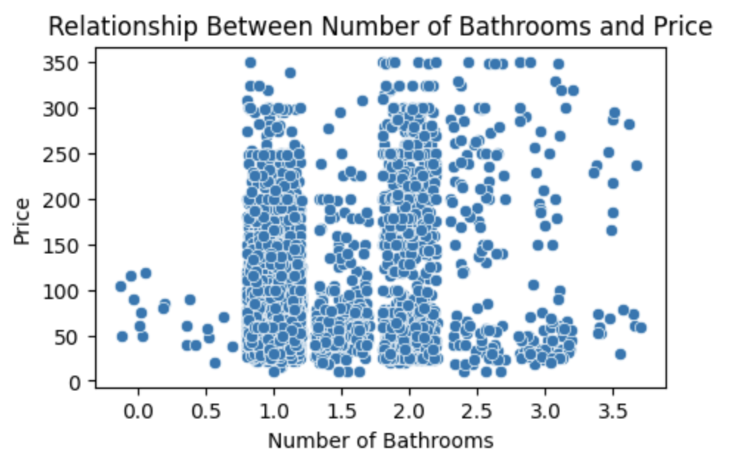
Numeric features
Price by bedrooms
Key numeric features:
accommodates, bedrooms, latitude, longitude, guests_included
Have linear correlation with price
Can be provided by the user or autogenerated (e.g. latitude and longitude)
Interestingly, bathrooms does not have a useful linear relationship to price
Remove outliers as we examine different features
Price by bathrooms

Slide 8
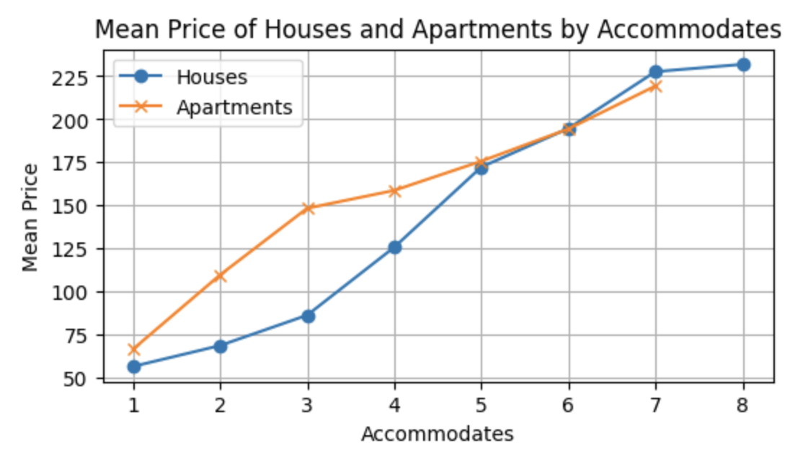
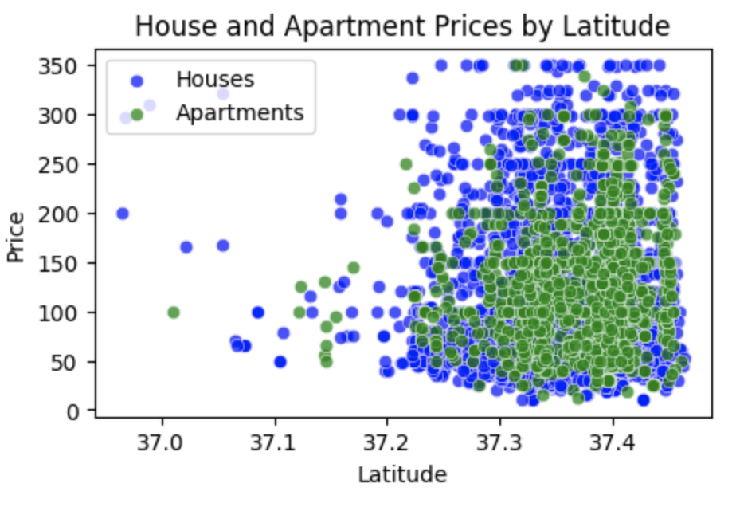
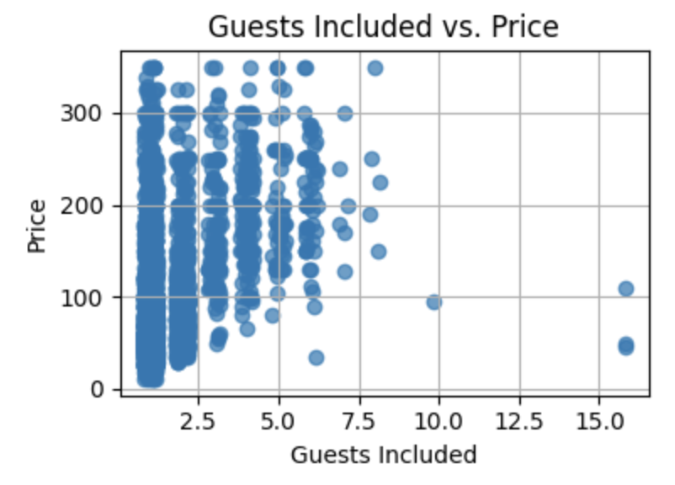
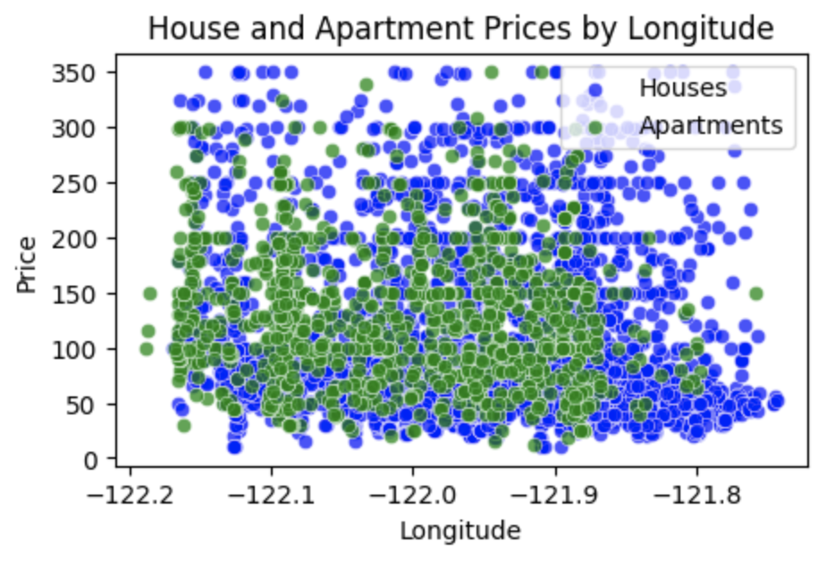

Slide 9
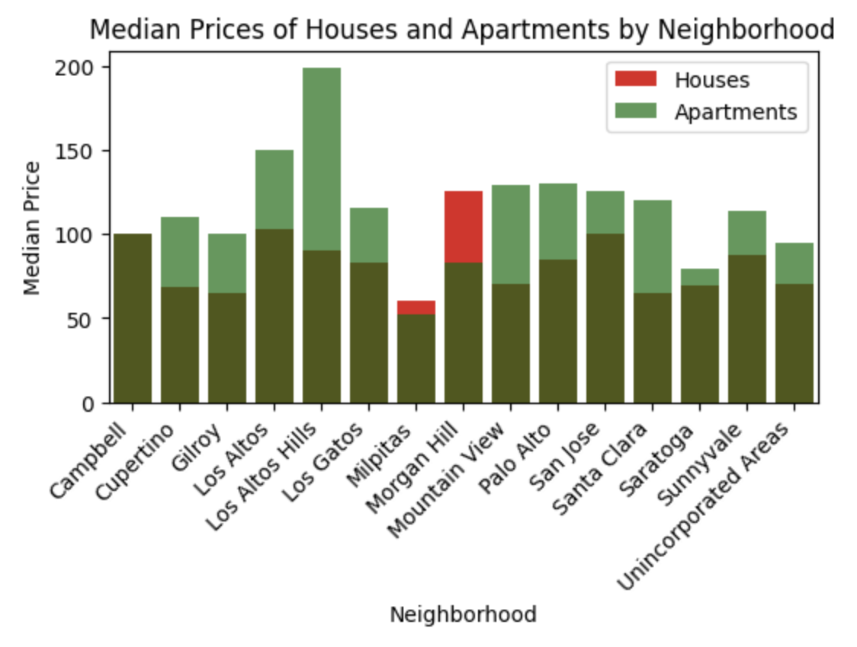
Categorical features
Key categorical features:
neighbourhood_cleansed, property_type, room_type
neighbourhood_cleansed was the most consistent of all the location columns compared to city, neighbourhood, and smart_location; it essentially represents the city
All these features can be easily provided by the user
OHE allows us to capture a linear relationship between these categorical variables and price
Remove outliers as we examine features (e.g. houses by neighborhood, zipcode count)

Slide 10
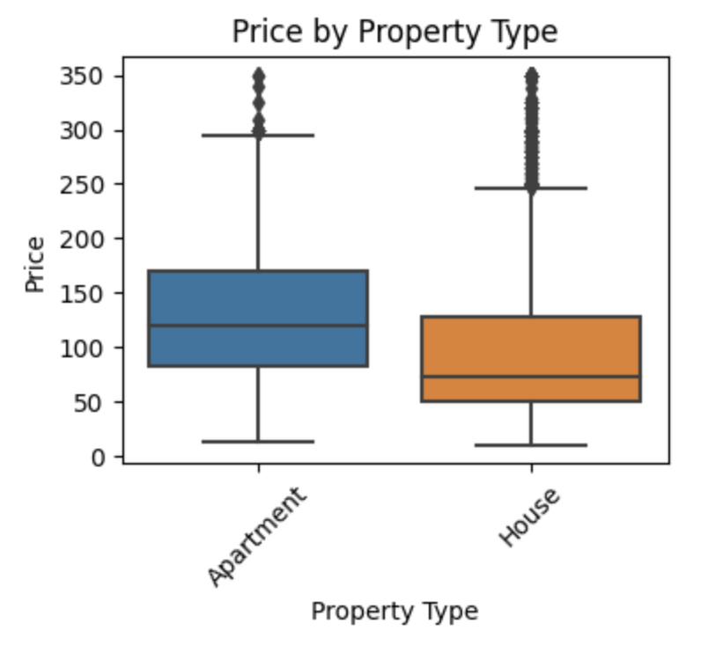
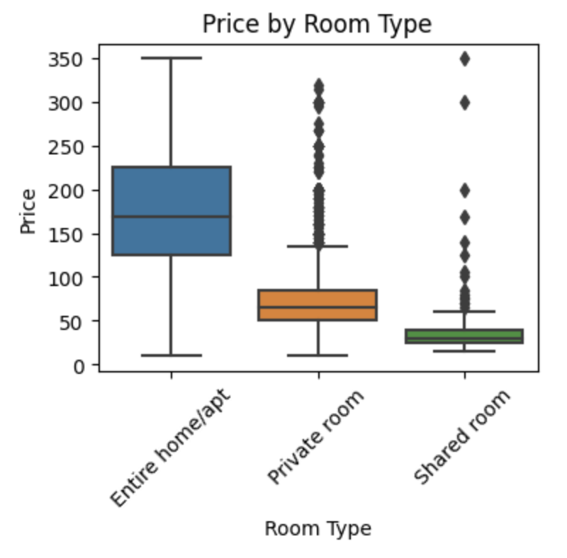

Slide 11
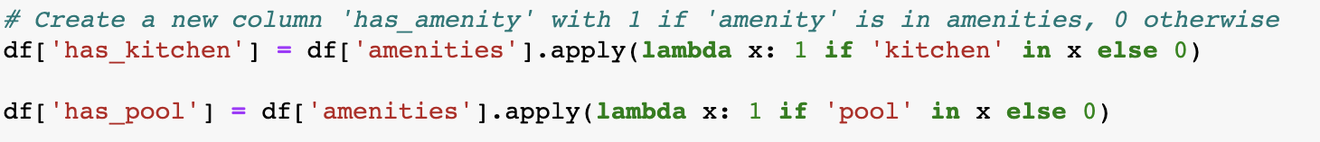
Booleans (subset of categoricals)
Can extract a great number of boolean features from the amenities column
Preprocessed amenities column contains a list of amenities for each data point, such as wifi, essentials, heating, hangers, etc.
Can use lambda expressions to define boolean features based on the amenities
The boolean features I included denote the presence or absence of: kitchen, pool, balcony, gym, dishwasher, hot tub, elevator, and private entrance
There are many others that can be extracted and tested, but these are the ones that worked best for my model

Slide 12
Part 2. Building the Model

Slide 13
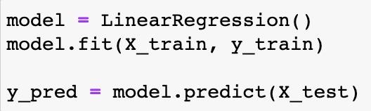
OHE, splitting, and training
One-hot encode the categorical variables using .get_dummies() (represent each category as a separate binary feature)
Split the data into X_train, y_train, X_test, and y_test using .train_test_split()
Fit the sklearn LinearRegression model with the training data: X_train, y_train
Get predicted values for the test data: y_pred = model.predict(X_test)
Input features: accommodates, bedrooms, latitude, longitude, guests_included, neighbourhood_cleansed, property_type, room_type, has_kitchen, has_pool, has_balcony, has_gym, has_dishwasher, has_hot_tub, has_elevator, has_private_entrance
Output feature: price

Slide 14
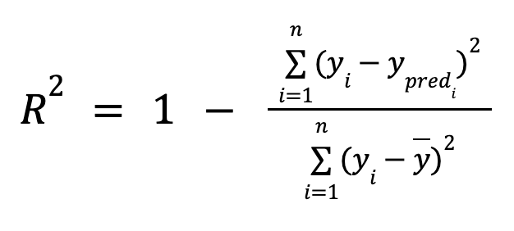
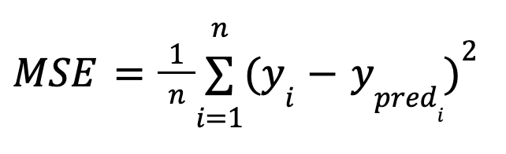
Evaluating the model's performance
Compare y_test and y_pred using mean_squared_error() and r2_score()
Mean squared error (MSE)
Average squared difference between the y_test values and the y_pred values produced by the model
Interpretation: Take the square root of MSE to get an error range
R² score
Compares the variance explained by our regression model to the total variance in the dependent variable (price)
Interpretation: 0 (poor fit) to 1 (perfect fit)

Slide 15
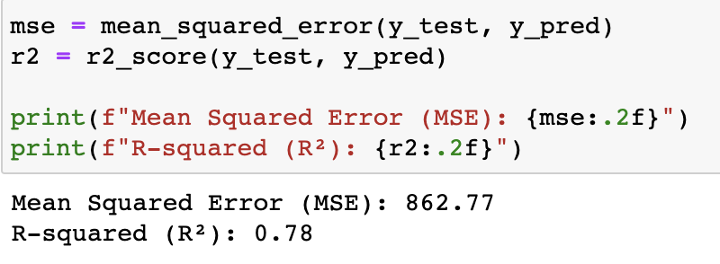


Our model's scores
MSE:
The square root of 862.77 is $29.38
Predictions deviate from actual values by about $29.38 in either direction
R² score:
Indicates that 78% of the variance in price is explained by our input features
Model does a good job of capturing patterns and variations in the data
22% of variance in price is unaccounted for

Slide 16
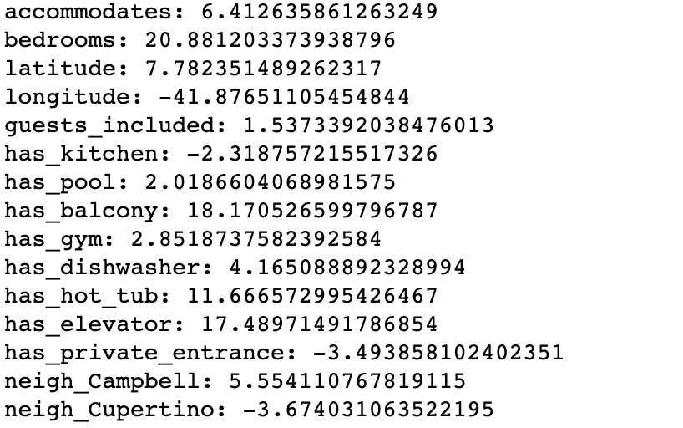
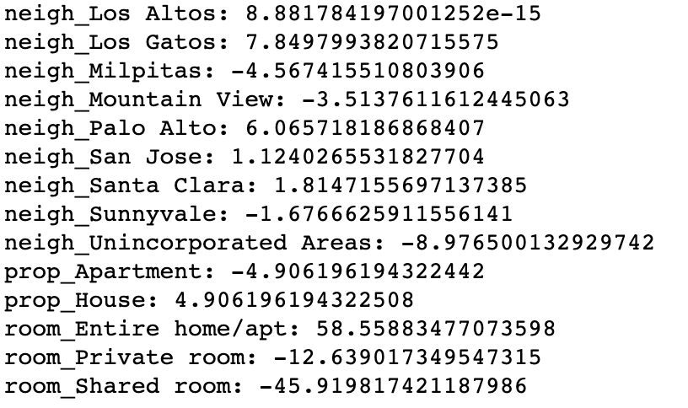


Examining the model coefficients
Model's coefficients reflect the impact each input variable has on the prediction of price
Some interesting standout coefficients highlighted below:

Slide 17
Part 3. Seeing the Model in Action

Slide 18
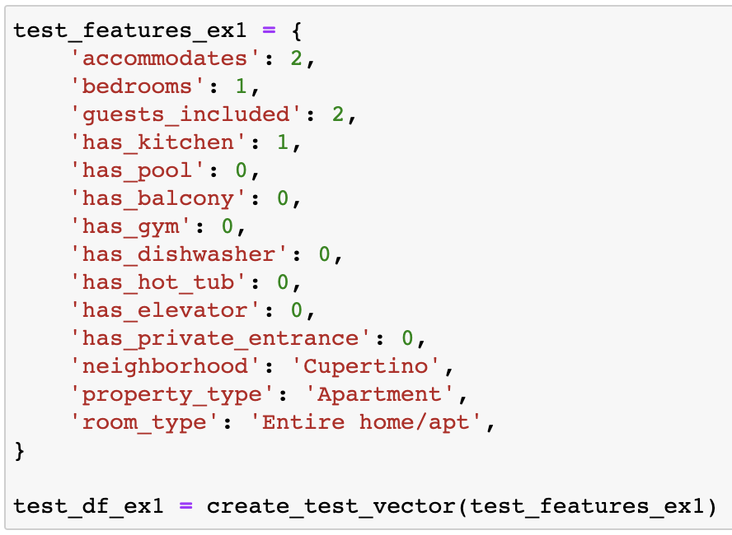
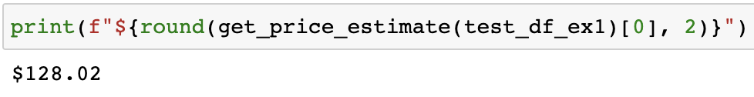
An entire 1bd apartment in Cupertino (mid-price example)

Slide 19
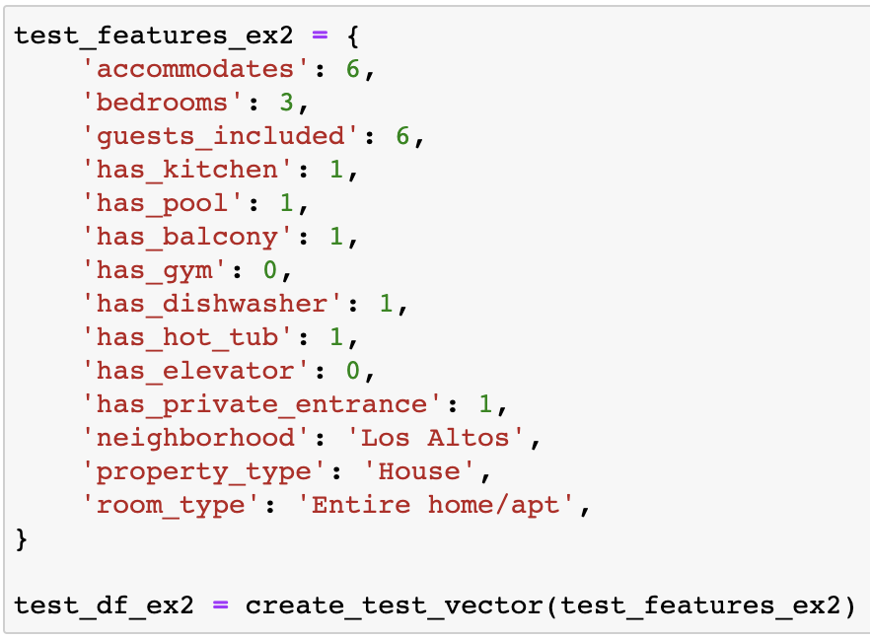
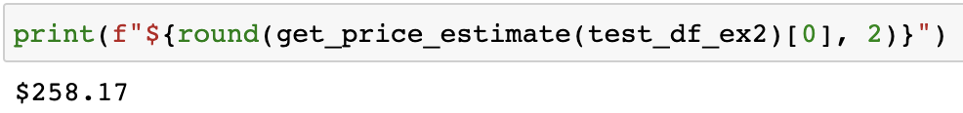
An entire 3bd house in Los Altos (high-price example)

Slide 20
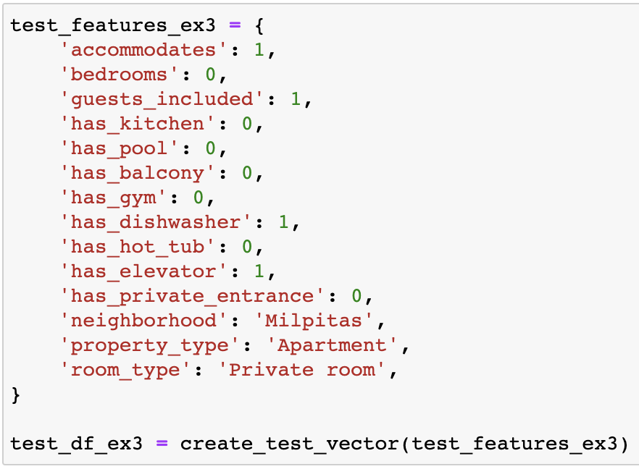
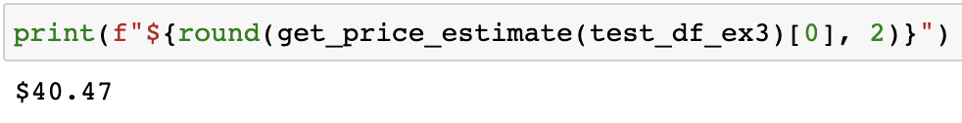
A private room in a 2bd apartment in Milpitas (low-price example)

Slide 21
Part 4. Improvement Opportunities

Slide 22
Square footage, dataset size, and NLP
22% of the variance in price is still unexplained
Our estimates range between ±$29.38
Other models such as SVR and RandomForestRegressor; random forest made a marginal improvement (R² score improved by .01), SVR made no improvement
Square footage
Dataset has very little square footage data
Square footage is closely correlated to price in real estate
Could account for a significant portion of the unexplained variability
Dataset size
A larger dataset of houses and apartments would provide more context
Could expand model to take other property types into account
NLP techniques
Could parse textual columns like description, summary, transit, etc.
Extract tokens that are associated with price or certain price ranges (e.g. near bus station)

