Slide 1

Cryptocurrency Crystal Ball
… a 30 days Forecast into Bitcoin

Slide 2
DRAFT
INTRODUCTION
In recent years cryptocurrencies has been on a constant rise. Cryptocurrencies are used as a means for digital transactions and for investment purposes around the world. Their nature of combining monetary units and encryption technology lately has attached substantial recognition in fields such as economics, computer science and cryptography. Bitcoin being one of the first cryptocurrency which was decentralized now has a market capital of 170 billion US dollars.
Bitcoin offers the opportunity for profit to be made by trading the asset. To implement a trading strategy based on the results of machine learning models is worthy of a study. As a result, this project will focus on the accuracy at which price the direction can be predicted.
Purpose
The purpose of this study is to find out with what accuracy the direction of the price of Bitcoin can be predicted using machine learning methods.
Goal
The goal of this project is to find a model where we can predict the value of the Bitcoin stock 30 days into the future. In short, the model will initiate a buy position if the price is predicted to go up and a sell if the price is predicted to go down.

Slide 3
DRAFT
DATA COLLECTION

Slide 4
DRAFT
PREDICTION ANALYSIS
Develop a cryptocurrency search system with comparative technical analysis of 30 days forecast for a day-trader to utilize.
Define Threshold:
Resistance level – daily highest price
Support level – daily lowest price
If Predicted Bitcoin Price is above threshold → ’Buy’
If Predicted Bitcoin Price is below threshold → ‘Sell’

Slide 5
DRAFT
MACHINE LEARNING MODELS
Two types of models:
Support Vector Machine (‘SVM’)
Deep Learning Model

Slide 6
DRAFT
MODEL - PERFORMANCE
SVM:
Deep Learning Machine:
Text
Text
Text
Text
Text
Text

Slide 7
DRAFT
DASHBOARD
Description of the tools that will be used to create final dashboard
Description of interactive element(s)

Slide 8
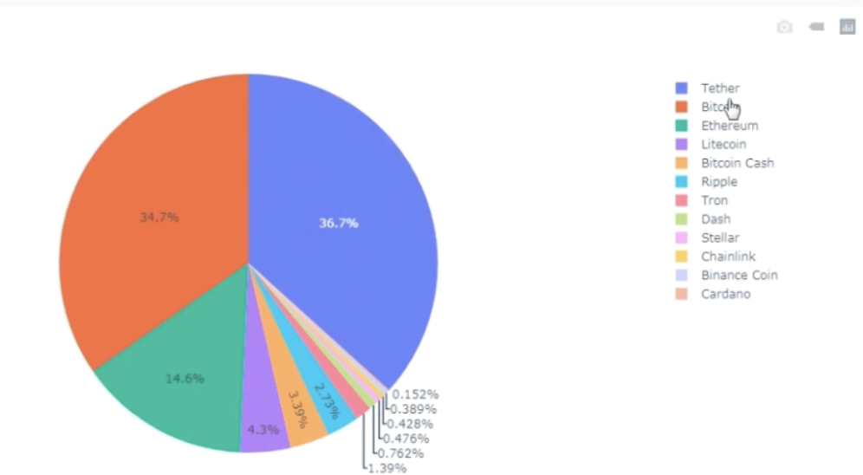
DRAFT
GRAPH 1 - TOP CRYPTOCURRENCIES

Slide 9
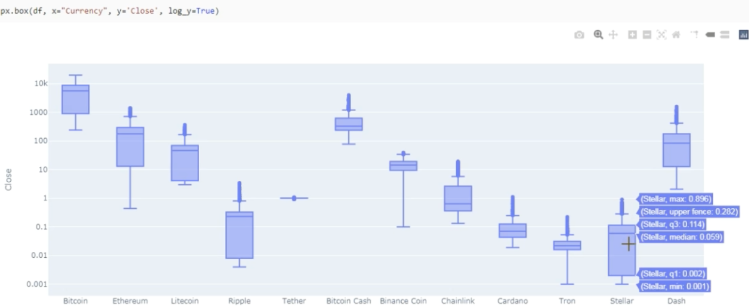
DRAFT
GRAPH 2 - TOP CRYPTOCURRENCIES

Slide 10
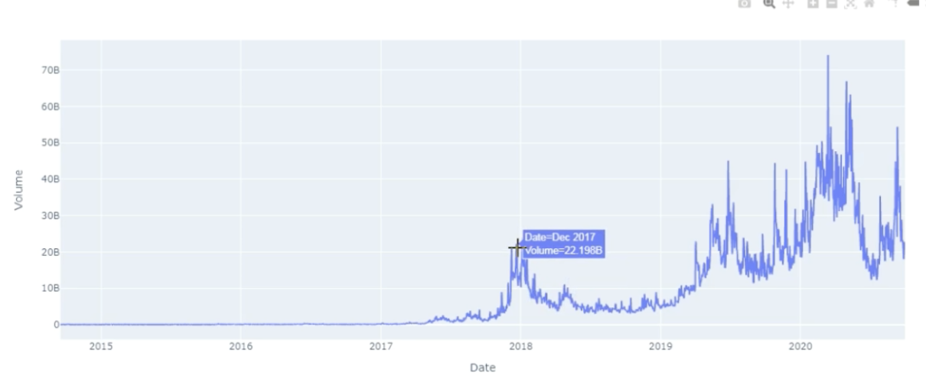
DRAFT
GRAPH 3 - BITCOIN

Slide 11
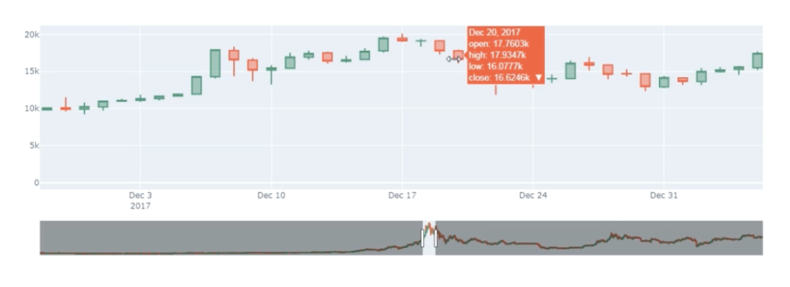
DRAFT
GRAPH 4 – BITCOIN 30 days prediction

Slide 12
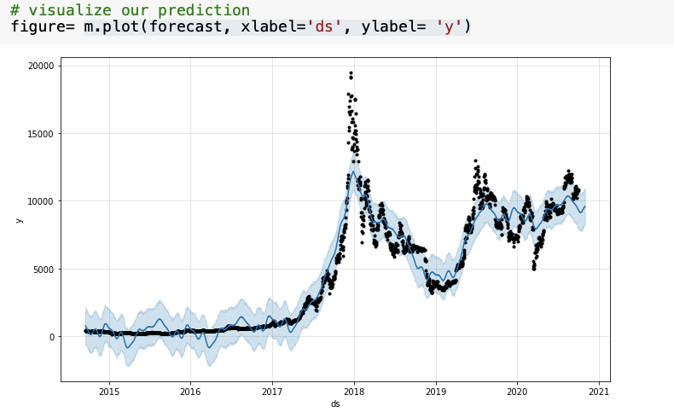
DRAFT
GRAPH 5 – BITCOIN
30 days prediction

Slide 13
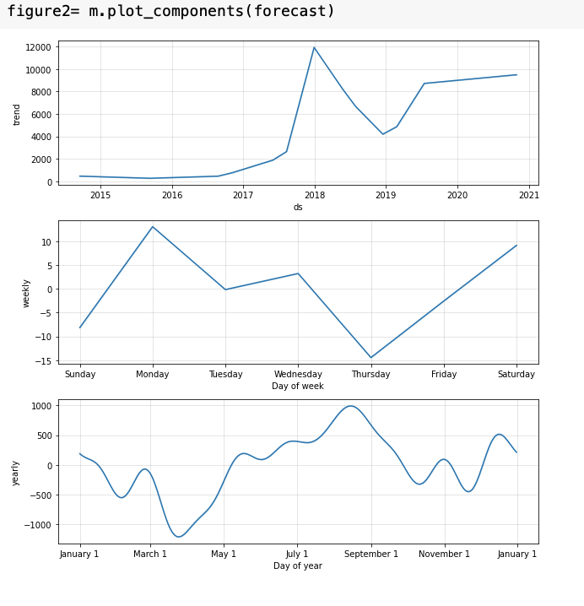
GRAPH 5 – BITCOIN
30 days prediction
DRAFT

Slide 14
DRAFT
GRAPH 6 – BITCOIN

