Slide 1

Cryptocurrency Crystal Ball
30 days Forecast

Slide 2
INTRODUCTION
Background
Cryptocurrencies are digital assets used for transactions and for investment purposes around the world. The largest currency, Bitcoin, has a market cap of $1.1 trillion USD.
Trading Bitcoin provides an opportunity for profit, just like trading stocks. Machine learning models can help predict the price of Bitcoin, to a degree of accuracy, and are being incorporated into trading strategies.
Purpose
The purpose of this study is to find out with what accuracy the price of the top 10 most common cryptocurrencies can be predicted using machine learning methods.
Goal
The goal of this project is to implement a machine learning model that can predict the top 10 most common cryptocurrencies price 30 days into the future. The model will indicate if these coins should be bought or sold depending on the current price.

Slide 3
DATA COLLECTION
Machine Learning Data
Data Source – Kaggle
ETL – Data was stored and called from AWS S3 bucket. Transformed by dropping N/A’s. We then pinpointed a single price point, in our case the “weighted price”
Cleaned Data – minute over minute Bitcoin pricing for 2020
Crypto Currency Analysis Data
Data Source – Facebook Prophet
ETL – Data was stored and called from AWS S3 bucket. It provided the 50 most poplar currencies .
Cleaned Data – day over day pricing for the Top 10 currencies for 2011-2020

Slide 4
PREDICTION ANALYSIS
Develop a cryptocurrency search system with comparative technical analysis of 30 days forecast for a day-trader to utilize.
Define Threshold:
Resistance level – daily highest price
Support level – daily lowest price
If Predicted Bitcoin Price is above threshold → ’Buy’
If Predicted Bitcoin Price is below threshold → ‘Sell’

Slide 5
MACHINE LEARNING MODEL
Support Vector Machine (‘SVM’):
SVM are a set of supervised learning methods used for classificationa, regression and outliers detection.
Advantages are effective in high dimensional spaces and uses a subset of training points in the decision function
Disadvantages are if there are more features than samples the model can overfit and it does not directly provide probability estimates

Slide 6
ANALYSIS
The below graphs are an analysis of our targeted cryptocurrencies. In this phase of the project, we used a source that provided market data on the top 50 most traded currencies, we then cleaned it and filtered to look at the top 10
Using FB Prophet and Colab we were able to create visualizations that give the viewer the best summary of those 10 currencies. These visualizations will be displayed on our dashboard and are interactive

Slide 7
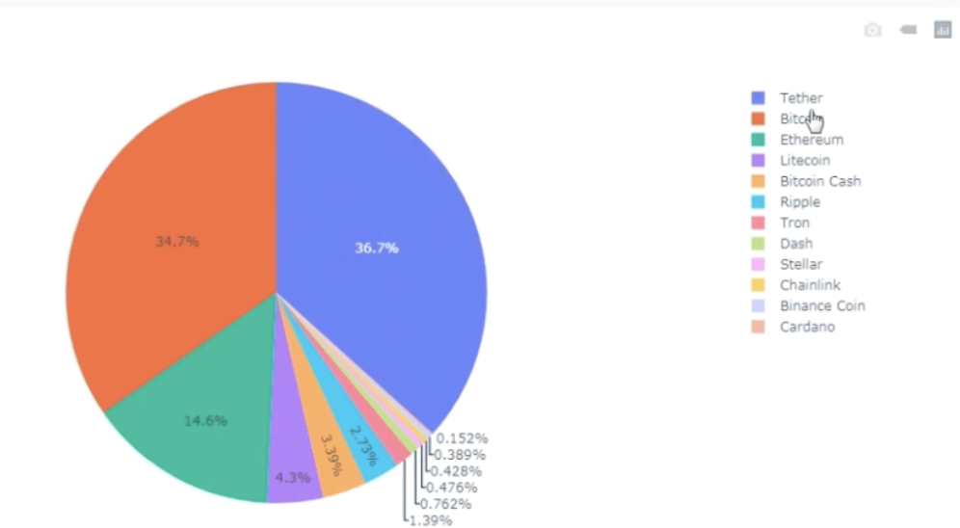
GRAPH 1 - TOP CRYPTOCURRENCIES

Slide 8
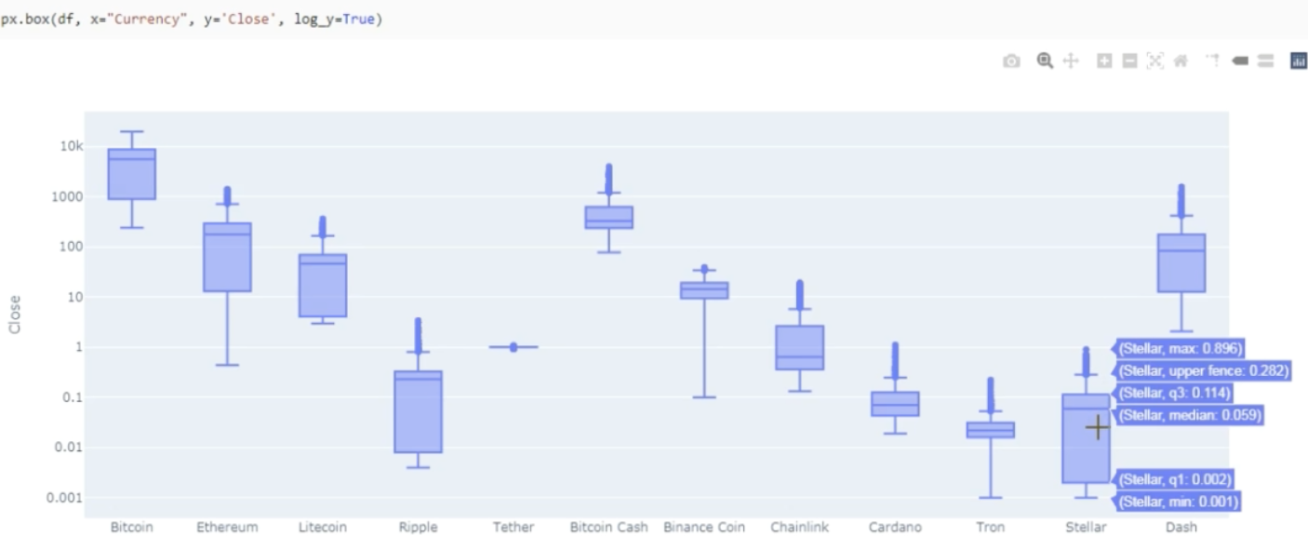
DRAFT
GRAPH 2 - TOP CRYPTOCURRENCIES

Slide 9
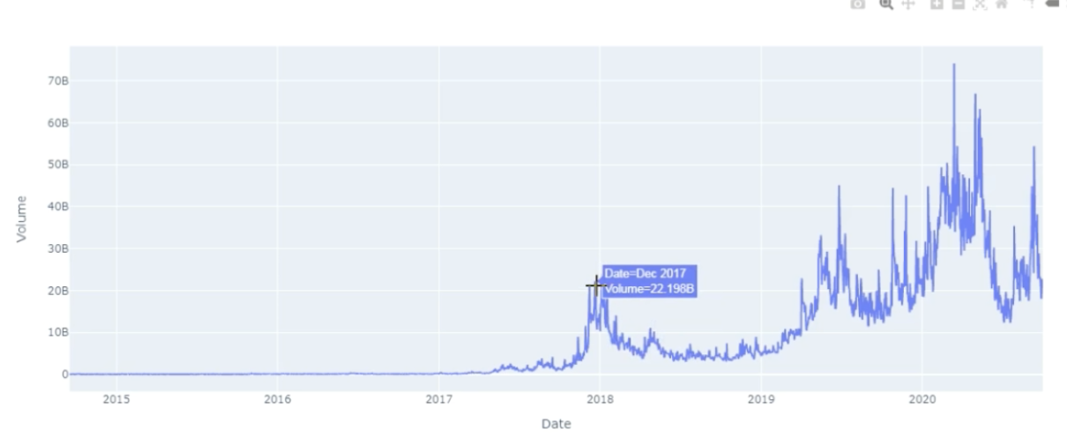
DRAFT
GRAPH 3 - BITCOIN

Slide 10
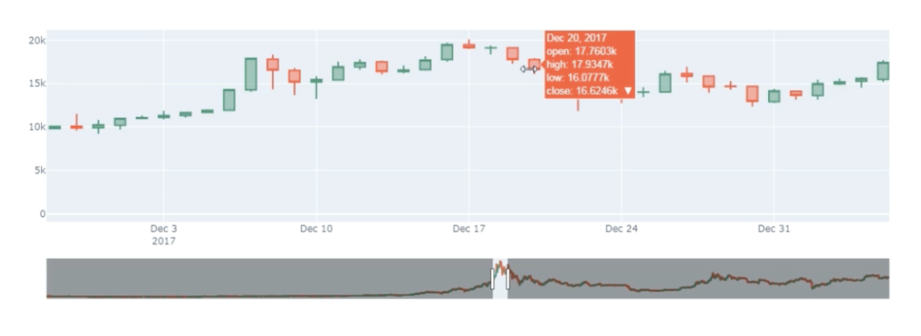
DRAFT
GRAPH 4 – BITCOIN 30 days prediction

Slide 11
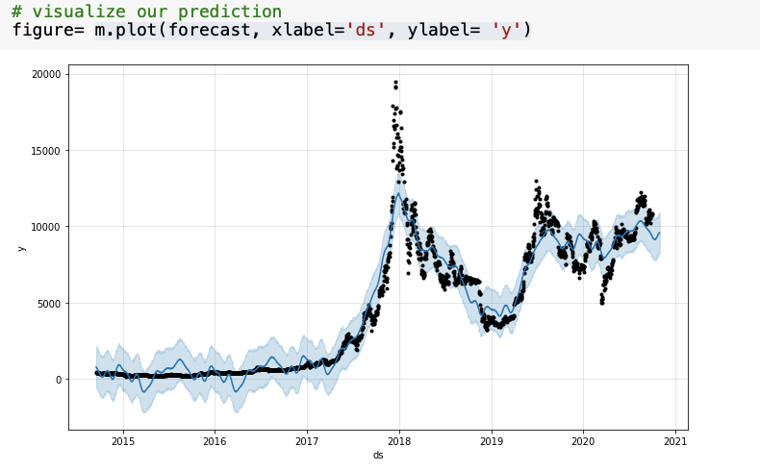
DRAFT
GRAPH 5 – BITCOIN
30 days prediction

Slide 12
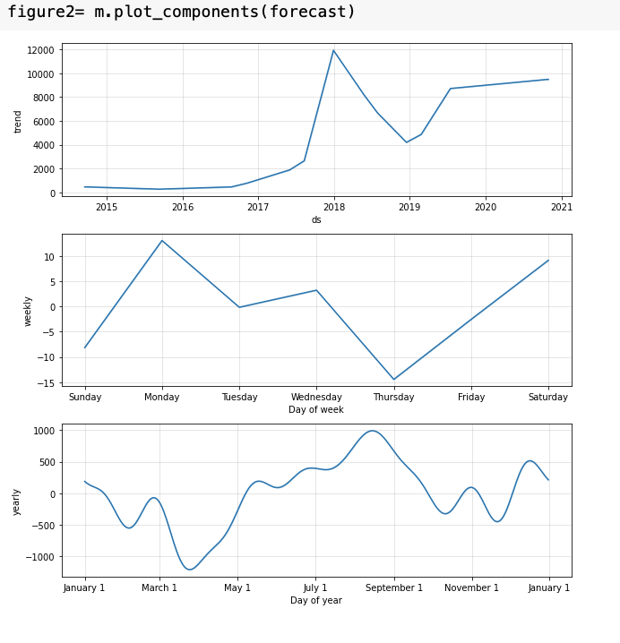
GRAPH 5 – BITCOIN
30 days prediction
DRAFT

Slide 13
DRAFT
GRAPH 6 – BITCOIN

