Slide 1

Analysis of Factors Affecting Road Accidents in the US
An In-depth Exploration of Accident Data
Presented by: Charles Paulinus

Slide 2

Introduction
This analysis explores the factors affecting road accidents in the US. The objective is to understand the key elements influencing accidents and the length of road impacted. Data Source: US Accidents dataset.

Slide 3

Data Preparation and Preprocessing
- Handling missing values.
- Dropping irrelevant or duplicate records.
- Converting data types for analysis.

Slide 4
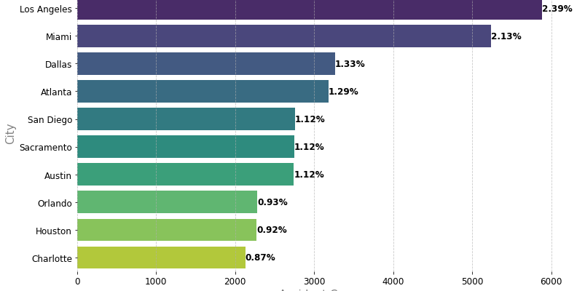
Exploratory Data Analysis (EDA)
Cities with most accidents:
Los Angeles (2.39%)
Miami (2.13%)

Slide 5
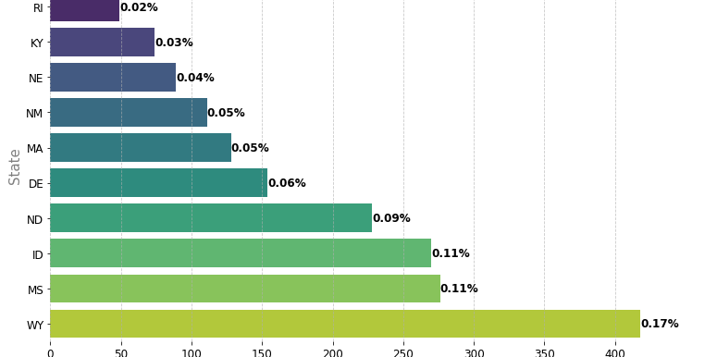
Exploratory Data Analysis (EDA)
Cities with Least Accidents:
Rhode Island (0.02%)
Kentucky (0.03%)

Slide 6
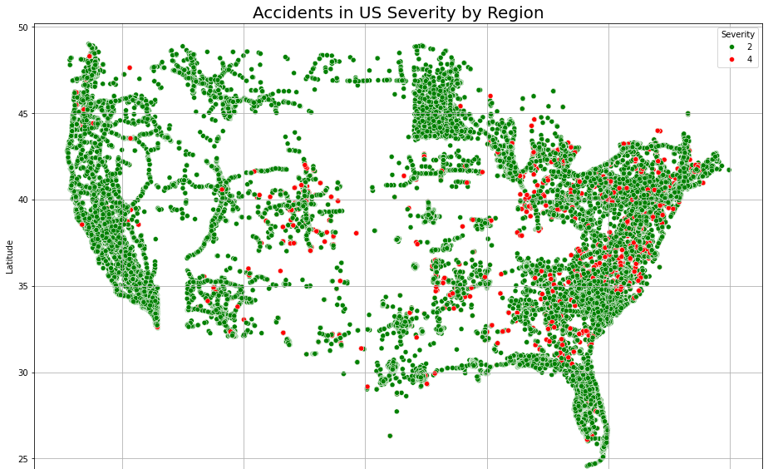
Spatial Analysis
Key Insight: The eastern part of the US is more prone to severe road accidents compared to the western part.

Slide 7
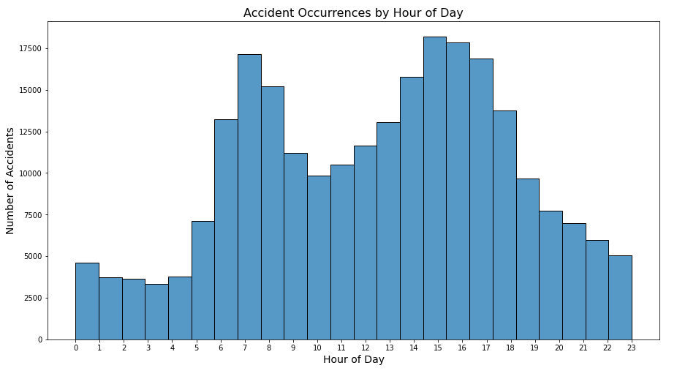
Temporal Analysis
Key Insight: Accidents show a bimodal distribution, peaking during morning and evening rush hours.

Slide 8
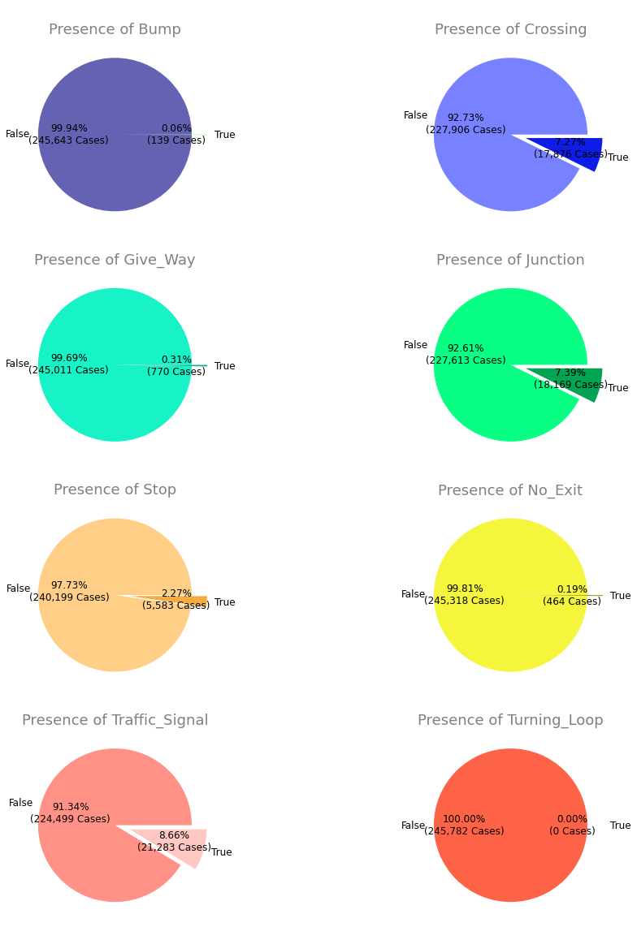
Accidents by Road Condition
The presence of crossings, junction, and traffic signals are highly associated with road accidents.

Slide 9
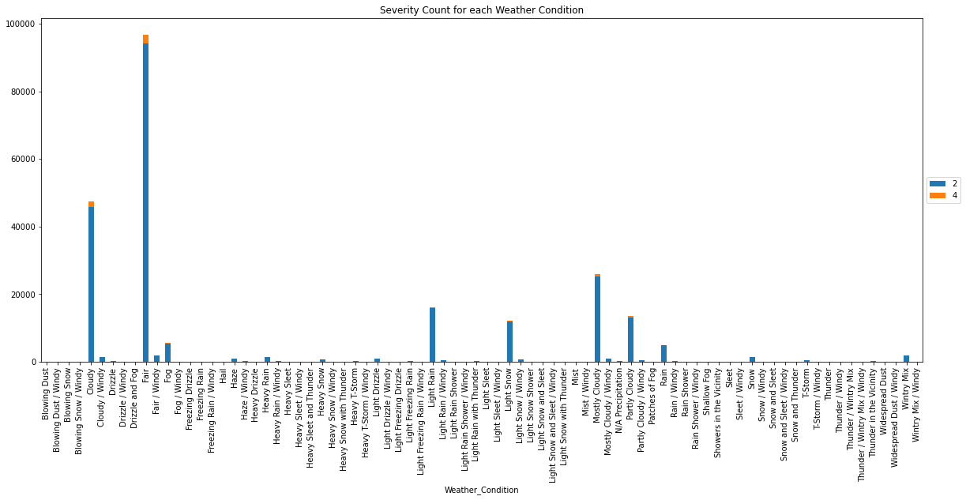
Accidents by Weather Condition
Most accidents occur in fair weather conditions, suggesting either that most driving occurs during fair weather conditions or potential mislabeling or further investigation needed.

Slide 10
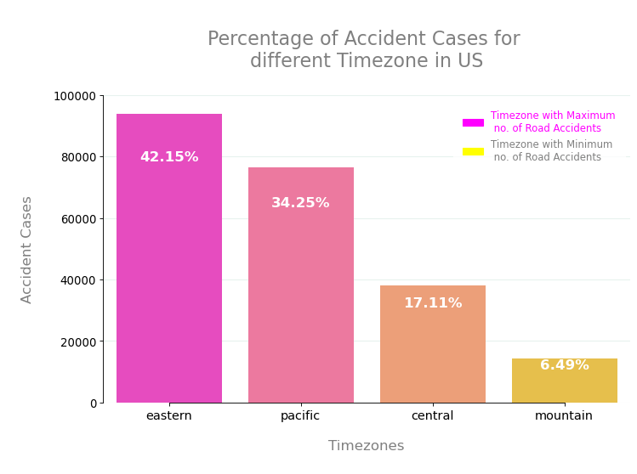
Timezone Analysis
The Eastern timezone has the highest percentage of accident cases, while the Mountain timezone has the least.

Slide 11

Feature Selection and Model Building
Process Overview:
Selection of relevant features for the model.
Removal of highly correlated features.
Model: Random Forest Regression used to predict the length of the road affected by accidents.
Feature Engineering: Inclusion of engineered features like median temperature in Celsius, UTC offset, etc.

Slide 12
Model Evaluation
Model Performance:
- Mean Absolute Error (MAE)
- Mean Squared Error (MSE)
- Root Mean Squared Error (RMSE)
- R-squared (R2)

Slide 13

Key Factors Affecting Road Length Impacted by Accidents
Air Pressure in inches
Visibility in miles
Starting location of accident
Average temperature per location
The presence of snow
Wind blowing in the NW direction

Slide 14
Conclusion and Recommendations
Focus on improving road conditions in high-risk areas.
Implement better traffic management during peak hours.
Conduct further investigations into weather condition labeling.

Slide 15

Q&A
Questions and further discussions.

