Slide 1


Principles of Robot Autonomy I
Section 8: Assembling an Autonomy Stack
(Case Study: Multiplexing)

Slide 2
Aims
Learn about multiplexing
Practice your ROS and coding skills
Prepare for the final project

Slide 3
Multiplexing
General concept
In robotics, it is very useful to quickly switch between different sensors or different controllers (e.g., if one fails)

Slide 4
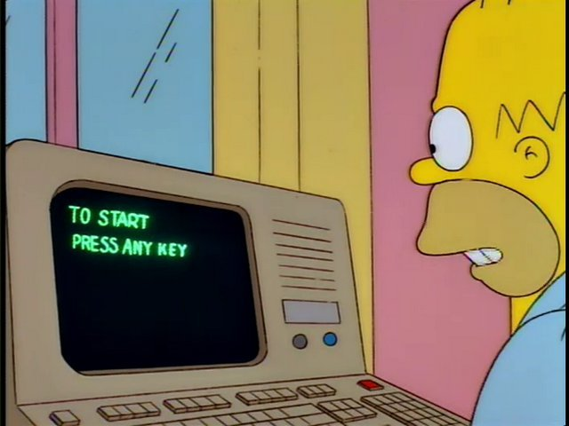
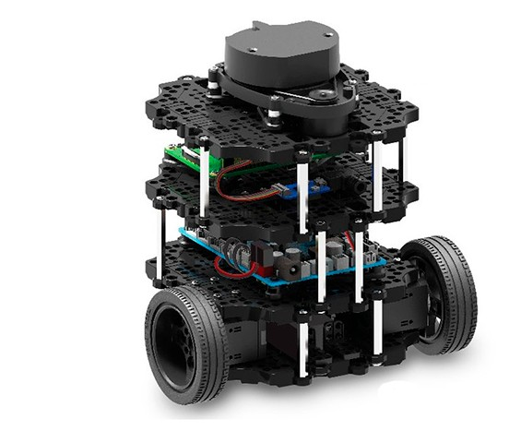
Multiplexing
Backup controller
Control input ROS topic
Controller 1
Multiplexer
position information, error messages, ...

Slide 5
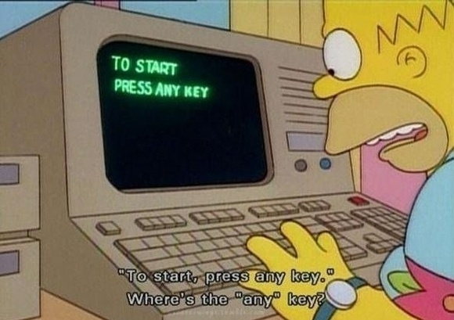
Multiplexing
Backup controller
Control input ROS topic
Controller 1
error message
Multiplexer
position information, error messages, ...

Slide 6
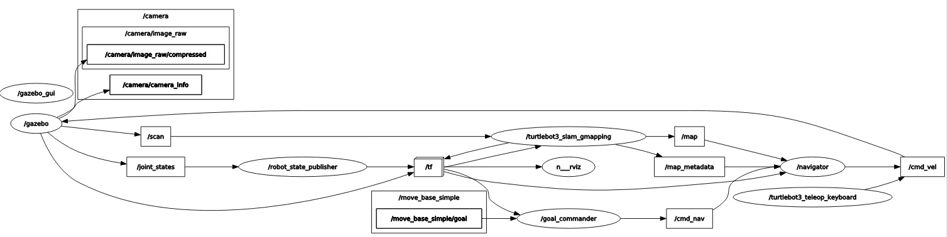
rqt_graph
Allows quickly visualizing the currently running software stack

Slide 7
Multiplexing
Multiple methods to implement multiplexing are possible
Hints and different methods are given in the handouts

