Slide 1

React full stack
Full stack Skills Bootcamp

Slide 2
Online Knowledge Base Platform
Lesson Overview:
In this lesson, we will be introduced to:
Introduction to the Challenge
Key Learnings
Project Requirements
Team Structure
Acceptance Criteria

Slide 3
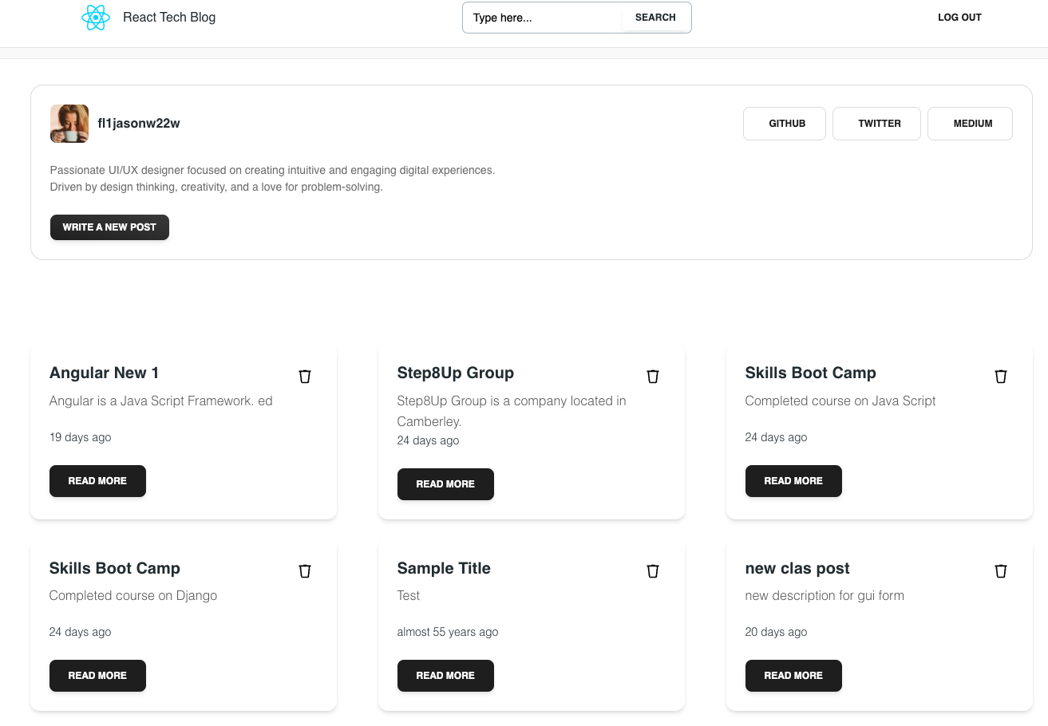
Introduction to the Challenge
Purpose: A platform for managing and sharing technical articles securely.
Frontend: Built using React (Vite framework) for a dynamic user experience.
Backend: Powered by NodeJS/Sequelize ORM, offering a secure and scalable API for data handling.
Goal: Enhance functionality and fix issues to create a robust knowledge-sharing tool.

Slide 4

Installation
Clone the Repository

Slide 5


Setting up: Create the Database
Navigate to root folder. Login to MySQL to create the database

Slide 6

Setting up: install Dependencies
Run the following command in the root directory to install dependencies for both server and client:

Slide 7

Setting up: Set up Environment Variables
copy .env.example files in the client and server folders, to cerate .env files. In the server folder, change your MySQL password
Seed the Database (Optional) If you want to populate the database with sample data, run:

Slide 8

Setting up: START the application
Run the following command to start the development server:

Slide 9
Setting up: Usage
Run the following command to start the development server:
Open your browser and navigate to http://localhost:5173 to access the LMS3000 application.
Explore features such as course management, student enrolment, and instructor assignments.
The Sequelize/NodeJS backend can be accessed via http://localhost:3001

Slide 10
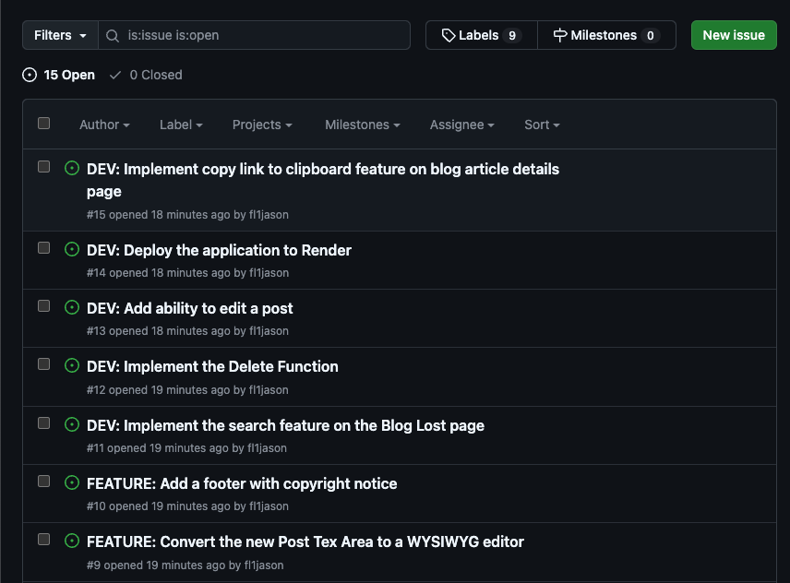
What Are GitHub Issues?
Definition: GitHub Issues are tools for tracking tasks, enhancements, and bugs in a project repository.
Features:
Assign issues to team members.
Add labels for categorization (e.g., bug, feature request, enhancement).
Include detailed descriptions, screenshots, or steps to reproduce.
Use Case: In Step8Up, GitHub Issues define tasks like fixing bugs, adding features, or improving the platform.

Slide 11
GitHub Pull Requests (PRs)
Definition: Pull Requests are a way to propose changes to the main codebase.
Workflow:
Create a branch for your work.
Commit changes and push to your fork or branch.
Open a Pull Request to merge changes into the main branch.
Collaborators review, discuss, and approve your PR.
Benefits:
Facilitates collaboration.
Tracks changes with detailed commit history.
Ensures code quality through reviews.

Slide 12
Current Developments vs. Bug Fixes and Feature Requests
Current Developments: Focus on enhancing the core functionality of the Step8Up Knowledge Base.
Bug Fixes: Resolve reported issues that hinder the application from functioning as expected.
Feature Requests: Add new capabilities to the platform, such as:
Improved user authentication.
Enhanced article tagging system.

Slide 13
Updating Progress Using GitHub Issues
Workflow:
Assign Yourself: Select an open issue and assign it to yourself.
Communicate Progress: Use comments to provide updates or ask for clarification.
Close the Issue: After completing the task and merging the related Pull Request, mark the issue as resolved.
Keep the Team Updated: Ensure transparency by tagging team members and summarizing changes in the issue thread.

Slide 14
Team Structure
Team Size: 3 members
Time Limit: 3 hours
Presentation: Showcase your app to the group, explaining your process and contributions.

Slide 15

Let’s Build Together!
Collaborate: Work as a team to enhance and support the Step8Up Knowledge Base.
Communicate: Use GitHub Issues and Pull Requests to streamline the development process.
Contribute: Learn and grow as you tackle real-world project challenges.
Let’s make Step8Up the go-to platform for technical knowledge sharing! 🎉

Slide 16
Questions?

