Slide 1
Is There an Immigration CRISIS Occurring in America?
Fact or Fiction Presents…

Slide 2
Our Goal…
Answer 3 Questions
What is an immigration crisis?
Is the U.S. experiencing an immigration crisis?
Is there a crisis on the US-Mexico border?

Slide 3
The Data
Where Did it Come From?
Department of Homeland Security
U.S. Border Patrol
U.S. State Department
What Kind of Data is It?
Immigration data on Syrian refugees in Turkey, Lebanon, and Jordan
Immigration data on border apprehensions
Immigration data on refugee and asylum grantees

Slide 4
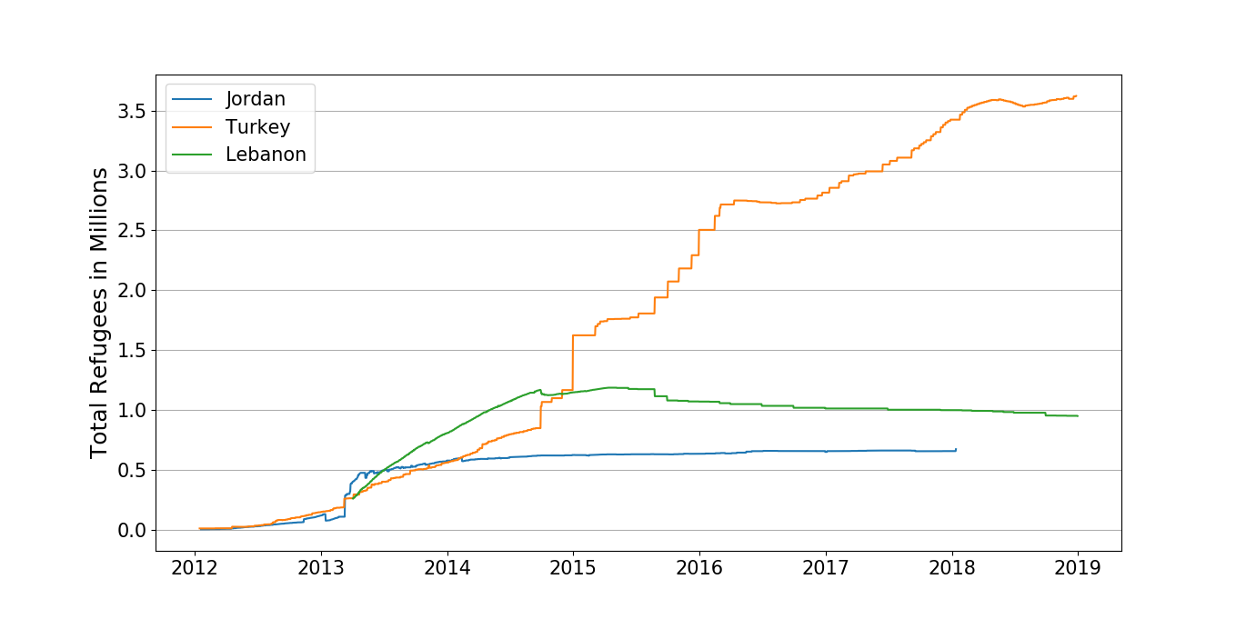
What does an actual crisis look like?

Slide 5
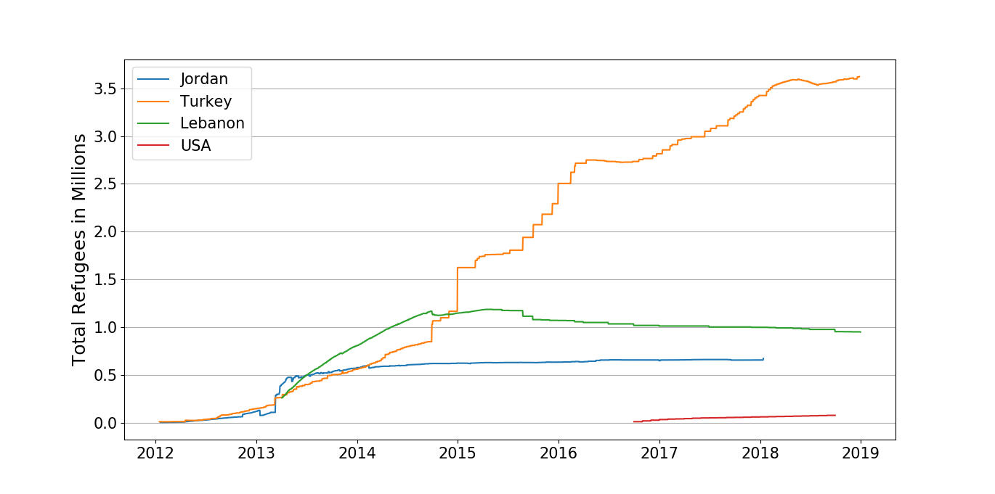
How does the USA compare?
'Source',

Slide 6
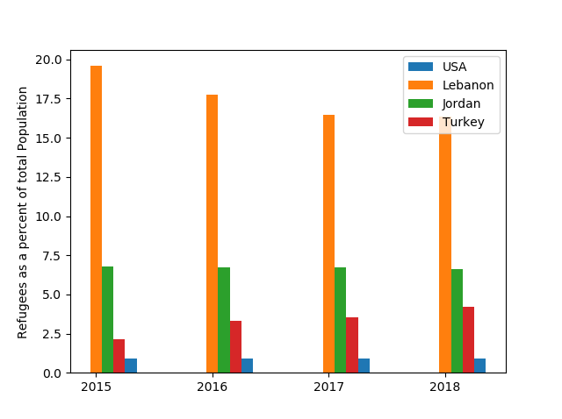
How is this Proportional to Population?

Slide 7
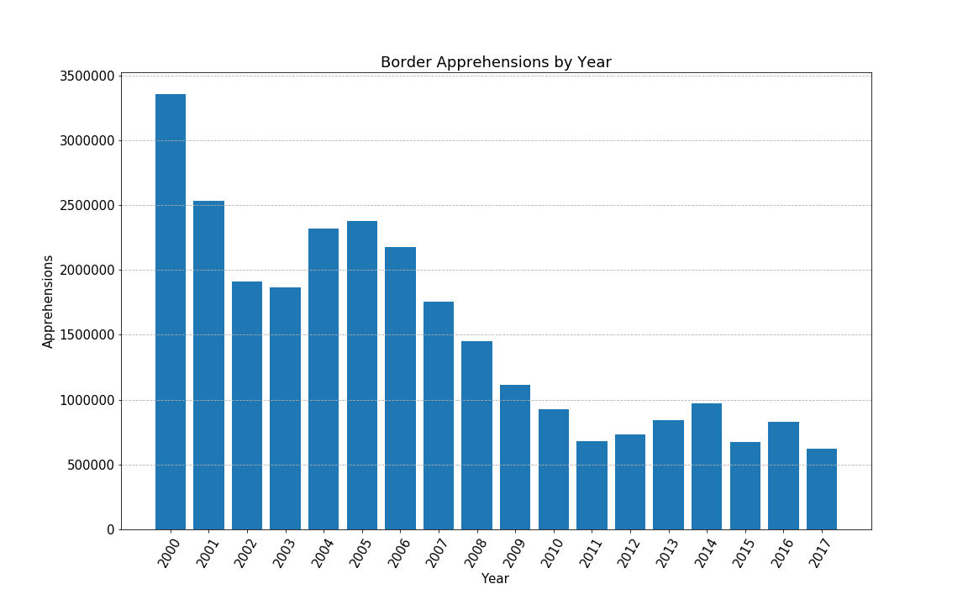
Has illegal immigration through our borders increased in the US?

Slide 8
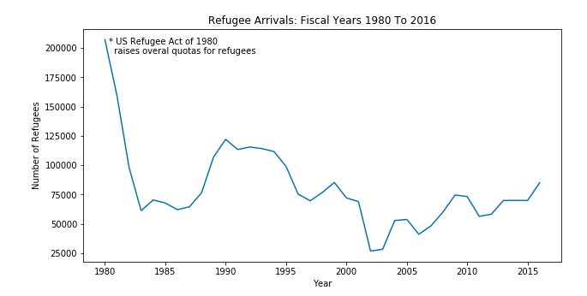
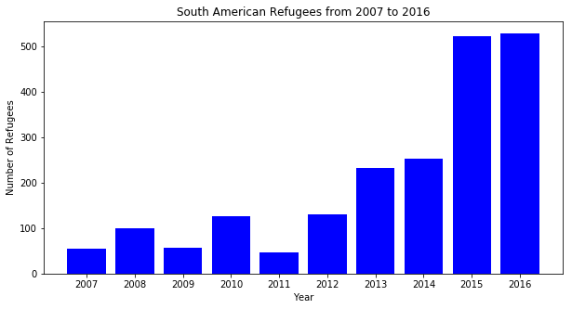
Has the number of refugees entering the US increased?
Has the number of South American refugees increased?

Slide 9
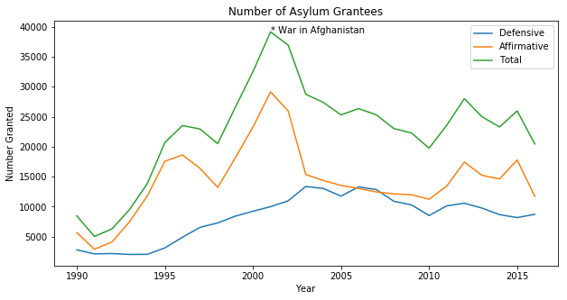
Have the number of asylum grantees increased?

Slide 10
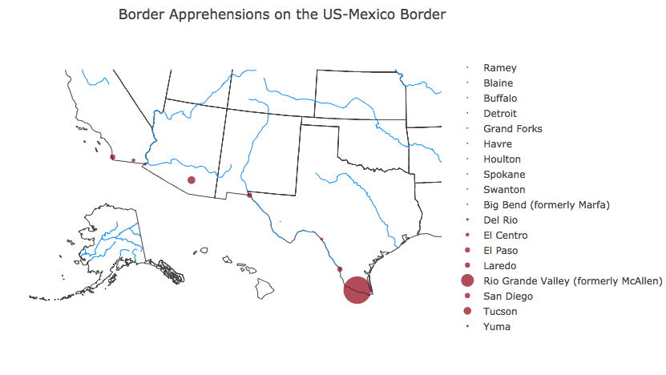
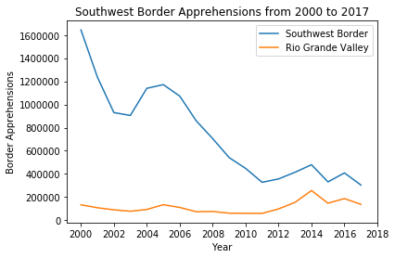

Slide 11
What Does The Data Tell Us?
•Border apprehensions show a general decline
•Refugees compared to population are almost nil
•Immigration from our southwest border is NOT at an all time high
•The number of refugees from Central and South America has risen
•The number of refugees as a whole has not increased drastically
•Asylum seekers peaked in 2001, Afghan War
•The U.S. is NOT experiencing an immigration ‘crisis’

Slide 12
Additional Sources
http://www.worldometers.info/world-population/lebanon-population/
https://data2.unhcr.org/en/situations/syria/location/71
http://www.worldometers.info/world-population/jordan-population/
https://data2.unhcr.org/en/situations/syria/location/36
http://www.worldometers.info/world-population/turkey-population/
https://data2.unhcr.org/en/situations/syria/location/113
http://www.wrapsnet.org/archives/

