Slide 1

VII
Section VII
Fixed Income Pricing Platform
From single-thread code to an institutional pricing, cloud- based, pricing engine
Ryse Private and Confidential, One Mifflin Place, Ste 400, Cambridge, MA, 02138, Mario Pardo, mario@ryseinc.com | 1

Slide 2
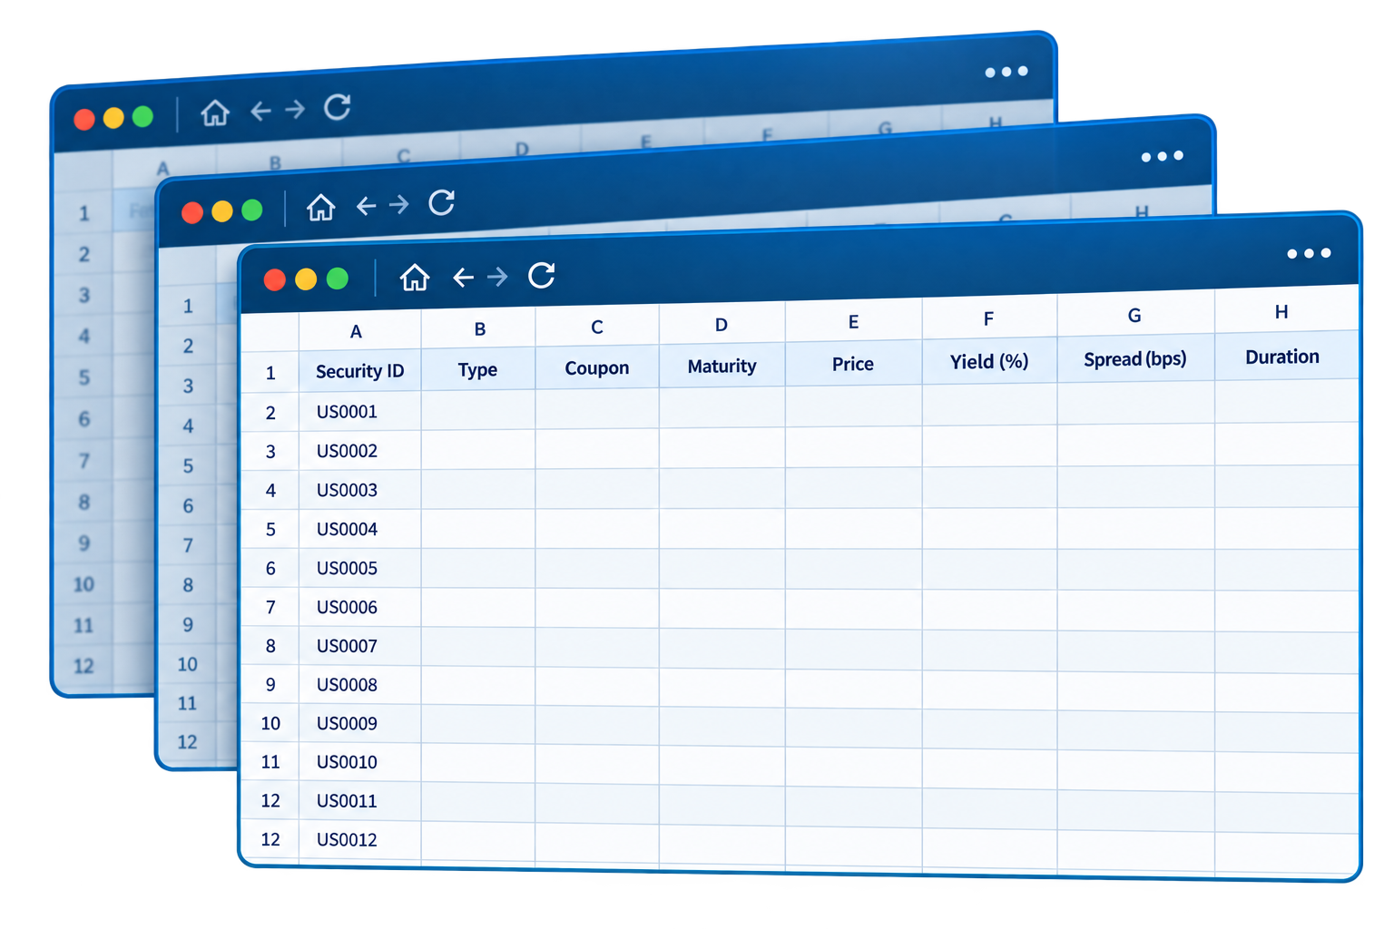

Section VII — Fixed Income Pricing Platform
A Critical Process Built on a Single, Highly Complex Database
Over ~14,000 Lines of SQL and .NET Code
Spread across multiple tables, with slow processing time,
Hard to maintain, generate continuous updates, and with an embedded key-person risk
Too Slow for High Volume Portfolios
A thousand what-if scenarios would take far too long to process, generating bottlenecks on the network and impacting other areas of the platform
Limited Scalability and Testing Capacity
Lack of efficient processing times makes it hard to be tested
Ryse Private and Confidential, One Mifflin Place, Ste 400, Cambridge, MA, 02138, Mario Pardo, mario@ryseinc.com | 2

Slide 3

Section VII — Fixed Income Pricing Platform
One Engine, Full Coverage, Built for Scale
All Fixed Income Instrument Classes
Unified
Pricing Engine
Cloud
Execution
Portfolio
Risk
Bonds, MBS, ABS,
Derivatives, etc.
Consistent, transparent
and testable pricing
Parallel computing
for scenario analysis
Portfolio-level risk
once coverage is complete
Reproducible
Testable
Parallelizable
Portfolio-aware
A single architecture designed to price every fixed-income instrument class, exposing the same logic across spreadsheets, the command line, and cloud services.
Ryse Private and Confidential, One Mifflin Place, Ste 400, Cambridge, MA, 02138, Mario Pardo, mario@ryseinc.com | 3

Slide 4
Section VII — Fixed Income Pricing Platform
Significant Progress
6 / 13
949
766
40 seconds
Categories
Complete
Securities
in scope
Priceable by
new engine
Full book reprices
on Azure
(measured)
JSON dictionaries for every input and output — enables parallel computing
Code already runs unchanged on Azure (Further testing required)
Next: focus on mortgage-backed securities and other instruments, then hand to Ryse’s
engineer for parallel-computing work
Ryse Private and Confidential, One Mifflin Place, Ste 400, Cambridge, MA, 02138, Mario Pardo, mario@ryseinc.com | 4

Slide 5

Section VII — Fixed Income Pricing Platform
One Engine, Consistent Results Across Every Interface.
Calculates Spread & Risk
Illustrative Output
Given a bond, today’s rate environment, and market price, calculates the implied spread and sensitivity to rate movements.
> price(bond)
Price 98.42
Spread 125 bps
Duration 5.8
Convexity 0.42
Runs three ways
Spreadsheet, command line, or API — all using the same calculation engine.
Reproducible to the byte
Run the same inputs again and obtain exactly the same results
Validated on a real portfolio
Same calculation engine
Tested against a pension fund fixed income portfolio from March 2009, where benchmark results were already known.
Excel • CLI • API
Ryse Private and Confidential, One Mifflin Place, Ste 400, Cambridge, MA, 02138, Mario Pardo, mario@ryseinc.com | 5

Slide 6
Section VII — Fixed Income Pricing Platform
2,260 Securities, 81% of the Portfolio Is Complete or Engine-Ready
•
2,260 securities across thirteen categories. Six categories are complete, representing 42% of the portfolio
•
Of the 949 securities in completed categories, 766 are priced by the new engine. The remaining 183 are individually identified, with most lacking required bond terms in the source records.
Ryse Private and Confidential, One Mifflin Place, Ste 400, Cambridge, MA, 02138, Mario Pardo, mario@ryseinc.com | 6

Slide 7
Section VII — Fixed Income Pricing Platform
Detailed Progress by Instrument Class
# | Category | Lines | Securities | Status
1 | Corporate Bonds | 811 | 732 | Complete
2 | Government Bonds | 153 | 147 | Complete
3 | Government Agencies | 42 | 39 | Complete
4 | Index-Linked Government Bonds | 16 | 15 | Complete
5 | Guaranteed Fixed Income | 11 | 9 | Complete
6 | Municipal / Provincial Bonds | 7 | 7 | Complete
7 | Government Mortgage-Backed | 888 | 882 | Engine built — next
8 | Non-Government C.M.O.s | 265 | 264 | WIP
9 | Asset-Backed Securities | 79 | 79 | WIP
10 | Commercial Mortgage-Backed | 73 | 69 | WIP
11 | FI Derivatives — Futures | 11 | 7
12 | FI Derivatives — Options | 9 | 9
13 | Other Fixed Income | 1 | 1 | Out of scope
 | Total | 2,366 | 2,260
Ryse Private and Confidential, One Mifflin Place, Ste 400, Cambridge, MA, 02138, Mario Pardo, mario@ryseinc.com | 7

Slide 8



Section VII — Fixed Income Pricing Platform
Three Independent Checks Validate the New Engine
Sanity Check
Independent Check
Validation Check
For a government's own bond, there should be no spread — it is the government curve
Match an external system
Recompute known values.
Where the client's custodian independently reports a risk figure, our system agrees — four of five agency bonds, with sensitivities of one to nine years, match within 0.75 years.
The team rebuilt the client's inflation adjustments from published government data: thirteen US inflation-linked bonds, matching to six parts in a million.
Japan's come out at 0.0 basis points, the UK's at 4.4 — the thermometer reads right in ice water
Japan: 0.00%
UK: 0.04%
Ryse Private and Confidential, One Mifflin Place, Ste 400, Cambridge, MA, 02138, Mario Pardo, mario@ryseinc.com | 8

Slide 9
Section VII — Fixed Income Pricing Platform
Complete, Scale, Deliver
1
Complete mortgage-backed book
Engine is built and tested; needs terms data, not development.
2
Finish remaining pooled classes
Mortgage obligations, asset-backed and commercial mortgage-backed;
each reuses existing machinery.
3
Host as a service and run in parallel
With Ryse’s engineer. Defined work, not a rewrite — system already
answers one request at a time.
4
Integrate to portfolio risk layer
Once coverage is complete.

Slide 10
MBS
ABS
CMO
CMBS
CLO
Structured Securities
Pricing & Risk
Modeling Method
A phased approach: establish portfolio risk quickly, then enhance the model with Bloomberg and empirical cash-flow behavior.
Ryse Private and Confidential, One Mifflin Place, Ste 400, Cambridge, MA, 02138,
Mario Pardo, mario@ryseinc.com | 10

Slide 11
Section VII — Fixed Income Pricing Platform
Three Approaches — Different Levels of Detail, Cost and Time
1 Reduced-Form Market Risk
2 Bloomberg + Empirical
Enhancement
3 Full Structural Model
Mario’s recommendation
Next-round enhancement
Intex / deal-model approach
• Use custodian market price as the anchor.
• Represent the security with simplified bond-equivalent cash flows.
• Calibrate an implied spread, then shock rates and spreads.
• Fastest path to portfolio VaR, ES and stress risk.
• Build on the historical Bloomberg extraction already developed by Lichen.
• Add principal paydowns, WAL and other available structured analytics.
• Improve prepayment, contraction and extension behavior empirically.
• Moderate effort; improves the reduced-form model rather than replacing it.
• Model collateral, CPR/CDR, severity, recoveries and deal waterfalls.
• Generate scenario-dependent tranche cash flows.
• Highest structural fidelity.
• Highest licensing, implementation and operating cost.
Recommendation: implement Level 1 now; use the existing engineering work and Bloomberg data to build Level 2; reserve Level 3 for cases requiring full deal-level analysis.
Ryse Private and Confidential, One Mifflin Place, Ste 400, Cambridge, MA, 02138,
Mario Pardo, mario@ryseinc.com | 11

Slide 12
Section VII — Fixed Income Pricing Platform
Quick Project — Put the Remaining Structured Securities Into Portfolio Risk
Custodian
Market Price
Bloomberg
Contractual Terms
Bond-Equivalent
Cash Flows
Calibrate
Implied Spread
Shock Rates
+ Spreads
Why this is the expedited solution
What it captures — and what it does not
• The portfolio already has an observed custodian price.
• No need to rebuild deal waterfalls before risk can be calculated.
• Uses the same rate/spread simulation architecture already developed for fixed income.
• Scales naturally to Monte Carlo and portfolio-level stress testing.
• The starting price reflects the market's aggregate assessment of structure, credit, liquidity and prepayment expectations.
• Spread shocks capture changes in required market compensation for risk.
• Cash flows do not yet respond explicitly to CPR, defaults, extension/contraction or waterfall rules.
• Sensitivities are therefore bond-equivalent risk measures, not full structural analytics.
Objective: obtain a consistent, market-calibrated risk estimate now — without claiming to reproduce the security's full structural valuation.
Ryse Private and Confidential, One Mifflin Place, Ste 400, Cambridge, MA, 02138,
Mario Pardo, mario@ryseinc.com | 12

Slide 13
Section VII — Fixed Income Pricing Platform
Next Round — Use Bloomberg and the Existing Engineering Work to Improve the Model
The historical work already completed becomes the empirical enhancement layer — not discarded work.
Existing Engineering Work
Expand Bloomberg Inputs
Enhanced Ryse Risk
• Historical monthly principal repayments.
• Observed realized cash-flow behavior.
• Existing validation against pools priced by another method.
• Infrastructure for Bloomberg-based data extraction.
• WAL and effective life, where available.
• Prepayment / CPR analytics and projected cash flows, where available.
• Effective duration and convexity.
• OAS / spread and additional structured-security analytics.
• Replace legal-maturity bullet behavior with a more realistic effective-life representation.
• Model contraction / extension more accurately.
• Relate historical paydowns to rates and other drivers.
• Retain the custodian market price as the calibration anchor.
Key benefit: improve prepayment and cash-flow behavior incrementally without requiring a full deal-waterfall engine on day one.
Ryse Private and Confidential, One Mifflin Place, Ste 400, Cambridge, MA, 02138,
Mario Pardo, mario@ryseinc.com | 13

Slide 14
Section VII — Fixed Income Pricing Platform
Longer-Term Choice — Full Structural Modeling Only Where the Use Case Requires It
NOW
Reduced-Form Risk
NEXT
Bloomberg + Empirical
OPTIONAL
Full Structural / Intex
Dimension
Reduced-Form
Enhanced
Full Structural
Implementation
Fast
Moderate
Major project
Incremental cost
Low
Moderate
High / licensing
Rates & spreads
Yes
Yes
Yes
Prepayment behavior
Limited
Improved
Explicit
Waterfall
No
Limited / observed outcome
Explicit
Recommended sequence: deliver portfolio risk first, enhance it with Bloomberg and empirical behavior second, and purchase/build full structural capability only when the analytical requirement justifies the cost.
Ryse Private and Confidential, One Mifflin Place, Ste 400, Cambridge, MA, 02138,
Mario Pardo, mario@ryseinc.com | 14

Slide 15
Section VII — Fixed Income Pricing Platform
Fixed Income Pricing Platform Development Team
LC
Lichen Chen (Charlie)
LY
Liping Yin
Pricing Engine, Calibration & Risk Layer
Fixed Income Pricing Platform Engineer
MS Business Analytics, Columbia University • BS Mathematics, University of Michigan
Fordham University (Quantitative Finance ), UCLA (Data Science), IUB (Computer Science)
Built the pricing engines, calibration and risk layer.
Quantitative research internships at Turing Fund and QiLin Investment; work in equity alpha, volatility forecasting and market microstructure.
Developed the core analytical components used to move the fixed-income pricing process toward a standardized, testable architecture.
Project team member supporting the development of the fixed-income pricing platform.
Built a sovereign bond pricing engine for a $1.3B book — Monte Carlo analytics and cointegration analysis
Developed an API integrated with client infrastructure using the Azure cloud interface
A focused team is building the pricing engine, calibration framework, and portfolio risk foundation.
Ryse Private and Confidential, One Mifflin Place, Ste 400, Cambridge, MA, 02138, Mario Pardo, mario@ryseinc.com | 15

