Slide 1
What is AI?
Tell us what you think in the Zoom chat!

Slide 2
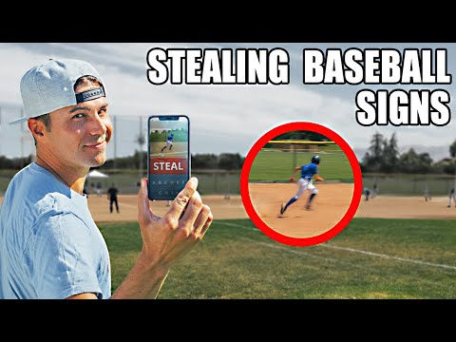

Slide 3
What are computers good at?
What do humans do better?
“Raise your hand” and we’ll call on you!

Slide 4
Computers learn from data

Slide 5
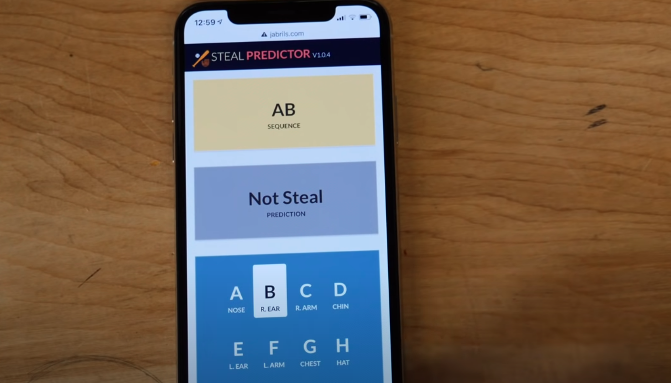
Computers learn from data

Slide 6
Computers learn from data
“Input Features”

Slide 7
Computers learn from data
“Prediction”

Slide 8
Computers learn from data
“Prediction”
(or “Label”)

Slide 9
Computers learn from data
“Training Example”

Slide 10
Q: But how do computers learn?

Slide 11
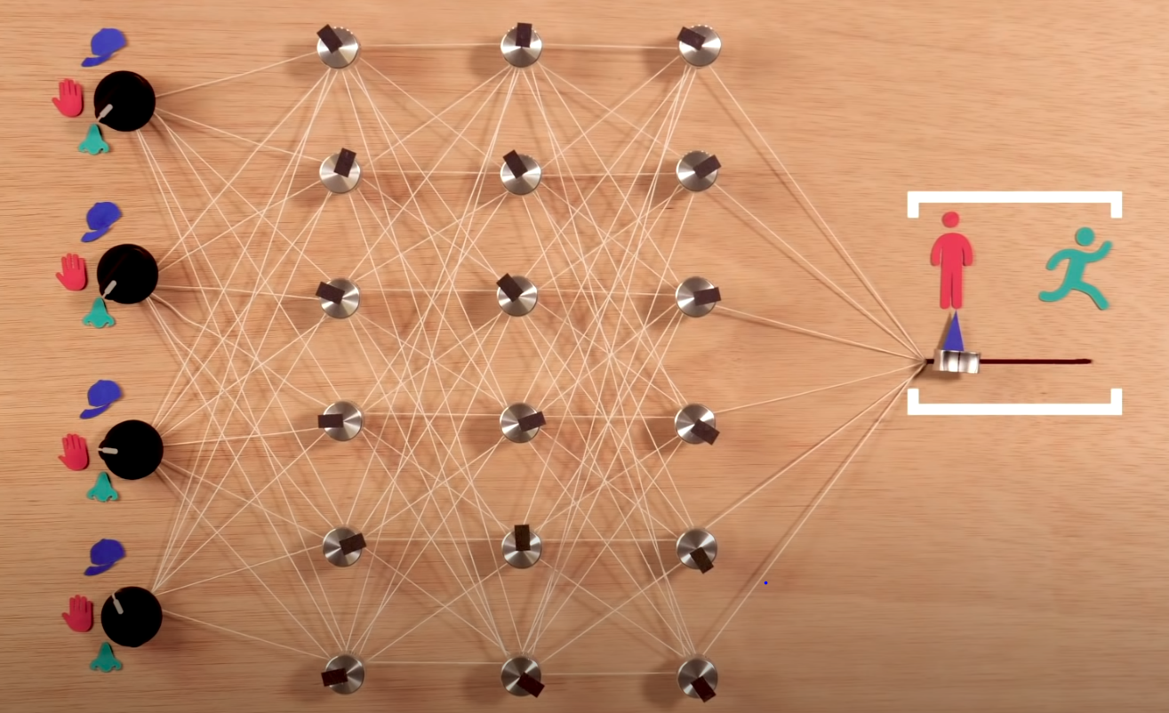
Q: But how do computers learn?

Slide 12
Q: But how do computers learn?
A: Feedback

Slide 13
Play Guess My Passcode (Colab / Jupyter)

Slide 14
What did you think of the game?
Zoom Chat

Slide 15
Q: How do computers learn?
Computers learn by making mistakes!

Slide 16
Q: How do computers learn?
Computers learn by making mistakes!
… and then adjusting via simple arithmetic operations to “learn” from their mistakes.

Slide 17
Real-World Connection
“Multipliers”

Slide 18
Real-World Connection
“Multipliers”
“Passcode”

Slide 19
Real-World Connection
“Multipliers”
“Passcode”
“Total”

Slide 20
Real-World Connection
“Input Features”
“Weights”
“Prediction”

Slide 21
Real-World Example

Slide 22
Real-World Example
Suppose you’ve designed a new shoe!
Can we use AI to help predict the best price to sell it at?

Slide 23
Let’s predict the price of a new shoe.
What features might be important?
“Raise your hand” and we’ll call on you!

Slide 24
Real-World Example: Predicting Shoe Prices
Features
Material Cost ($)

Slide 25
Real-World Example: Predicting Shoe Prices
Features
Material Cost ($)
Brand Popularity (1-10)

Slide 26
Real-World Example: Predicting Shoe Prices
Features
Material Cost ($)
Brand Popularity (1-10)
Customer Age

Slide 27
Real-World Example: Predicting Shoe Prices
Features
Material Cost ($)
Brand Popularity (1-10)
Customer Age
Prediction
Price ($)

Slide 28
Real-World Example: Predicting Shoe Prices
Material Cost ($) | 7
Brand Popularity | 3
Customer Age | 16
Prediction ($)
Actual Price ($)

Slide 29
Real-World Example: Predicting Shoe Prices
Material Cost ($) | 7
Brand Popularity | 3
Customer Age | 16
Prediction ($) | 5
Actual Price ($)

Slide 30
Real-World Example: Predicting Shoe Prices
Material Cost ($) | 7
Brand Popularity | 3
Customer Age | 16
Prediction ($) | 5
Actual Price ($) | 25

Slide 31
Real-World Example: Predicting Shoe Prices
Material Cost ($) | 7 | 15
Brand Popularity | 3 | 5
Customer Age | 16 | 18
Prediction ($) | 5
Actual Price ($) | 25

Slide 32
Real-World Example: Predicting Shoe Prices
Material Cost ($) | 7 | 15
Brand Popularity | 3 | 5
Customer Age | 16 | 18
Prediction ($) | 5 | 20
Actual Price ($) | 25

Slide 33
Real-World Example: Predicting Shoe Prices
Material Cost ($) | 7 | 15
Brand Popularity | 3 | 5
Customer Age | 16 | 18
Prediction ($) | 5 | 20
Actual Price ($) | 25 | 32
...

Slide 34
Real-World Example: Predicting Shoe Prices
Material Cost ($) | 7 | 15
Brand Popularity | 3 | 5
Customer Age | 16 | 18
Prediction ($) | 5 | 20
Actual Price ($) | 25 | 32
10
9
15
49
50
...

Slide 35
Bonus Challenges
Researcher: How can you evaluate how well AI works for different people?
Entrepreneur: Can you come up with your own AI project idea?
Inventor: Can you invent your own algorithm for prediction?
Mathematician: Learning rate challenge problem
Teacher: Explain how AI learns to a friend or family member
Engineer: Can you code an AI that beats “Guess My Passcode”?

