Slide 1
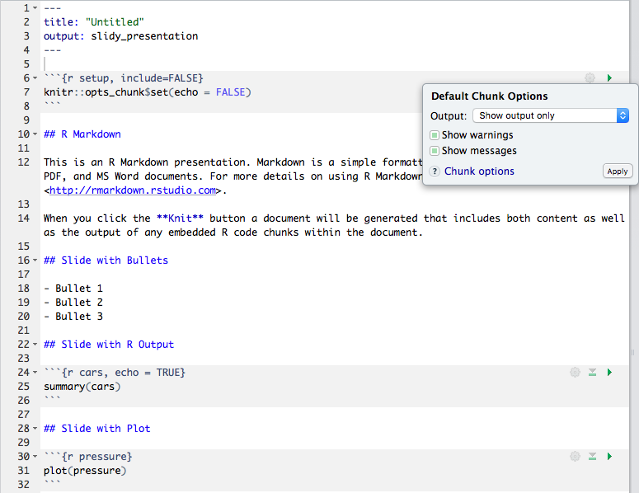
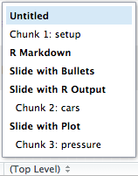
preamble (or header) which tells RStudio what to output (and how), written in YAML
clicking the cog provides an interface for changing code chunk options (the global options in this case)
special code chunk that sets “global” code chunk options
## represent subheadings
in the case of output: X_presentation documents these deliminate
slides
code chunk: both output and the code will be displayed because of the option echo = TRUE
naming code chunks allows you to easily navigate through your document and to find errors later

Slide 2
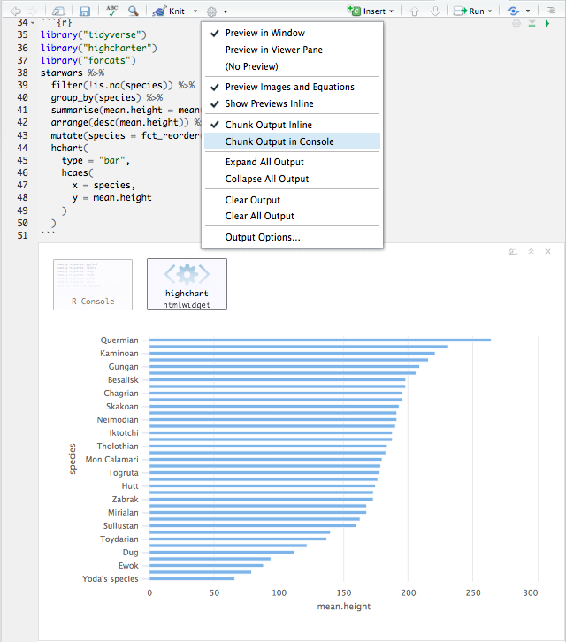
clicking the ”play” button on a code chunk will run just that code chunk
click this cog to access the options for the RMarkdown document, including “Chunk Output in Console”
click here for both the commands and keyboard shortcuts to evaluate:
all code chunks
all codes chunks above/below current chunk
evaluate current code chunk
output appears directly below code chunks, rather than in the console or viewer panel.
This output has two elements:
messages that would be printed to the console
the htmlwidget output itself

