Slide 1
🎙 REMINDER: Hit Record before you start · Save to Drive / Zoom cloud
GO-18338 Nearby Galaxies HST Treasury
Working group update — goals · status · synergies · JWST MCT
Charles Kilpatrick · [Meeting date]
Also: JWST MCT due Nov 4 — Overleaf + signup links later in this deck

Slide 2
Agenda
Six stops
1
Goals & data
What we proposed / must deliver
2
Working group
Who · done · long-term
3
APT / observations
Phase II implementation
4
Synergies
Roman · JWST · Euclid · Rubin
5
Organization
Where work lives
6
JWST MCT
Due Nov 4 — read / endorse

Slide 3
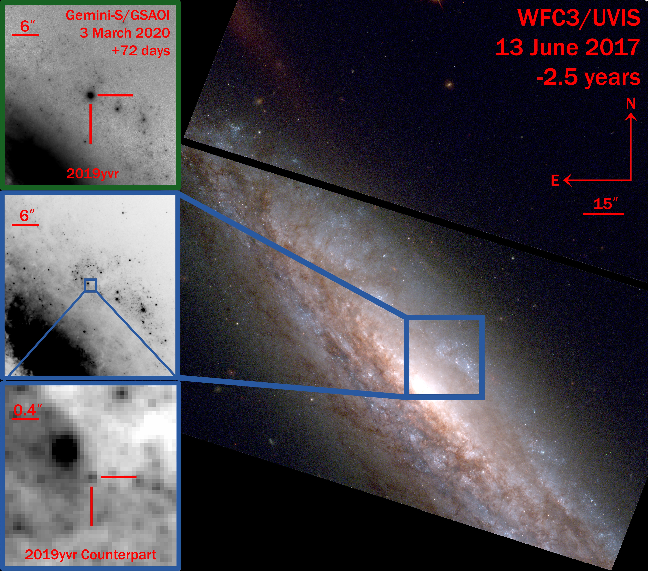
1 · Goals
Why HST now: pre-explosion UV/optical priors
• 121 luminous SF galaxies <20 Mpc still missing UV/optical filters
• Rubin/Roman/Euclid cannot replace HST UV + resolution
• First epoch for variability & failed-SN tests
• Cycle 34: LTM · Hubble–Roman · HWO precursor
Example: SN 2019yvr progenitor candidate from pre-explosion HST (Kilpatrick et al.).

Slide 4
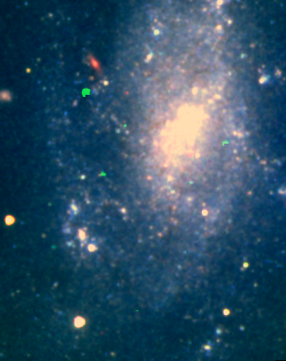
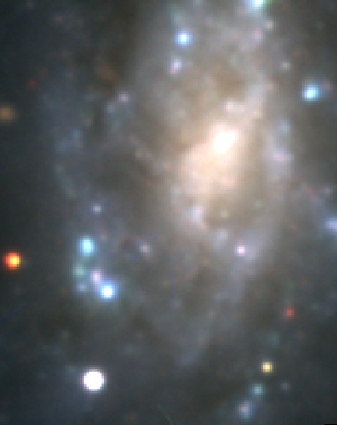
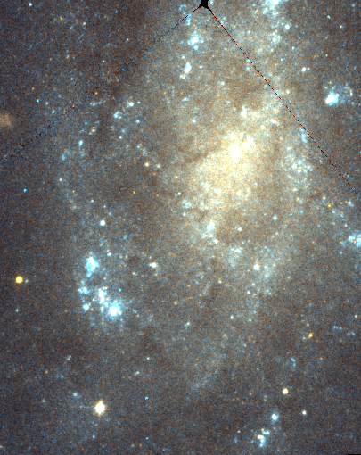
1 · Goals
Same galaxy, three facilities — only HST resolves the stars
HST
Rubin-like
Euclid-like

Slide 5
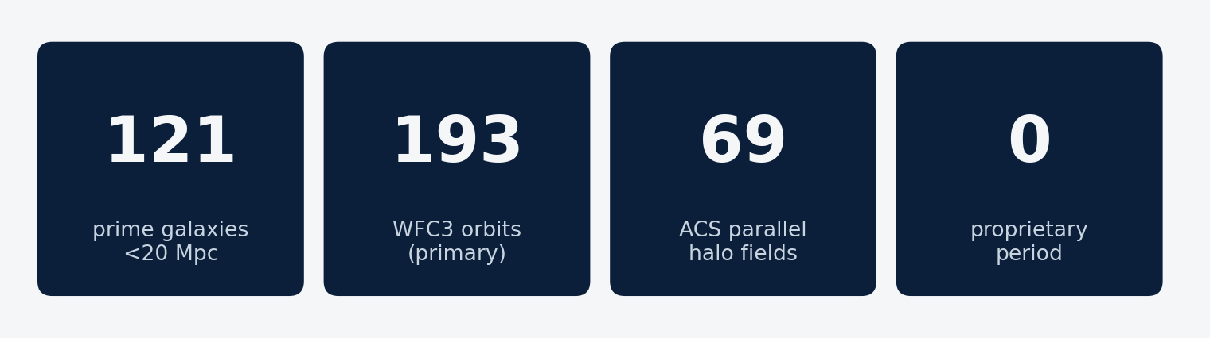
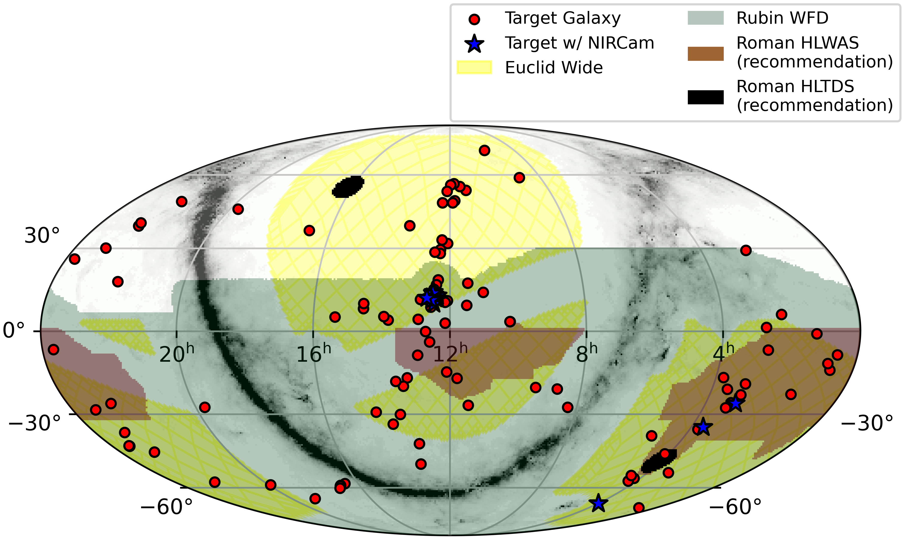
1 · Data
What we get: gap-filling WFC3 + ACS halo parallels
• F336W / F606W / F814W only where missing
• ≤2 orbits/target; flexible scheduling
• ACS F606W+F814W parallels on 69 fields
• Blue stars: JWST/NIRCam overlap
All-sky map from the Cycle 34 proposal (targets vs Euclid / Rubin / Roman footprints).

Slide 6
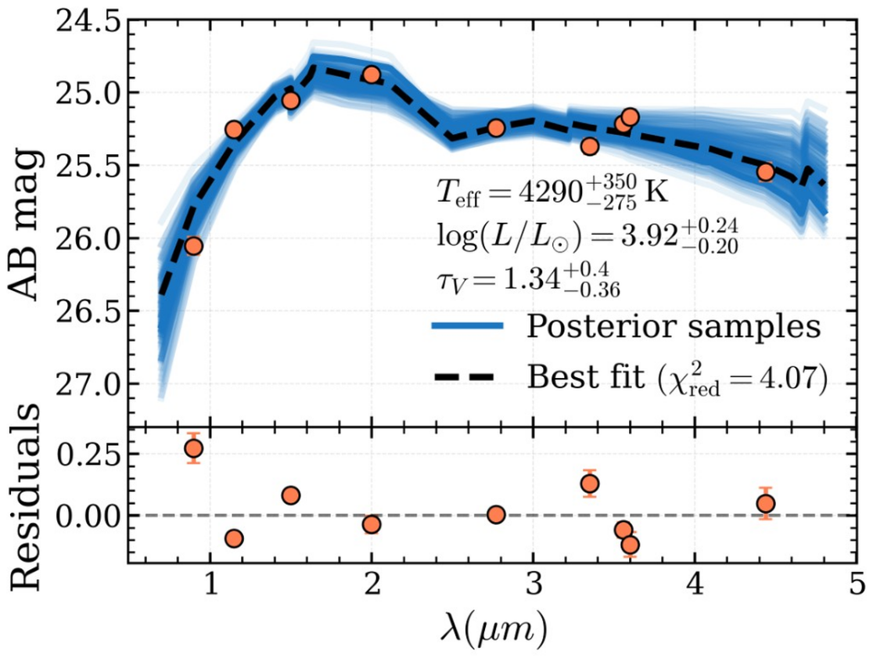
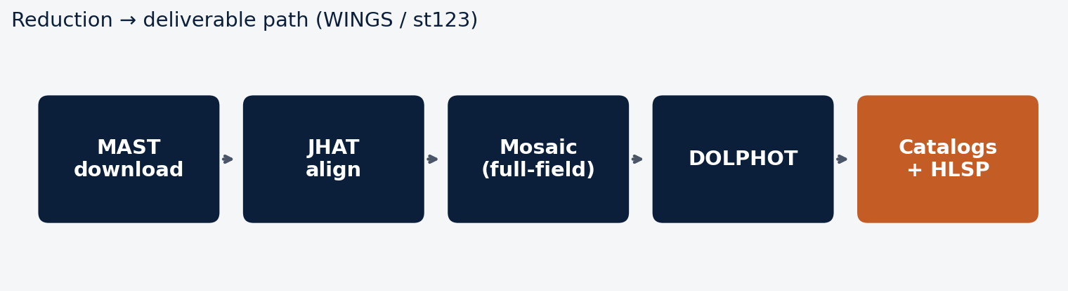
1 · Science plan
What we do with the data
• JHAT → Gaia-aligned frames
• DOLPHOT crowded-field photometry
• Fake-star completeness
• TRGB from ACS parallels
• Products for Roman crowding / CCS
Left: example multi-band SED fit recovering Teff, Lbol, dust (JWST pathfinder science).

Slide 7
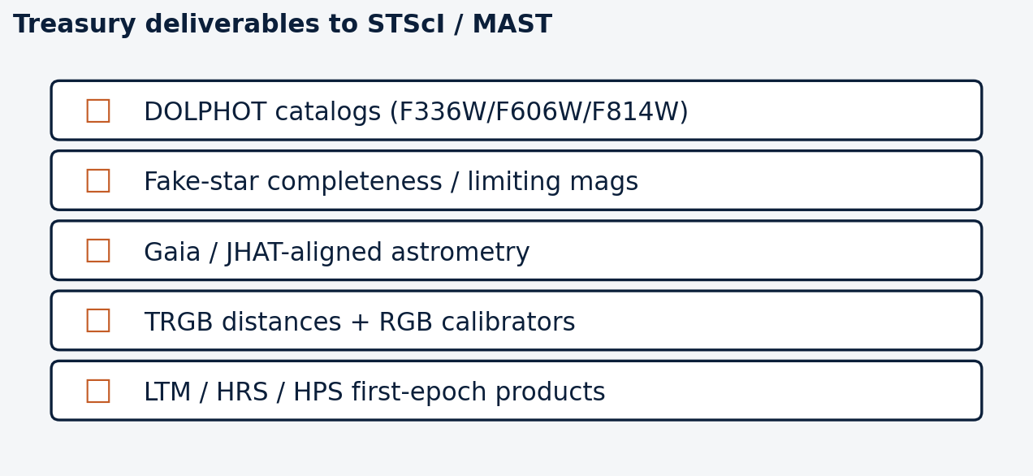
1 · Deliverables
Required STScI / Treasury products
No proprietary period. Coordinate HLSP catalogs with STScI for Hubble–Roman science.

Slide 8
2 · Working group
Status so far
• PI: Charles Kilpatrick · contributors: [Aswin, … — fill names]
• Phase II APT complete → 121 prime + 69 parallel fields in campaign catalog
• WINGS / st123 pipeline running full-field mosaic + DOLPHOT refresh
• Long-term: HLSP → MAST; papers; Roman/JWST/Euclid synergy products

Slide 9
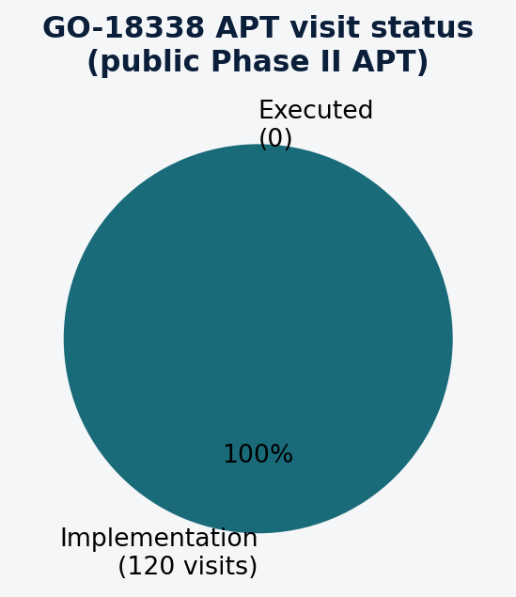
3 · APT & observations
Phase II is in implementation — nothing flown yet
• HST-GO-18338 public APT (Apt 2026.5.1)
• Title: Completing a Legacy Dataset… 121 Nearby SF Galaxies
• 120 visits · Status = implementation
• Special orients: NGC 1350, UGC 11920
• Update this slide when first visits execute

Slide 10
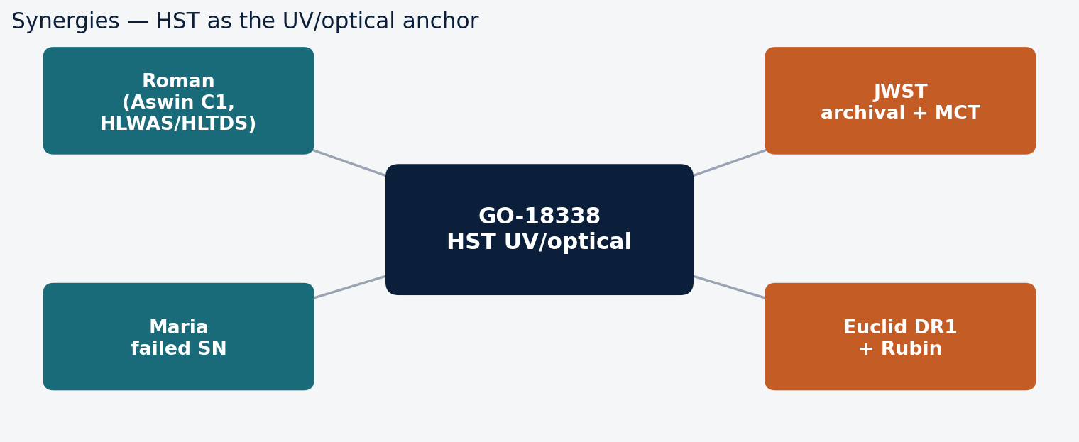
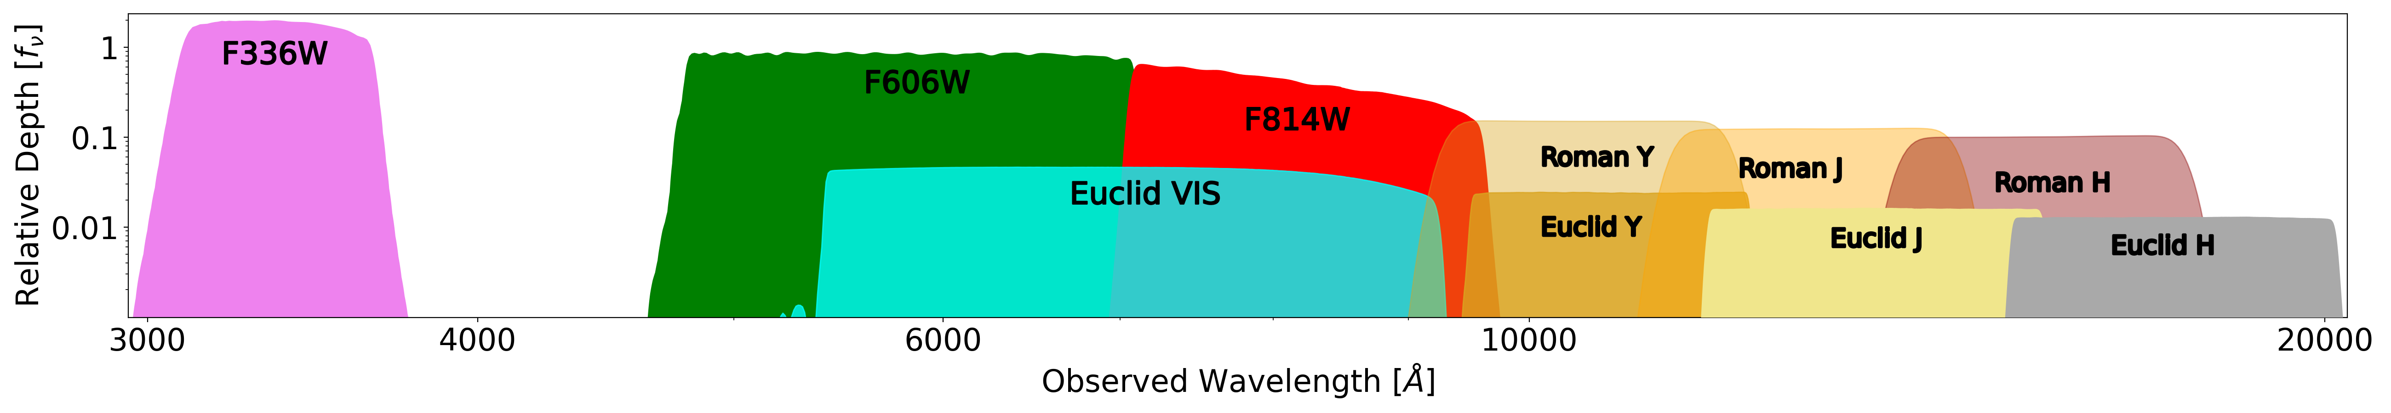
4 · Synergies
HST anchors the UV/optical; others fill IR + time domain
Right: relative depth vs wavelength — HST UV/opt vs Euclid & Roman IR (proposal Fig.).

Slide 11
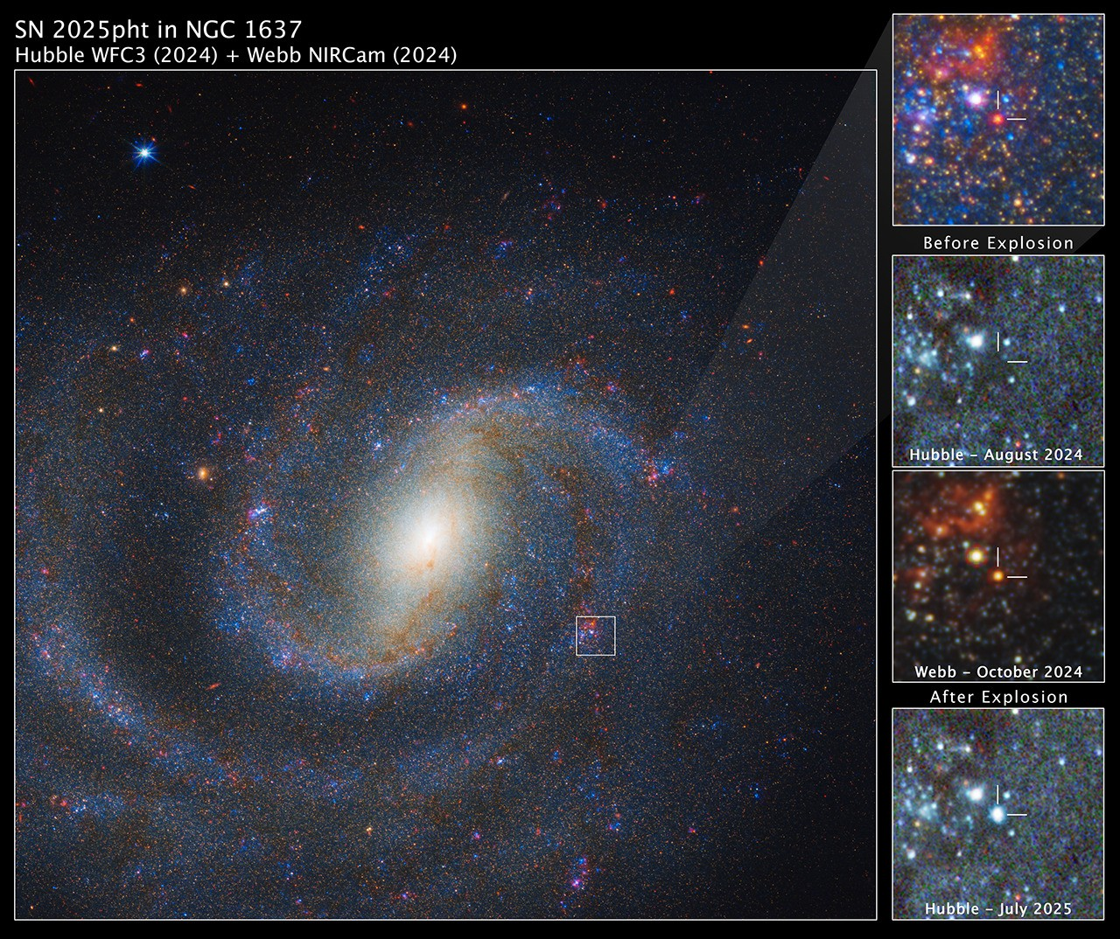
4 · Synergies
Overlap with Roman, Euclid, Rubin — and HST↔JWST science
Left: GO-18338 targets on survey footprints. Right: SN 2025pht — HST + JWST synergy example.

Slide 12
5 · Organization
Where the work lives
Scheduling
Reductions
Science
Synergies
• PI ↔ STScI CS
• APT updates
• Visit readiness
• WINGS + st123
• QA / remosaic
• [who runs batches]
• Photometry
• TRGB
• SN / failed SN
• HLSP / papers
• Roman (Aswin)
• Maria failed SN
• JWST MCT
• Euclid DR1

Slide 13
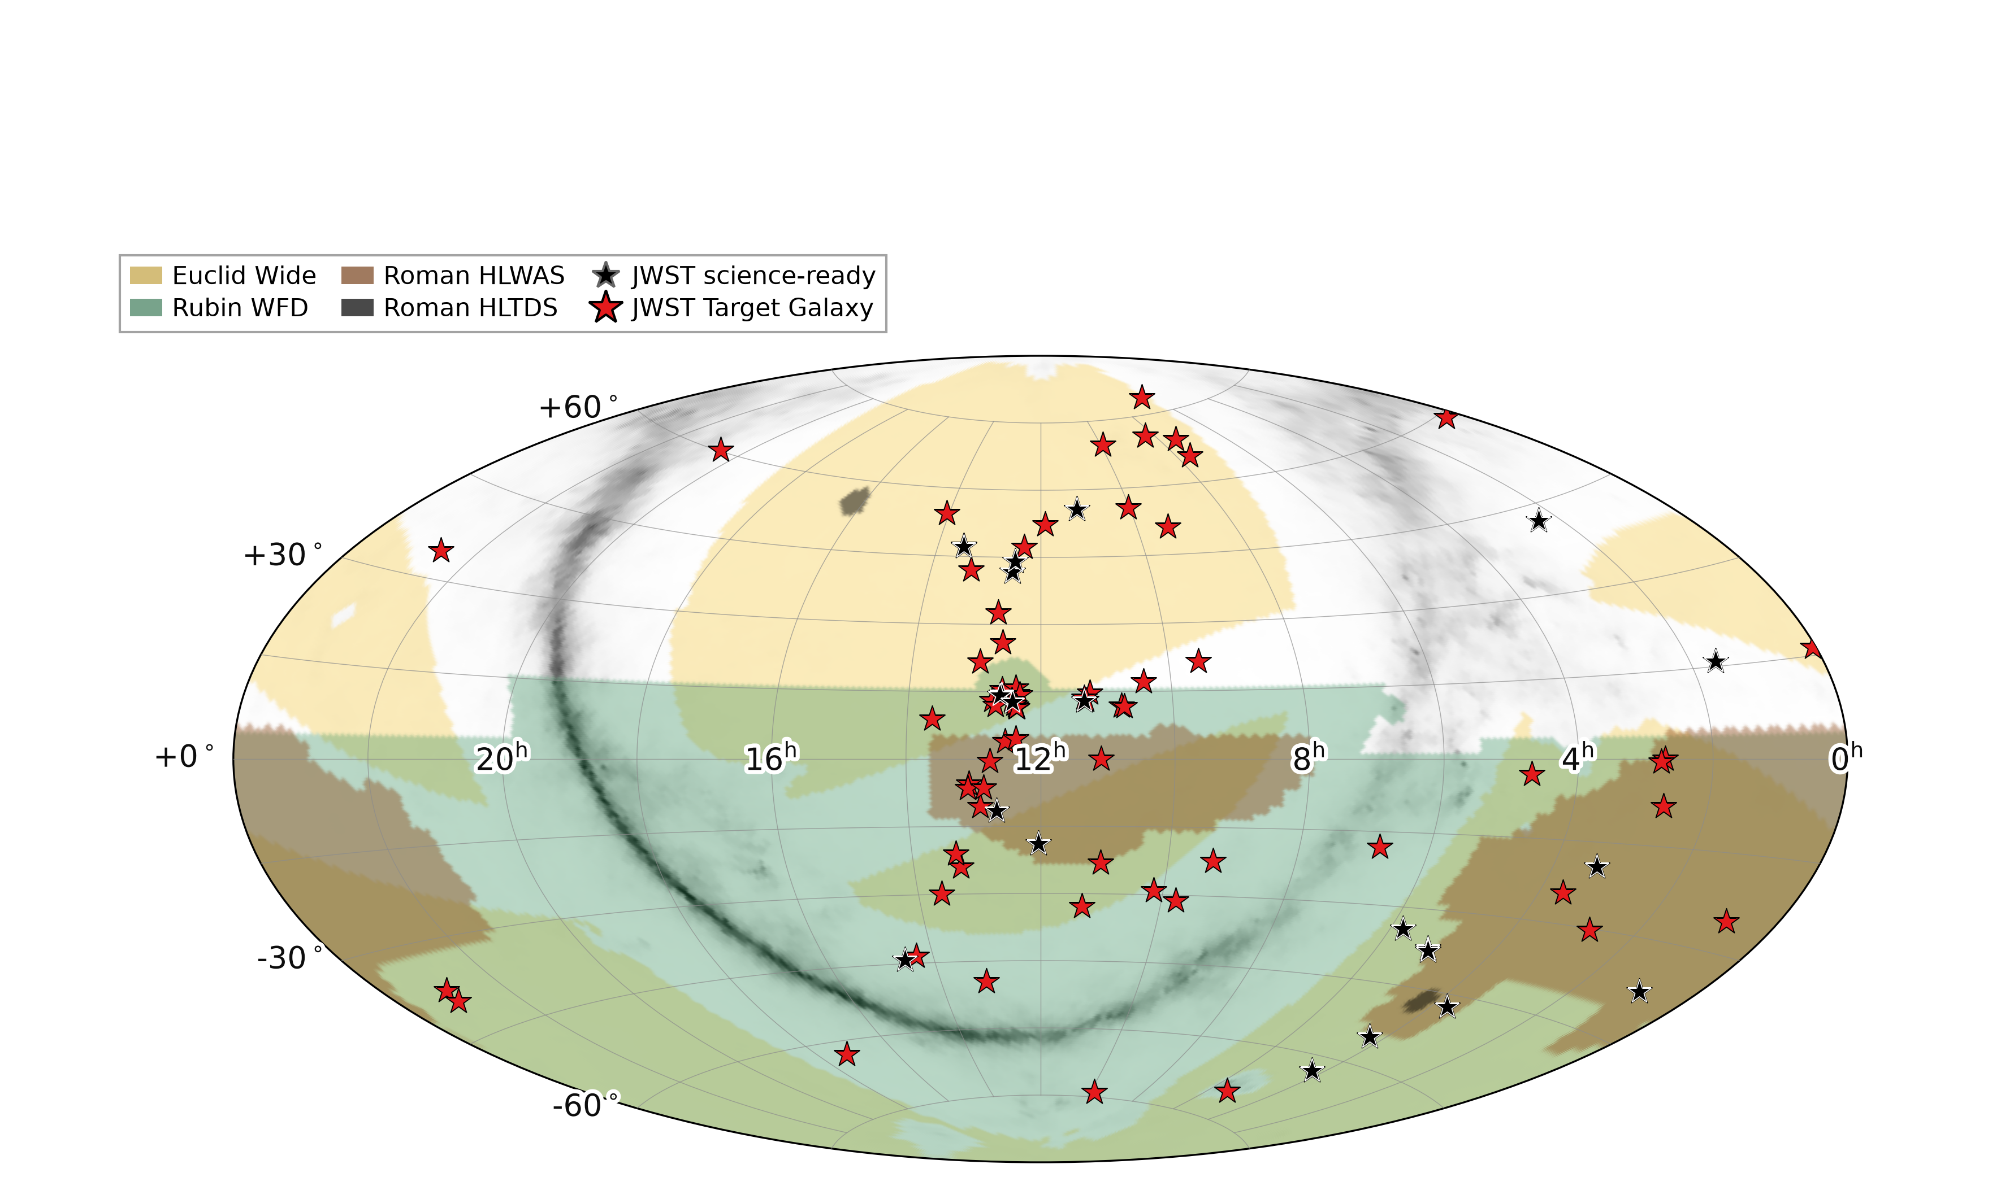
6 · JWST MCT
Gap-filling NIRCam census — due Nov 4
• ~120 luminous disks <25 Mpc
• Six-filter NIRCam (~0.9–4.4 µm)
• ~6× today’s science-ready sample
• ~600 charged hours / 3 cycles
• Public catalogs + physical params
Black = ~21 science-ready disks today; red = proposed MCT gap-fill (white paper Fig. 3).

Slide 14
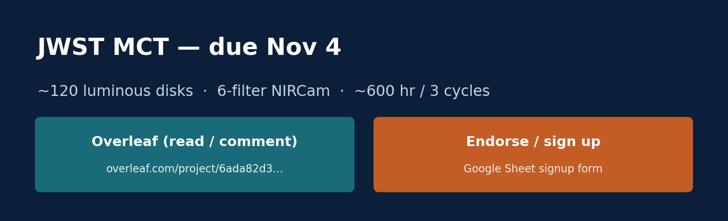
6 · JWST MCT
Please read, comment, and endorse
Overleaf (draft / comments)
https://www.overleaf.com/project/6ada82d329dc7fb707946547/share#e486a995793d1f77871f070e4ae66425f9af8f42c2818fc6
Sign up / endorse (Google Sheet)
https://docs.google.com/spreadsheets/d/1em2n5s9nkfAk5EAykao6lBlzAkRJ0I370pCCQtTfmC4/edit?usp=sharing
Already includes Kilpatrick, Drout, Bowes, …

Slide 15
Takeaways
→ GO-18338 = UV/optical Treasury backbone for Local Volume massive-star & progenitor science
→ Phase II in implementation — pipeline ready as visits fly
→ Synergies with Roman, JWST, Euclid, Rubin are intentional
→ Action: MCT Overleaf comments + Sheet signup by Nov 4

