Slide 1

Distributor Training, India
Internal Use Only
Content and example slides for running a distributor training session
January 2015

Slide 2
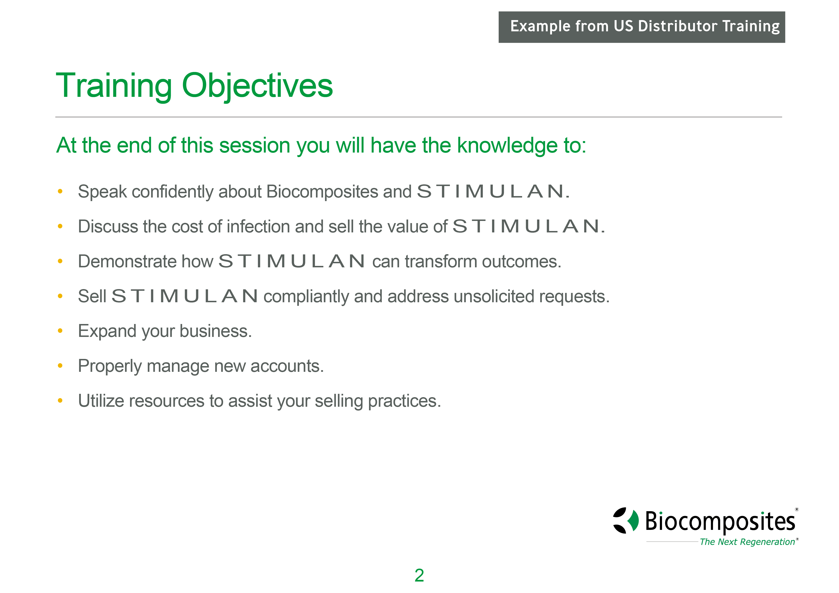

Slide 3
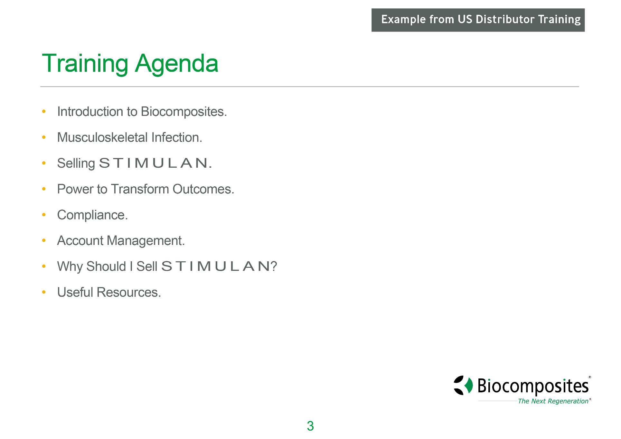


Slide 4
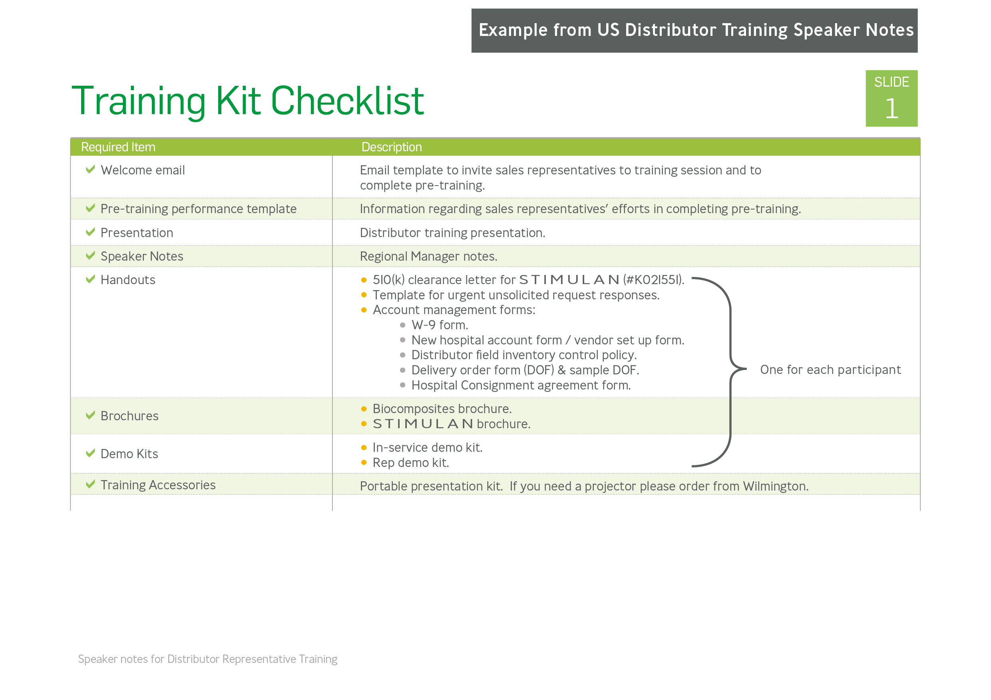

Slide 5
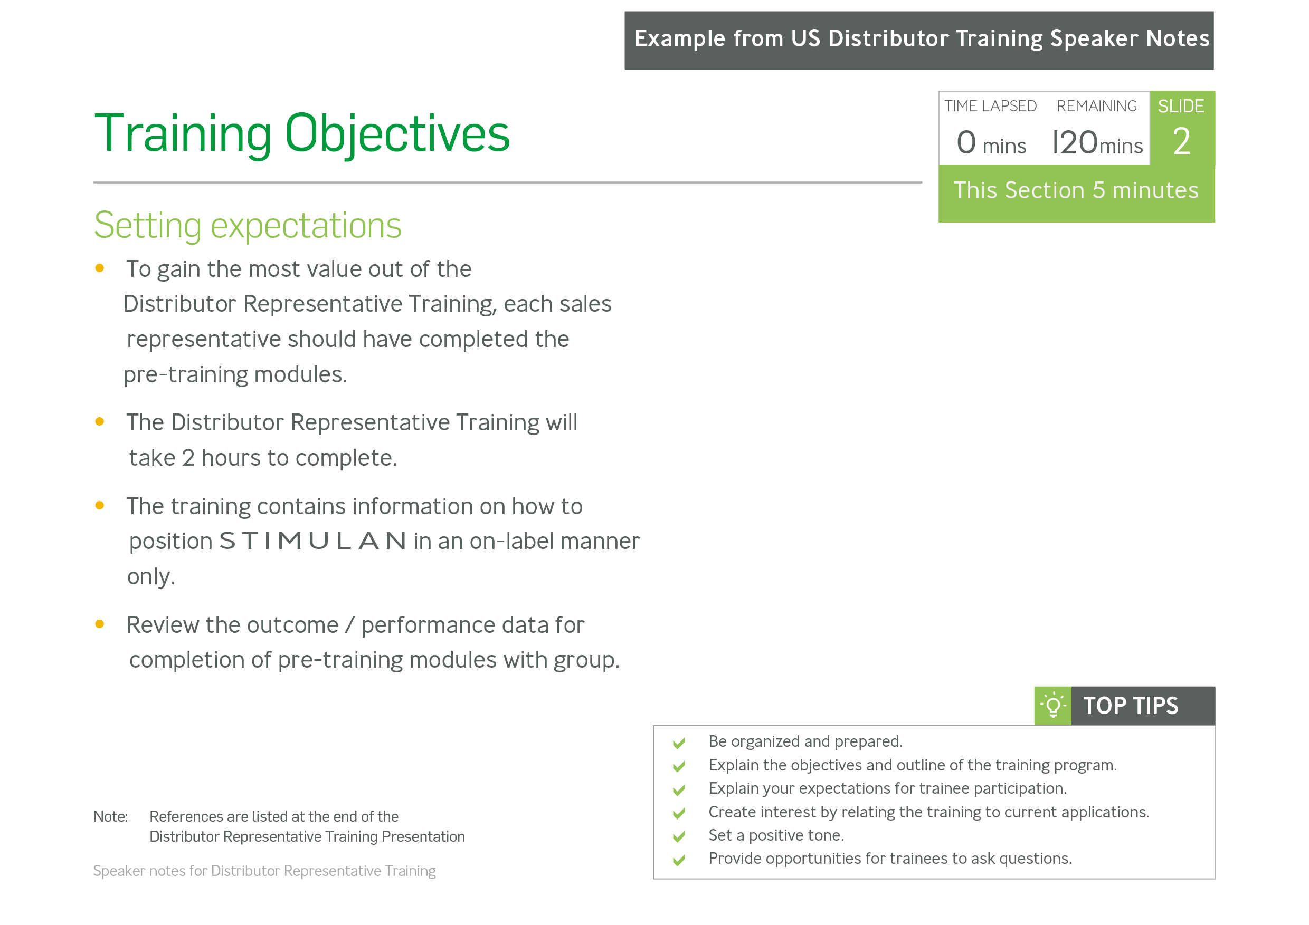

Slide 6
