Slide 1

Clinical Presentation for EU

Slide 2
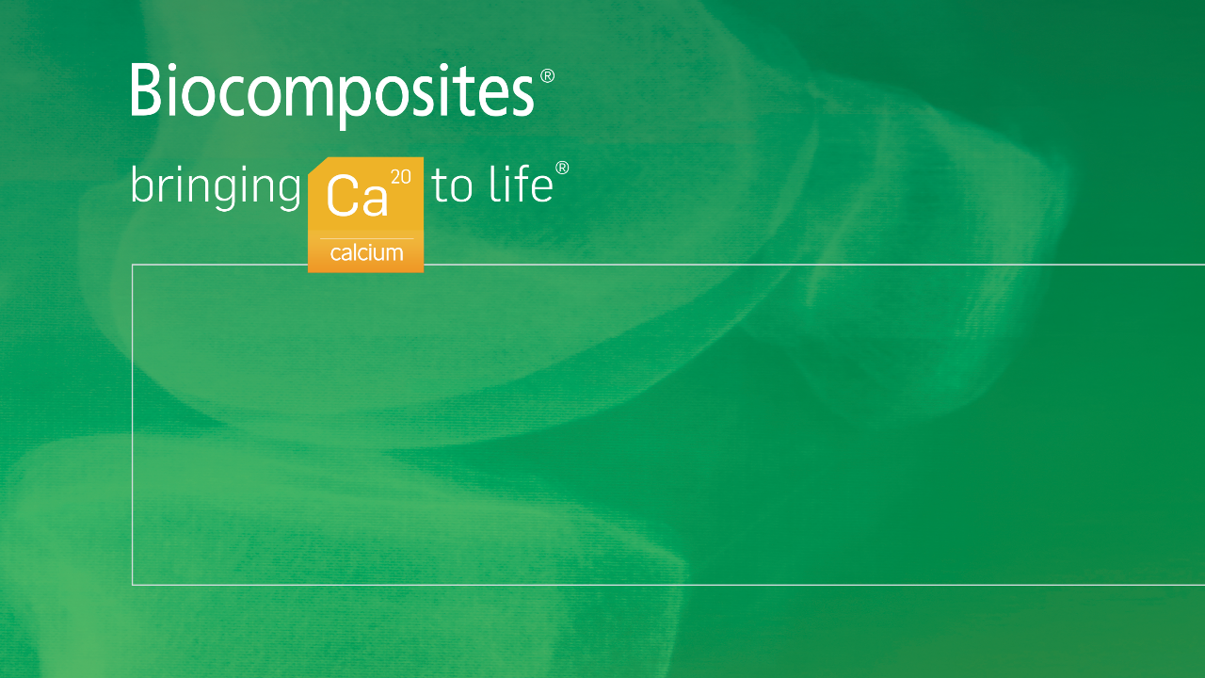
Innovative approaches to infection management
Singular focus on calcium compound technologies
Deep expertise
Dedicated to quality
Based in Keele, UK – with companies in the USA and China, and a presence in Canada and India

Slide 3
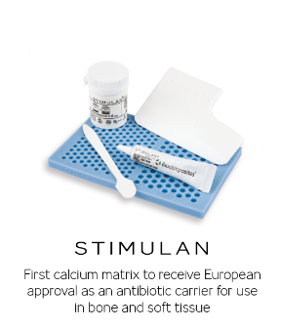
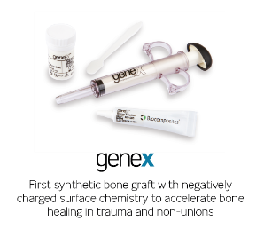
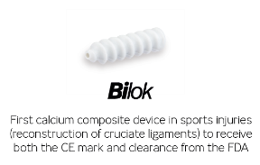
Innovation is at the very heart at what we do
At Biocomposites we are proud of our series of world firsts.
Our continuing investment has resulted in over 100 IP grants and registrations.
We are at the frontier of musculoskeletal infection, trauma, spine and sports injuries.

Slide 4
Trauma and non-unions

Slide 5
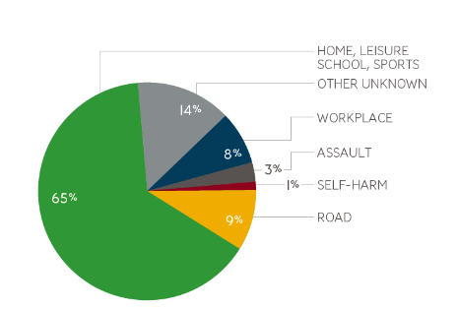
Trauma and non-unions
Trauma has a significant and ever increasing impact on healthcare systems
In the EU, 5.3 million people are admitted to hospital as a result of accident or violence-related injury¹
In the EU, €80 billion per year is the estimated cost of injuries treated in hospitals (inpatients and ambulatory care)¹
Injuries attending Emergency Departments in EU¹

Slide 6
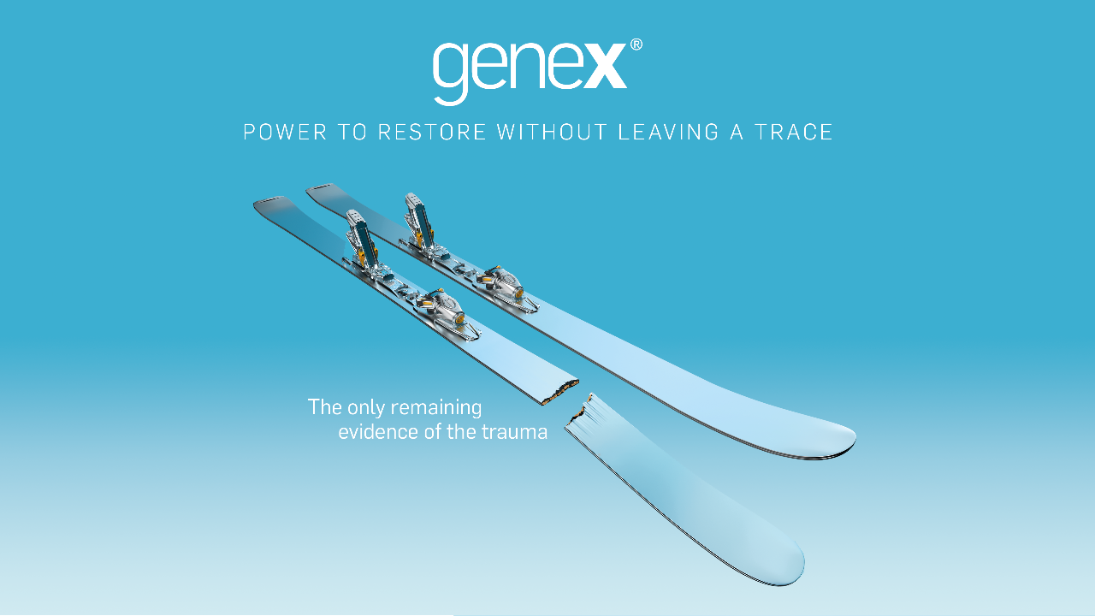

Slide 7

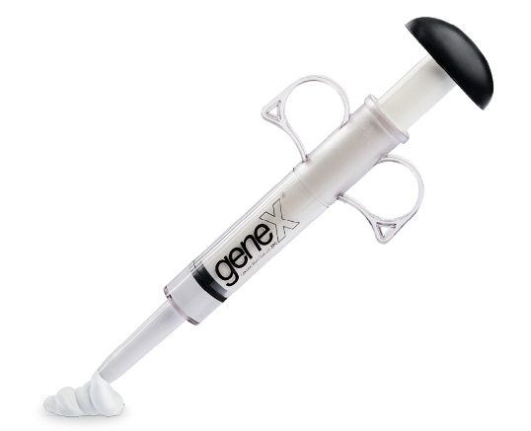
Perfect partner for your trauma and non-unions
genex is a catalyst for bone healing
It complements the body’s natural healing processes
Approved for bony voids and defects that are not intrinsic to structural stability

Slide 8
Designed to be completely absorbed and leave no trace
genex is a precisely balanced ß-tricalcium phosphate/calcium sulfate hemihydrate compound with distinct design properties:
Contains no hydroxyapatite (HA)
Negatively charged surface chemistry
genex provides a powerful scaffold for accelerated bone restoration and helps to hinder soft tissue ingrowth:
Fully absorbed within 12 months
Enhances osteogenic response
Restores strong healthy bone

Slide 9
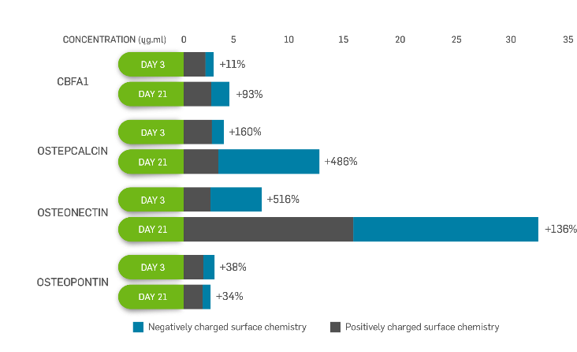
Enhances the osteogenic response to accelerate bone growth - 5x normal levels²

Slide 10
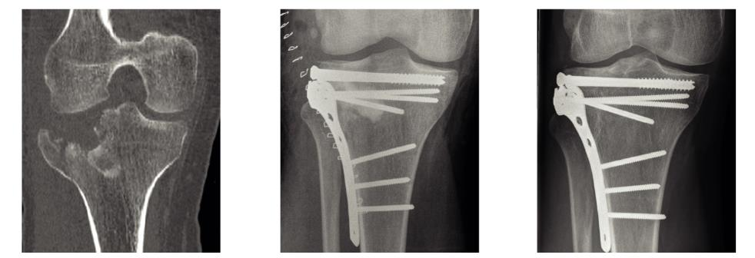
Restores strong healthy bone within a clinically relevant timeframe³
Tibial plateau fracture
Post-operative
15 months
genex restores bone to normal trabecular structure in 36 weeks⁴

Slide 11
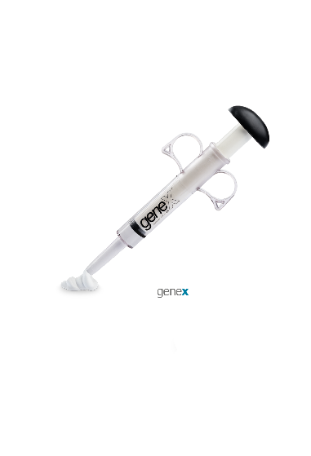
Versatility at your fingertips
Versatile and easy to prepare
Sets within 15 minutes at body temperature
Can be digitally implanted or injected in difficult-to-reach sites, or minimally invasive procedure

Slide 12
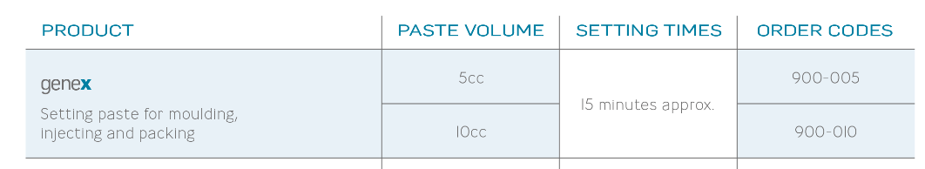
A range of surgical applications

Slide 13
Treatment goals
Truly absorbable at an optimal rate
Biocompatible
Osteoconductive with a matrix allowing bone growth
Physiological pH
Hydrophilic
Controlled purity

Slide 14
Applications / case studies

Slide 15
What is genex indicated for?
INDICATIONS FOR USE
genex is indicated only for bony voids or defects/gaps that are not intrinsic to the stability of the bony structure
genex is indicated to be gently packed into voids or defects of the skeletal system (i.e. long bones, extremities, spine and pelvis)
genex bone graft substitute resultant paste can be injected, digitally packed into the bone void to cure in situ or moulded into solid implants that are to be gently packed into the defect
The bony defects or cavities may be surgically created or the result of traumatic injury. genex provides a bone graft substitute that resorbs and is replaced with bone during the healing process

Slide 16
What is genex contraindicated for?
CONTRAINDICATIONS
Filling of defects which are intrinsic to the stability of the bony structure
Severe vascular or neurological disease
Uncontrolled diabetes
Severe degenerative bone disease
Pregnancy
Uncooperative patient who can't or won't follow post-operative instructions including individuals who
abuse drugs or alcohol
Hypercalcaemia

Slide 17
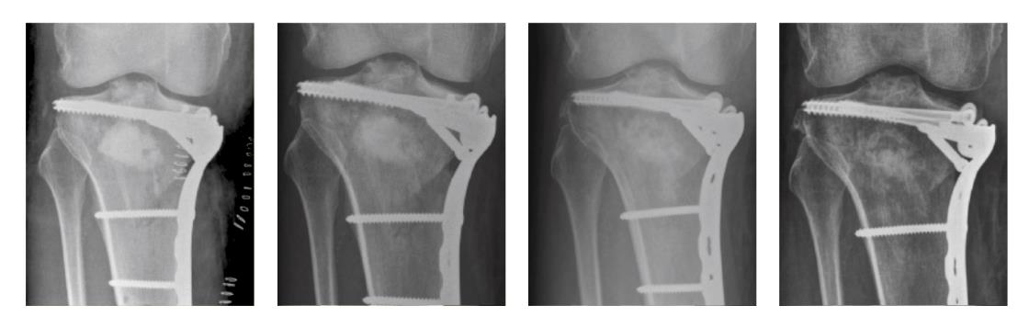
Comminuted tibial plateau fracture with genex paste⁵
Post-operative
4 weeks
12 weeks
6 months

Slide 18
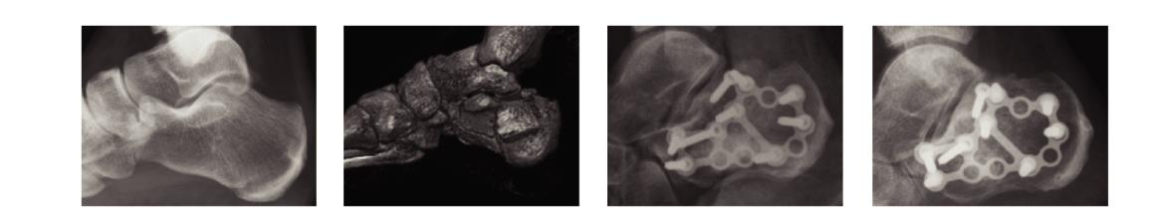
Comminuted calcaneal fracture with genex paste⁵
Pre-operative
Pre-operative – 3D CT
Post-operative
3 months

Slide 19
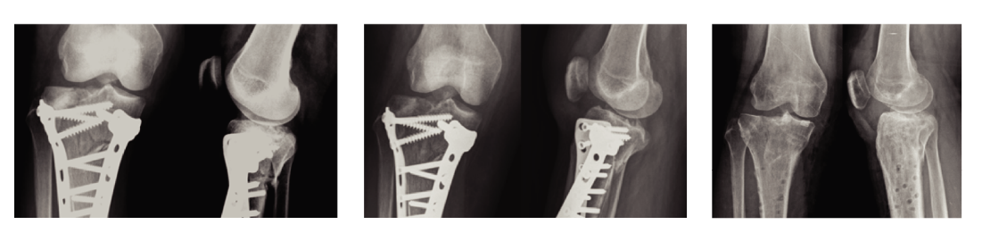
Tibial plateau fracture with genex paste⁶
1 month
3 months
12 months

Slide 20
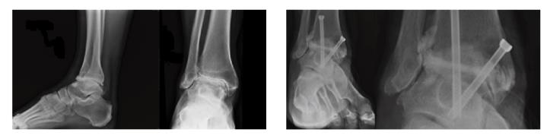
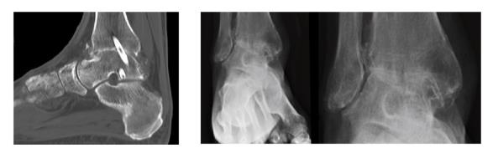
Ankle arthrodesis with genex paste⁷
Pre-operative
Post-operative
5 months – CT Scan
12 months

Slide 21
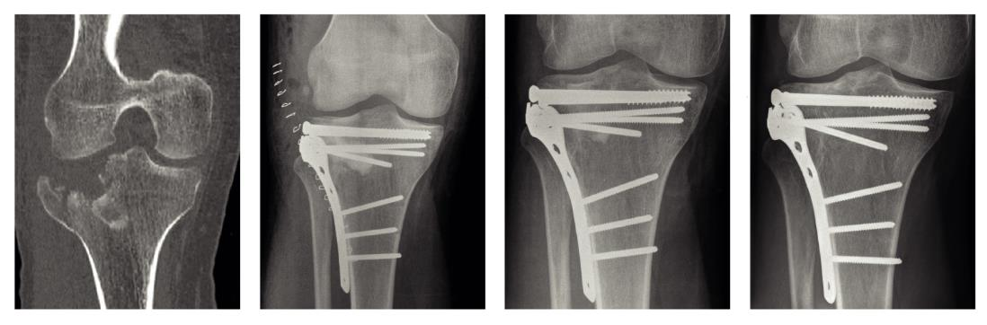
Case Study courtesy of Mr. Hemant K. Sharma Consultant Orthopaedic Surgeon, Senior Clinical Tutor, Hull, UK
Presentation CT scan
Post-operative
6 months
15 months

Slide 22
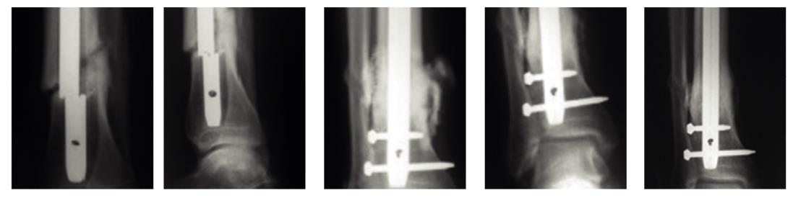
Case Study courtesy of Professor James B. Richardson Consultant Orthopaedic Surgeon/Professor of Orthopaedics, Oswestry, UK
Presentation
Presentation
Post-operative
3 months
10 months

Slide 23
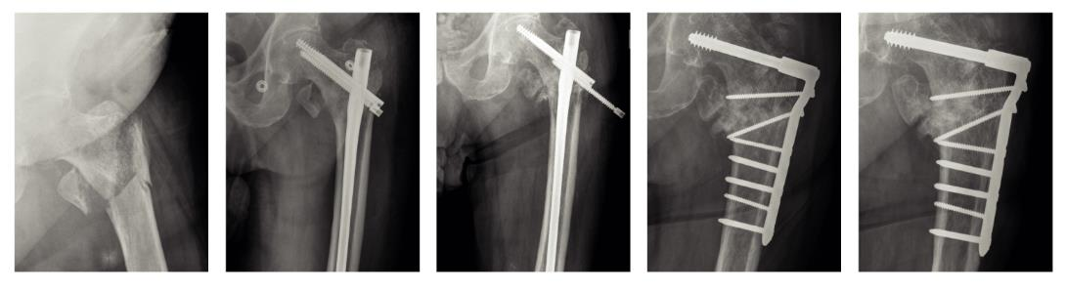
Case Study courtesy of Mr. Aamer Nisar and Mr. Shiva Gopal Consultant Orthopaedic Surgeons, Hull, UK
Presentation
Post-operative
4 months – screw backing out
4 months
1 year post revision

Slide 24
Preparation guidelines

Slide 25
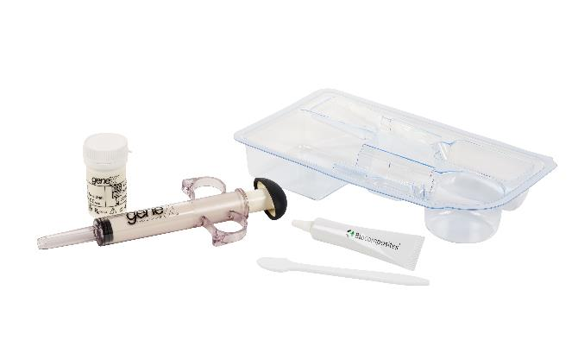
Preparation guidelines for genex

Slide 26
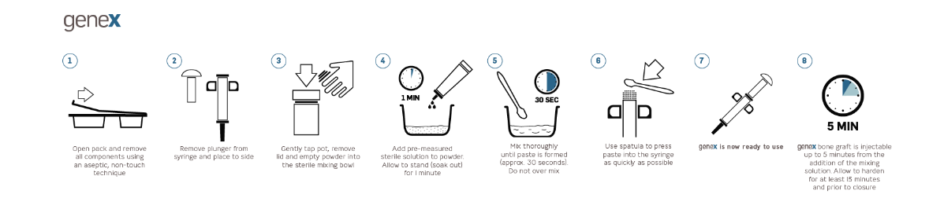
Preparation guide
Preparation of genex takes only a few careful moments. Use only the mixing solution provided.
Do not add any additional substances to the paste.
SURGEON'S TIPS
1. Only start to prepare genex after the surgical site has been prepared
2. If implanting digitally, the genex paste can be used after completion of step 5
3. Once implanted, do not disrupt the genex paste while it is setting

Slide 27
Find out more at biocomposites.com
For indications, contraindications, warnings and precautions see Instructions for Use.
©2020, Biocomposites, STIMULAN, genex, Bilok, Bringing Calcium to Life, Power to Transform Outcomes, DRy26 and Power to Restore are trademarks/registered trademarks of Biocomposites Ltd. All rights reserved. No unauthorised copying, reproduction, distributing or republication is allowed unless prior written permission is granted by the owner, Biocomposites Ltd.
Patents granted: EP 1390086 B1, US 8632796, CN ZL02809194.9, US 8496955, GB2367552, EP 1204599 B1, US 6780391, EP 1436019 B1, US 8563024, CN ZL02825134.2, EP 2594231 B1, US 88883063, CN ZL201210466117.X, GB2496710, EP 3058899 B1, US 10390954
Patents pending: GB1502655.2, US 15/040075, CN 201610089710.5, GB1704688.9, EP 18275044.8, US 15/933936, CN 108619579A
MA0174R3

Slide 28
References
Injuries in the European Union – Summary of injury statistics for the years 2012-2014 – 6th Edition.
Cooper, J.J., J.A. Hunt, and F. Pu, Enhancing the Osteogenic Potential of Bioabsorbable Implants through Control of Surface Charge., in Society for Biomaterials 2007 Annual Meeting. 2007: Chicago, Illinois, USA.
Data on file, Mr H. K. Sharma.
Yang, H.L., et al., Bone healing response to a synthetic calcium sulfate/beta-tricalcium phosphate graft material in a sheep vertebral body defect model. J Biomed Mater Res B Appl. Biomater, 2012. 100B(7): p. 1911-21.
Data on file, Mr A. Karladani.
Data on file, Mr Y. S. Chan.
Data on file, Professor J. B. Richardson.

