Slide 1
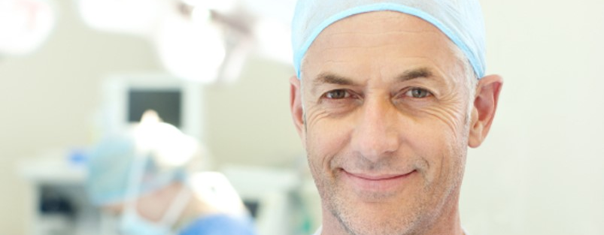

Clinical Presentation
for USA
Presenter:
Date:

Slide 2
Disclosure of Commercial Support
Consultant for Biocomposites Inc.
(Please add any additional disclosures that are applicable)

Slide 3
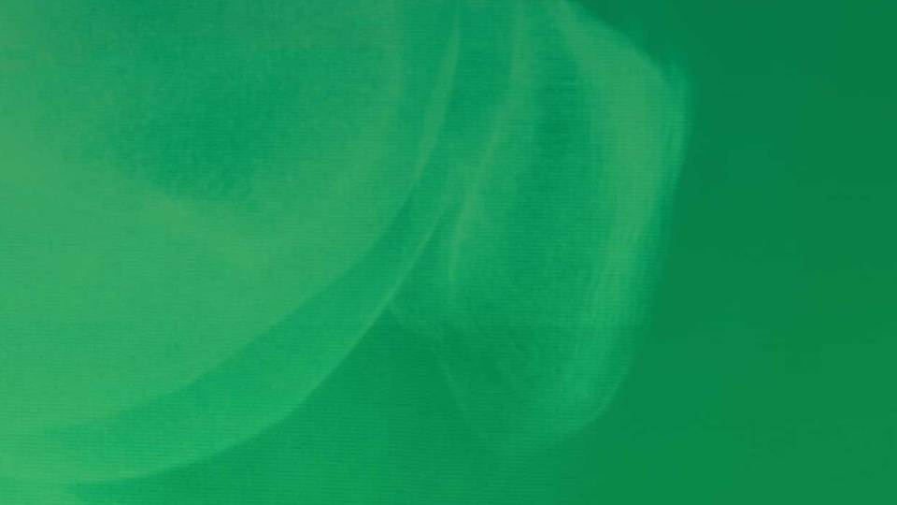

Biocomposites
bringing to life®
Ca²⁰
calcium
Innovative approaches to void management at infected sites
Singular focus on calcium compound technologies
Deep expertise
Dedicated to quality
Based in Keele, UK – with companies in the USA and China, and a presence in Canada, Europe and India

Slide 4
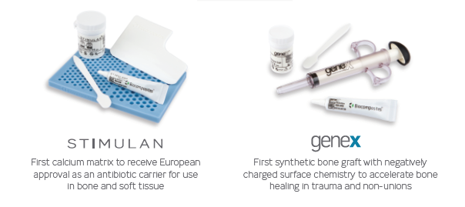
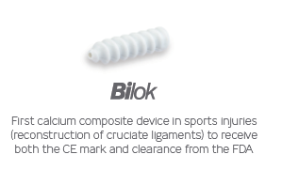
Innovation is at the very heart of what we do
At Biocomposites we are proud of our series of world firsts
Our continuing investment has resulted in over 100 IP grants and registrations
We are at the frontier of musculoskeletal infection, trauma, spine and sports injuries

Slide 5

Trauma and non-unions
PRIVATE & CONFIDENTIAL.
5

Slide 6
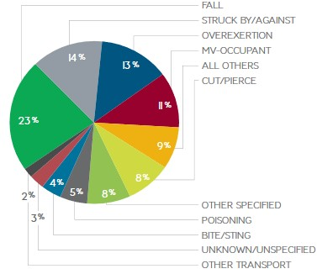
Trauma and non-unions
Trauma has a significant and ever increasing impact on healthcare systems
In the USA, there are over 41 million emergency department visits and 2.3 million hospital admissions¹
In the USA, trauma has an estimated economic burden of $671 billion a year, including both healthcare costs and lost productivity¹
Leading causes of non-fatal unintentional injuries
(age 15-65), in USA²
PRIVATE & CONFIDENTIAL.

Slide 7

Treatment goals
✓ Restores natural bone structure
✓ Completely absorbed and leaves no artifact to impair structural integrity
✓ Reduce avoidable complications
✓ Improve patient outcomes and decrease hospital readmissions
✓ Improve treatments while decreasing overall treatment cost
✓ Reduce the potential cost to the hospital of the Affordable Care Act
PRIVATE & CONFIDENTIAL.

Slide 8
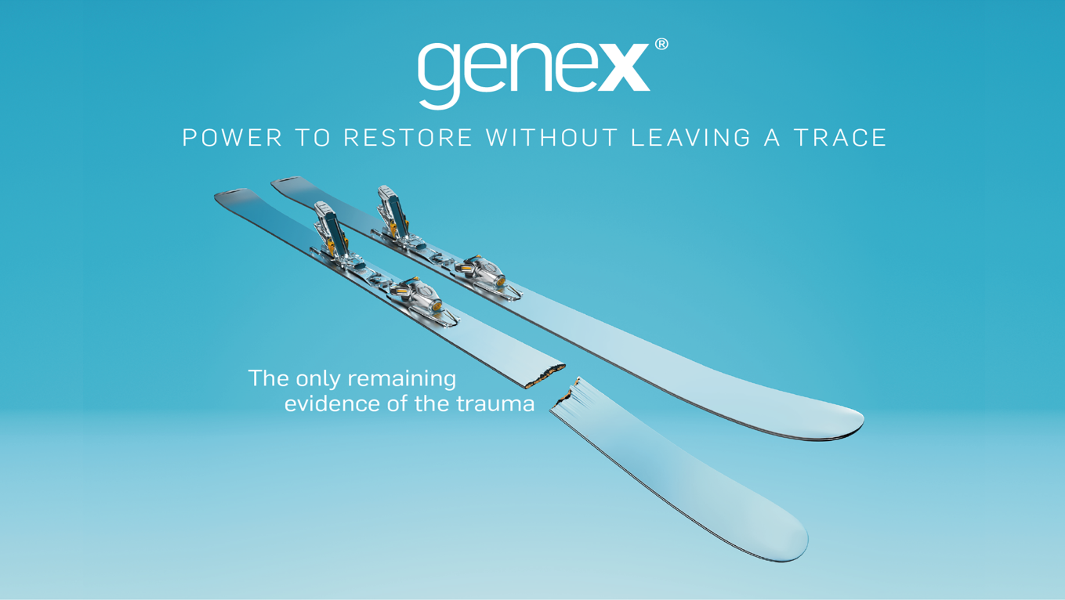

Slide 9
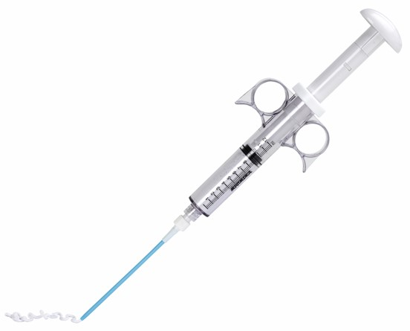
Perfect partner for your trauma and non-unions
✓ genex is a catalyst for bone healing
✓ It complements the body’s natural healing processes
✓ Cleared for bony voids and defects that are not intrinsic to the stability of the bony structure

Slide 10
Designed to be completely absorbed and leave no trace
genex is a precisely balanced ß-tricalcium phosphate/calcium sulfate hemihydrate compound with distinct design properties:
✓ Contains no hydroxyapatite (HA)
✓ Negatively charged surface chemistry
genex provides a powerful scaffold for accelerated bone restoration and helps to hinder soft tissue ingrowth:
✓ Fully absorbed within 12 months
✓ Enhances osteogenic response
✓ Restores strong healthy bone

Slide 11
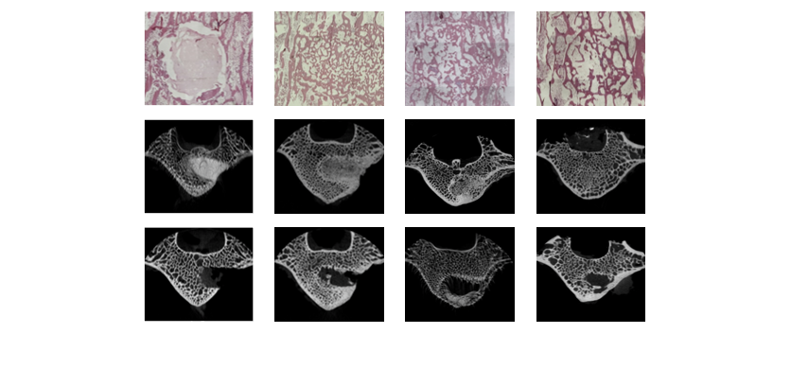
Completely absorbed within 12 months^{3,4}
genex contains no hydroxyapatite. HA can only be absorbed at 1-2% per year⁵
genex
Decalcified histology
H&E stain
genex
Micro-CT
Sham
Micro-CT
genex implantation
8 weeks
16 weeks
36 weeks

Slide 12
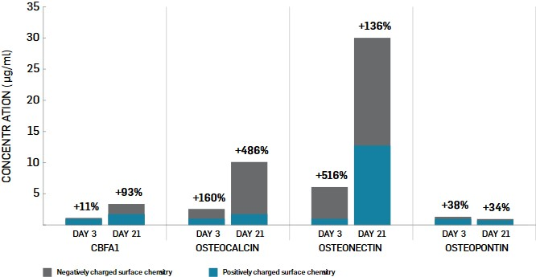
Enhances the osteogenic response to accelerate bone growth - 5x normal levels⁶

Slide 13
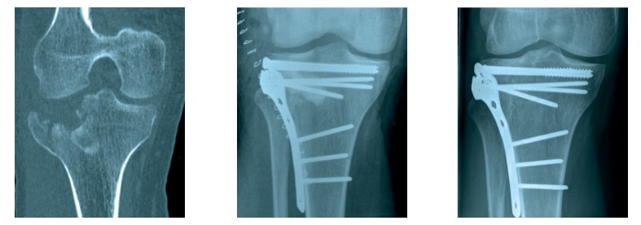
Restores strong healthy bone within a clinically relevant timeframe⁷
Tibial plateau fracture
Post-operative
15 months
genex restores bone to normal trabecular structure in 36 weeks³

Slide 14
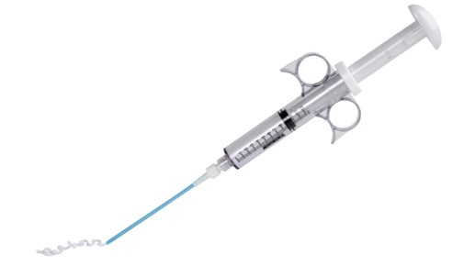
Versatility at your fingertips
Versatile and easy to prepare
genex Bone Graft Substitute sets within 15 minutes at body temperature
Can be digitally implanted or injected in difficult-to-reach sites or minimally invasive procedures
Bone Graft Substitute

Slide 15
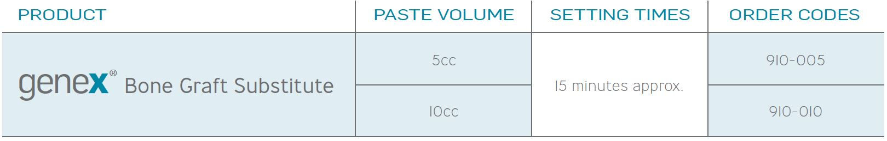

Slide 16
Applications / case studies
16

Slide 17
What is genex indicated for?
INTENDED USE
genex injectable paste provides a bone graft substitute that resorbs and is replaced with bone during the healing process
INDICATIONS FOR USE
genex is indicated only for bony voids or defects/gaps that are not intrinsic to the stability of the bony structure
genex is indicated to be gently packed into voids or defects of the skeletal system (i.e. long bones, extremities, spine and pelvis)
genex resultant paste can be injected, digitally packed into the bone void to cure in situ or molded into solid implants that are to be gently packed into the defect
The bony defects or cavities may be surgically created or the result of traumatic injury. genex provides a bone graft substitute that resorbs and is replaced with bone during the healing process

Slide 18
What is genex contraindicated for?
CONTRAINDICATIONS
Filling of defects which are intrinsic to the stability of the bony structure
Severe vascular or neurological disease
Uncontrolled diabetes
Severe degenerative bone disease
Pregnancy
Uncooperative patient who can’t or won't follow post-operative instructions including individuals who abuse drugs or alcohol
Hypercalcaemia

Slide 19
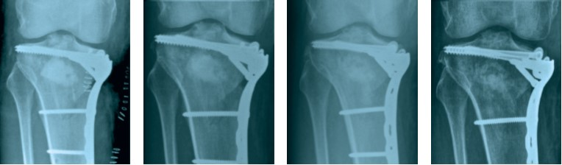
Comminuted tibial plateau fracture with genex⁸
Post-operative
4 weeks
12 weeks
6 months

Slide 20
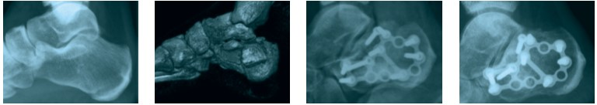
Comminuted calcaneal fracture with genex⁸
Pre-operative
Pre-operative - 3D CT
Post-operative
2 months

Slide 21
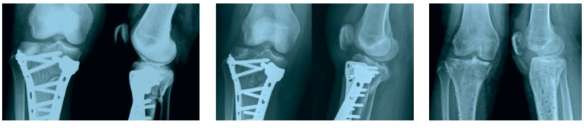
Tibial plateau fracture with genex⁹
1 month
3 months
12 months

Slide 22
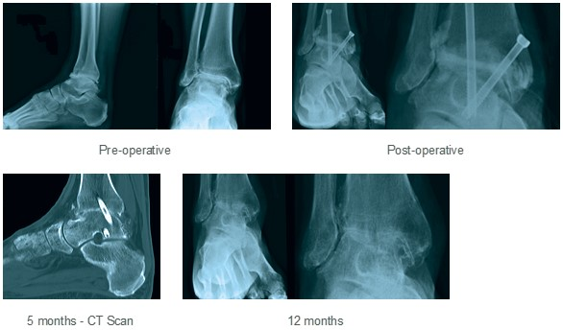
Ankle arthrodesis with genex¹⁰
Pre-operative
Post-operative
5 months – CT scan
12 months

Slide 23
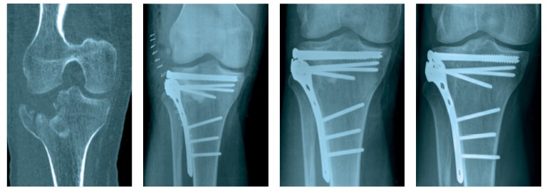
Courtesy of Mr Hemant K Sharma, Hull, UK
Presentation – CT scan
Post-operative
6 months
15 months

Slide 24
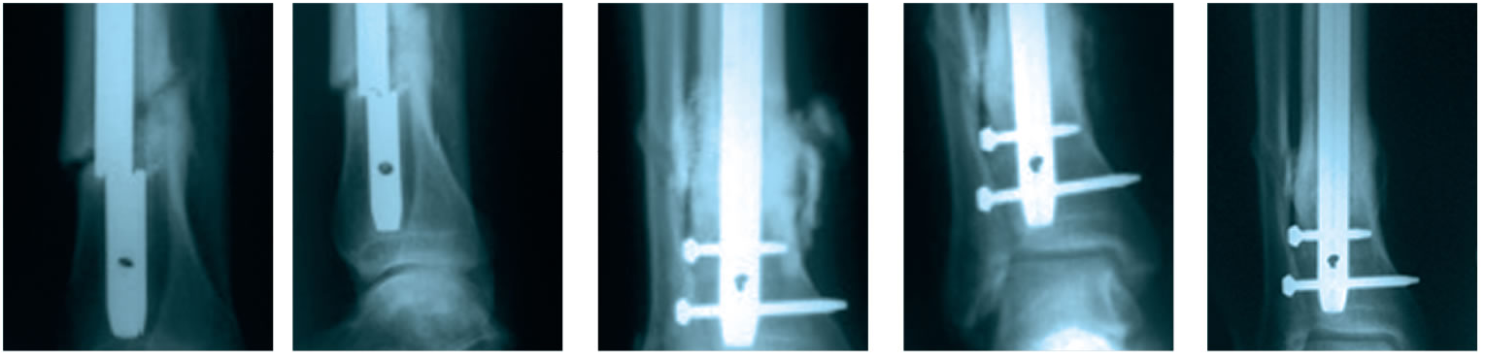
Courtesy of Professor James B Richardson, Oswestry, Shropshire, UK
Presentation
Post-operative
3 months
10 months

Slide 25
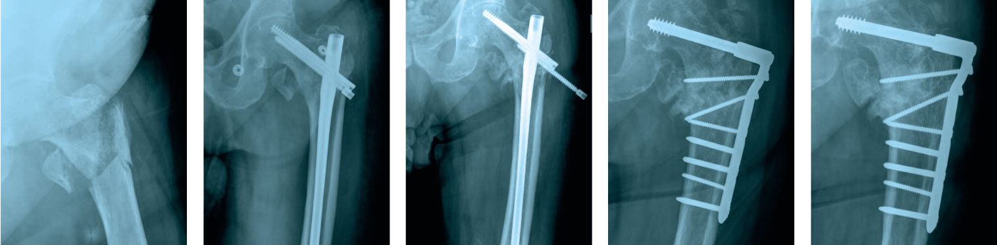
Courtesy of Mr Aamer Nisar & Mr Shiva Gopal, Hull, UK
Presentation
Post-operative
4 months – screw
backing out
4 months
1 year post revision

Slide 26
Preparation guidelines

Slide 27
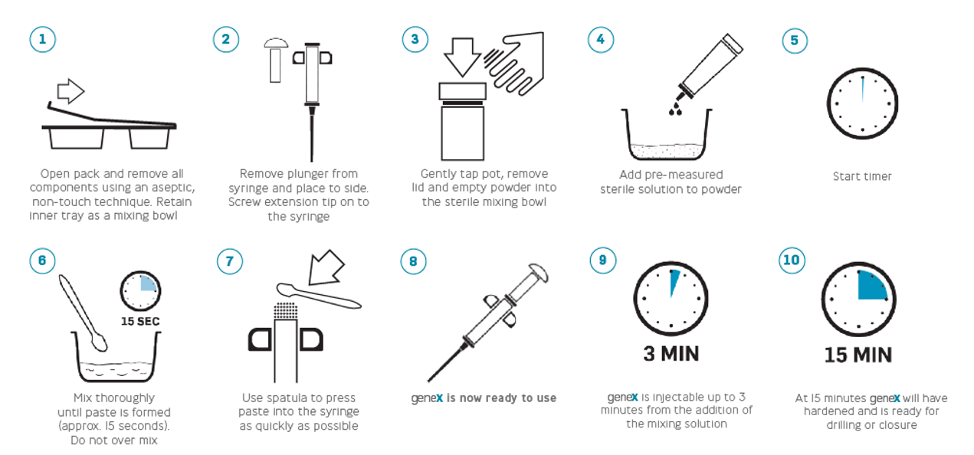
Preparation guide for injection
Preparation of genex takes only a few careful moments. Use only the mixing solution provided.
Do not add any additional substances to the paste. All times stated are measured from the start of the timer.

Slide 28
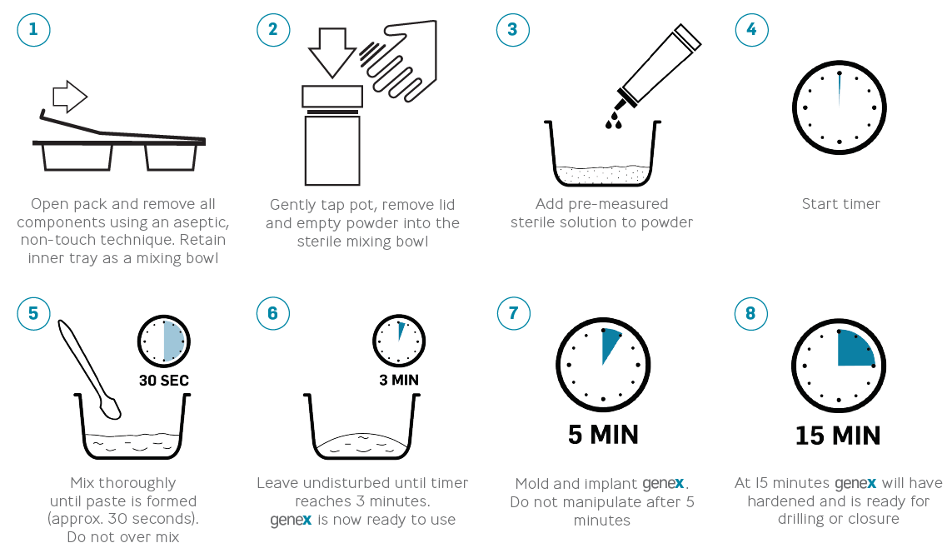
Preparation guide for manual implantation
Preparation of genex takes only a few careful moments. Use only the mixing solution provided. Do not add any additional substances to the paste. All times stated are measured from the start of the timer.

Slide 29
Find out more at biocomposites.com
For indications, contraindications, warnings and precautions see Instructions for Use.
©2020, Biocomposites, genex and Power to Restore are trademarks/registered trademarks of Biocomposites Ltd. All rights reserved.
No unauthorized copying, reproduction, distributing or re-publication is allowed unless prior written permission is granted by the owner, Biocomposites Ltd.
Patents granted: EP 1390086 B1, US 8632796, CN ZL02809194.9, US 8496955
MA0209R3

Slide 30
References
1. http://www.nationaltraumainstitute.org/home/trauma_statistics.html.
2. http://www.cdc.gov/injury/wisqars/nonfatal.html
3. Yang HL et al. Bone healing response to a synthetic calcium sulfate/beta-tricalcium phosphate graft material in a sheep vertebral body defect model. J Biomed Mater Res B Appl Biomater 2012;100B(7):1911–21.
4. Data on file, Mr A Nisar and Mr S Gopal.
5. Pina S, Ferreira JMF. Bioresorbable plates and screws for clinical applications: A review. J Healthcare Engineering 2012;3(2):243–60.
6. Cooper, J.J., J.A. Hunt, and F. Pu, Enhancing the Osteogenic Potential of Bioabsorbable Implants through Control of Surface Charge., in Society for Biomaterials 2007 Annual Meeting. 2007: Chicago, Illinois, USA.
7. Data on file, Mr HK Sharma.
8. Data on file, Mr A Karladani.
9. Data on file, Mr YS Chan.
10. Data on file, Prof JB Richardson.

