Slide 1
Investment Opportunity:
French Swap Spreads
S&P Dividend Presentation from Nov 2023
October 2026

Slide 2
Executive Summary: French Opportunity
Buy a 4 year Expiry Option on a 5 year Maturity France vs Euribor Swap Spread
French bonds (‘OATs’) have dislocated massively vs European swaps in the last few weeks as the market gets increasingly nervous about the state of French finances, the looming budget negotiations and the approaching Presidential election in the spring.
The entry point is highly attractive versus history, particularly in recent days as levered investors were stopped out their positions.
While this exposure typically requires tremendous leverage and ongoing refinancing risk, we have been able to structure it with four-year non-recourse financing, at ESTR+17
Given the enormous margin of safety of rolling into a 1 year expiry bond and the unique financing structure, we think the expected value is skewed massively in our favor. There’s plenty of time for normalization to occur, but even if the market were to become dramatically more dislocated over the next four years, the returns would still be extremely attractive. Permanent loss of capital would require the market to price a material likelihood of French default within 12 months of expiry (presumably due to France leaving the EU).

Slide 3
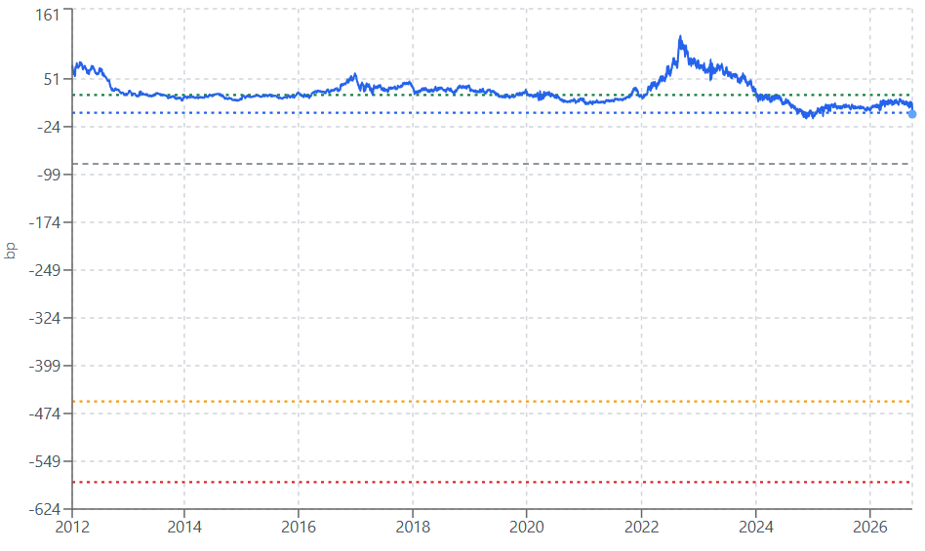
[Scenario Analysis: 4y IRRs]
Time Series of a Generic ~1y French Bond vs Euribor, last 14y¹
4yr IRRs at different at-expiry spread levels²
43% IRR at 50th percentile (since 2012)
42% IRR roll to spot (nothing changes)
36% No roll (Spot today)
Investment break-even
100% impairment (at end of 4 years)
¹ Source: Bloomberg, Liminality Calculations
² Scenario Analysis of FRTR 3 ¼ 02/25/32, rolled forward 4y
Source: Bloomberg, Liminality Calculations
Note: Returns are dependent on level of swap spread
Notes:
Consistent tightening since post GFC

Slide 4
Why is there a Dislocation?
Long Term Factors
[Budget, fiscal]
[Political dysfunction, lack of will to fix the situation]
Short Term Factors
[Levered unwinds]
[Rates globally moving higher, higher volatility in rates complex with global tightening cycle back in early innings]

Slide 5
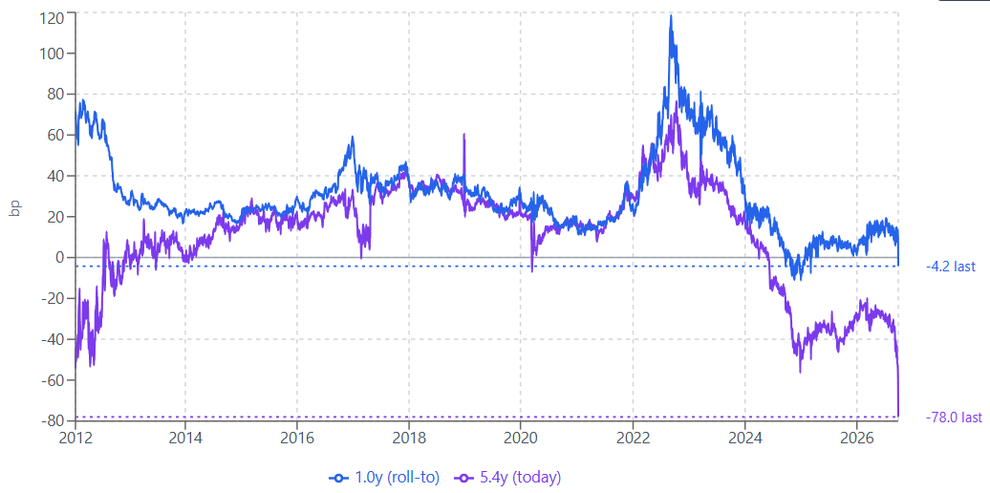
Base Case: Attractive Roll over ~4y
In 4.4 years the FRTR 3 ¼ 02/25/32 bond will roll into the ~1y point on the curve
~1 year maturity
~5.4 year maturity
Source: Bloomberg, Liminality Calculations

Slide 6
[Scenario Analysis: 4y IRRs]
Time Series of a Generic ~1y French Bond vs Euribor, last 14y¹
4yr IRRs at different at-expiry spread levels²
43% IRR at 50th percentile (since 2012)
42% IRR roll to spot (nothing changes)
36% No roll (Spot today)
Investment break-even
100% impairment (at end of 4 years)
¹ Source: Bloomberg, Liminality Calculations
² Scenario Analysis of FRTR 3 ¼ 02/25/32, rolled forward 4y
Source: Bloomberg, Liminality Calculations
Note: Returns are dependent on level of swap spread
Notes:
Consistent tightening since post GFC

Slide 7
Risks
French swap spreads could continue to gap lower, and we could have mark to market losses from here. But for permanent impairment at expiry, it would likely require [x]
[Far left wins in April presidential election, Melenchon looks to ‘cancel’ the debt]
[France leaves the EU]

Slide 8
[Insert Italy chart during 2012 era]

Slide 9
Appendix

Slide 10
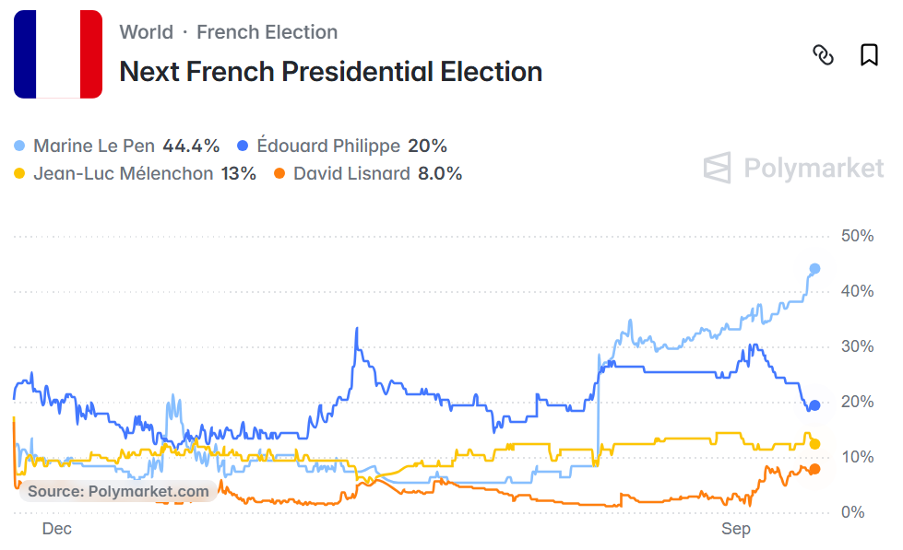
Presidential Election Polymarket odds
Le Pen is expected to win. Melenchon is ~13% currently

Slide 11
French Presidential Upcoming Calendar
[insert]

Slide 12
Disclaimer
No offer or solicitation
Nothing herein constitutes or should be construed as an offering of securities or a recommendation to purchase or sell securities or commodity interests. If an offer of securities were to made in the future, it must be made only through a confidential private placement memorandum (“PPM”) and related subscription documents.
Eligibility requirements
Potential investors must meet the eligibility requirements set forth in the PPM. The information contained herein is for informational and discussion purposes only, reflects the opinions of the author and no other person, and to the extent factual is accurate only as the date hereof. Liminality Capital does not undertake to update any information that subsequently becomes inaccurate. Past performance is no guarantee of future results.
Not advice
This material is intended for informational purposes only and should not be construed as legal or tax advice, nor is it intended to replace the advice of a qualified attorney or tax advisor. The recipient should conduct his or her own analysis and consult with professional advisors prior to making any investment decisions.

Slide 13
Appendix:
Original July 2025 Presentation

Slide 14
Investment Opportunity:
Swap Spreads on Belly Treasury Bonds
S&P Dividend Presentation from Nov 2023
July 2025

Slide 15
TABLE OF CONTENTS
EXECUTIVE SUMMARY
INVESTMENT DESCRIPTION
SCENARIO ANALYSIS
RISKS

Slide 16
Executive Summary
Buy a 2y Expiry Option on a 6y Treasury Swap Spread
6y Treasuries have attractive roll and carry to the 4y point on the curve (especially Coupon Strips)
The entry point is highly attractive versus history. There is an ongoing dislocation from, among other things, levered players getting stopped out
While this exposure typically requires tremendous leverage and ongoing refinancing risk, we have been able to structure it with two-year non-recourse financing
While there are risks to this trade not working, we have probabilistic conviction that the expected value is skewed massively in our favor, there is plenty of time for normalization to occur, and there are likely upcoming catalysts from regulatory reform

Slide 17
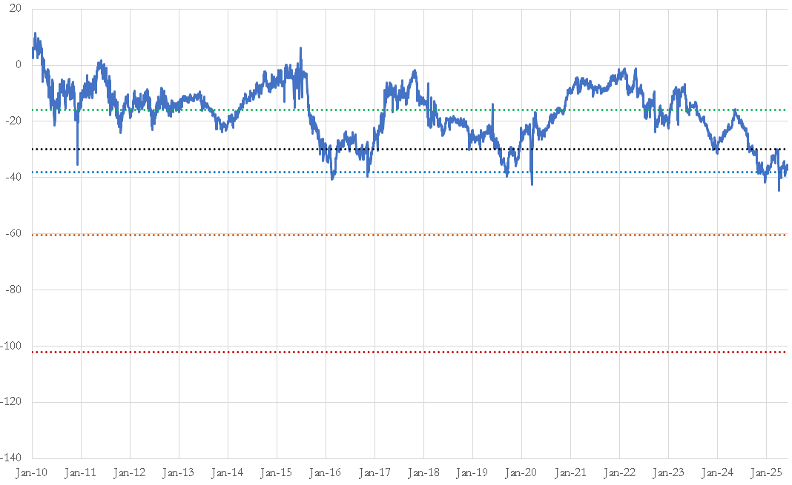
Scenario Analysis: 2y IRRs
Time Series of a Generic ~3.75y Coupon Strip, last 15y¹
2yr IRRs at different at-expiry spread levels²
42% IRR at 50th percentile (since 2010)
30% IRR at March 2025 high ~10th percentile
23% IRR roll to spot (nothing changes)
Investment break-even
100% impairment (at end of 2 years)
¹ Source: Bloomberg z spread *-1, Liminality Calculations
² Scenario Analysis of S 02/15/31, rolled forward 2y, at ~4% rate levels on Treasuries
Source: Bloomberg, Liminality Calculations
Note: Returns are dependent on level of swap spread
Notes:
Consistent tightening since post GFC

Slide 18
TABLE OF CONTENTS
EXECUTIVE SUMMARY
INVESTMENT DESCRIPTION
SCENARIO ANALYSIS
RISKS

Slide 19
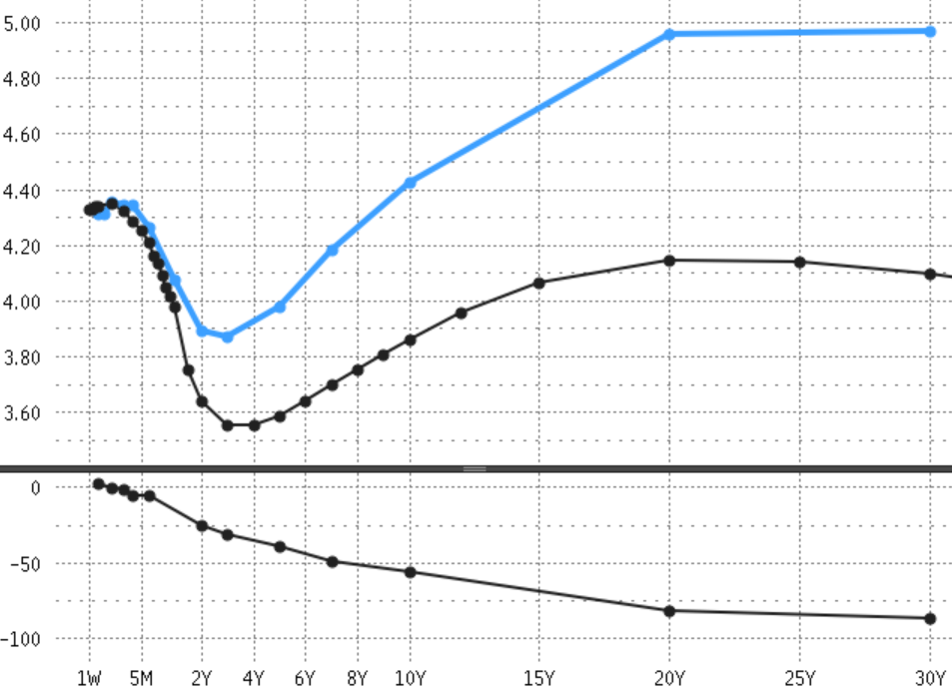
What Is A Swap Spread?
US Yield Curves
A swap spread is the difference between the yield on a government bond, like a Treasury, and the yield on a swap with the same maturity
To be ‘long’ a swap spread, buy a Treasury and pay fixed on a SOFR swap, fully hedging the duration risk
Treasury Yield Curve
Swaps Yield Curve
Swap Spreads at each point of the Yield Curve
Swap Spread (Swap Minus Treasury)
Certain market participants prefer to trade duration synthetically via swaps, which, among other factors, creates supply and demand imbalances between swaps and treasuries. For the past 15 years swaps have typically traded rich (lower yield) and treasuries traded cheap (higher yield).
Source: Bloomberg

Slide 20
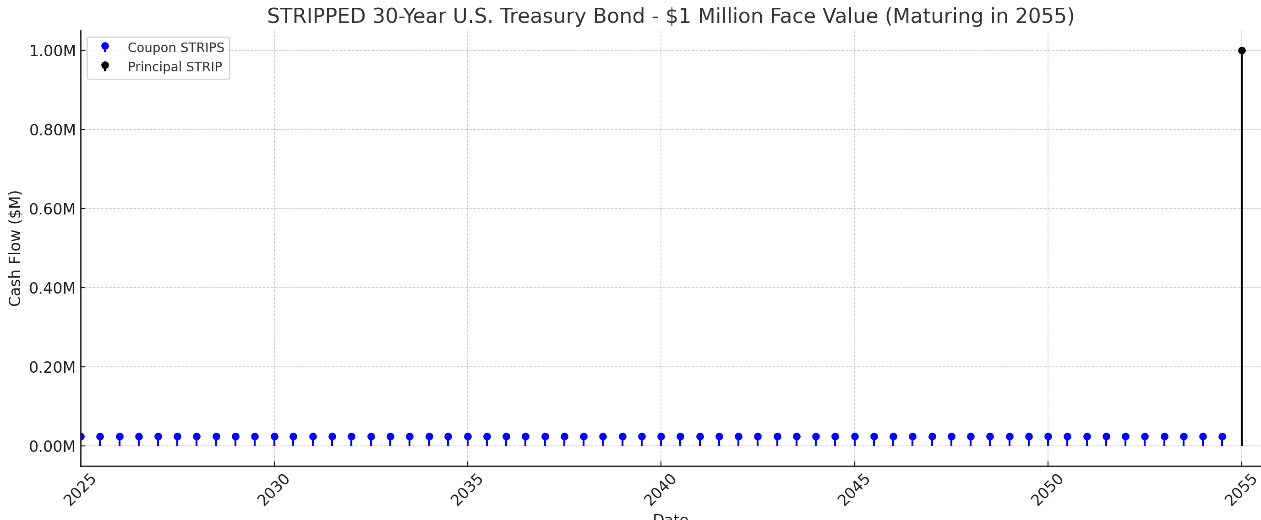
What Is A Treasury Coupon Strip?
A Treasury coupon strip is created when periodic interest payments (‘coupons’) are separated from the principal (‘face value’) of a traditional Treasury bond, creating new securities where the sum of their economics are equivalent to owning the whole bond.
Certain market participants prefer to own principal strips to maximize their duration exposure (per dollar of invested capital), mostly at the longer end of the curve. Therefore, principal strips trade rich (lower yield) and coupon strips trade cheap (higher yield), structurally.

Slide 21
6 Year Swap Spreads Are Dislocated
The 02/15/31 Treasury coupon strip is close to 15 year lows
~5.75 year maturity
Source: Bloomberg, Liminality Calculations
Notes:
Consistent tightening since post GFC

Slide 22
Why is there a Dislocation?
Long Term Factors
Quantitative tightening (‘QT’) by the Federal Reserve
Dealer balance sheet constraints
Increased budget deficits have increased Treasury supply
Short Term Factors
At year end dealers were stuffed with coupon strips and at capacity limits to warehouse and intermediate risk
In Q1 the trade became crowded due to excitement around potential regulatory changes, which led to levered players being forced out of positions during the market-wide volatility after 4/2 Liberation Day

Slide 23
What is the Trade?
Buy a Treasury Bond
Pay Fixed on an Interest Rate Swap
Finance the Package: The leverage is synthetic; we enter into a derivative agreement called a ‘Total Return Swap’ that provides ~50:1 to ~60:1 leverage, locking in financing for 2 years
Importantly, the package includes an embedded option: a floor that limits our downside – i.e. this makes the financing non-recourse

Slide 24
What is the Trade? Illustrative Example
Total Return on Bond =
Interest + Bond Appreciation
BANK
(Total Return Payer)
LIMINALITY
(Total Return Receiver)
SOFR + 39bps
(2y of Funding Locked In)
Underlying
Cash Flows
Treasury Bond or Treasury Coupon Strip
(Underlying Asset)
Unique Feature: Limited Downside (Liminality buys an option struck 45bp out-of-the-money)

Slide 25
TABLE OF CONTENTS
EXECUTIVE SUMMARY
INVESTMENT DESCRIPTION
SCENARIO ANALYSIS
RISKS

Slide 26
Base Case: Attractive Roll over 2y
In 2 years the S 02/15/31 coupon strip (~5.75 maturity) will roll into the ~3.75y point on the curve
~3.75 year maturity
~5.75 year maturity
Source: Bloomberg, Liminality Calculations

Slide 27
Scenario Analysis: 2y IRRs
Time Series of a Generic ~3.75y Coupon Strip, last 15y¹
2yr IRRs at different at-expiry spread levels²
42% IRR at 50th percentile (since 2010)
30% IRR at March 2025 high ~10th percentile
23% IRR roll to spot (nothing changes)
Investment break-even
100% impairment (at end of 2 years)
¹ Source: Bloomberg z spread *-1, Liminality Calculations
² Scenario Analysis of S 02/15/31, rolled forward 2y, at ~4% rate levels on Treasuries
Source: Bloomberg, Liminality Calculations
Note: Returns are dependent on level of swap spread
Notes:
Consistent tightening since post GFC

Slide 28
Upside Case: Potential Upcoming Catalysts
The Trump administration is focused on bank de-regulation, and Treasury Secretary Bessent is fixated¹ on the levers he can pull to optimize the cost of government funding.
Bank de-regulation proposals under active consideration include:
  exempting Treasuries from bank Supplementary Leverage Ratio ‘SLR’ calculations
  indexing regulatory thresholds (like the GSIB surcharge) to economic growth
Michelle Bowman, Trump’s appointee for Fed Vice Chair for Supervision, is pivoting hard from the Biden-era Fed regulatory agenda. She recently said “…an upcoming rewrite of bank leverage rules is just a ‘first step’ in reviewing the ‘distorted’ bank capital requirements.”²
New Fed Chair in May 2026: while outgoing Chair Powell has supported reforms³, Trump will choose a new Fed Chair next year who can continue to drive the agenda from the top
While some market participants dispute the likely magnitude of particular reforms, fairly, we do think it is likely that these changes will be adopted, and if these reforms don’t work then they’ll try something else
¹ https://www.bloomberg.com/news/articles/2025-05-23/bessent-sees-easing-capital-rule-on-us-treasuries-this-summer
² https://www.reuters.com/sustainability/boards-policy-regulation/feds-bowman-eyes-broad-set-bank-capital-reforms-2025-06-23/
³ https://www.americanbanker.com/news/powell-backs-leverage-ratio-update-treasury-market-reform

Slide 29
TABLE OF CONTENTS
EXECUTIVE SUMMARY
INVESTMENT DESCRIPTION
SCENARIO ANALYSIS
RISKS

Slide 30
Risks
Swap spreads could continue to grind lower, making new all-time lows. What would cause that?
Supply: The increasing likelihood of large budget deficits will increase the supply of net Treasury issuance which, all else equal, could weigh on swap spreads
Demand: Foreign demand for US dollars and US Treasuries could decline for a variety of reasons. The Fed may be reluctant to re-start QE like they did in the past, removing an important source of demand over the last 15 years
An increase in demand for receiving on swap, or a decrease in demand for paying on swaps, could put pressure on swap spreads
Bank de-regulation efforts by the Trump administration may not work, or may not be sufficient to offset these other factors mentioned above

Slide 31
Appendix

Slide 32
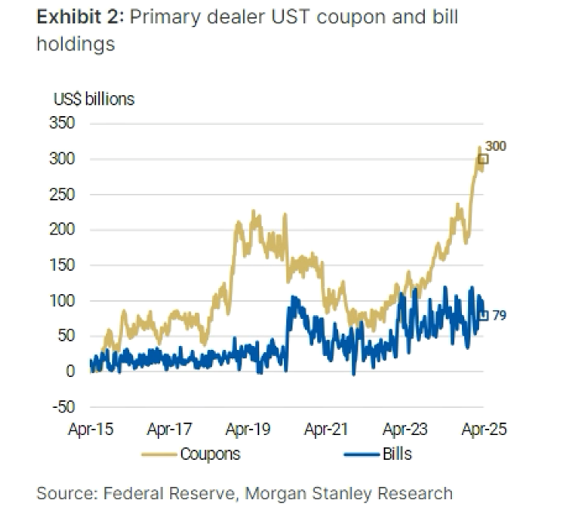
Dealers Stuffed with Treasury Bonds
Source: Morgan Stanley

Slide 33
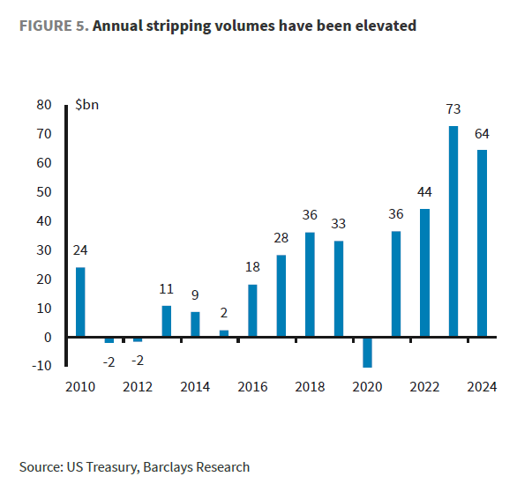
Treasury Stripping Volumes Elevated
Source: Barclays

Slide 34
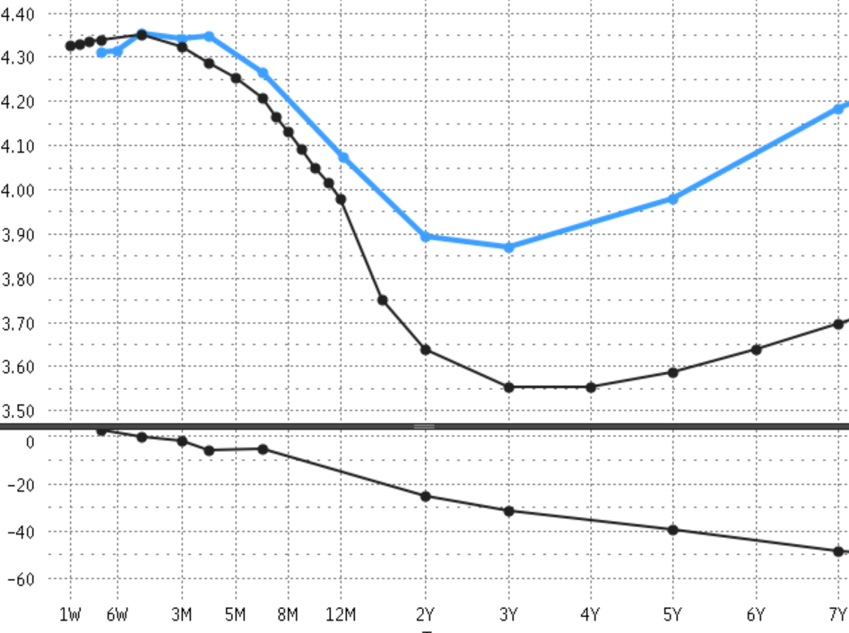
Swap Spreads <7y
US Yield Curves
Treasury Yield Curve
Swaps Yield Curve
Swap Spreads at each point of the Yield Curve
Swap Spread (Swap Minus Treasury)
Source: Bloomberg

Slide 35
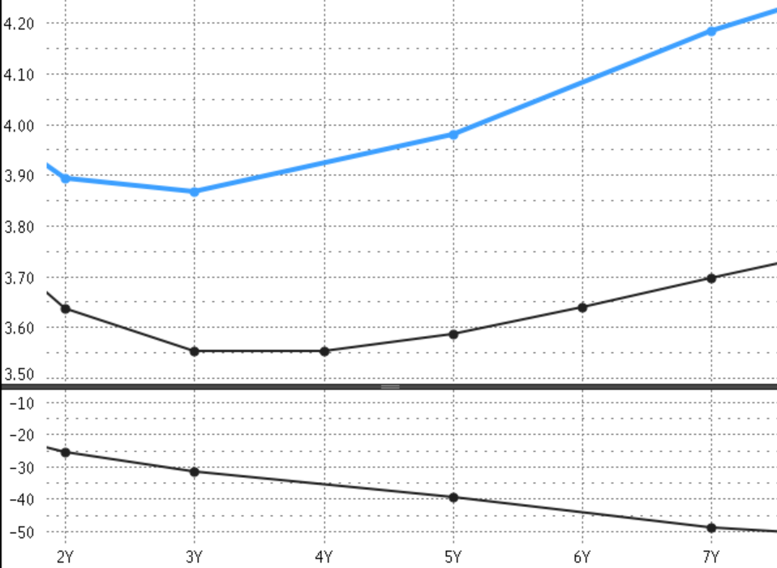
Swap Spreads 2y to 7y
US Yield Curves
Treasury Yield Curve
Swaps Yield Curve
Swap Spreads at each point of the Yield Curve
Swap Spread (Swap Minus Treasury)
Source: Bloomberg

Slide 36
Disclaimer
No offer or solicitation
Nothing herein constitutes or should be construed as an offering of securities or a recommendation to purchase or sell securities or commodity interests. If an offer of securities were to made in the future, it must be made only through a confidential private placement memorandum (“PPM”) and related subscription documents.
Eligibility requirements
Potential investors must meet the eligibility requirements set forth in the PPM. The information contained herein is for informational and discussion purposes only, reflects the opinions of the author and no other person, and to the extent factual is accurate only as the date hereof. Liminality Capital does not undertake to update any information that subsequently becomes inaccurate. Past performance is no guarantee of future results.
Not advice
This material is intended for informational purposes only and should not be construed as legal or tax advice, nor is it intended to replace the advice of a qualified attorney or tax advisor. The recipient should conduct his or her own analysis and consult with professional advisors prior to making any investment decisions.

