Slide 1
LIMINALITY CAPITAL / PROPOSED REVISION
Proposed slide replacements
A clearer account of the trade, its assumptions and its downside
The investment case should lead with the financed package and its documented payoff.
Keep the thesis and visual identity. Rebuild the mechanics, return attribution, policy argument, scenario page and risk page.
Model outcomes remain manager-supplied. This is not an investor-ready final deck.
Reviewer draft • Replacement pack • 6 October 2026
1
Notes:
This pack is a review proposal. It replaces selected pages, not the entire original deck. Model values are carried over from the source and remain unverified. Final pricing, documentation, capital composition and event settlement must be supplied before circulation. See the companion review for all 23 original slide assessments.

Slide 2
LIMINALITY CAPITAL / PROPOSED REVISION
A financed French spread opportunity
Indicative exposure through 25 February 2031; market inputs 2 October 2026
ENTRY VALUATION
MANAGER MODEL
CAPITAL AT RISK
−83 bp
4.75x
€1.1m
French benchmark yield exceeds the Euribor swap rate by about 83 bp.
Gross multiple at roll-to-spot; 4.05x if the spread stays at −83 bp.
Per €100m face, including premium. The entire commitment can be lost.
Quoted financing: €STR + 17 bp. Protection and settlement remain subject to final documentation.
Reviewer draft • Replaces original slide 4 • 6 October 2026
2
Notes:
Replace “roll alone returns 42%” with comparison against the no-roll scenario. At 4.05x no roll and 4.75x roll-to-spot, most modelled return is attributable to the financed package. Investment maximum loss is not validated without the contract. Multiples are gross of fees and conditional on the full model assumptions. They are not expected returns.

Slide 3
LIMINALITY CAPITAL / PROPOSED REVISION
Specify the package and the protection
Financing margin is fixed for the term; the €STR rate remains floating
Leg | Indicative description
Bond | OAT 3.25% due 25 February 2032
Rate hedge | Pay fixed / receive 6m Euribor; hedge notional specified by DV01
Financing | €STR + 17 bp to 25 February 2031
Capital | €1.1m per €100m bond face, including premium
Floor | Exact payoff, forward and strike to be stated in the term sheet
THE INVESTOR NEEDS
Premium vs collateral
Coupon treatment
No-margin obligation
Bank and sovereign event settlement
Close-out at option expiry
2026 entry → 2031 option settlement → 2032 bond maturity
Reviewer draft • Replaces original slide 8 • 6 October 2026
3
Notes:
The current deck does not specify whether the floor is on terminal value, cumulative TRS return, a bond price or a spread. Add actual forward level, strike, premium/collateral split, no-margin terms, bank identity/credit support, early-termination and credit-event provisions. Do not equate investment break-even with option strike. The funding base and swap hedge notional are missing. The actual contract must specify settlement at expiry, not assume a further year of funded holding.

Slide 4
LIMINALITY CAPITAL / PROPOSED REVISION
Explain returns with cash flows
The 4.33% yield is an economic yield; the bond’s annual cash coupon is 3.25%
Cash-flow source | What belongs in the model
OAT | Coupon receipts + change in bond value, including accretion
Interest-rate swap | Six-month Euribor receipts − fixed payments
Financing | €STR-based charges + the 17 bp funding margin
Floor / option | Premium at entry + contract-defined event/expiry settlement
Roll-to-spot adds 0.70x in the supplied model: 4.05x → 4.75x gross multiple.
Reviewer draft • Replaces original slide 9 • 6 October 2026
4
Notes:
A correct euro reconciliation needs actual clean/dirty entry price, €100m face, swap fixed rate/notional and schedules, funding principal/rate/reset/payment convention, coupon reinvestment/distribution, floor settlement, premium and collateral, fees and exit costs. Do not claim current par-curve basis equals future realized six-month Euribor minus €STR carry. Do not fabricate a waterfall from the scenario multiples.

Slide 5
LIMINALITY CAPITAL / PROPOSED REVISION
French spreads price several kinds of risk
France has a national central bank, but no independent monetary backstop
SOVEREIGN RISK
MARKET STRUCTURE
REFERENCE CURVE
Fiscal path
Supply
Euribor
Debt sustainability, political choices and possible credit or currency events.
Investor flows, collateral value, liquidity and constrained balance sheets.
The bank-funding swap curve differs from €STR OIS and leaves basis exposure.
The financing structure changes how these risks are held. It does not remove them.
Reviewer draft • Combines original slides 10 and 11 • 6 October 2026
5
Notes:
The current deck unnecessarily treats swap spreads as either credit or plumbing. Euribor benchmark, sovereign fundamentals, bond liquidity/collateral, supply and swap demand all matter. Bulgaria joined on 1 January 2026, bringing the euro area to 21 members; 2025 annual data can still use EA20. Sources: Eurostat April 2026 release; EMMI Euribor methodology; ECB redenomination research. Do not infer absence of any credit risk for US/UK debt.

Slide 6
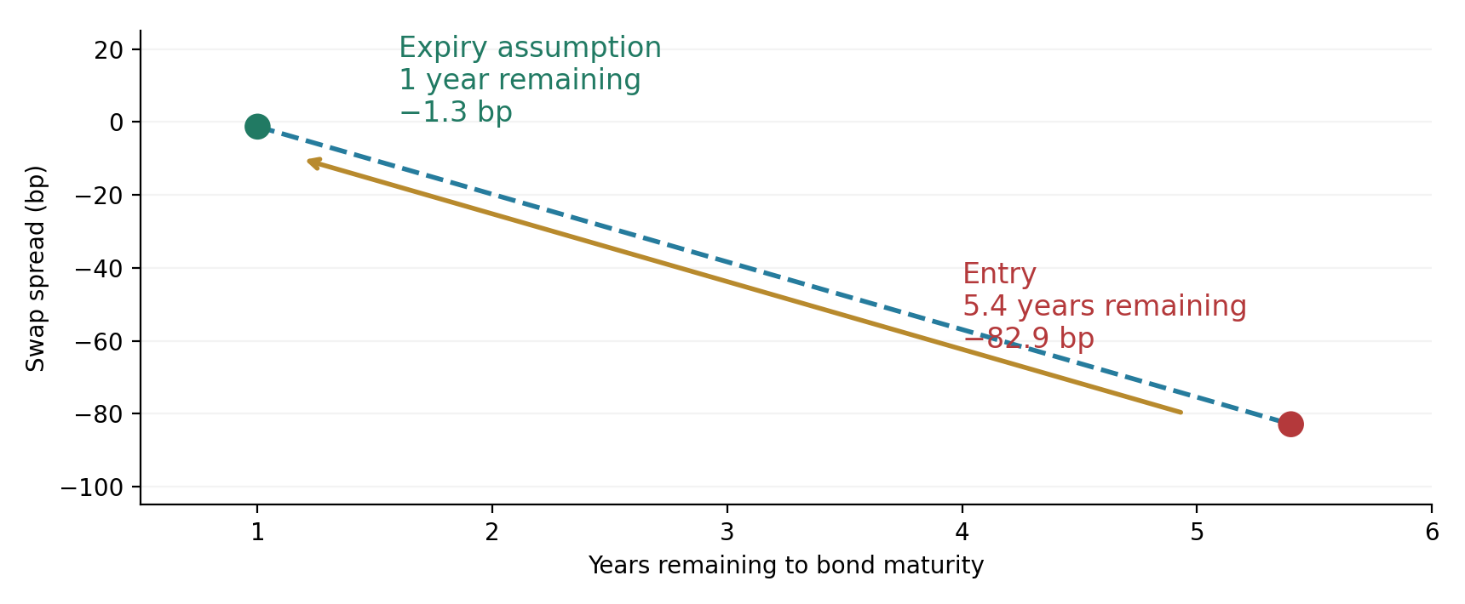
LIMINALITY CAPITAL / PROPOSED REVISION
Roll-down improves the modelled outcome
A roll-to-spot assumption concerns the future curve; it is not a guarantee
4.05x → 4.75x
+0.70x incremental
capital multiple
Shorter maturity reduces price sensitivity. Credit risk remains.
Schematic, not a measured curve. Source: deck scenarios; other model assumptions unchanged.
Reviewer draft • Replaces original slide 16 • 6 October 2026
6
Notes:
The two points below are a schematic using the deck’s approximate matched entry and interpolated one-year scenario. They are not a newly observed yield/spread curve. On the source table, 4.75x versus 4.05x is a 0.70x difference. Pull-to-par concerns a performing bond’s price, not a necessary narrowing of its yield spread. Retain an explicit default/credit-event scenario.

Slide 7
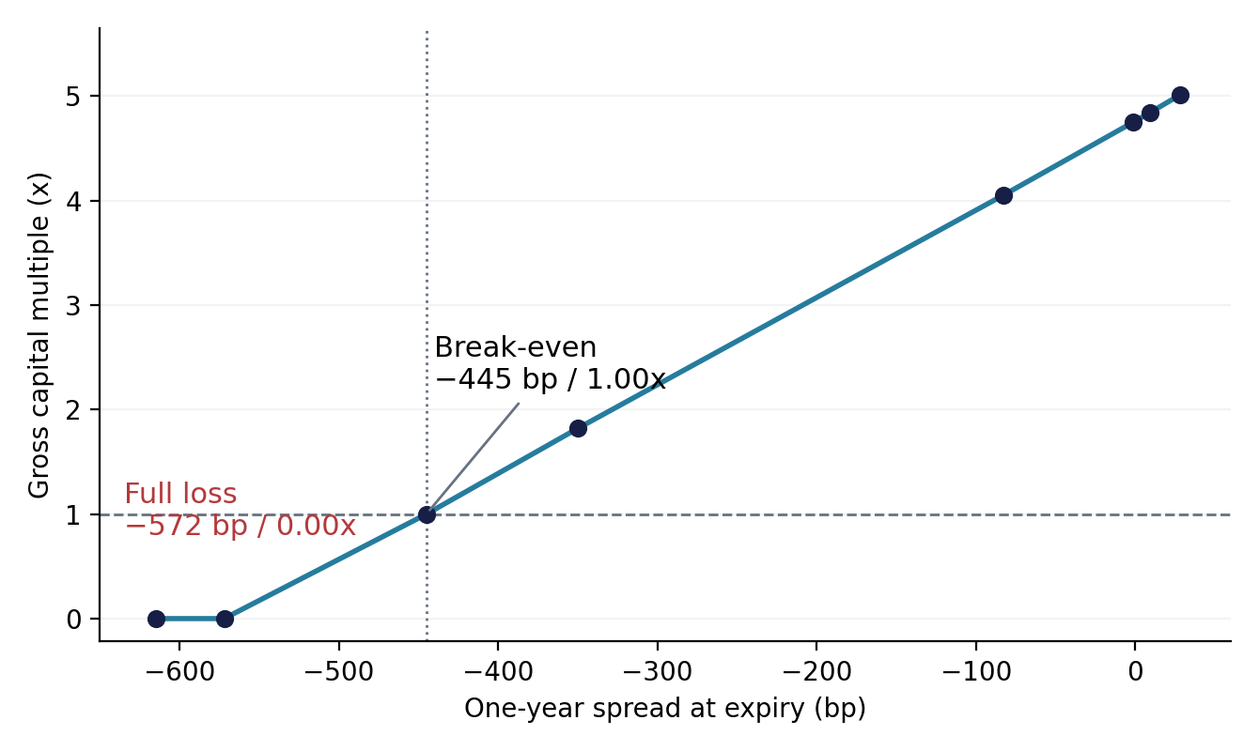
LIMINALITY CAPITAL / PROPOSED REVISION
Show capital outcomes directly
Illustrative gross multiples from the manager model; all other assumptions held constant
Expiry spread | Gross MOIC
+28 bp | 5.01x
−1.3 bp: roll to spot | 4.75x
−83 bp: no spread change | 4.05x
−350 bp: stress | 1.82x
−445 bp: break-even | 1.00x
−572 bp or below | 0.00x
Illustrative connectors, not a validated payoff formula. Model and documentation remain to be reconciled.
Reviewer draft • Replaces original slide 17 • 6 October 2026
7
Notes:
These values are copied from the original table, not independently repriced. The line only joins supplied scenario points and is not a contractual payoff formula. Do not add IRR until dated cash flows reconcile. At terminal-only 4.40-year holding period, 1.82x is about 14.6%, not 14.0%; 4.75x is about 42.5%, versus 42.3% shown. The spread thresholds are model outcomes and are not established contractual strike levels.

Slide 8
LIMINALITY CAPITAL / PROPOSED REVISION
European support is conditional
Institutional incentives matter; they are separate from the contractual floor
Tool / consideration | Why it may help | What limits the argument
TPI | Counter disorderly fragmentation | Fiscal, sustainability and transmission assessment; ECB discretion
OMT | Short-maturity sovereign purchases | Qualifying programme, conditionality and ECB discretion
APP / PEPP history | Evidence of policy capacity | Past programmes do not guarantee new purchases
France’s systemic importance | Strong incentives to stabilize | No guarantee against loss, restructuring or redenomination
Policy support is an investment judgment. The floor depends on the actual contract.
Reviewer draft • Replaces original slides 14 and 15 • 6 October 2026
8
Notes:
Sources: ECB TPI announcement of 21 July 2022, OMT technical features of 6 September 2012, ECB programme pages, European Commission France EDP page. The exact TPI fiscal criterion allows an EDP country if it has not been assessed as failing effective action; do not call France automatically ineligible. OMT requires an appropriate EFSF/ESM programme. APP/PEPP reinvestments have ended. Systemic importance is a judgment supporting low default probability, not a repayment guarantee. Redenomination outcome is contract- and law-dependent.

Slide 9
LIMINALITY CAPITAL / PROPOSED REVISION
Politics matters through transmission to the trade
The 2027 election is a catalyst; the investment continues to February 2031
Channel | Potential development | Relevance to the position
Fiscal path | Budget compromise or renewed slippage | Bond issuance, debt sustainability and spread valuation
European support | Compliance or conflict over policy conditions | Timing and availability of stabilizing intervention
Debt / currency regime | Any challenge to repayment or denomination | Tail loss and contract-defined credit-event settlement
Confirmed election dates: first round 18 April 2027; second round 2 May 2027.
Reviewer draft • Replaces original slide 13 • 6 October 2026
9
Notes:
Primary election dates: French Ministry of Interior, 18 April and 2 May 2027. The October Budget 2027 dossier separates €54bn total effort from €43bn in financial bills. Exact poll snapshots and legal timetables belong in the appendix with archived primary evidence. Do not equate cancelling central-bank-held bonds with private OAT repudiation; explain any proposed connection. Retain current court advice for Le Pen eligibility and cassation timing.

Slide 10
LIMINALITY CAPITAL / PROPOSED REVISION
The entire capital commitment can be lost
The intended floor addresses liability and financing risk; it does not make capital safe
Risk | Structure is intended to address | Residual exposure
Expiry spread | Floor limits trade liability | Partial or full loss of committed capital
Funding / margin | Term margin and no additional margin | Contract exceptions and early termination
Counterparty / legal | Documented non-recourse provisions | Bank failure, enforceability and event settlement
Liquidity / valuation | Ability to hold to expiry | NAV drawdowns, early exit and fund redemptions
Rates / currency / basis | Initial DV01 hedge | Curve, convexity, floating basis, FX and costs
A complete risk statement needs the final contract, not just a spread-history comparison.
Reviewer draft • Replaces original slide 19 • 6 October 2026
10
Notes:
The original risk slide contains [x] and bracketed drafting placeholders. Replace them completely. Default or EU exit is not necessary to lose all invested capital under the model; sufficiently adverse spread at expiry can do so. The maximum-loss and no-margin claims must be validated across all contractual events. Counterparty/sovereign wrong-way risk is relevant if the bank is exposed to the same crisis. Fund redemptions or liquidity needs can force early exit despite term financing.

Slide 11
LIMINALITY CAPITAL / PROPOSED REVISION
Connect the trade to the investor’s exposure
Illustration only: proposed allocation and fund terms have not been supplied
Capital as % of NAV | 4.75x outcome: NAV gain | 0.00x outcome: NAV loss
2% | +7.5% | −2.0%
5% | +18.75% | −5.0%
10% | +37.5% | −10.0%
Add the actual investment vehicle, allocation, loss budget, fees, liquidity and capacity.
Total contribution over the life of the trade; excludes fees, taxes, FX and other portfolio effects.
Reviewer draft • New portfolio-context slide • 6 October 2026
11
Notes:
No allocation recommendation is made. If A percent of fund NAV is invested as the sleeve’s capital, a 4.75x gross result contributes A × (4.75−1), and total sleeve loss contributes −A, with other portfolio values unchanged and protection as intended. Outcomes are over the trade life, not annual NAV returns. Ignore fees, taxes, FX, rebalancing and other positions only for this pedagogical illustration. Replace with the actual proposal and liquidity/capacity details.

Slide 12
LIMINALITY CAPITAL / PROPOSED REVISION
An optional hedge needs its own risk model
Low-coupon long / high-coupon short: an equal-recovery convergence idea
Long: OAT 0.5% May 2040
Short: OAT 4.5% April 2041
Entry hedge: about 141 face long / 100 short
Common price | Net gain*
90 | +52.21
75 | +46.06
40 | +31.71
Equal recovery is an assumption.
DV01 neutrality leaves other risks.
Economic carry differs from coupon cash.
*Per 100 face short, using displayed clean prices and immediate convergence. Excludes carry, accrued interest, financing and costs.
Keep optional. Establish financing, recovery treatment and sizing before adding it to the main strategy.
Reviewer draft • Replaces original slide 21; appendix • 6 October 2026
12
Notes:
Quoted prices from the original: low 55.63 and high 93.75. At exact 141/100 face, common clean-price payoff net = 1.41(R−55.63)+(93.75−R). € terms per 100 face short. Approximate coupon-aware DV01 ratio 1.406 is consistent with 141 rounded. Cash coupons total −3.795 per year before cash interest/financing; at 2.2% on released clean-price cash 15.3117, net is around −3.458 before financing. This is not the full economic carry. Include actual dirty prices, repo, short-borrow cost/recall, convexity/curve, event treatment and recovery conventions. Financing may prevent access to released cash. Common recovery is a hypothesis, not guaranteed by similar yields.

