Slide 1

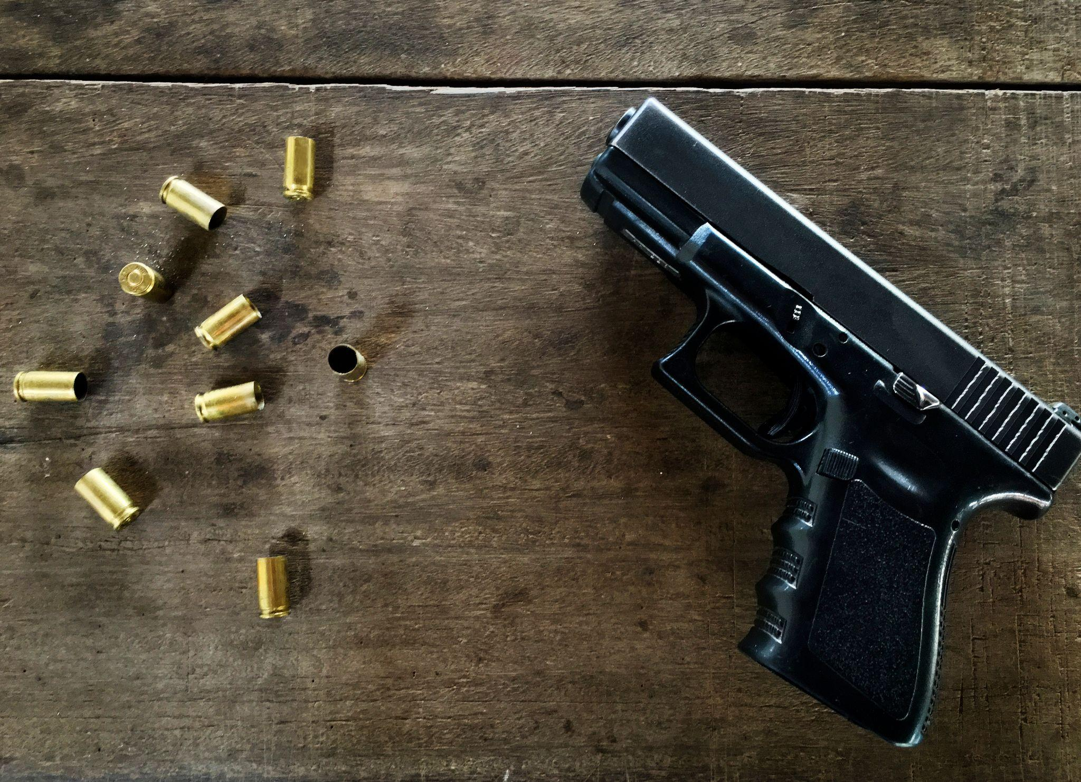
Sentiment Analysis on gun laws in the USA
Group 16
Alicia Chua Jieying, Anil Ankitha
Arora Srishti, Justyn Phoa Zairen
Liu Chang Song, Tan Mei Xuan
Notes:
Hello everyone, we are group 16 We will now be presenting our NLP assignment. The proj that our group has decided on is the Sentiment Analysis on gun laws in the USA

Slide 2
Team Members
Team | Roles
Alicia Chua Jieying | Innovation: Stacking Ensemble
Anil Ankitha | Classification: Naive Bayes
Arora Srishti | Innovation: Bi-LSTM User Interface
Justyn Phoa Zairen | Crawling: Reddit Classification: Doc2Vec
Liu Chang Song | Classification: KNN and RF
Tan Mei Xuan | Crawling: Twitter Data Preprocessing

Slide 3
01
Introduction
02
Data Preparation
Table of contents
03
Classification
04
Innovation
05
Conclusion
Problem Statement
Methodology
Different classification approaches
Enhancing the classification approach
Limitation and Future Works

Slide 4
01
Introduction
02
Data Preparation
Table of contents
03
Classification
04
Innovation
Problem Statement
Methodology
Different classification approaches
Enhancing the classification approach
Notes:
This are our table of contents

Slide 5
05
UI Demo
Table of contents
06
Conclusion
UI Demo for classification
Limitation and Future Works

Slide 6
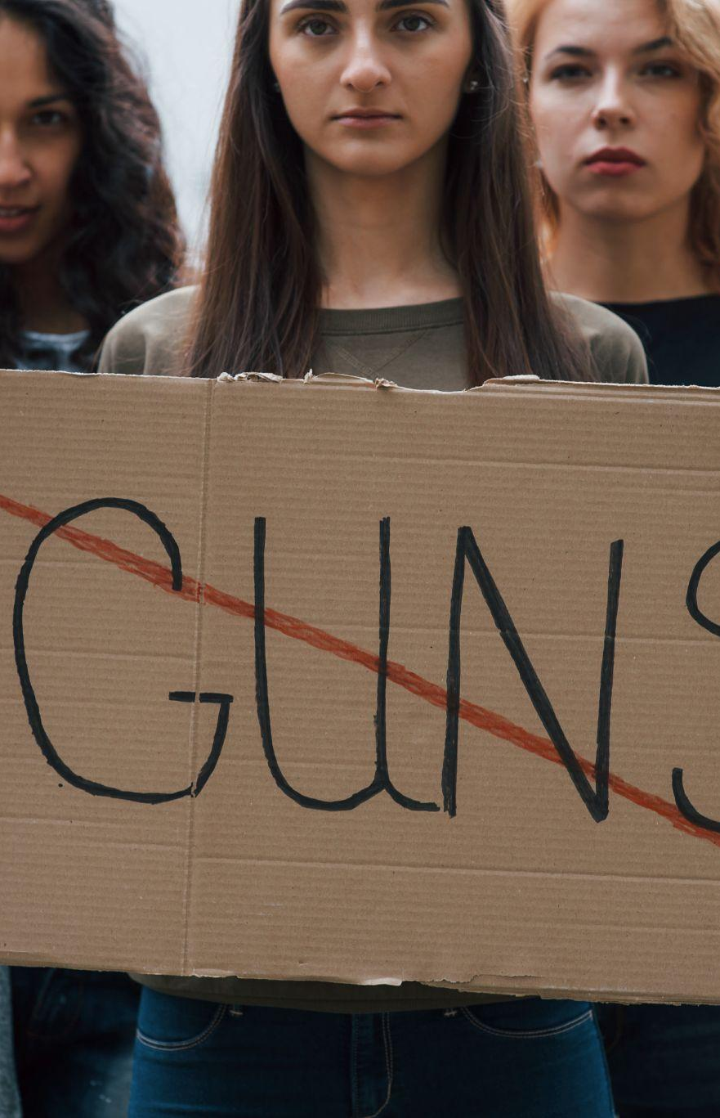
01
Introduction
Notes:
I will start by talking about the introduction

Slide 7
Background
Gun control is one of the most controversial issues in the US
Gun violence has surged amid the COVID-19 pandemic. In 2021, gun-related deaths accounted for more than 45,000 people.
This has raised several questions about the existing gun control policy in the US.
Many debates and discussions between gun-control advocates and gun-rights proponents have been ongoing on social media platforms.
Notes:
Gun control is one of the most controversial issues in the United States (US). In 2021, gun-related deaths accounted for more than forty-five thousand people, the highest toll in decades; and this figure is projected to increase. This has raised several questions about the existing gun control policy in the US. Many debates and discussions between gun-control advocates and gun-rights proponents have been ongoing on social media platforms.

Slide 8
Problem Statement
Aims to capture the public opinion on gun laws in the US in terms of pro- and anti-gun sentiments
Perform sentiment analysis in terms of polarity and subjectivity detection.
Notes:
Our project aims to capture the public opinion on gun laws in the US in terms of pro- and anti-gun sentiments by performing polarity and subjectivity detection.

Slide 9
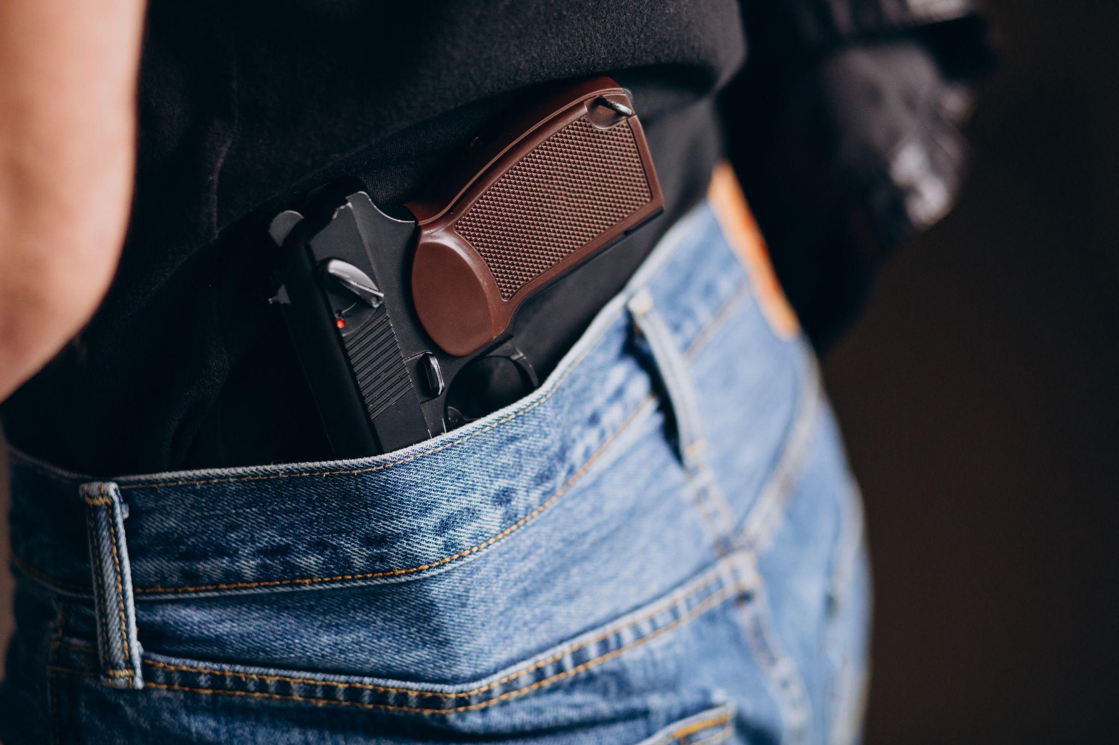
02
Data
Preparation
Notes:
Moving on to data preparation

Slide 10
Methodology
Prepare Dataset
Pre-processing
Manual Labelling
Text Normalization
Crawling text corpus
Data cleaning
Label corpus based on the sentiment
0, 1, -1
Stemming
Lemmatization
Notes:
This are the methodology for our data preparation

Slide 11


Methodology for Crawling
Twitter
Reddit
Archiving database, Pushshift, that contains both real-time and historical Reddit posts.
Snscrape library
Keywords:
("USA” OR "the US")
(#gunlaws OR "gun control" OR "gun laws" OR "gun violence”)
Notes:
In our project, we crawled from 2 platforms, Twitter and Reddit. The keywords used are words related to gun laws

Slide 12
Data Cleaning
The steps are as follows:
Characters are converted to lowercase
URLs, hashtags and mentions are removed
Punctuations and non-alphanumeric characters are removed
Decoded HTML special characters
Notes:
Moving on to data cleaning.
The steps are as follows ..

Slide 13
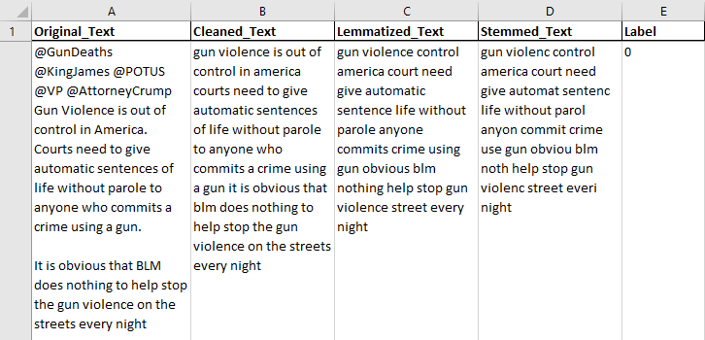
Text Normalization
Stemming & Lemmatization
Notes:
We performed stemming and lemmatization on the text corpus.

Slide 14
Manual Labelling
Labelled a total of 1,214 rows of data
The labelled classes are as follows:
0 = Neutral
1 = Anti Gun (Guns should be banned)
-1 = Pro Gun (In favour of keeping guns)
Notes:
And have manually labelled the data based on the sentiment. The 3 label classes are as follows.

Slide 15
03
Classification
Notes:
The next part is for classification. After being manually labeled and preprocessed, the data has been split into 80% for training courses and 20% for testing classes. For the classification, we first performed subjectivity detection by splitting values labelled with 0 indicating the neutrality of opinion from values labelled with - 1 and 1 which means the opinions are either positive or negative. Polarity detection is done by only considering the negative and positive manual labels. To get the optimum evaluation score for processing, we took into account various preprocessing techniques for each model, specifically stemming and lemmatization and various classification methods.

Slide 16
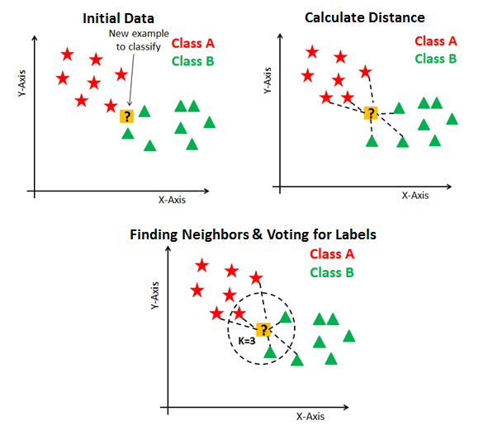
K-nearest neighbors (KNN)
Scikit-learn’s kNN implementation
GridSearchCV for hyperparameters
tuning
Tried different text normalization and vectorizer:
TF-IDF gives better accuracy
Stemming and Lemmatization give similar results
(Subjectivity)
(Polarity)
Notes:
First we tried KNN method, we used Scikit-learn’s kNN implementation to train and test the k nearest neighbor classifier. For the classifier, we feed a list of hyperparameters, namely metric, leaf size, neighbor size and weight into grid search cv which will give us the optimal combination of hyperparameters. Then we take advantage of the results and use it as the kNN model. For vectorizer, we tried both count vectorizer and TF-IDF vectorizer. It turned out that the latter performs better. We also used 5-fold cross validation to avoid a biased result and the accuracy is around 70%.

Slide 17
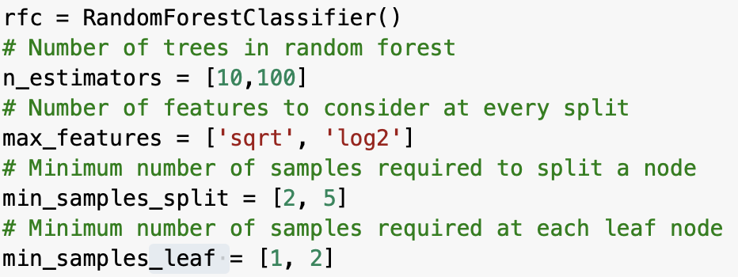
Random Forest (RF)
Hyperparameters for grid search cv to give the best combination
Tried different text normalization and vectorizer:
Stemming and Lemmatization give similar results.
(Subjectivity)
(Polarity)
Notes:
Next we used Random Forest on the labeled dataset. Similar to kNN implementation, we listed down various hyperparameters for grid search to tune with so that we can achieve a better accuracy. For Random Forest, stemming and lemmatization also give similar results for both subjectivity and polarity detection, with around 70% of accuracy.

Slide 18
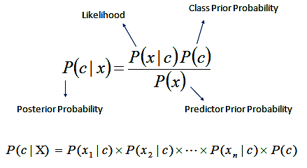
Naive Bayes Model
Introduction
Supervised learning algorithms based on Bayes’ theorem
Method for estimating posterior probability
Notes:
Naive Bayes methods are a set of supervised learning algorithms based on applying Bayes’ theorem with the “naive” assumption of conditional independence between every pair of features given the value of the class variable and has no bearing on the presence of any other feature. Naive Bayes offers a method for estimating the posterior probability P(y | x) of each class y, given an object x, utilizing the information in sample data. When we obtain these estimations, we can use them for categorization or other decision-supporting applications.

Slide 19
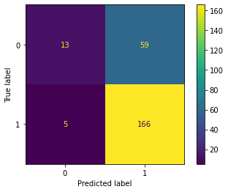
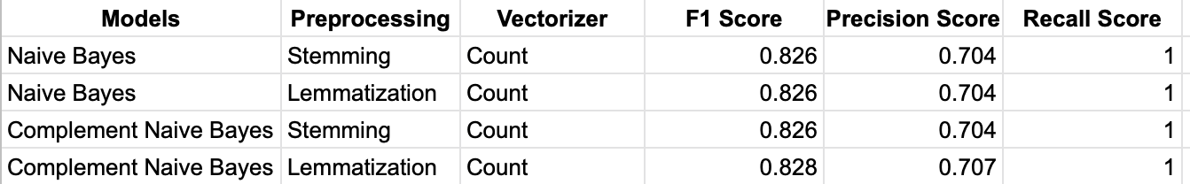
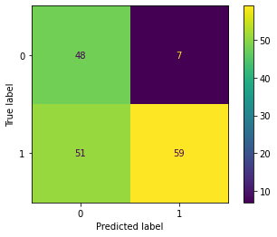
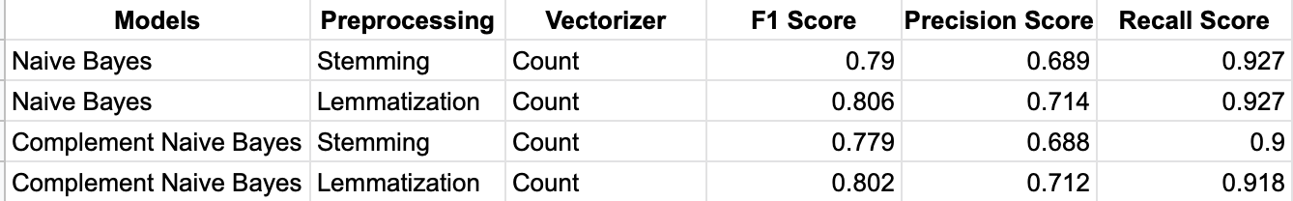
Naive Bayes Model
Implementation
MultinomialNB() model from Scikit-learn
ComplementNB() model from Scikit-learn
Results
Notes:
In this case, we used Scikit-Naive learn's Bayes implementation, specifically MultinomialNB() and ComplementNB(), Multinomial naive Bayes implements the naive Bayes algorithm for multinomially distributed data, and is one of the two classic naive Bayes variants used in text classification.
Complement Naive Bayes is an adaptation of the standard Multinomial Naive Bayes algorithm that works well with imbalanced datasets. Instead of calculating the probability of an item belonging to a specific class, we calculate the probability of the item belonging to all classes in complement Naive Bayes.
For evaluation of the classification model, we have used the count vectorizer and TF-IDF vectorizer on stemmed and lemmatized processed data, and concluded that the results for both the vectorizers are almost equal, about 70% for both subjectivity and polarity detection.

Slide 20
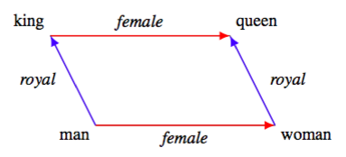
Doc2Vec
Introduction
Use Doc2Vec as a word embedding technique as compared to TF-IDF and Count Vectorizer in previous sections
Generates representation vectors out of words that encapsulate relationships between words
Notes:
Other than using TF-IDF and Count Vectorizer as our word embedding techniques, we also used Doc2Vec, which Generates representation vectors out of words. The relationships between words are encapsulated by the vectors, which is shown by the famous example of “king - man + woman = queen”

Slide 21
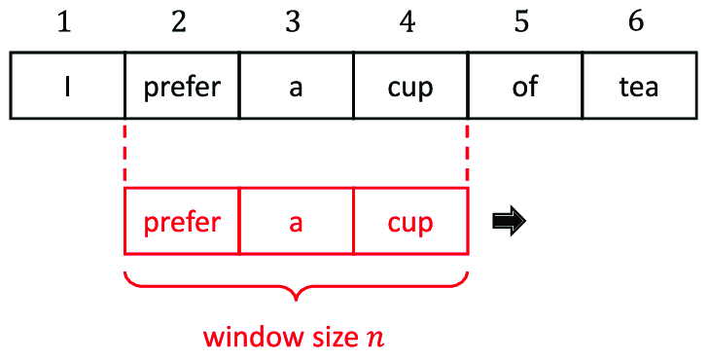
Doc2Vec
Implementation
Use gensim library to create Doc2Vec models
Train on preprocessed text (lemmatized and stemmed)
Produce document vectors of length 40 using a sliding window of length 10
Notes:
In terms of actual implementation, we used the gensim library to create Doc2Vec models and trained them on the preprocessed text from earlier. Using a sliding window of length 10, we produced document vectors of length 40.

Slide 22
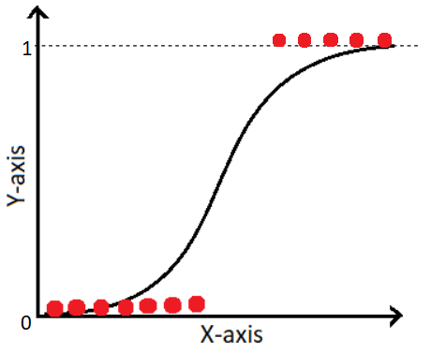
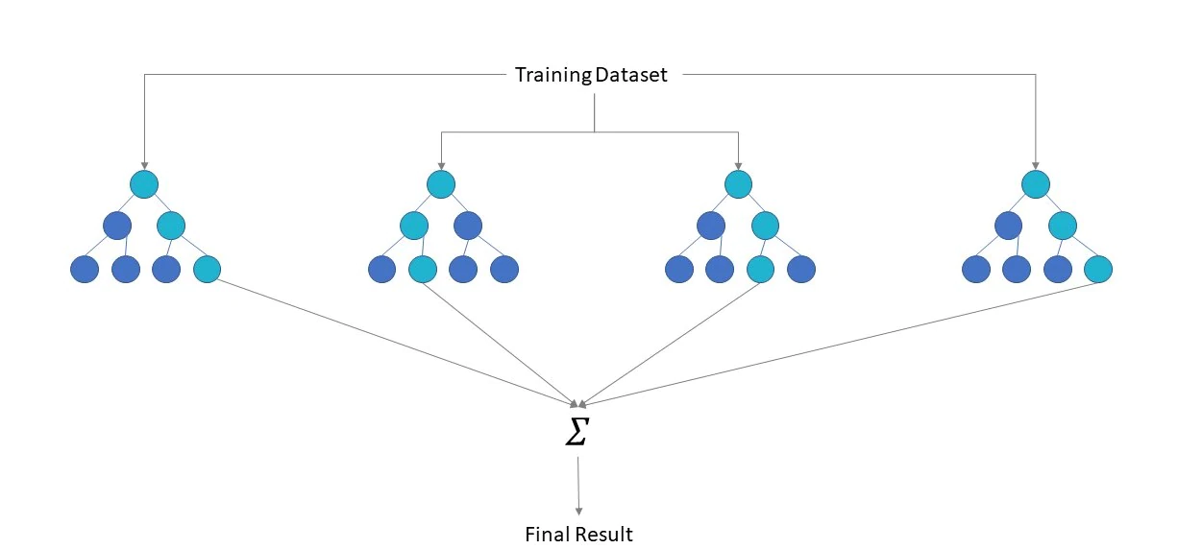
Doc2Vec
Classification Models
Logistic Regression
Decision Tree
Random Forest
Support Vector Machines
Notes:
These document vectors are then fed into regular supervised classification models such as logistic regression, decision tree, random forest and SVMs which we used to predict the subjectivity and polarity of a particular text sample.

Slide 23
Results - Subjectivity Detection
Count Vectorizer and TF-IDF
Model | Dataset | Precision | Recall | F1
KNN | Stemming | 0.728 | 0.953 | 0.825
 | Lemmatization | 0.728 | 0.953 | 0.825
RF | Stemming | 0.707 | 0.964 | 0.812
 | Lemmatization | 0.703 | 0.994 | 0.822
Naive Bayes | Stemming | 0.704 | 0.988 | 0.823
 | Lemmatization | 0.704 | 1 | 0.826
Complement Naive Bayes | Stemming | 0.704 | 1 | 0.826
 | Lemmatization | 0.707 | 1 | 0.826
Notes:
Here are the results of the models that we have developed for subjectivity detection

Slide 24
Results - Subjectivity Detection
Doc2Vec
Model | Dataset | Precision | Recall | F1
Logistic Regression | Stemming | 0.704 | 1 | 0.826
 | Lemmatization | 0.704 | 1 | 0.826
Decision Tree | Stemming | 0.726 | 0.713 | 0.701
 | Lemmatization | 0.696 | 0.714 | 0.701
Random Forest | Stemming | 0.706 | 0.930 | 0.803
 | Lemmatization | 0.720 | 0.953 | 0.817
Support Vector Classifier | Stemming | 0.704 | 1 | 0.826
 | Lemmatization | 0.704 | 1 | 0.826
Notes:
..

Slide 25
Results - Polarity Detection
Count Vectorizer and TF-IDF
Model | Dataset | Precision | Recall | F1
KNN | Stemming | 0.712 | 0.945 | 0.812
 | Lemmatization | 0.715 | 0.955 | 0.817
RF | Stemming | 0.682 | 0.936 | 0.802
 | Lemmatization | 0.687 | 0.955 | 0.796
Naive Bayes | Stemming | 0.689 | 0.927 | 0.79
 | Lemmatization | 0.714 | 0.927 | 0.806
Complement Naive Bayes | Stemming | 0.688 | 0.9 | 0.779
 | Lemmatization | 0.712 | 0.918 | 0.802
Notes:
..

Slide 26
Results - Polarity Detection
Doc2Vec
Model | Dataset | Precision | Recall | F1
Logistic Regression | Stemming | 0.667 | 1 | 0.800
 | Lemmatization | 0.667 | 1 | 0.800
Decision Tree | Stemming | 0.715 | 0.627 | 0.672
 | Lemmatization | 0.671 | 0.718 | 0.696
Random Forest | Stemming | 0.721 | 0.864 | 0.794
 | Lemmatization | 0.665 | 0.773 | 0.735
Support Vector Classifier | Stemming | 0.685 | 0.964 | 0.800
 | Lemmatization | 0.667 | 1 | 0.800
Notes:
..

Slide 27

Summary of Classification
Subjectivity Scores
Precision: 0.7
Recall: 0.98
F1: 0.82
Polarity Scores
Precision: 0.68
Recall: 0.93
F1: 0.77
What’s next?
Use innovative techniques to improve our classification accuracy
Notes:
In summary, our models performed better on average for the subjectivity detection task, with precision scores of around 0.7, recall scores of high 0.9s and even 1s in some cases, and an average f1 score of 0.82.
For polarity detection, our models achieved on average a precision score of 0.68, recall score of 0.93 and f1 score of 0.77.
There is definitely more room for improvement, and in the next section, we will discuss how we can implement innovative techniques to improve our overall model performance.

Slide 28
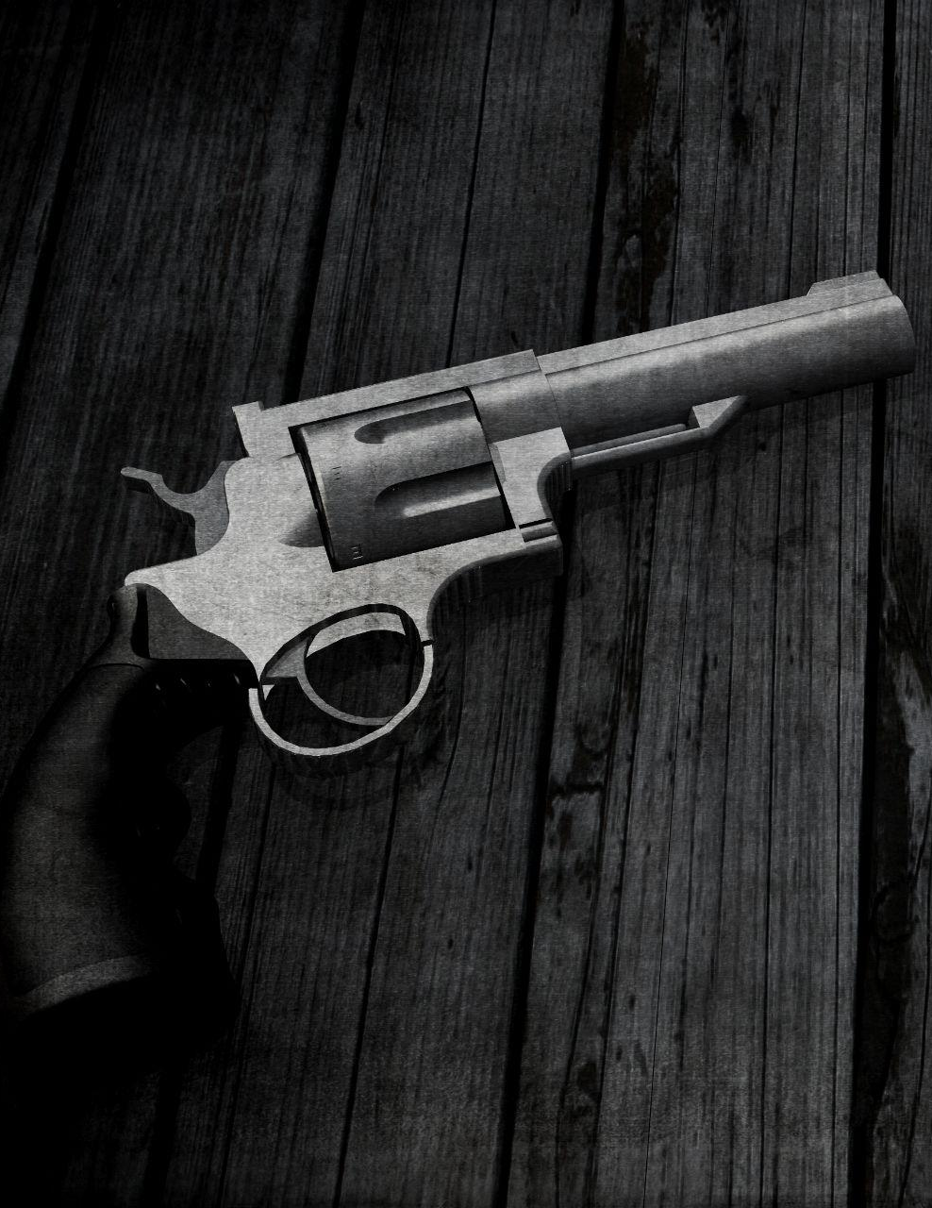
04
Innovation
Notes:
To enhance classification, we have adopted 2 innovation techniques.

Slide 29



Stacking-Ensemble
Statistical issue → High variance
Main problems solved by Ensemble Learning
Computation issue → Computational variance
Representation issue → High bias
Notes:
First, we used ensemble learning. Stacking is a type of ensemble learning method. It promotes a better predictive performance as it reduces the variance component of the prediction error by alleviating 3 issues faced by classification models: Statistical, computation and representation issues.

Slide 30
Stacking-Ensemble
Run dataset on base ML algorithms
Outputs are parsed as inputs to a meta classifier
Outputs from base ML algorithms are combined
Meta classifier combines input & output improved prediction
Notes:
There are a few steps to model stacking. First, we will run the dataset on normal machine learning algorithms and combine these outputs. These outputs, which are in the form of feature vectors and their respective classifications, will then be used as inputs for our meta classifier. The meta classifier will learn the best way to combine the inputs and output an improved prediction.

Slide 31
Stacking-Ensemble
Subjectivity | Precision Score | Recall Score | F1 Score | Accuracy
0 | 0.63 | 0.25 | 0.36 | 0.72
1 | 0.73 | 0.93 | 0.82
Weighted average | 0.70 | 0.72 | 0.68
73.5%
Average accuracy
Polarity | Precision Score | Recall Score | F1 Score | Accuracy
0 | 0.69 | 0.60 | 0.64 | 0.75
1 | 0.78 | 0.84 | 0.81
Weighted average | 0.75 | 0.75 | 0.75
Notes:
We did stacking for both subjectivity and polarity. The average accuracy obtained is 73.5%.

Slide 32
Targeted Issues
Motivation
“If the people who love trying to make Chicago the poster child for gun violence only zoomed out and saw how the US is viewed that way by the rest of the world. Perhaps there would be a better understanding of the larger issue.”
Long tweet
Shift in subject of sentences
Need to understand context
Can we use RNN?
No → Long term dependency in RNN
Notes:
If the people who love trying to make Chicago the poster child for gun violence only zoomed out and saw how the US is viewed that way by the rest of the world.
Perhaps there would be a better understanding of the larger issue.

Slide 33
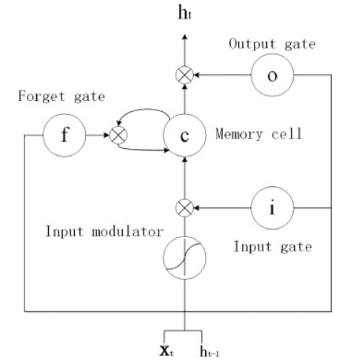
Long Short Term Memory (LSTM)
Illustration of LSTM unit. The weight matrices are represented by lines with arrows.
Notes:
The memory block is better at identifying and utilizing long range context because it uses purpose-built memory cells to store information.

Slide 34
Bi - Directional Long Short Memory
“ The OP suggests that gun control leads to loss of freedom. It's intended to be compared to gun control in the US.
But in each case, gun control followed loss of civil rights, not vice versa.The OP is wrong. We're a long way from being a dictatorship.”
Need to overcome lack of future context
Notes:
Conventional LSTM networks can only utilize historical context. However, a lack of future context could result in a misunderstanding of the problem's significance. As a result, it is Bi-LSTMs are introduced

Slide 35
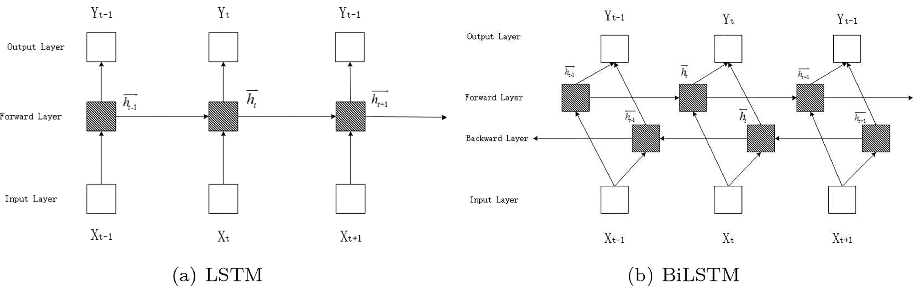
Bi - Directional Long Short Memory
Must unfold forward and backward hidden states for each time step
Backpropagation over time is used (BPTT)
Notes:
Bilstm can access both the preceding and following contexts by combining a forward hidden layer with a backward hidden layer, as shown in (b) illustration. Similar to conventional network forward and backward passes, the forward and backward passes across the unfolded network over time are carried out, with the exception that BiLSTM must unfold the forward hidden states and the backward hidden states for each time step. In order to train the BiLSTM networks, backpropagation over time is used (BPTT).

Slide 36
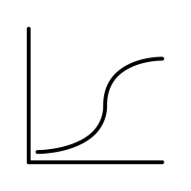
Bi-LSTM Architecture
h_{t-1}
h_{t-1}
h_{t}
h_{t}
^
y
h_{t+1}
h_{t+1}
Text Input
Word Embeddings
Bi-LSTM Layer
Dense sigmoid layer

Slide 37
Results
 | Precision Score | Recall Score | F1 Score
Subjectivity | 0.71 | 0.98 | 0.82
Polarity | 0.67 | 0.88 | 0.76

Slide 38
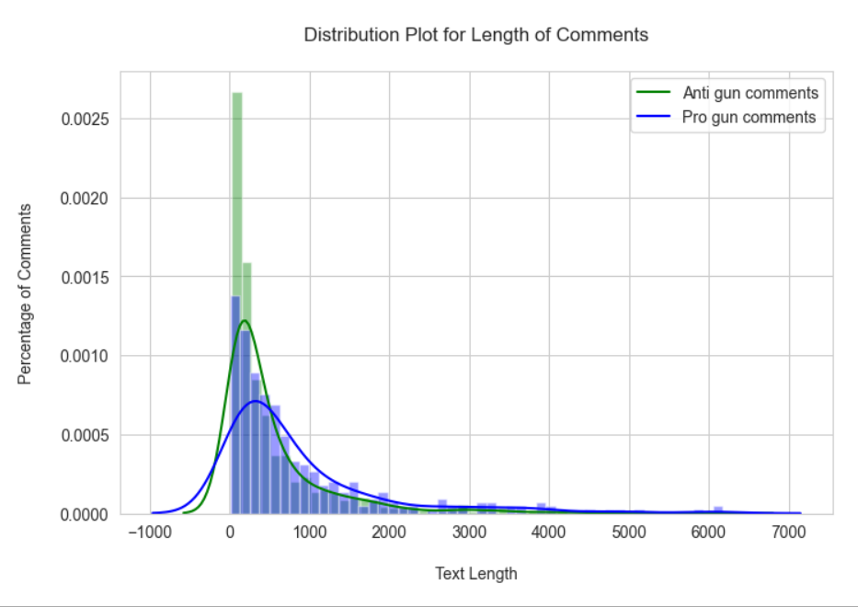
Need for Attention based Bi-LSTM
Average length of = 638.8 words
Maximum length ~ 4000 words
Few important parts of sentence might be ignored

Slide 39
Architecture: Attention based Bi-LSTM
h_{t-1}
h_{t-1}
h_{t}
h_{t}
^
y
Attention Layer
h_{t+1}
h_{t+1}
Text Input
Word Embeddings
Bi-LSTM Layer
Attention Layer
Dense sigmoid layer

Slide 40
Results
 | Precision Score | Recall Score | F1 Score
Subjectivity | 0.72 | 0.99 | 0.80
Polarity | 0.64 | 0.85 | 0.82

Slide 41
Summary of Models
 | Precision Score | Recall Score | F1 Score
Stacked Ensemble | 0.70 | 0.72 | 0.68
BI- LSTM | 0.71 | 0.98 | 0.82
Attention based Bi-LSTM | 0.72 | 0.99 | 0.80
 | Precision Score | Recall Score | F1 Score
Stacked Ensemble | 0.75 | 0.75 | 0.75
BI- LSTM | 0.67 | 0.88 | 0.76
Attention based Bi-LSTM | 0.64 | 0.85 | 0.82

Slide 42
05
UI Demo
Notes:
..

Slide 43


Slide 44
06
Conclusion
Notes:
..

Slide 45
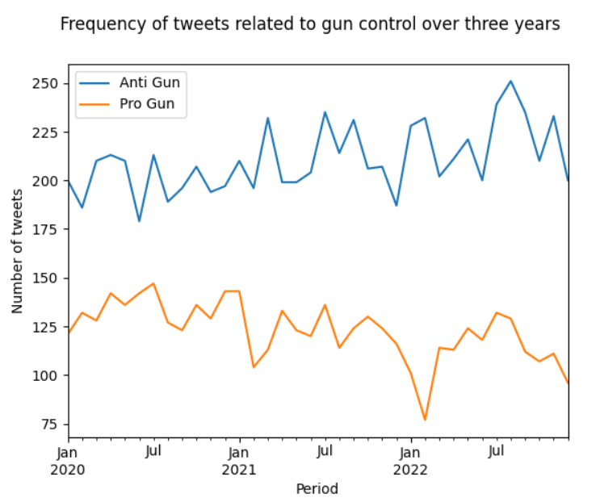
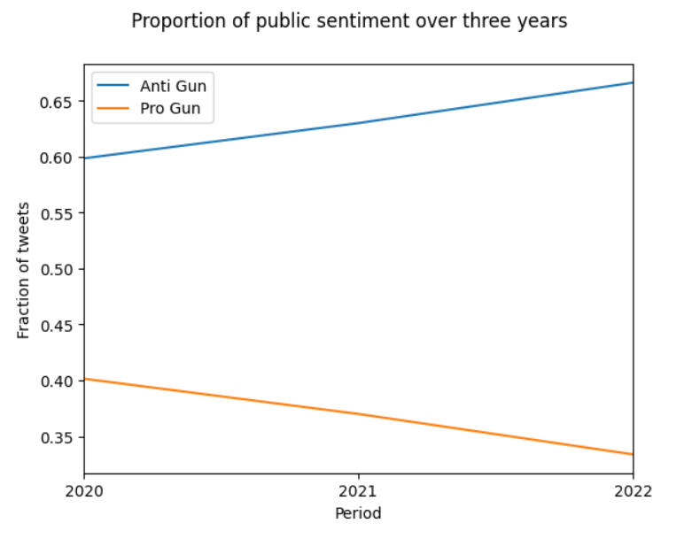
Trends Observed
The number of anti gun sentiments expressed have increased linearly over the past three years

Slide 46
Future Works
“Just the way Putin likes it… fill USA full of guns, install a puppet; divide the country; let it blow itself up… no nukes required”
Sarcasm Detection
“If the people who love trying to make Chicago the poster child for gun violence only zoomed out and saw how the US is viewed that way by the rest of the world. Perhaps there would be a better understanding of the larger issue.”
Idioms and Phrases Mapping
“It’s clearly the GOP funded by NRA Rubles that have kept responsible gun laws dead”
NER
Few Shot Learning to overcome the limited annotated data
Notes:
..

Slide 47
Thanks!

