Slide 1
UNO

Slide 2
Microcontroller Board
UNO

Slide 3
UNO

Slide 4
Power Supply
UNO

Slide 5
UNO

Slide 6
Continuous Rotation Servos
UNO
Sabretooth 2x5 R/C Motor Driver

Slide 7
UNO

Slide 8
Lidar Sensor
Lidar Mount & Step Servo
UNO

Slide 9
UNO

Slide 10
Micro SD Storage Board
ESP8266-1 Internet Chip
UNO

Slide 11
#ifndef _TRACKS_H_
#define _TRACKS_H_
#include <Servo.h>
// Tracks uses the sabertooth 2x5 rc motor driver with the following configuration:
// pin 3 is ON, 1, 2, 4, 5, 6 are OFF
// FWD and TURN orange connected to forwardPin and turnPin (see attach)
// FLIP + (red) and - (brown) connected to arduino Vin and Gnd
typedef enum TracksState
{
STANDING_STILL,
MOVING_FORWARD,
MOVING_BACKWARD,
TURNING_LEFT,
TURNING_RIGHT
} tracksState;
class Tracks
{
public:
static const int FORWARD_PIN = 5;
static const int TURN_PIN = 4;
static const int MOVE_SPEED = 20;
static const int MOVE_TIME = 100;
Tracks();
~Tracks() {}
void setup();
void loop();
void turnToAngle(int angle);
void clockwiseTurn(int angle);
void clockwiseCircle();
void counterClockwiseTurn(int angle);
void counterClockwiseCircle();
void goForward(int units);
void goBackward(int units);
void stop();
inline int heading() { return m_heading; }
inline int x() { return m_x; }
inline int y() { return m_y; }
inline tracksState state() { return m_state; }
private:
void turnRight();
void forward();
void backward();
void turnLeft();
Servo left;
Servo right;
int m_heading;
int m_x;
int m_y;
tracksState m_state;
int m_delay;
};
#endif
UNO

Slide 12
#include "Tracks.h"
Tracks::Tracks() :
m_x(0),
m_y(0),
m_heading(0),
m_state(TracksState::STANDING_STILL),
m_delay(0) {}
void Tracks::setup()
{
left.attach(TURN_PIN, 1000, 2000);
right.attach(FORWARD_PIN, 1000, 2000);
}
void Tracks::loop()
{
switch (m_state)
{
case TracksState::STANDING_STILL:
stop();
break;
case TracksState::TURNING_LEFT:
turnLeft();
break;
case TracksState::TURNING_RIGHT:
turnRight();
break;
case TracksState::MOVING_FORWARD:
forward();
break;
case TracksState::MOVING_BACKWARD:
backward();
break;
}
m_delay--;
if (m_delay <= 0)
{
m_delay = 0;
m_state = TracksState::STANDING_STILL;
}
}
void Tracks::turnRight()
{
right.write(40);
left.write(130);
}
void Tracks::turnLeft()
{
right.write(130);
left.write(40);
}
void Tracks::forward()
{
left.write(90 - MOVE_SPEED);
right.write(90 - MOVE_SPEED);
}
void Tracks::backward()
{
left.write(90 + MOVE_SPEED);
right.write(90 + MOVE_SPEED);
}
void Tracks::stop()
{
left.write(90);
right.write(90);
}
// 90 means turn Skooter 90 degrees to the left,
// -90 means turn Skooter 90 degrees to the right
void Tracks::turnToAngle(int angle)
{
(angle < 0 ? clockwiseTurn(-angle) : counterClockwiseTurn(angle) );
}
void Tracks::clockwiseTurn(int angle)
{
m_delay = floor(angle * 10250.0 / 360.0);
m_state = TracksState::TURNING_RIGHT;
turnRight();
}
void Tracks::counterClockwiseTurn(int angle)
{
m_delay = floor(angle * 11000.0 / 360.0);
m_state = TracksState::TURNING_LEFT;
turnLeft();
}
void Tracks::clockwiseCircle()
{
m_delay = 10750;
m_state = TracksState::TURNING_RIGHT;
turnRight();
}
void Tracks::counterClockwiseCircle()
{
m_delay = 11250;
m_state = TracksState::TURNING_LEFT;
turnLeft();
}
void Tracks::goForward(int units)
{
m_state = TracksState::MOVING_FORWARD;
m_delay = units * MOVE_TIME;
forward();
}
void Tracks::goBackward(int units)
{
m_state = TracksState::MOVING_BACKWARD;
m_delay = units * MOVE_TIME;
backward();
}
UNO

Slide 13
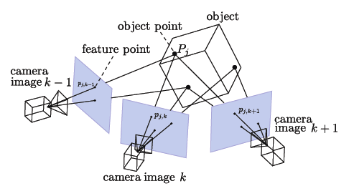
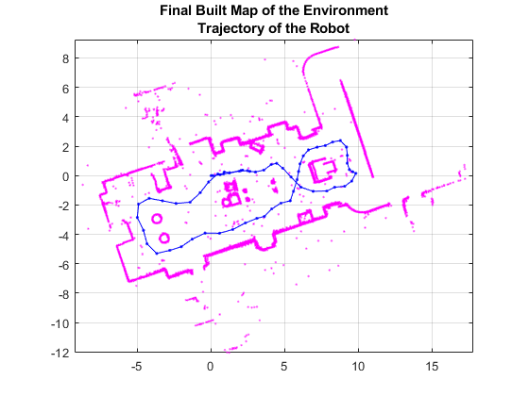
Future plans...
Fig1. V-SLAM 3D structure mapping by cometlabs.
Fig2. SLAM Floormap by mathworks.

