Slide 1
Automated processing of test results
Project 3
Carlos Martínez Boto

Slide 2
Workflow in my last job
Test engineer: Organizes a test
Service provider: Executes it
Technicians: Disassembly
Test engineer: Analysis
Test specification
Devices to test
Data
Tested devices
List of issues
Detail photos
Parts
Write test report
Analysis
Following design iteration
Update issues database
Causes
Consequences
Possible measures

Slide 3
Problem with this manual workflow
Issues not consistently described
Examples:
Use of unspecific terms: “damage”, “stains”
Use of synonyms: “rust” and “corrosion”
Different wordings: “corrosion on part X” or “part X presents corrosion”
Difficult to check if an issue was already known
Duplicates or inefficient manual search
Risk: loss of information

Slide 4
Automated approach (n8n)
Database
Drive
Initialization of true new issues
List of issues
Intelligent comparison
Drive
E-Mail
ChatGPT
ChatGPT
Matches with existing issues
Gmail
Photos
Analysis
ChatGPT
Notify stakeholders
Update database with new findings
Slack
ChatGPT
Drive

Slide 5
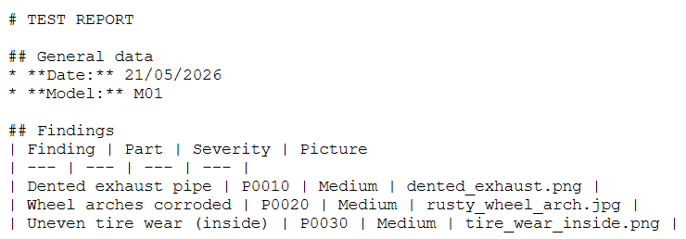
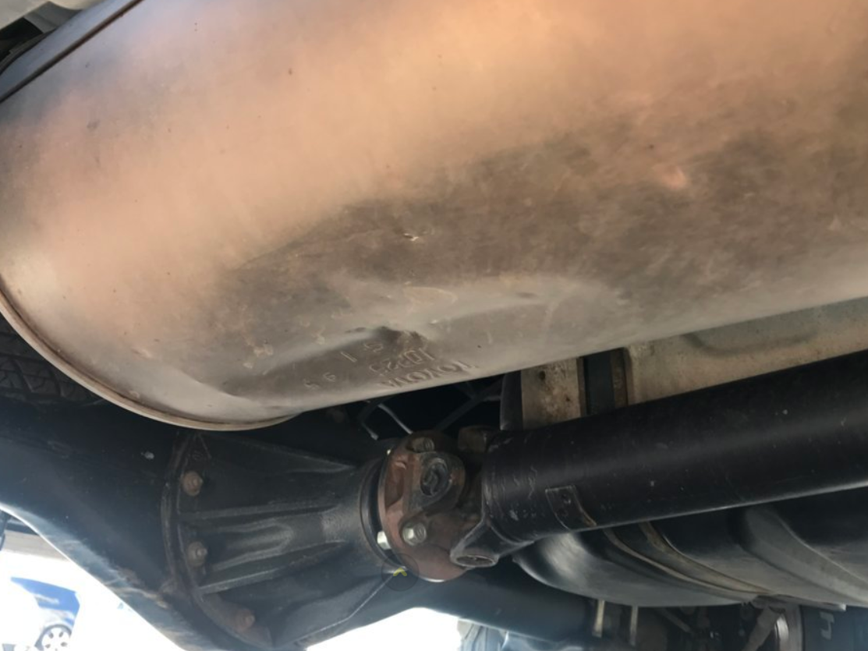
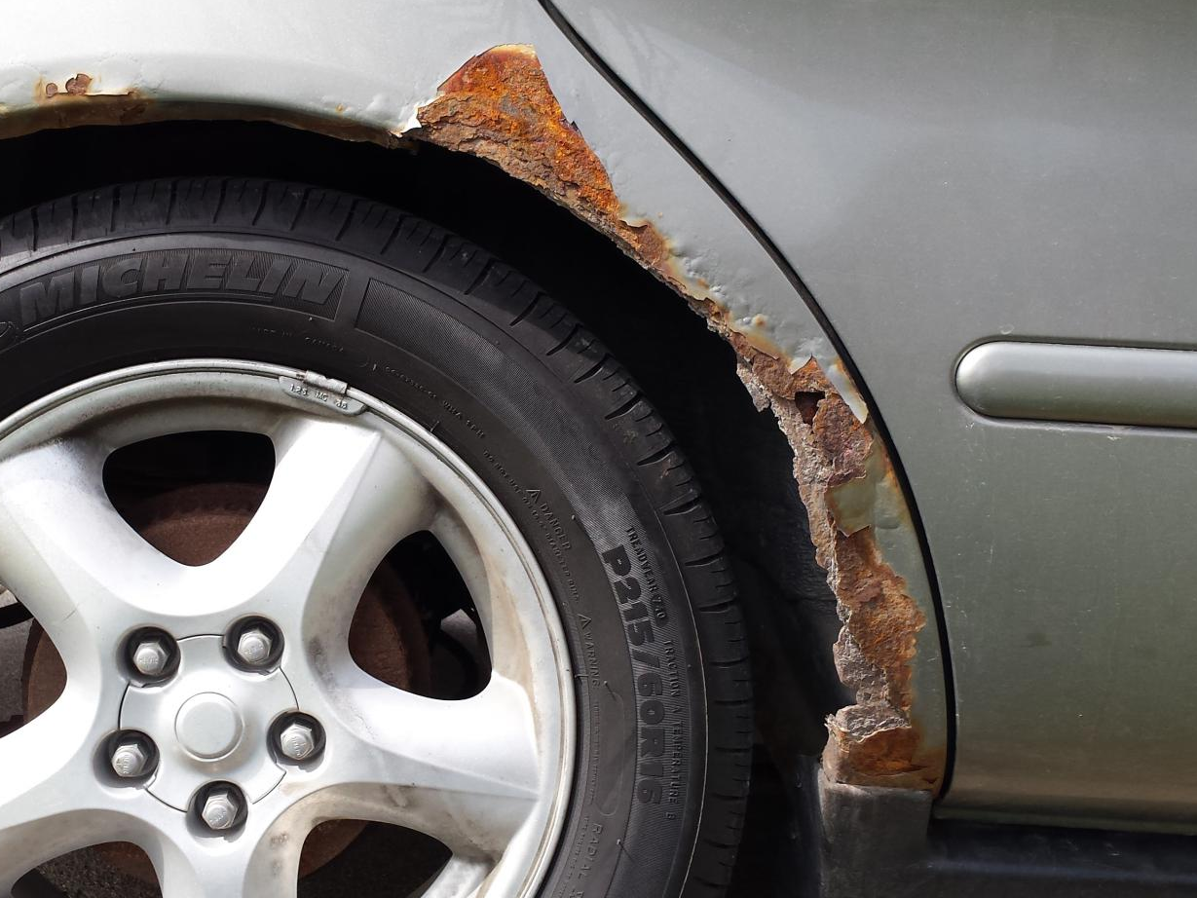
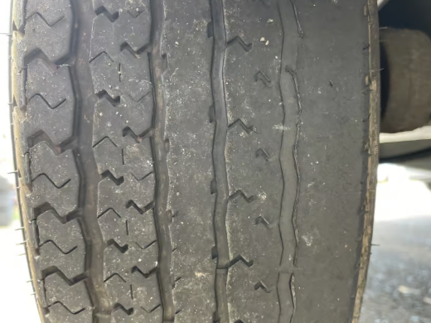
Example - Input

Slide 6
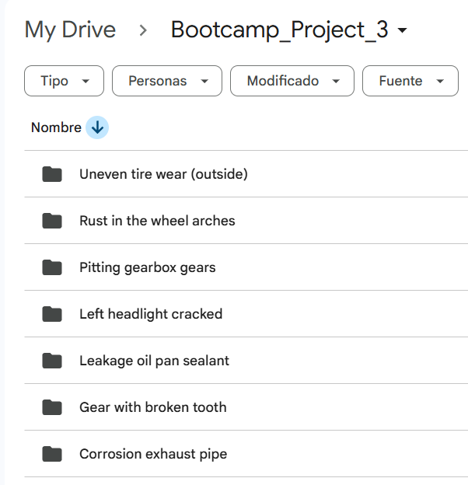
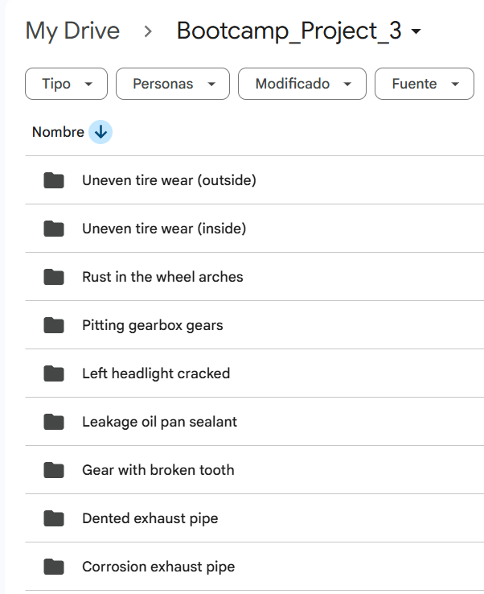
Example – Database before and after

Slide 7
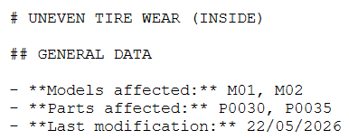
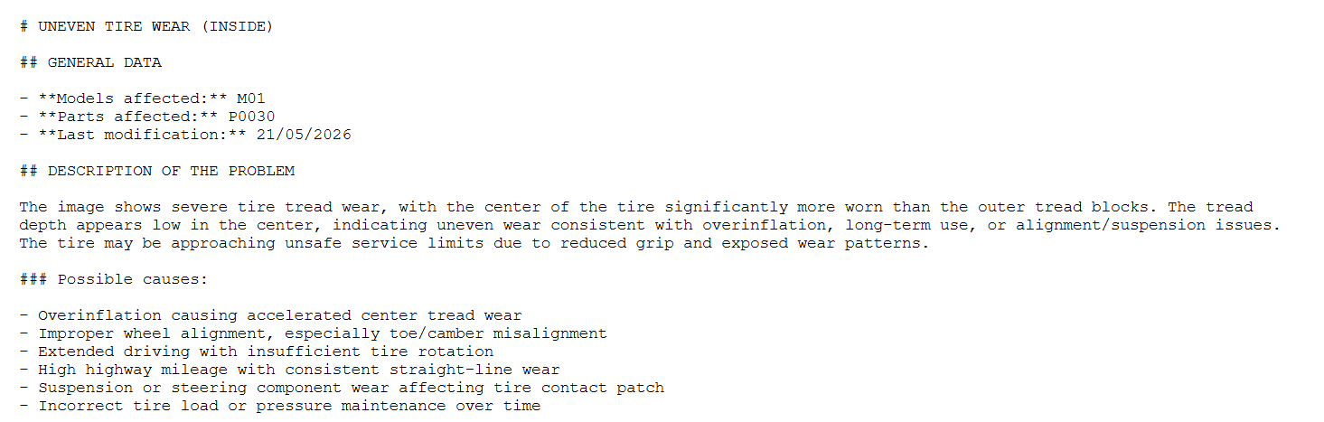
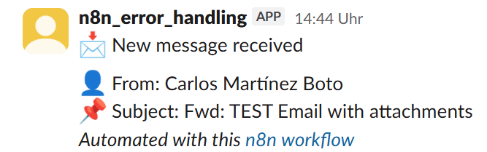
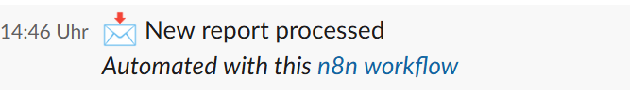
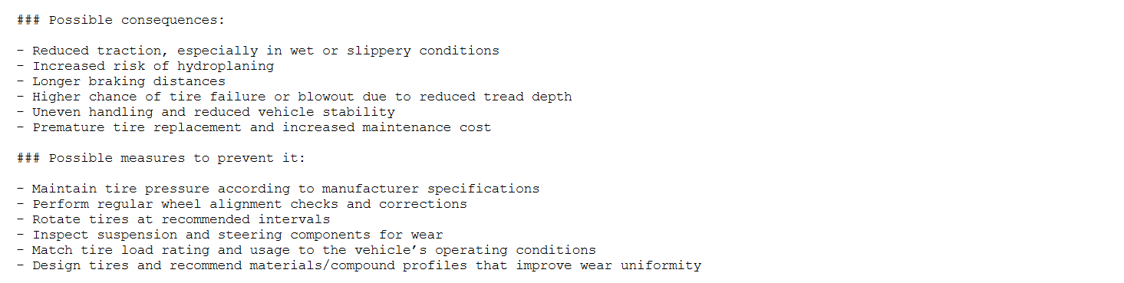
Example - Output
Update
Improper wheel alignment, especially toe/camber misalignment
High highway mileage with consistent straight-line wear
Perform regular wheel alignment checks and corrections
Rotate tires at recommended intervals

Slide 8
Current limitations / Assumptions
Access through dedicated address that receives only this inputs (example: test_reports@company.com).
The issue descriptions in the report are detailed enough for a meaningful classification (type of damage and affected part should be qualitatively identifiable).

Slide 9
Possible next steps
Filter out non-related emails
Would enable using the tool from a personal address.
Filter out vague or unrelated descriptions like “damage to part X” or "test interruption because of rig malfunction“
Ask for further detail or manual classification).
Give the LLMs context (RAG)
Test specifications, descriptions of the parts…
Picture analysis with existing knowledge from previous issues
Use commercial reporting software

Slide 10
Thank you for your attention
QUESTIONS?

